Slide 1
Mama Mia! The Secret is in the Sauce!
The Five Mother Sauces
Notes:
What are some sauces you can think of? Why are they important to cooking? This presentation will cover the 5 mother sauces used in classical cuisine. At the end of the PowerPoint ™ you should be able to name the 5 mother sauce and briefly describe each sauce.

Slide 3
Saucier [fr. so see ay]
  Sauce cook - Prepares sauces and strews and sauté foods to order.
  The Chef de Saucier uses flavor profiles from the Five Mother Sauces to compliment meat, fish, poultry and vegetable dishes of various cuisines.
Notes:
In a classical kitchen brigade one of the positions is a saucier. Preparation and production of sauces, stews, and sautéed food is their main responsibility. In smaller kitchens, sauce preparation may be done by a chef or various cooks.

Slide 4
Mother Sauces
  A basic sauce used in the production of other sauces.
  The five leading hot sauces are:
    Béchamel
    Véloute
    Espagnole (brown sauce)
    Tomato
    Hollandaise
  The cold sauces are mayonnaise and vinaigrette.
Notes:
The 5 mother sauces are just the beginning. Each mother sauce is a base for a derivative (spinoff)sauce. For example:
• Béchamel – créme or mornay sauce;
• Véloute – Allemande or curry sauce;
• Espagnole – demi-glacé;
• Tomato – meat sauce – like one used for spaghetti;
• Hollandaise – bérnaise sauce.
There are many more sauce derivatives, but it is important to learn and master the 5 mother sauces.

Slide 5
Béchamel
  (French) A rich cream sauce made from cream and a roux, with an onion pique.
  Can be used as an ingredient in baked pasta recipes like lasagna, and also in casseroles. But it's also the basis for some of the most common white sauces such as:
    Crème Sauce
    Mornay Sauce
    Cheddar Cheese Sauce
  Video Recipe: Bechamel
  Sauce Chef Keith Snow
  http://youtu.be/wfTR7juCgUg
Notes:
The French are known for their rich creamy sauces, and béchamel is a great place to begin learning. Most sauces will be flavored with herbs, and maybe sautéed aromatic vegetables(onions, garlic, celery, etc.), but in order to make a smooth sauce, once the sauce is finished cooking, the sauce must be strained leaving a creamy, velvety texture. Video Recipe: Bechamel Sauce Chef Keith Snow
http://youtu.be/wfTR7juCgUg
This classic Mother sauce is one of the 5 foundational sauces in French cuisine. It can be used in many ways and many in variations, or compound sauces can spring from this. Chef Keith Snow of
http://www.harvesteating.com shows you how to make Bechamel sauce the classic way in this detailed video.

Slide 6
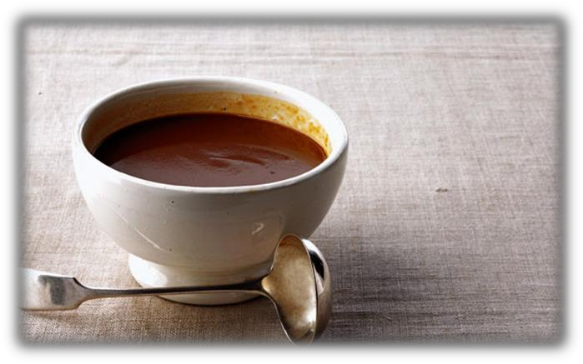
Espagnole
  Traditionally made of a rich meat stock, a MIREPOIX of browned vegetables, a brown ROUX, herbs and sometimes tomato paste.
  Also known as Brown Sauce.
  Examples of small sauces made from Espagnole:
    Mushroom Sauce
    Madeira Sauce
    Port Wine Sauce
Notes:
If you have heard of a brown gravy, that is a more generic term for an espagnole sauce. This slide shows a couple of vocabulary terms that may be unfamiliar with you. A Mirepoix (mir pwa) is a mixture of 3 aromatic vegetables – onion, carrots, and celery. If you were cooking Cajun food you would use a Trinity – onions, celery, and bell pepper. A roux is a mixture of fat and flour mixed together to form a paste like substance that will thicken the sauce. The longer the roux cooks, the darker the sauce becomes and the more robust the flavor.

Slide 7
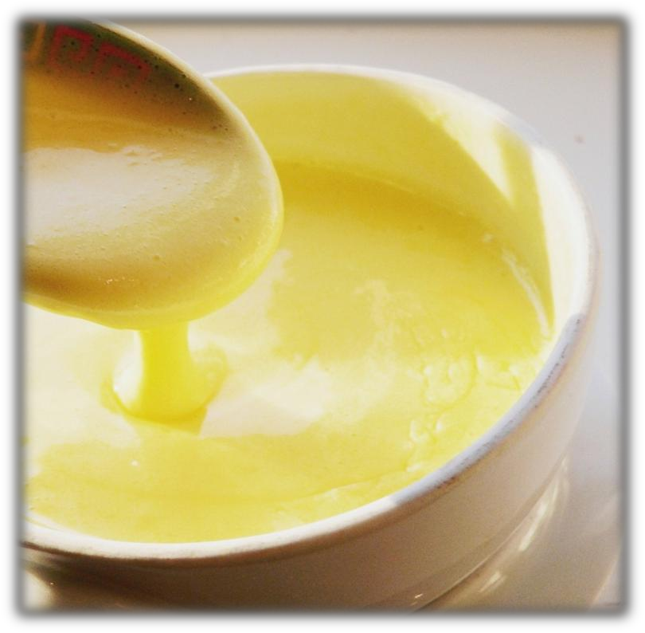
Hollandaise
  A sauce made of butter, egg yolks, and flavorings (especially lemon juice).
  Particularly delicious on seafood, vegetables and eggs. Small sauces that can be made from Hollandaise:
    Béarnaise Sauce
    Dijon Sauce
Notes:
A hollandaise sauce is an egg thickened sauce. It is a difficult sauce to master because at any point, if you are not careful, it can break. When it breaks, the eggs curdle and produces a rough, rather than a smooth, texture. Hollandaise sauce is used when making eggs benedict.

Slide 8
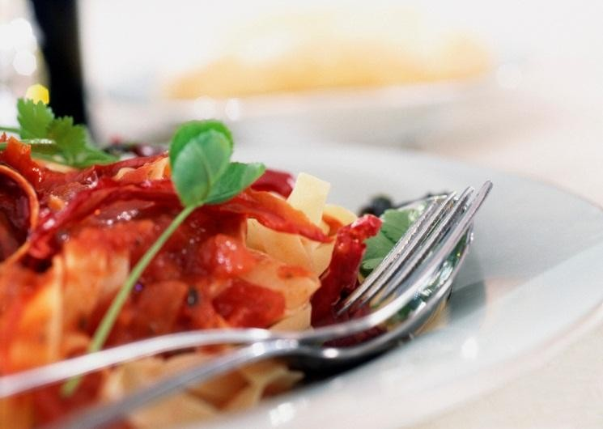
Tomato Sauce
  Made with puréed tomatoes to give the sauce texture and flavor. This type of sauce may be referred to as Coulis (koo- lee)—a French term that means a purée of vegetables and fruit.
  Small sauces made from the classic tomato sauce:
    Spanish Sauce
    Creole Sauce
Notes:
When we think of tomato sauce, we generally think of pasta. If you are using it on another food besides pasta, and perhaps purée additional vegetables along with the tomatoes, you have just created a Coulis (koo-lee). A vegetable coulis may be used on meat dishes, where as a fruit coulis may be used on desserts.

Slide 9
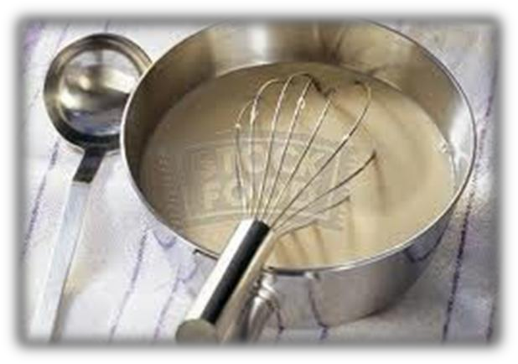
Velouté
  (French) A sauce made with veal stock, cream, and tightened with a white roux.
  Chicken velouté fortified with cream becomes the Suprême Sauce.
  Veal velouté thickened with a liaison of egg yolks and cream becomes the Allemende Sauce.
  Fish velouté plus white wine and heavy cream becomes the White Wine Sauce.
  Small sauces from velouté can be derived from the velouté directly, or from each of the three secondary sauces. For ex:
    Normandy Sauce
    Bercy Sauce
    Mushroom Sauce
    Shrimp Sauce
    Herb Seafood Sauce
Notes:
Many sauces are flavored with stocks. We are familiar with beef stock, and chicken stock, but do you know about veal stock, or fish stock, or vegetable stock? They are made the same way as a beef or chicken stock but using different base flavorings. The velouté sauce traditionally uses a veal stock. It is thickened with a white roux – which is melted fat mixed 1 to 1 with flour to create a paste that is barely cooked keeping the white color.

Slide 10
References/Resources
  Textbooks:
    Gisslen, W. (2007). Professional Cooking, Sixth Edition, Chapter 8, Hoboken, NJ: John Wiley and Sons pages 159-171.
    Beasley, E. (2007) FS Prep Culinary Curriculum Lessons, Third Edition, Unit 4, Sauces, Chicago, IL: Texas Restaurant Association Education Foundation, pages 4—76 to 4—80.
  Websites:
    What Are The Mother Sauces?
    In the culinary arts, the term "mother sauce" refers to any one of five basic sauces, which are the starting points for making various secondary sauces or "small sauces."
    http://culinaryarts.about.com/od/sauces/tp/Mother-Sauces.htm
  YouTube™
    Video Recipe: Bechamel Sauce Chef Keith Snow
    This classic Mother sauce is one of the 5 foundational sauces in French cuisine. It can be used in many ways and many in variations, or compound sauces can spring from this.
    http://youtu.be/wfTR7juCgUg

