Slide 1

Managing Your Paycheck
Practicum in Culinary Arts
Practicum in Hospitality Services

Slide 2
Copyright
Copyright © Texas Education Agency, 2015. These Materials are copyrighted © and trademarked ™ as the property of the Texas Education Agency (TEA) and may not be reproduced without the express written permission of TEA, except under the following conditions:
1) Texas public school districts, charter schools, and Education Service Centers may reproduce and use copies of the Materials and Related Materials for the districts’ and schools’ educational use without obtaining permission from TEA.
2) Residents of the state of Texas may reproduce and use copies of the Materials and Related Materials for individual personal use only, without obtaining written permission of TEA.
3) Any portion reproduced must be reproduced in its entirety and remain unedited, unaltered and unchanged in any way.
4) No monetary charge can be made for the reproduced materials or any document containing them; however, a reasonable charge to cover only the cost of reproduction and distribution may be charged.
Private entities or persons located in Texas that are not Texas public school districts, Texas Education Service Centers, or Texas charter schools or any entity, whether public or private, educational or non-educational, located outside the state of Texas MUST obtain written approval from TEA and will be required to enter into a license agreement that may involve the payment of a licensing fee or a royalty.
For information contact: Office of Copyrights, Trademarks, License Agreements, and Royalties, Texas Education Agency, 1701 N. Congress Ave., Austin, TX 78701-1494; phone 512-463-7004; email: copyrights@tea.state.tx.us.
Copyright © Texas Education Agency, 2015. All rights reserved.

Slide 3

Paycheck
A check for salary or wages made out to an employee
Copyright © Texas Education Agency, 2015. All rights reserved.
Notes:
You have a job! That means you will get a paycheck!
You can also call it your income or wages.
Decisions will need to be made as to:
How will you spend your money?
What will you buy?
Will you save any money?
You may not get to see the actual check because many businesses are now paying their employees with an electronic paycheck where you check is automatically deposited into a bank account.

Slide 4

Budgets
Help you to:
  Control where your money goes
  Work toward short and long-range goals
  Keep from overspending
  Reduce wasteful spending
Copyright © Texas Education Agency, 2015. All rights reserved.
Notes:
Budget: An estimate of income and expenditure for a set period of time

Slide 5
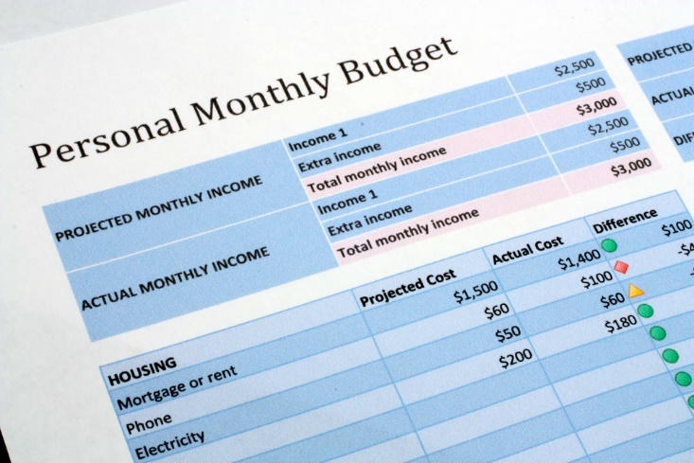
Personal Budget Steps
Set Financial Goals
List Income and Expenses
Balance Your Budget
Keep Track
Evaluate Your Budget
Copyright © Texas Education Agency, 2015. All rights reserved.
Notes:
A personal budget is a finance plan that allocates future personal income towards expenses, savings and debt repayment.

Slide 6
Financial Goals
Needs
Wants
Set goals in order
  Short-range
  Long-range
  Emergency fund
Copyright © Texas Education Agency, 2015. All rights reserved.
Notes:
Decide what your needs and wants are and then save for them.
Short-term goals may include a:
cell phone
flat-screen TV
trendy purse
Long-term goals may include saving money for a:
car
college education
vacation
An emergency fund would cover unexpected expenses such as a:
broken, lost or stolen cell phone
car repairs
hospital bills

Slide 7

Income and Expenses
Wages
Fixed
Flexible
Copyright © Texas Education Agency, 2015. All rights reserved.
Notes:
Income: Money received, especially on a regular basis, for work
Expenses: The amount of money that is needed to pay for or buy something

Slide 8

Wages
Money that is paid or received for work or services, as by the hour, day or week
Money for taxes is deducted
Copyright © Texas Education Agency, 2015. All rights reserved.
Notes:
Deductions: An amount that is or may be deducted from something, especially from taxable income or tax to be paid

Slide 9


Fixed Expenses
Must be paid regularly
  Car payments
  Insurance
  Mortgage or rent
Copyright © Texas Education Agency, 2015. All rights reserved.
Notes:
If you have purchased a car for transportation to your job, then car payments and insurance are fixed expenses.
You need a place to live and will have to pay rent if you do not live with your parents.
Can you think of other fixed expenses?

Slide 10



Flexible Expenses
Varying amounts are paid
  Clothing
  Entertainment
  Food
  Recreation
  Utilities
Copyright © Texas Education Agency, 2015. All rights reserved.
Notes:
Sometimes called variable expenses because the amounts vary.
What other flexible expenses can you think of?

Slide 11
Balancing the Budget
Income
Paycheck
Expenses
Entertainment
Dining out
Clothes
Expenses should equal income or less
Account for every penny
Copyright © Texas Education Agency, 2015. All rights reserved.
Notes:
If your monthly expenses exceed your income, you will need to either increase your income or decrease your expenses.

Slide 12

Keeping Track
Record all income you receive
Record every purchase
Check your bank account often
Copyright © Texas Education Agency, 2015. All rights reserved.
Notes:
Avoid spending any money that was not on your planned list of expenses.
Be an informed consumer. Know where, when and how to shop
Make sure to check your bank account frequently either online or by phone to make sure that all expenses have been recorded before you make new purchases. Bank charges for overdraft fees can wreck a budget.

Slide 13

Evaluate Your Budget
Is it working?
Have you reached your goals?
Do changes need to be made?
Copyright © Texas Education Agency, 2015. All rights reserved.
Notes:
Goals, income and expenses may change so your budget will need to change.
Be sure to make the adjustments.

Slide 14
References and Resources
Images:
Shutterstock™ images. Photos obtained with subscription. (Slides 1, 3, 5, 6, 8, 9, 10, 11, 13, 14, 16)
Textbook:
Littrell, J. J., Lorenz, J. H., & Smith, H. T. (2009). From school to work. Tinley Park, IL: Goodheart-Willcox.
Copyright © Texas Education Agency, 2015. All rights reserved.

