Slide 1
Mapping the Road to a Career in Education
  Principles of Education and Training

Slide 3

What is the purpose of a map?
Notes:
A map can display political boundaries, population, physical features, natural resources, roads, climates, elevation (topography) and economic activities. In this lesson we are going to be mapping the road to a career in education. Our map is going to display educational requirements, required characteristics and skills needed for specific jobs or careers, career pathways, salaries and evaluate personal career goals. Will your map lead you to the road of education?

Slide 4
  “If you want to live a happy life, tie it to a goal, not to people or things.”
  --Albert Einstein
Notes:
What do you think this quote means?
Einstein was saying it is good to admire the qualities of others or the things we have in life, but in order to have fulfillment, happiness should come from the satisfaction of goals achieved.

Slide 5
  “Without goals, and plans to reach them, you are like a ship that has set sail with no destination.”
  -- Fitzhugh Dodson
Notes:
What do you think Dodson meant by this quote?
You must make a plan for your future; if you do not, you will never reach your goals.

Slide 6

Setting Goals
  Specific
  Measureable
  Attainable
  Realistic
  Time bound
Notes:
SMART is an acronym that originated in 1981 by creator Peter Drucker in his Management Review entry and now is widely used throughout education and the business world. Goals must be specific – meaning you must be able to clearly define the goal or objective. Goals must also be measureable so that any individual can easily gauge, measure or determine their success or failure. Goals must be attainable through a step-by-step plan that outlines what the goals are. Goals must also be realistic so that you can attain them. And lastly, goals should be tied to a time limit. Setting a time frame for goals ensures you will meet them.
Can you apply the SMART way of setting goals to help you achieve your goals in life?

Slide 7


Short-Term versus Long-Term Goals
  Short-term goal: A goal that can be achieved within a year
  Long-term goal: A goal that will take more than a year to achieve
Notes:
Short-term goal: A goal that can be achieved within a year. For example, study for a test, finish an essay, do chores or plan for the summer. These goals can be a stepping stone for a long-term goal.
Long-term goal: A goal that will take more than a year to achieve. For example, go to college, save for your dream car or become a high school teacher.
Goals need to be realistic, specific and measurable. A person cannot expect to lose 100 pounds in a month. Make sure the goal is something you can realistically attain within a set time period.

Slide 8

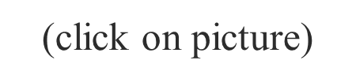
Achieving Your Goals in Life
Notes:
Ask anyone who Will Smith is, and you will most likely hear that he is an actor, a rapper or a producer. How do you think he achieved such success in his life?
Will Smith believes that success begins with believing in yourself. He said that before anyone else can believe it, you must believe it and make a plan for it. Will Smith did not wake up one day as a multi-millionaire with sold-out performances and top box office hits - he made it a goal for himself to achieve greatness! Your life goals require the same type of planning that Will Smith made for himself.
Play the YouTube (TM) video of Will Smith's collection of motivational speeches.
Will Smith - Ultimate Motivational Speeches
Actor Will Smith provides some excellent motivational advice on achieving your goals in life.
https://www.youtube.com/watch?v=Ucv8O75erpg

Slide 9


Obstacles in Life
  Always work toward your goal! If not, you’re working against your goal.
  Crises in the family
  Finances
  Health issues
  Lack of motivation
  Lack of resources
  Procrastination
  Time
Notes:
Crises in the family – Divorce, separation, homelessness, death in the family, abuse or drug use can be obstacles.
Finances – A lack of finances can make it difficult to work towards a goal. It can also be a motivator. How?
Health issues - Studies have found many health problems related to stress. Stress seems to worsen or increase the risk of conditions like obesity, heart disease, Alzheimer's disease, diabetes, depression, gastrointestinal problems and asthma.
Lack of motivation – Why do some people have a lack of motivation?
Lack of resources – Resources can include money, family support, transportation, basic needs or knowledge.
Procrastination – Do you procrastinate?
Time – Some people do not make good use of their time.
What are some obstacles in your life? Give students time to reflect and share personal stories.
How can you overcome the obstacles in your life in order to achieve your short-term and long-term goals?

Slide 10

Success
  Personal
  Professional
Notes:
There are two types of success we will discuss today: personal and professional.

Slide 11
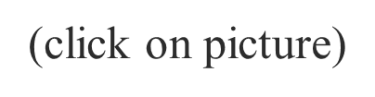
Do You Believe in Me?
Notes:
Teacher note: This video is about nine minutes long. You may opt to assign it as an enrichment activity rather than showing it in class.
Do You Believe In Me?
Dalton Sherman was the keynote speaker at the Dallas ISD district in-service. He spoke to thousands of educators giving an inspiring speech that has now gone viral.
https://www.youtube.com/watch?v=HAMLOnSNwzA

Slide 12

Personal Success
  Related to the individual
    Examples:
    Getting a part-time job
    Joining a team or club
    Passing a test
    Taking on a leadership role
    Winning the part in a play
Notes:
Personal success is unique to the individual. What is your definition of personal success? What are some other personal successes that could be added to this list? (Have students write down the examples on their notes.)

Slide 13

Professional Success
  Related to one’s career
    Examples:
    Being offered an internship
    Career advancement
    Getting a good job
    Getting into a good college
    Having a high GPA
    Obtaining scholarships
Notes:
Professional success is related to one’s career. What is your definition of professional success? What are some other examples of professional successes that could be added to this list? (Have students write down the examples on their notes.)

Slide 14

Education and Training
Notes:
What careers fall into the Education and Training Career Pathway? Allow students to discuss the possibilities.
Some possible answers include:
Curriculum specialist
Early childhood educator
Education administrator
Education counselor
Elementary teacher
High school teacher
Instructional coordinator
Librarian
Middle school teacher
Preschool teacher
School and career counselors
School psychologist
Special education teacher
Speech-language pathologists
Principal
Superintendent
Teacher assistants

Slide 15

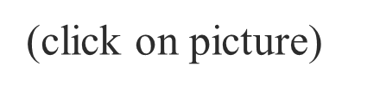
Notes:
The first step on your road to a career in education is making smart decisions about your education and career options.
Teacher note: You will download the college and career planning guide when you click on the picture. This might take about 20 seconds (depending on your Internet service). After you download it, proceed to page 2. Discuss the information on this page.
Achieve Texas
AchieveTexas in Action: A College and Career Planning Guide
http://www.achievetexas.org/2010%20Guides/71712%20AchTxEd_comp_np.pdf

Slide 16

Education and Training
Career Pathways
  Education and Training Career Cluster
    Administration and Administrative Support
    Professional Support Services
    Teaching and Training
Notes:
There are three pathways that fall under the Education and Training Career umbrella. The three pathways are Administration and Administrative Support, Professional Support Services and Teaching and Training.

Slide 17
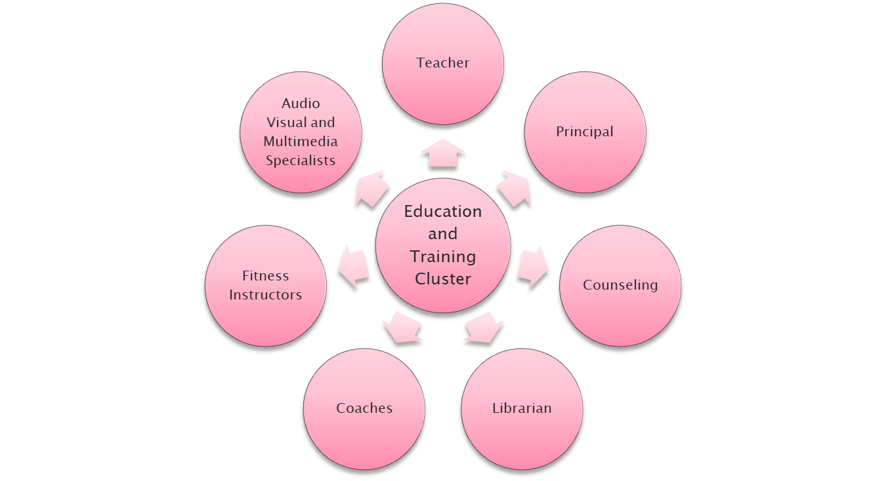
A World of Possibilities
Notes:
There are several different careers within the Education and Training Cluster. Teaching is not the only career available in education, as some people may think. In fact, there are numerous jobs and careers related to teaching that help teachers do their job in the education field.
Ask the following: What are some other careers related to education that are not represented on the board? How do all of the careers fit together so that the education world works together cohesively?

Slide 18

Administration
  Master’s degree
  One to five years work experience
  Average salary $86,970.00
  Job growth
    10 % (about average)
Notes:
A principal’s position requires a minimum of a master’s degree. According to the Bureau of Labor Statistics (BLS), the average salary in 2010 for principals was $86,970.00. The BLS said in 2010 there was an increase by 10 % in administrative careers.
Information from: http://www.bls.gov/ooh/management/elementary-middle-and-high-school-principals.htm

Slide 19

Administrative Support
  High school diploma or equivalent
  On-the-job training
  Average salary $34,660.00
  Job growth
    12% (about average)
Notes:
In this field, professionals provide instructional leadership and manage the day-to-day activities in schools, colleges and universities. They also manage educational programs in businesses, correctional facilities and community service organizations.
Administrative staff require only a high school diploma and on-the-job training. The average salary for administrative staff, according to the BLS was $34,660.00 in 2010, and the job outlook was 12%.
Information from: http://www.bls.gov/ooh/office-and-administrative-support/secretaries-and-administrative-assistants.htm

Slide 20

Professional Support Services
  High school diploma or equivalent
  On-the-job training
  Average salary $23,220.00
  Job outlook
    15% (average growth)
Notes:
Professionals in this field assist students in schools with personal and family needs, mental health needs, educational goals and career decision making.
Support staff members usually have a high school diploma or equivalent. According to the Bureau of Labor Statistics (BLS), the average salary in 2010 for teacher assistants was $23,220.00. The BLS said in 2010 there was 15% growth each year for teacher assistants.
Information from: http://www.bls.gov/ooh/education-training-and-library/teacher-assistants.htm

Slide 21

Teaching and Training
  College degree
    Bachelor’s degree minimum
  Additional certifications
  Average salary $51,380.00
  Job outlook
    17% (about average)
Notes:
In addition to being knowledgeable in the subjects they teach, professionals in this area must be able to communicate, inspire trust and confidence, motivate learners and understand their educational and emotional needs.
The education and training necessary for careers within the education and training cluster varies greatly depending on the specific job tasks. For example, a teacher would require a minimum of a bachelor’s degree. Teachers may also require additional certifications such as a Gifted and Talented (GT) certification to work with GT students. According to the Bureau of Labor Statistics, the average salary in 2010 for teachers was $51,380.00. The BLS said in 2010 there was a 17% increase in the need for new teachers.
Information is from: http://www.bls.gov/ooh/Education-Training-and-Library/Kindergarten-and-elementary-school-teachers.htm

Slide 22

Employability Skills and Personal Qualities
  Job skills
  Higher-order thinking skills
  Personal qualities
Notes:
Employability skills are the basic skills necessary for getting, keeping and doing well on a job.
They can be organized in many ways:
Job Skills
basic academic skills
listening
math
oral communication
reading
science
writing
Higher-Order Thinking Skills
decision making
learning
problem solving
reasoning
thinking creatively
Personal Qualities
adaptable
cooperative
honest
positive attitude
punctual
responsible
self-confident
self-control
self-motivated
team spirit
well groomed
Do you have the employability skills and personal qualities necessary for getting, keeping and doing well on a job? If not, how can you obtain them?

Slide 23

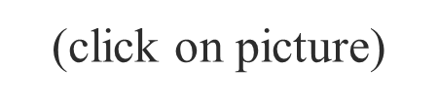
Don’t Be Afraid to Fail!
Notes:
We all have a road to travel to achieve our goals. We all fail, and some of the best growth we get is from failing and learning from it. We grow more in difficulty and intense times than in easy, happy ones.
If It’s To Be, It’s Up To Me
A slideshow and rap for success based on a quote and used as a motivator for students.
http://youtu.be/UthWDpvkuFU

Slide 24

Questions?

Slide 25
References and Resources
  Images:
    Microsoft Office Clip Art: Used with permission from Microsoft.
  Books:
    Career Choices: A Guide for Teens and Young Adults, Third Edition by Mindy Bingham and Sandy Stryker
    Although this book is geared more toward middle school, it is still an excellent resource for this course. It encourages teens to ask questions about their goals, desires, wants and passions in order to facilitate the thought process of their future plans.
    Early Childhood Education Today, Twelfth Edition by George S. Morrison
    This book is a great resource on early childhood education. It covers the foundation of education, programs and resources for children and families, educational needs of infants through the primary grades and the special needs of children and families.

Slide 26
References and Resources
    Exploring Teaching: An Introduction to Education by Richard Arends, Nancy E. Winitzky and Margaret D Tannenbaum
    This book encourages students to explore what teaching is and how to become an educator.
    Introduction To Teaching: Becoming A Professional. (Fifth Edition). by Don Kauchak & Paul Eggen
    For any student going into the teaching profession, this is an excellent choice. It is an easy read for students on all levels. It covers the changing teaching profession, the foundations of education and how to become an effective teacher.
    Teaching by Sharleen Kato
    Students will learn about the history of education and what it means to be a teacher with this textbook.

