Slide 1
Marketing Fundamentals
Travel and Tourism Management

Slide 3

Marketing
Notes:
The action or business of promoting and selling products or services, including market research and advertising
Marketing includes many activities such as a:
Marketing plan
Market research
Strategies
4 P’s of marketing

Slide 4
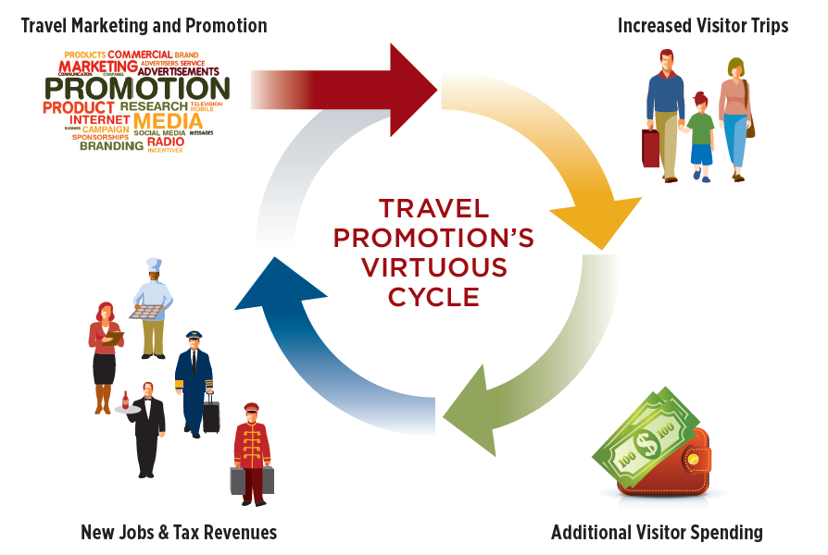
Travel Promotion
Notes:
Travel promotion strengthens economic vitality.
Promoting travel will spur growth and create jobs.

Slide 5

Steps
  Market Research
  Set Goals and Objectives
  Develop Strategies
  Evaluate the Plan
Notes:
A marketing plan is essential to promote your business and invite customers to buy your product.
It may have many steps but generally these basic steps are involved.

Slide 6

Market Research
  Helps you to:
    Decide how to segment the market
    Focus on a target market
    Study the competition
    Understand the market
Notes:
Market research is the action or activity of gathering information about consumers’ needs and preferences.

Slide 7
Goals and Objectives
  Develop specific goals
  For example:
    Advertise on social media (goal)
    Increase customer travel (objective)
  Set timelines
Notes:
The goals should be based on the business situation.
Goals can be less structured, whereas, objectives are more concrete.
Increasing customer travel is a permanent outcome a business wishes to see, stemming from the goal of advertising on social media.

Slide 8

Strategies
  The heart of the marketing plan
    Marketing budget is set
    Plan is detailed
    Staff is assigned
Notes:
Timelines are given for completion of the plan.

Slide 9

Evaluate
  Questions to consider:
    Did the market plan work?
    Do changes need to be made?
    How can we improve?
    What can be done better?
Notes:
All good marketing plans should be evaluated and questions answered.
Always return to your market research when evaluating.

Slide 10
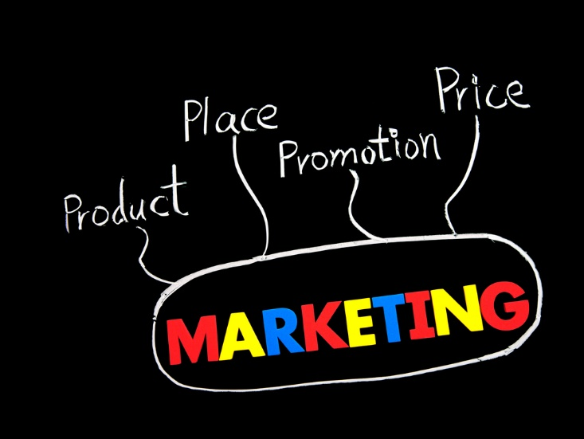
4 P’s of Marketing
  Product
  Place
  Price
  Promotion
Notes:
Also called the marketing mix.

Slide 11
Products
  Includes all activities involved in development of product(s)
  Keep target market in mind
  Look for changes in wants and needs of target market
  Make changes if necessary
  Goods
    Tangible – hold or touch
    Examples: caps, t-shirts
  Services:
    Intangible – can not touch
    Examples: spa services, miniature golf game
Notes:
This also includes developing the concept of the business.
What type of travel and tourism business will it be?
Products fit into two categories:
Goods which are items you can hold or touch, called tangible.
Examples include clothing, pens, food, towels, robes, teddy bears and even toothpaste
Services are intangible, or something that cannot be touched.
Examples include miniature golf games, a massage or facial, going to the movie theater or concert

Slide 12

Place
  Key factor in determining success of the business
    Location, location, location!
    Where is the right place?
Notes:
The location is important in determining how successful your business will be.
Have you ever seen the same type of businesses side by side or across the street from each other?
How do you think that effects each business?

Slide 13
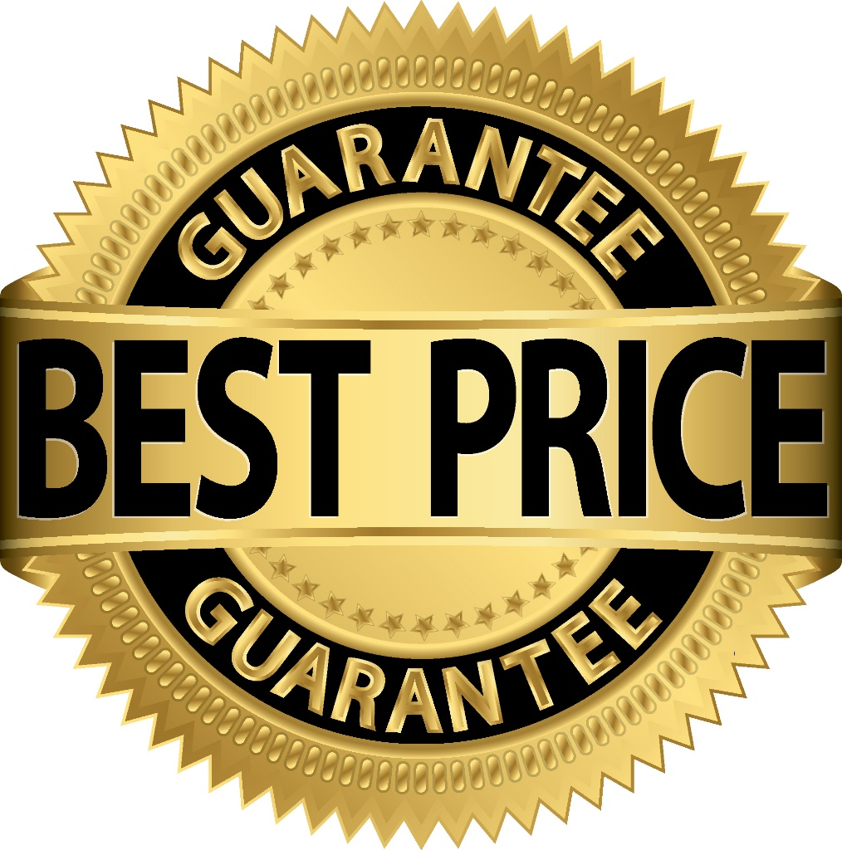
Price
  Know cost and profit goals
  Know what competitor’s charge
  Set the exact price
Notes:
Setting the right price can be a complex task and involves many factors.
The general price ranges of low, moderate or high may already be set by the product.

Slide 14
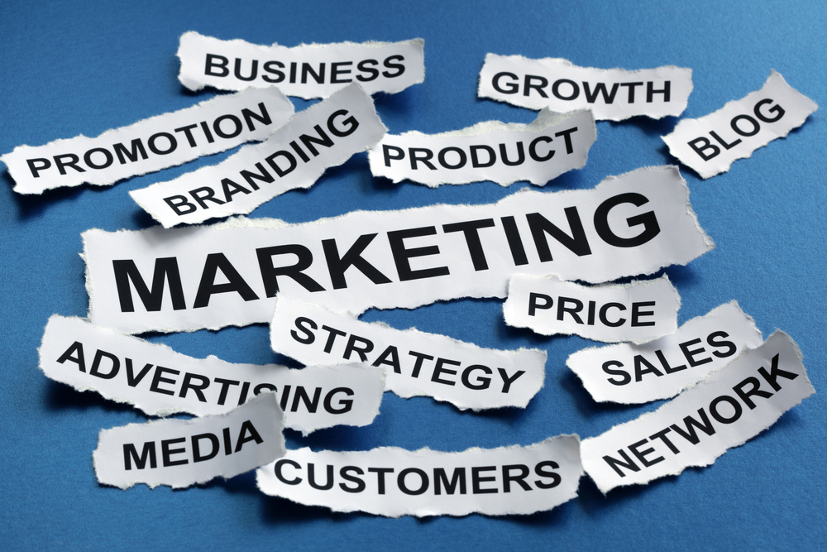
Promotion
  Communication with customers includes:
    Advertising
    Public relations
    Sales
    Sales promotion
Notes:
Promotion is where you actually influence the customers to buy the product.
Advertising - a paid form of promotion that persuades and informs the public about what a business has to offer.
Public relations - consists of activities performed to create goodwill between the public and the business.
Sales – occurs when a representative of the company speaks directly with the customer about the product.
Sales promotion - a specific offer designed to increase sales.

Slide 15
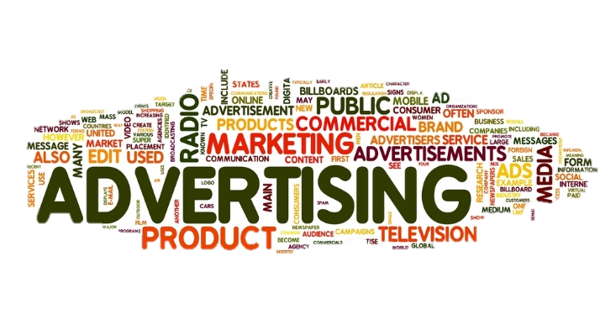
Advertising
  A nonpersonal communication
  Broadcast to a large number of people
  Sometimes referred to as an ad
Notes:
Advertising is a paid form of promotion that persuades and informs the public about what a business has to offer.

Slide 16
Advertising
  Billboards
  Commercials
  Internet
  Print Advertising
  Reader Boards
Notes:
Some advertisements include:
Billboards - large outdoor boards for displaying advertisements
Commercials - a television or radio advertisement
Internet - the global communication network that allows almost all computers worldwide to connect and exchange information
Print advertising - advertising in newspapers or magazines, rather than on television, radio or the internet
Reader boards - a visual display board that conveys information about a wide variety of subjects, including advertising for products or services, travel, news or event information

Slide 17
Public Relations
  Creates goodwill
    Doing something good or newsworthy
    Making sure the public knows about it
  Skills include:
    Communication
    Creativity
    Research
    Writing
Notes:
Public relations is the state of the relationship between the public and a company or other organization or a famous person.

Slide 18

Sales
  Group sales
    Includes charitable groups, corporations, professional associations and social groups
    Consists of selling travel and tourism services
    Is a large percentage of revenue
  Suggestive selling
    Recommending additional products or services to a customer
    May increase sales
Notes:
Sales are the exchange of a commodity for money; the action of selling something.

Slide 19
Sales Promotion
  Intended to increase sales
  Include:
    Coupons
    Free product samples
    Loyalty programs
    Sweepstakes
    Two-for-one offers
Notes:
Maybe referred to as an incentive – something that attracts a person to do something.
Can you think of other sales promotions that have enticed you to the sale?

Slide 20
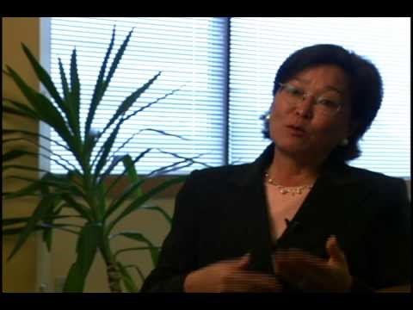
SBA Delivering Success: Marketing 101
(click on link)
(image from video)
Notes:
Click on hyperlink to view YouTube™ video:
SBA Delivering Success: Marketing 101
The U.S. Small Business Administration and the U.S. Postal Service bring you Delivering Success—video interviews with successful entrepreneurs who share the lessons they've learned about owning a small business.
https://youtu.be/YUoKi8DQxv4

Slide 21

Notes:
What does this quote mean to you?

Slide 22
Let’s Review!
  What is marketing and what does it include?
  Why is travel marketing and promotion important?
  What are the steps to a marketing plan?
  What are the 4 P’s of marketing?
  What are tangible and intangible products?
  What are some ways to promote products?
  What type of advertisements for travel have you seen?
  What can be used to increase sales in the industry?
Notes:
Answers to the questions are found within the slide presentation or may vary with class discussion.

Slide 23

Questions?

Slide 24
References and Resources
  Images:
    Shutterstock™ images. Photos obtained with subscription. (Slides 1, 3, 5, 6, 7, 8, 9, 10, 12, 13, 14, 15, 17, 18, 19, 21, 23)
  Textbooks:
    Farese, Kimbrell, Woloszyk, (2002) Marketing Essentials, Woodland Hills, California: Glencoe McGraw-Hill, Inc.
    Reynolds, J. S. (2014). Hospitality services. Tinley Park. IL: Goodheart-Willcox Company.
  Websites:
    Small Business Administration
    Marketing 101: A Guide to Winning Customers
    This course is designed to provide a basic overview of marketing. It is a practical program
    with real-world examples and helpful tips. The course is directed to small business owners
    who are interested in reaching a broader customer base.
    https://www.sba.gov/tools/sba-learning-center/training/marketing-101-guide-winning-
    customers

Slide 25
References and Resources
  Websites:
    U.S. Travel Association
    We assist members with programs and platforms to help promote travel to and within the
    U.S., especially through IPW, the pre-eminent international trade show bringing travel to
    America.
    https://www.ustravel.org/
  YouTube(tm):
    SBA Delivering Success: Marketing 101
    The U.S. Small Business Administration and the U.S. Postal Service bring you Delivering
    Success—video interviews with successful entrepreneurs who share the lessons they’ve
    learned about owning a small business.
    http://youtu.be/YUoKi8DQxv4

