Slide 1
Marketing Strategies for Your Restaurant

Slide 2

Marketing
The action or business of promoting and selling products or services, including market research and advertising

Slide 3

Market Segmentation and Target Market

Slide 4

Market Research
Helps you to:
Decide how to segment the market
Focus on a target market
Study the competition
Understand the market

Slide 5
Market Segmentation
A subgroup of a larger market
May be segmented by:
Age
Family size
Income levels
Children
Teens
Age
Adults
Senior citizen

Slide 6

Target Market
A good target market is:
  Easy to identify
  Large
  Able to afford your product
  Willing to buy your product

Slide 7

Marketing Strategy
The goal of increasing sales and achieving a sustainable competitive advantage

Slide 8
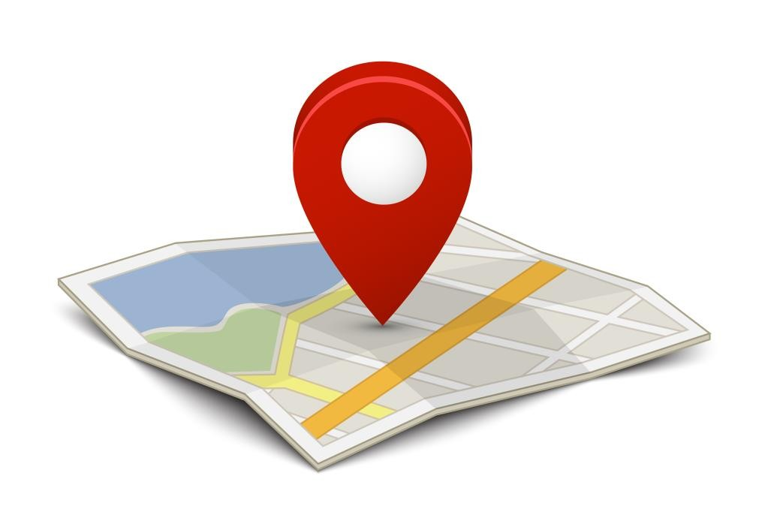
Location
Most important decision
Check for:
  Access
  Parking
  Traffic patterns
Keep in mind:
  How much money is needed
  What can you afford

Slide 9
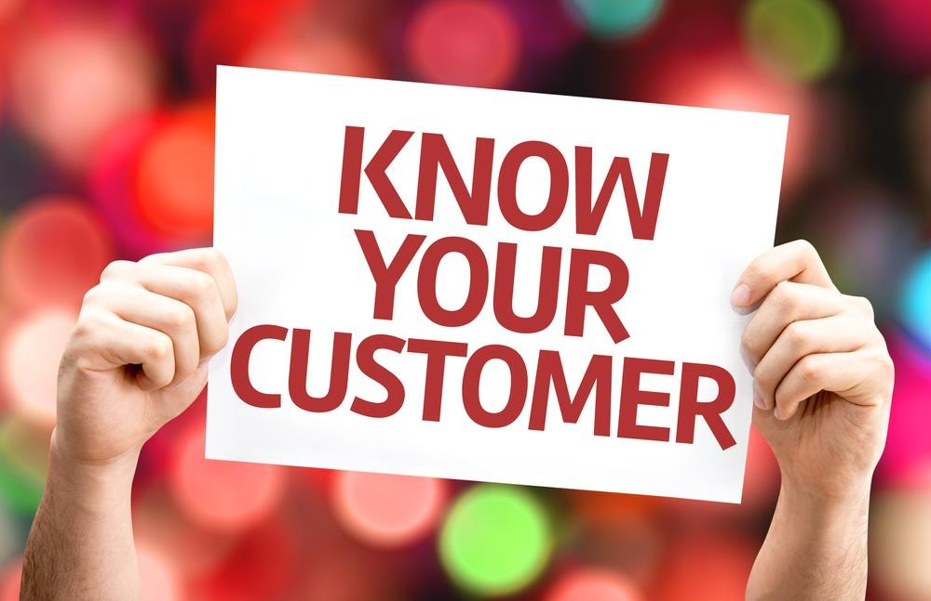
Customers
Analyze the target market
Focus on this clientele
Market and advertise to these potential customers

Slide 10

Competition
Know your competitors
Find out:
  How close they are
  How many there are
  How you can make your venue stand out

Slide 11

Trends
Keep the future in mind
Keep up with trends
Make changes if needed

Slide 12
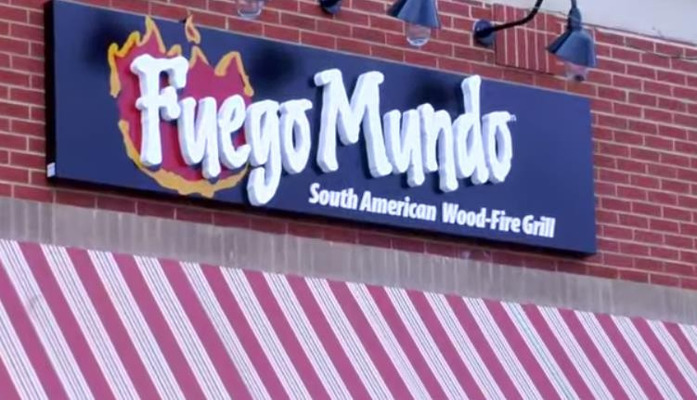
Fuego Mundo: Interact with Your Community using Free Marketing

Slide 13


Slide 14
References and Resources
Images:
Shutterstock™ images. Photos obtained with subscription. (Slides 1, 3, 4, 5, 7, 8, 9, 10, 11, 12, 14) Textbook(s):
  Culinary essentials.(2010). Woodland Hills, CA: Glencoe/McGraw-Hill.
  Foundations of restaurant management & culinary arts. (2011). Boston, MA: Prentice Hall.
  Reynolds, J. S. (2010). Hospitality services: Food & lodging. Tinley Park. IL: Goodheart-Willcox Company. Website(s):
Small Business Association Learning Center - Competitive Advantage - What sets you apart from your competition? Learn how to get a competitive advantage with this course. Learn how to brand, study your competition, identify customers and their preferences, create pricing strategies and much more. Leverage the uniqueness of your business to create a real competitive advantage. https://www.sba.gov/tools/sba-learning-center/training/competitive-advantage
YouTube™:
Fuego Mundo: Interact with your Community using Free Marketing - Fuego Mundo creates a unique dining experience by bringing the flavors, spices, and culture of South America to Sandy Springs, GA. The restaurant uses social media to request feedback from its customers for improvement. Even its name was decided on a social network! https://www.youtube.com/watch?v=a0QtkVEL6H0

