Slide 1
Marketing Techniques for the Hospitality Industry
  Hospitality Services

Slide 3

The action or business of promoting and selling products or services, including market research and advertising
Notes:
Marketing includes many activities such as a:
Marketing plan
Market research
Strategies
4 P’s of marketing

Slide 4

  The part of the business plan outlining the marketing strategy for a product or service
Notes:
The marketing plan is generally included as part of the overall business plan.

Slide 5

Steps
  Market Research
  Set Goals and Objectives
  Develop Strategies
  Evaluate the Plan
Notes:
A marketing plan is essential to promote your business and invite customers to buy your product.

Slide 6

Market Research
  Helps you to:
    Decide how to segment the market
    Focus on a target market
    Study the competition
    Understand the market
Notes:
Market research is the action or activity of gathering information about consumers’ needs and preferences.

Slide 7
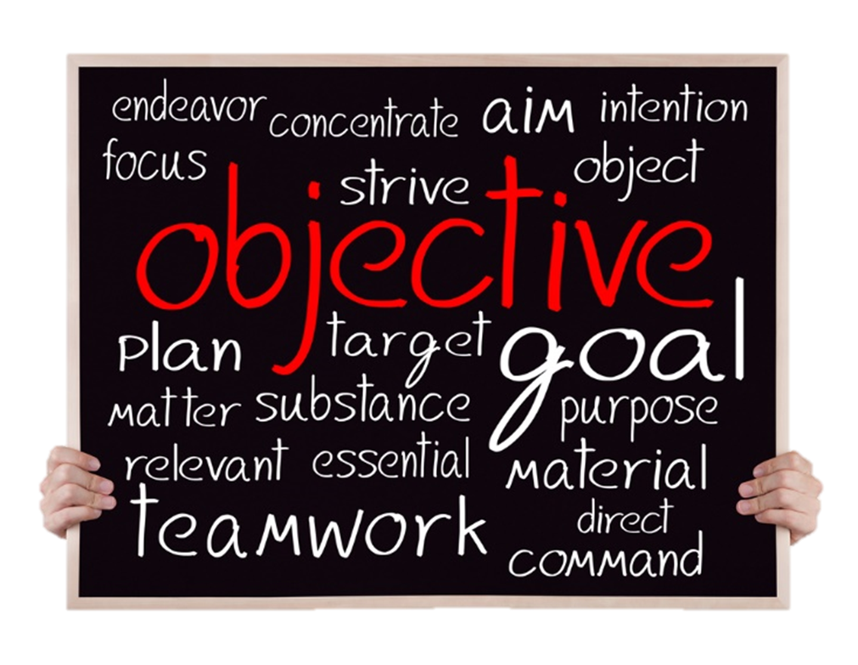
Goals and Objectives
  Develop specific goals
  For example:
    Advertise on social media (goal)
    Increase customers on weekdays (objective)
  Set timelines
Notes:
The goals should be based on the business situation.

Slide 8

Strategies
  The heart of the marketing plan
    Marketing budget is set
    Plan is detailed
    Staff is assigned
Notes:
Timelines are given for completion of the plan.

Slide 9

Evaluate
  Questions to consider:
    Did the market plan work?
    Do changes need to be made?
    How can we improve?
    What can be done better?
Notes:
All good marketing plans should be evaluated and questions answered.

Slide 10
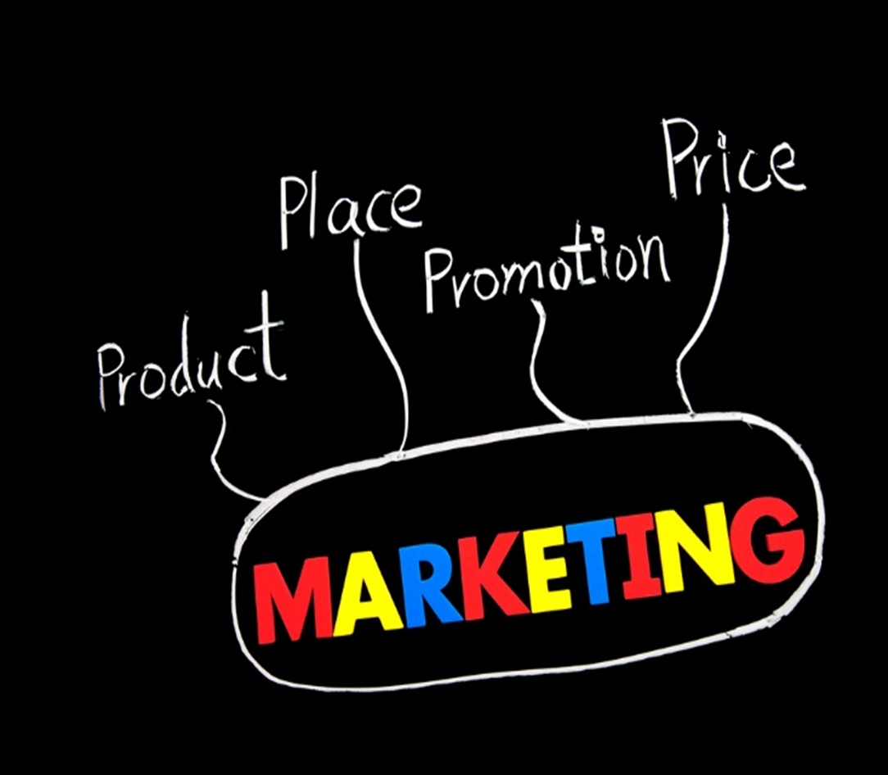
4 P’s of Marketing
  Product
  Place
  Price
  Promotion
Notes:
Also called the marketing mix.

Slide 11
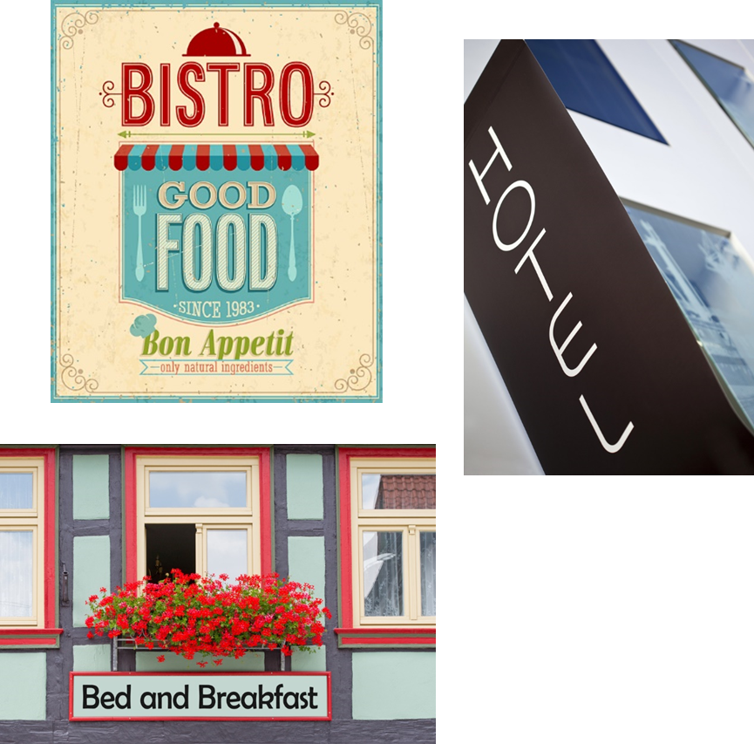
Product
  Includes all activities involved in development of product(s)
  Keep target market in mind
  Look for changes in wants and needs of target market
  Make changes if necessary
Notes:
This also includes developing the concept of the business.

Slide 12

Place
  Key factor in determining success of the business
  Location, location, location!
  Where is the right place?
Notes:
The location is important in determining how successful your business will be.

Slide 13

Price
  Know cost and profit goals
  Know what competitor’s charge
  Set the exact price
Notes:
Setting the right price can be a complex task and involves many factors.

Slide 14

Promotion
  Communication with customers
    Advertising
    Public relations
    Sales
    Sales promotion
Notes:
Promotion is where you actually influence the customers to buy the product.

Slide 15

Advertising
  A nonpersonal communication
  Broadcast to a large number of people
  Sometimes referred to as an ad
Notes:
Advertising is a paid form of promotion that persuades and informs the public about what a business has to offer.

Slide 16
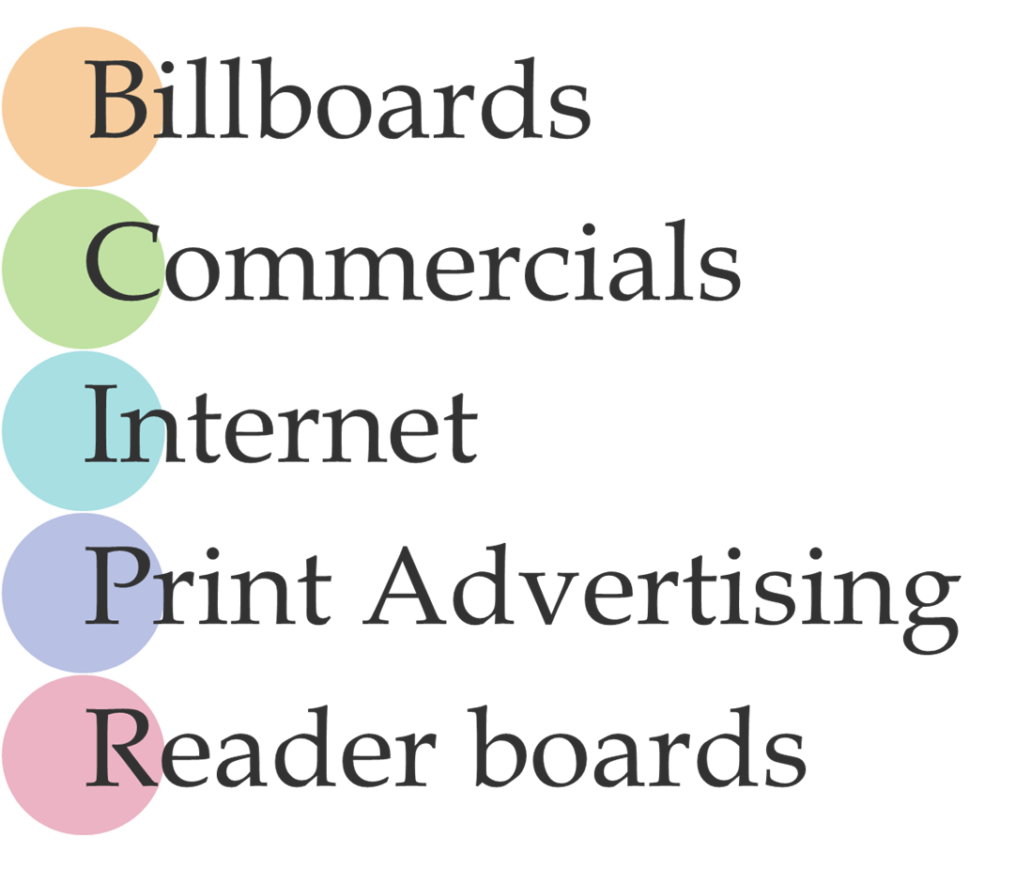
Notes:
Some advertisements include:
Billboards - large outdoor boards for displaying advertisements
Commercials - a television or radio advertisement
Internet - the global communication network that allows almost all computers worldwide to connect and exchange information
Print advertising - advertising in newspapers or magazines, rather than on television, radio or the internet
Reader boards - a visual display board that conveys information about a wide variety of subjects, including advertising for products or services, travel, news or event information

Slide 17

Public Relations
  Creates goodwill
    Doing something good or newsworthy
    Making sure the public knows about it
  Skills include:
    Communication
    Creativity
    Research
    Writing
Notes:
Public relations is the state of the relationship between the public and a company or other organization or a famous person.

Slide 18

Sales
  Group sales
    Includes charitable groups, corporations, professional associations and social groups
    Consists of selling meals, lodging and facility services
    Is a large percentage of revenue
  Suggestive selling
    Recommending additional products or services to a customer
    May increase sales
Notes:
Sales are the exchange of a commodity for money; the action of selling something.

Slide 19
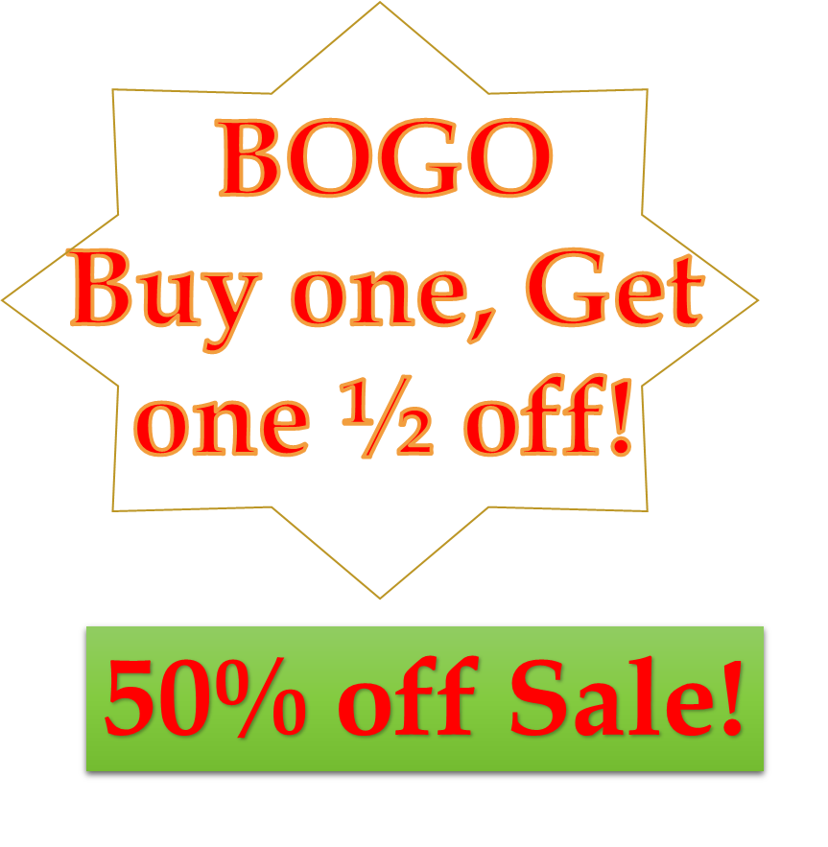
Sales Promotion
  Intended to increase sales
  Include:
    Coupons
    Free product samples
    Loyalty programs
    Sweepstakes
    Two-for-one offers
Notes:
Maybe referred to as an incentive – something that attracts a person to do something.

Slide 20

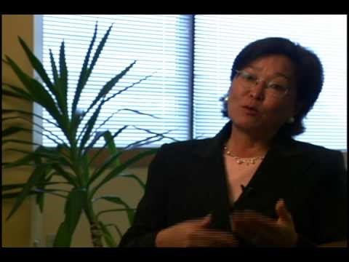
SBA Delivering Success: Marketing 101
Notes:
Click on hyperlink to view YouTube™ video:
SBA Delivering Success: Marketing 101
The U.S. Small Business Administration and the U.S. Postal Service bring you Delivering Success—video interviews with successful entrepreneurs who share the lessons they've learned about owning a small business.
https://youtu.be/YUoKi8DQxv4

Slide 21


Slide 22
References and Resources
  Images:
    Shutterstock™ images. Photos obtained with subscription. (Slides 3, 4, 5, 6, 7, 8, 9, 10, 11, 12, 13, 14, 15, 17, 18, 21)
  Textbooks:
    Reynolds, J. S. (2010). Hospitality services: Food & lodging. Tinley Park. IL: Goodheart-Willcox Company.
  Website:
    Small Business Administration
    Marketing 101: A Guide to Winning Customers
    This course is designed to provide a basic overview of marketing. It is a practical program with real-world examples and helpful tips. The course is directed to small business owners who are interested in reaching a broader customer base.
    https://www.sba.gov/tools/sba-learning-center/training/marketing-101-guide-winning-customers

Slide 23
References and Resources
  YouTube(tm):
    SBA Delivering Success: Marketing 101
    The U.S. Small Business Administration and the U.S. Postal Service bring you Delivering Success—video interviews with successful entrepreneurs who share the lessons they've learned about owning a small business.
    http://youtu.be/YUoKi8DQxv4

