Slide 1
Transportation, Distribution and Logistics
The Retail Supply Chain

Slide 3
Supply chains and the consumer
  We love supply chains, they deliver us the goods
  Supply chaining is a method of collaborating horizontally – among suppliers, retailers, and customers – to create value
  Today’s cutting edge technology allows the chain to move quickly and efficiently

Slide 4
Step 1
  Raw materials or partially completed components arrive at manufacturing plant

Slide 5
Step 2
  Final completed product is shipped to warehouse for storage until distribution to retailer

Slide 6
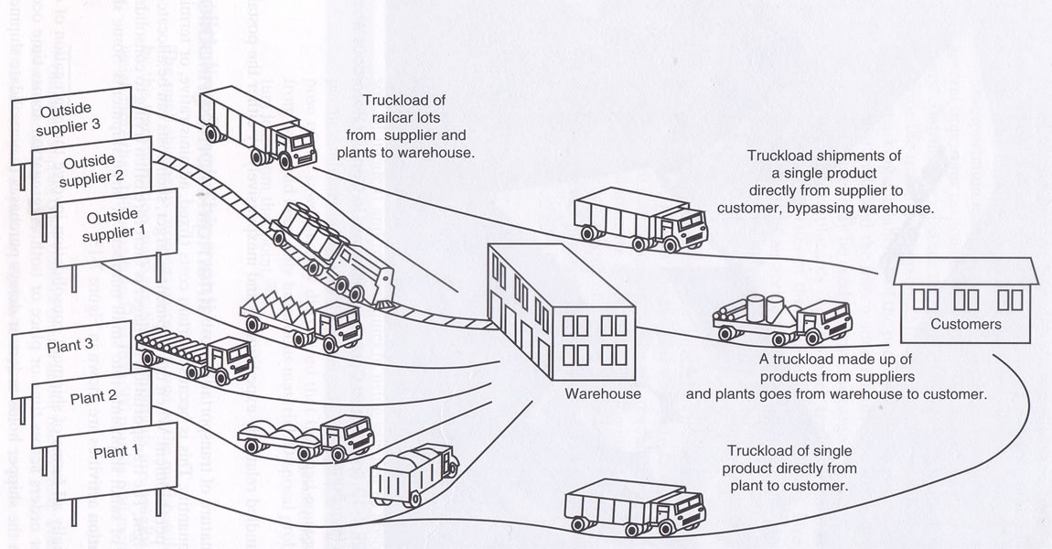
Steps 2 and 3

Slide 7
Step 3
  Order from retailer is received and item is transported to retail store

Slide 8
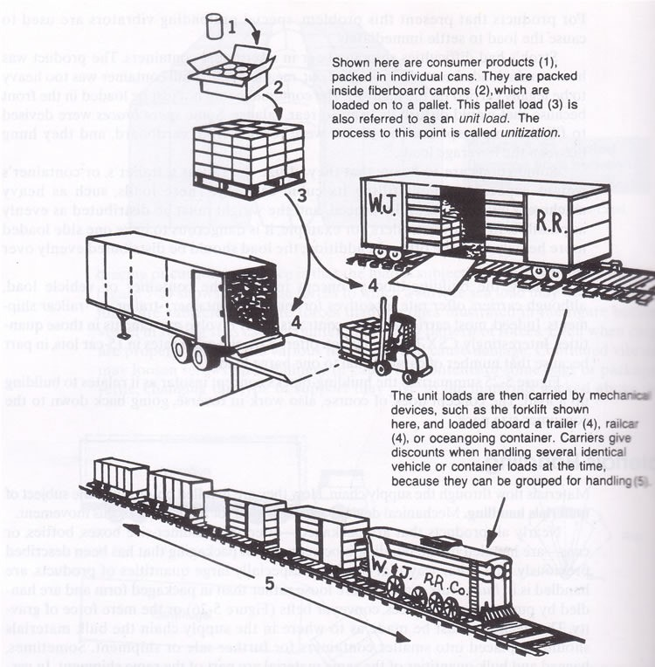

Slide 9
Step 4
  Product is placed on display awaiting consumer purchase

Slide 10
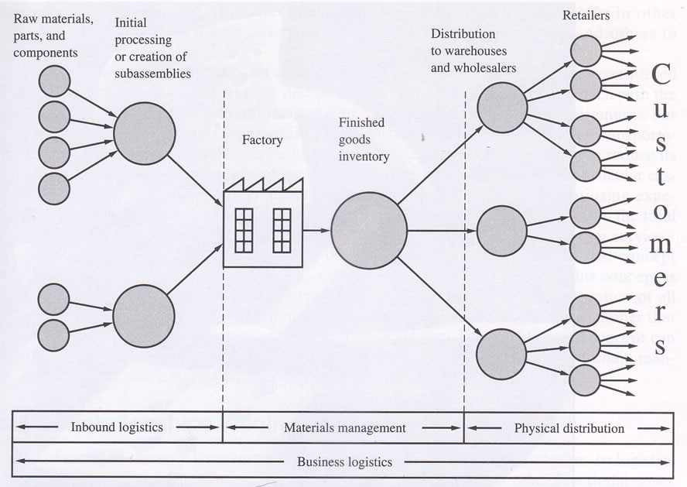
Summary

Slide 11
Wal-Mart 24/7/365
  Delivery
  Sorting
  Packing
  Distribution
  Buying
  Manufacturing
  Reordering
  Delivery
  Sorting
  Packaging
  ………….

Slide 12
Links
  A Distribution Center
  Wal-Mart Distribution Type “logistics” in Video Search, click on third video “Wal-Mart Distribution Centers”
  Wal-Mart Sustainability Type “logistics” in Video Search, click on second video “Sustainability”
  Wal-Mart Logistics Type “logistics” in Video Search, click on first video “Wal-Mart Logistics”

