Slide 1
Math + Science =
Quality Food

Slide 3

Quality Control
Notes:
What is quality?
Quality is a high level of value or excellence.
Quality control is a system that ensures that everything will meet the foodservice establishment’s standards.

Slide 4

Standards
Food Production and Service
Inventory
Purchasing, Receiving and Storing
Notes:
The demand for high quality standards reduces food costs.

Slide 5

Food Production and Service
Standard:
Portion sizes
Portion costs
Recipes
Notes:
All of these elements in the foodservice industry help to ensure quality standards.
Customers will receive the quality foods at each visit and multiple locations of the same venue.

Slide 6

Inventory
Physical inventory
Calculate cost
  Latest purchase price (FIFO)
  Actual purchase price
  Weighted average purchase price
  Last in, first out (LIFO)
Notes:
Taking inventory ensures quality standards will serve as a cost-control measure.

Slide 7

Purchasing, Receiving, and Storing
Purchasing
    Choose from credible suppliers
Receiving
    Receive items efficiently
Storing
    Store items safely
Notes:
Allows for quality standards to be implemented and reduces costs in all aspects of the food venue.

Slide 8

Math and Science in Baking
Notes:
Baking is different from cooking in that it involves math and science.

Slide 9
Science of Baking
Formula
Recipe
Ingredients listed by decreasing weight
Precise weight measurements are used
Instructions not always included
Ingredients listed in order of use
Followed by procedures for successful results
Notes:
A formula is a special type of recipe that is used in baking.

Slide 10
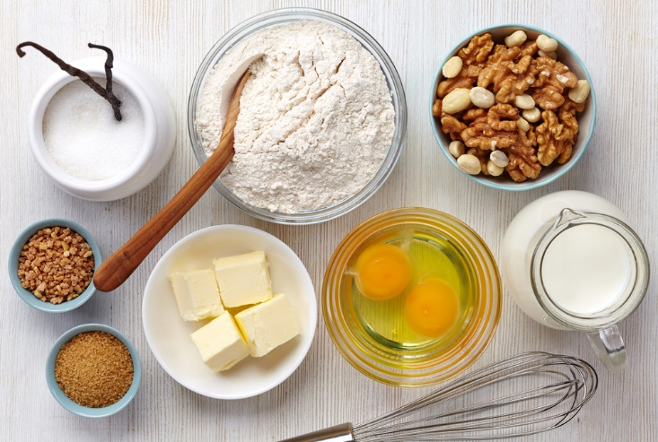
Standardized Recipes for Baking
An exact science that requires precise measuring and accuracy
Recipe includes the exact amount of each ingredient
Often listed in percentages
Notes:
These recipes may not always include instructions needed to prepare the product.
A standardized recipe includes written procedures to prepare a known quantity and quality of a certain food.

Slide 11

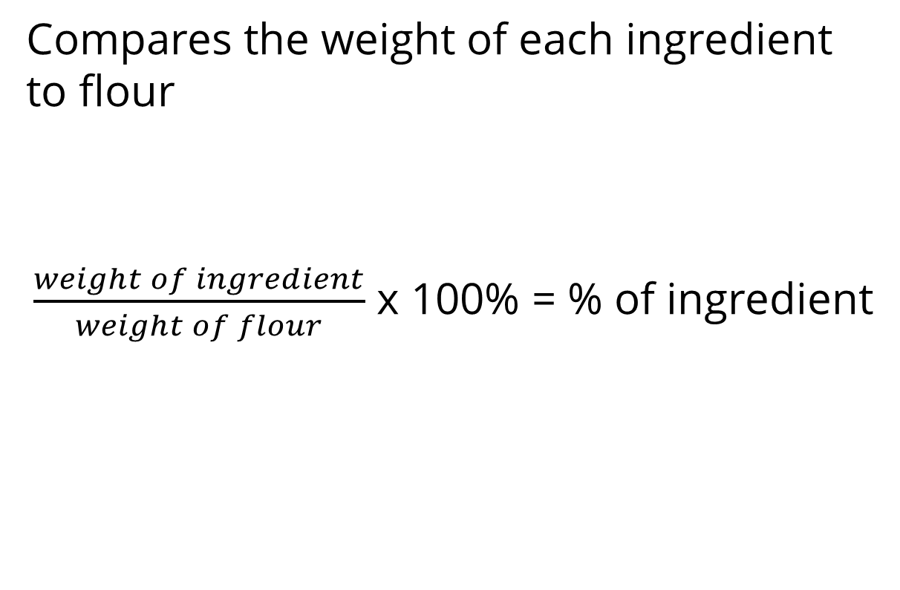
Baker’s Percentage
Compares the weight of each ingredient to flour
$\frac{weight of ingredient}{weight of flour}$ x 100% = % of ingredient
Notes:
Baker’s percentage - each ingredient in a formula is expressed as a percentage of the flour weight, and the flour weight is always expressed as 100%.
We will practice calculating the baker’s percentage in the Guided Practice section.

Slide 12
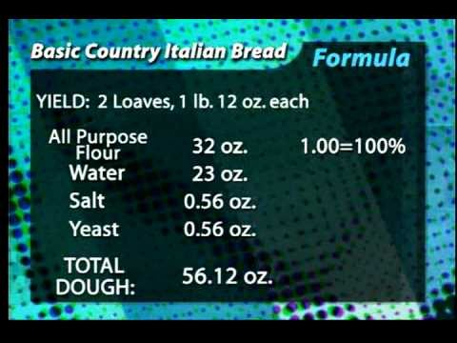
Baker's Percentage
Notes:
Click on hyperlink to view video:
Baker’s Percentage
This measuring system is commonly used when a formula contains flour.
https://youtu.be/xJqe5_g22kU

Slide 13

Notes:
What does this quote mean to you?

Slide 14
Let’s Review!
What is quality control?
What are the three standards the foodservice industry uses to control costs?
What the three elements in food production to ensure quality standards?
What is FIFO?
How is science involved in baking?
How is math involved in baking?
Notes:
Answers to the questions are found within the slide presentation or may vary with class discussion.

Slide 15


Slide 16
References and Resources
Images:
Shutterstock™ images. Photos obtained with subscription. (Slides 1, 3, 4, 5, 6, 7, 10, 11, 13, 15)
Textbooks:
Culinary essentials. (2010). Woodland Hills, CA: Glencoe/McGraw-Hill.
Foundations of restaurant management & culinary arts: Level 2. (2011). Boston, MA: Prentice Hall.
Websites:
Food Buying Guide
Calculator for Child Nutrition Programs
http://fbg.nfsmi.org/Default.aspx
National Food Service Management Institute
Part of the School of Applied Science at The University of Mississippi, is the only federally funded national center dedicated to applied research, education and training, and technical assistance for child nutrition programs. The Institute was established by Congress in the Child Nutrition and WIC Reauthorization Act of 1989. It is funded by a grant administered through the United States Department of Agriculture (USDA), Food and Nutrition Service (FNS).
http://www.nfsmi.org/Default.aspx
YouTube™:
Baker’s Percentage
This measuring system is commonly used when a formula contains flour.
https://youtu.be/xJqe5_g22kU

