Slide 1
Mathematical Applications in Human Services
  Practicum in Human Services

Slide 3
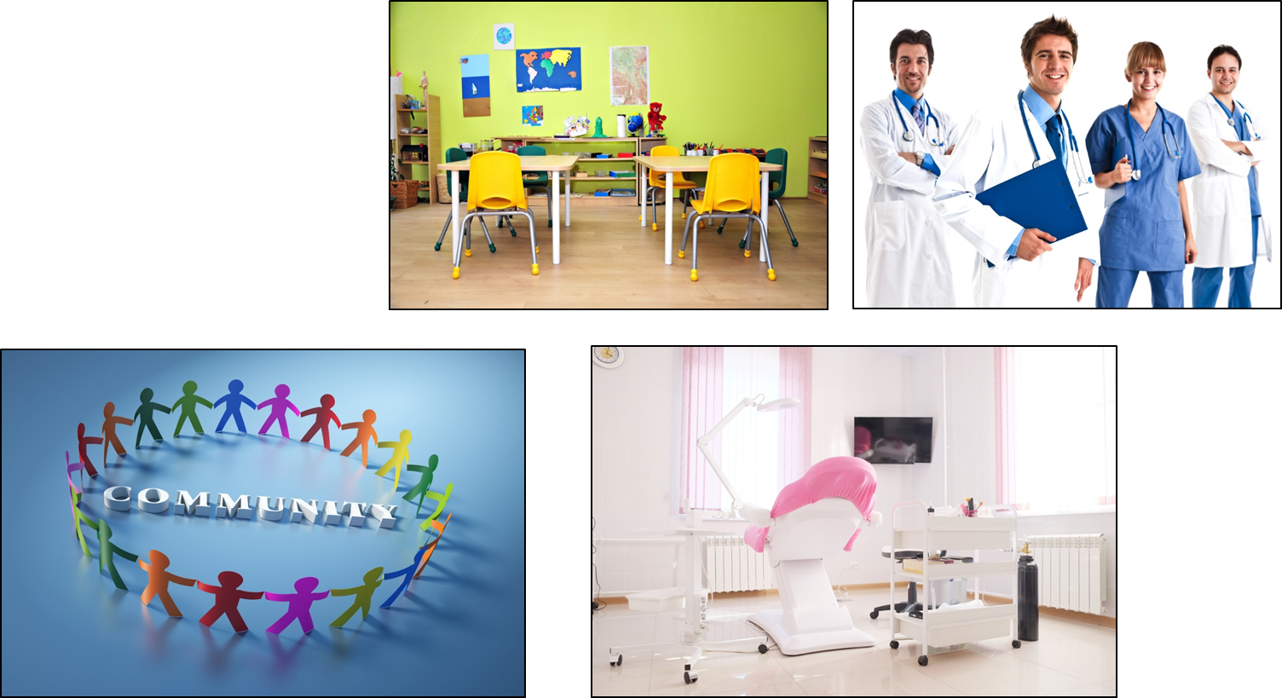
Human Services Career Pathways
Notes:
Practicum in Human Services provides occupational specific training and focuses on the development of:
Consumer Services
Early Childhood Development and Services
Counseling and Mental Health Services
Family and Community Services
Personal Care Services

Slide 4

Mathematical Applications
Notes:
In this lesson, we are going to focus on mathematical applications in Human Services.
What do you know already?
Allow students to share.

Slide 5

Mathematics Used in Various Occupations
Notes:
Whether it's a prescription in the healthcare field, an order for a product online, supplies for an office or disbursement of a government manual, orders and billings are a part of Human Services. Each specific industry and office have a structure in place for managing the orders and billing process. Errors can be costly and new employees are expected to listen carefully, follow instructions and ask questions to clarify in order to avoid problems.
How much mathematics are used in various occupations in Human Services?
What kind and in what ways?
Allow students to share.

Slide 6

What are employers looking for?
  They want their employees to be able to:
  communicate their thoughts with other employees
  reason
  work with technical equipment
Notes:
According to Mathguide.com, employers are looking for three basic traits. They want their employees to be able to:
communicate their thoughts with other employees
reason
work with technical equipment
How can math deal with developing reason and working with technical equipment?
How can math affect communication? Effectively using math can increase the ability to speak and write more plainly. Language, at least the type needed for work, tends to be organized and mathematical ability helps with that process.

Slide 7

Consumer Services
Notes:
Have you worked in a Human Services-related occupation?
What mathematical applications were used?
Allow students to share.

Slide 8

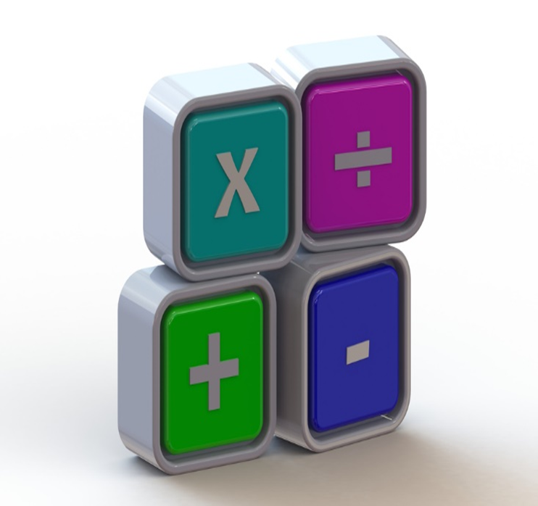
Consumer Services
Notes:
What can you tell from this picture?
How does it relate to occupations in Human Services?
What clues do you get from this slide?
Allow students to share.

Slide 9

Early Childhood Development and Services
Notes:
What does this image show?
What is it used for?
How can this be used in the field of Early Childhood Development and Services?
Allow students to share.

Slide 10
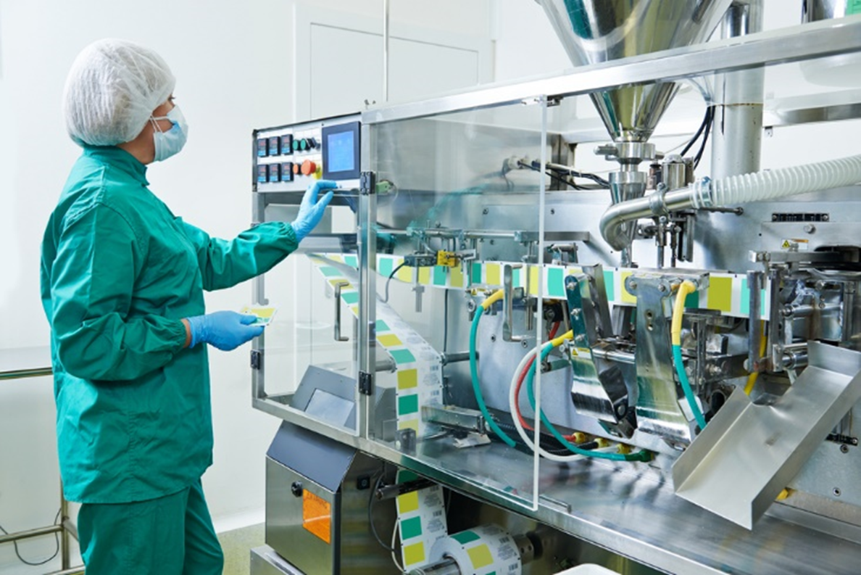
Counseling and Mental Health Services
Notes:
What is happening in this slide? What mathematical applications could be used in this occupation?
As a therapist/counselor, why is it important to possess good mathematics skills?
Allow students to share.
Teacher note: It is called a bulk bottle unscrambler. They are a necessity in an age where most companies receive their bottles in bulk. Bottle unscramblers have a small footprint with high speed capabilities and options such as ionized air cleaning of bottles before they are filled with product.

Slide 11

Family and Community Services
Notes:
What type of technology in used for mathematical applications at the workplace?
Allow students to share.

Slide 12

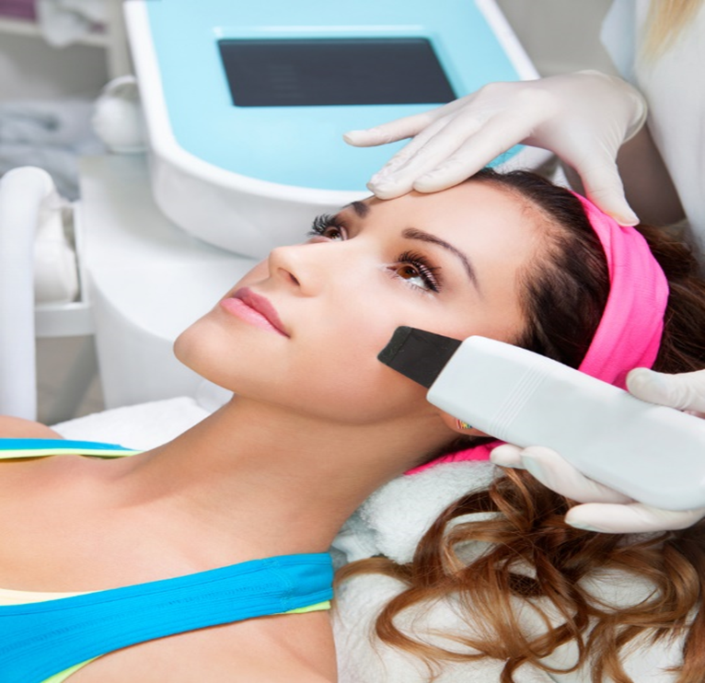
Personal Care Services
Notes:
As a cosmetologist, what do you need to know about use and application of mathematics at the workplace?
Allow students to share.

Slide 13
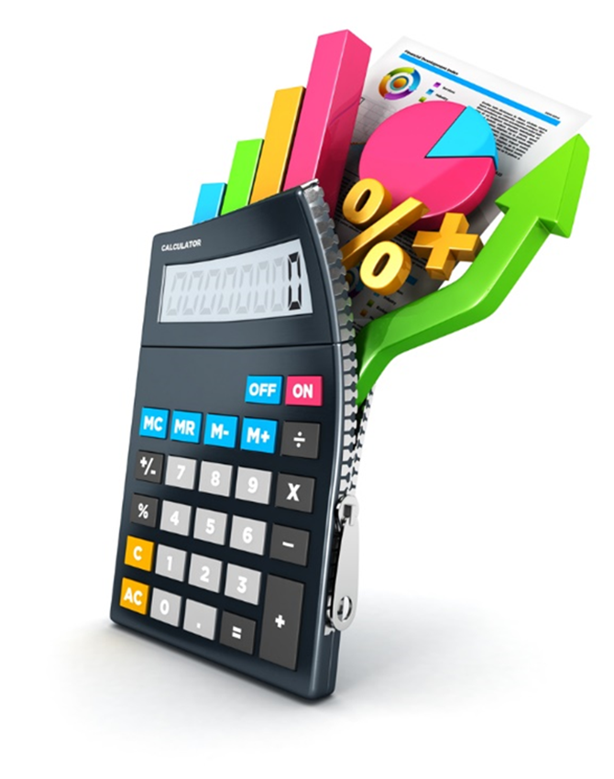
Your Turn
Notes:
Distribute Career and Mathematical Application Investigation (see All Lesson Attachments tab) and introduce the project.

Slide 14


Slide 15

  The following video can be viewed at the end of the Guided Practice section of this lesson.

Slide 16

We Use Math
(click on image)
Notes:
Click on image to view video:
We Use Math - Introduction
Meet professionals from a number of exciting fields who use mathematics in their jobs every day.
https://youtu.be/aYIv4jggQJc

Slide 17
References and Resources
  Images:
    All photos obtained through a license with Shutterstock.com™.
  Websites:
    Barrett Rose and Lee, Inc.
    The Essential Skill of Numeracy
    http://www.barrettrose.com/the-essential-skill-of-numeracy/
    Mathematical Association of America
    Research Sampler 6: Examining how mathematics is used in the workplace
    http://www.maa.org/programs/faculty-and-departments/curriculum-department-guidelines- recommendations/teaching-and-learning/examining-how-mathematics-is-used-in-the-workplace

Slide 18
References and Resources
  Math for Careers
    How you use Math at work.
    http://www.khake.com/page56.html
    Why Must I Learn Math?
    Mathematics is no longer just a subject taken by the elite. Now it has rightfully become a staple in our educational systems even though it is not appreciated by many people until it is needed.
    http://www.mathguide.com/issues/whymath.html#8
  YouTube™:
    We Use Math – Introduction
    Meet professionals from a number of exciting fields who use mathematics in their jobs every day.
    https://youtu.be/aYIv4jggQJc

Slide 19
  Abc
  Abc

Slide 20
  Abc
  Abc

Slide 21
  Abc
  Abc

Slide 22
  Abc
  Abc

Slide 23
  Abc
  Abc

Slide 24
  Abc
  Abc

Slide 25
  Abc
  Abc

Slide 26
  Abc
  Abc

Slide 27
  Abc
  Abc

Slide 28
  Abc
  Abc

Slide 29
  Abc
  Abc

Slide 30
  Abc
  Abc

