Slide 1
Measurement matters!
  Food Science

Slide 3
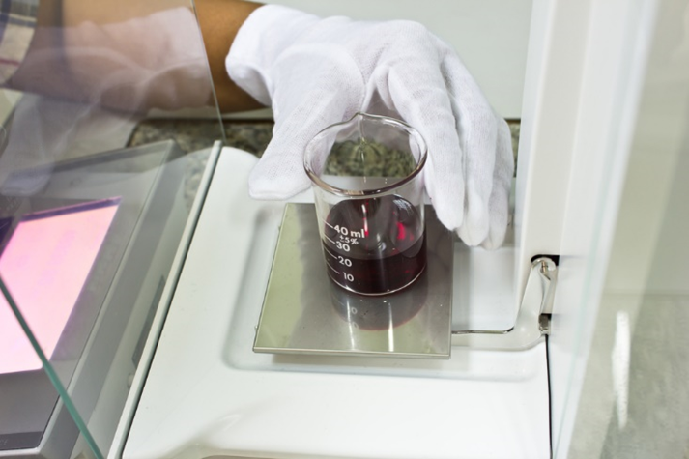
Measurements in Food Science
  To take accurate measurements, follow these guidelines:
  Identify the system of measurement
  Determine what is to be measured
  Decide what method of measurement will give most consistent results
Notes:
Measurement - a collection of quantitative data made by comparing a quantity with a standard unit

Slide 4
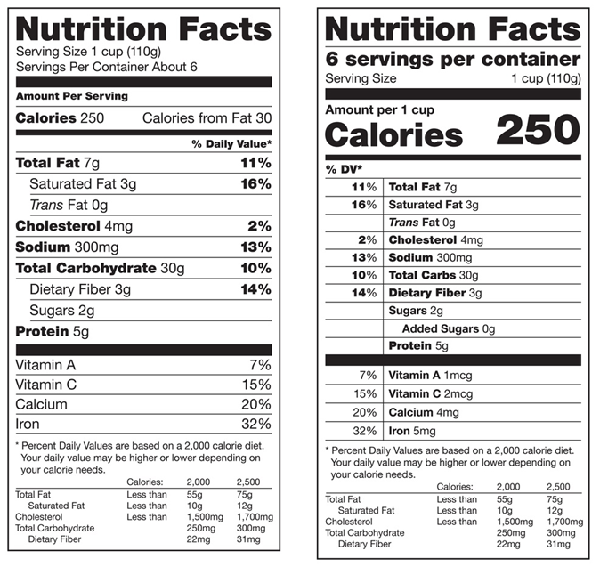
The Metric System
Notes:
The metric system is a decimal system of measurement.
All units in the metric system are divisible by ten.
Examples of the metric system in the United States are:
drinks sold in liters (L)
food mas shown in grams (g)
road signs show distance in kilometers (km)
running competitions measured in meters (m)

Slide 5
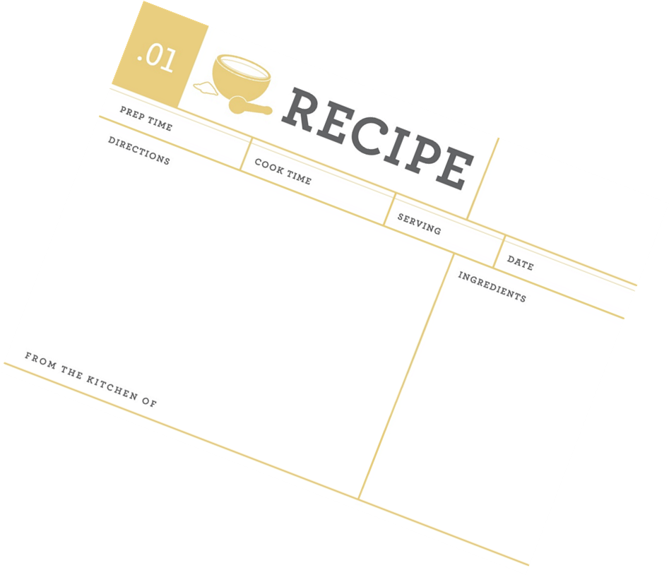
Cooking and Baking Success
  Just as in science, cooking and baking requires exactness
  Recipes have been tested to ensure the same product is produced every time
  Precise numbers and units will develop a consistent product
Notes:
It is important to know how to measure and read measurements accurately in science and in the kitchen.
Recipes are scientific equations that help produce the same product every time.
Just as we know 2 + 2 will always equal 4, we know that our cookie recipe should produce the same product every time.
The only difference between these two formulas is that with the recipe, you are responsible for accurate measurements to develop a consistent product.

Slide 6
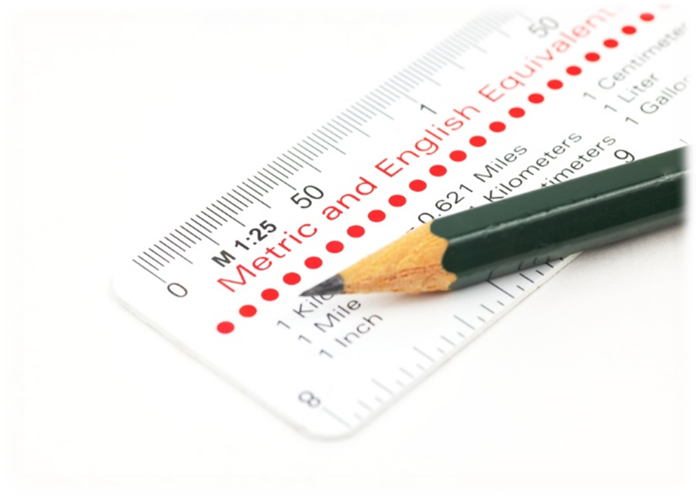
Basic Metric Units
  Length
  Time
  Mass
  Volume
  Temperature
Notes:
In this food science course, we will use the basic metric units of length, mass, temperature, time and volume.

Slide 7
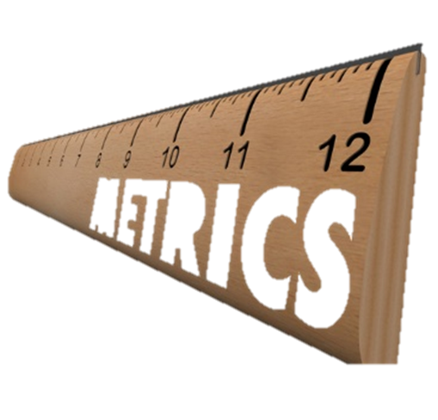
Measuring Length
  Equipment
    Metric ruler
    Meter stick
  Common Units
    centimeters (cm)
    millimeters (mm)
Notes:
Length is the distance between two points.
Demonstrate how to use a metric ruler and/or a meter stick.

Slide 8
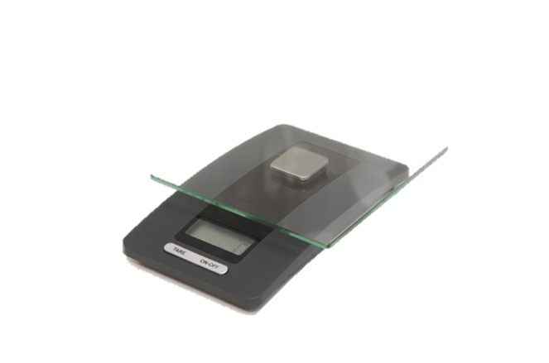
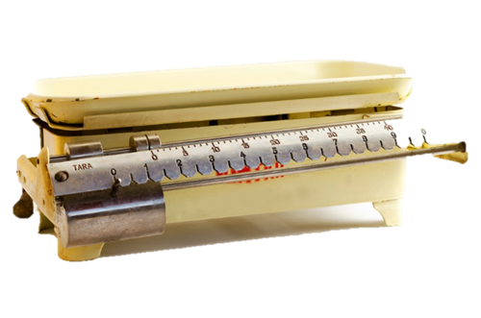
Measuring Mass
  Equipment
  Electronic balance
  Triple beam balance
  Common Units
  ounces
  gram
  kilogram
  pounds
Notes:
Mass is a measure of the quantity of matter.
The two most common tools for measuring mass are the electronic balance and triple beam balance (scales may also be used).
A triple beam balance has three beams.
Items to be weighed will need to be placed on weighing papers, weighing dishes, cupcake liners or coffee filters.
Demonstrate how to measure mass.

Slide 9
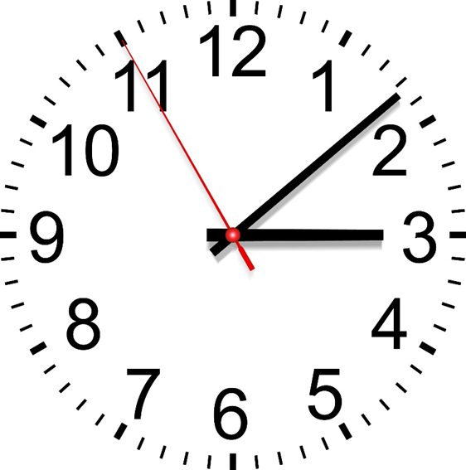
Measuring Time
  Equipment
    Clock
    Watch
  Common Units
    Seconds
Notes:
Time will be measured in seconds in most food science experiments using a clock or a watch.
Someone should be assigned as a timer to record start and stop times.

Slide 10
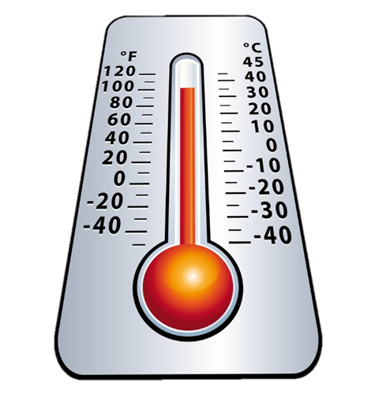
Measuring Temperature
  Equipment
    Thermometer
  Common Units
    Celsius degree (°C)
    Fahrenheit (°F)
Notes:
Temperature is a measure of heat intensity.
Most laboratory thermometers are marked with both Celsius and Fahrenheit scales.

Slide 11
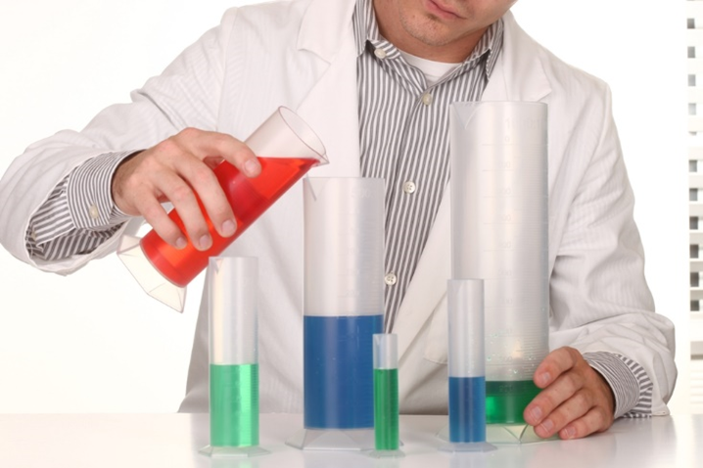
Measuring Volume
  Equipment
    Beakers
    Graduated cylinders
  Common Unites
    liters (L)
    milliliters (mL)
Notes:
Volume is the amount of space occupied by an object.
Liquids are usually measured by volume.
Be sure to place the container on a level surface and read the volume at eye level.
Demonstrate this procedure.

Slide 12
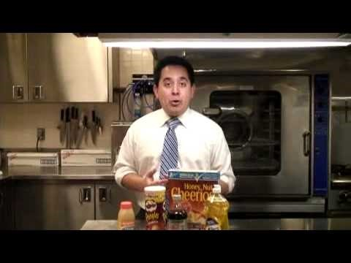

U. S. Switch to Metric System?
  The Federal Eye' Ed O'Keefe answers a reader's question about U.S. efforts to switch to the metric system
Notes:
Click on image to view YouTube™ video:
U.S. Switch to Metric System?
'The Federal Eye' Ed O'Keefe answers a reader's question about U.S. efforts to switch to the metric system.
http://youtu.be/xXK-QJ_9SLs

Slide 13
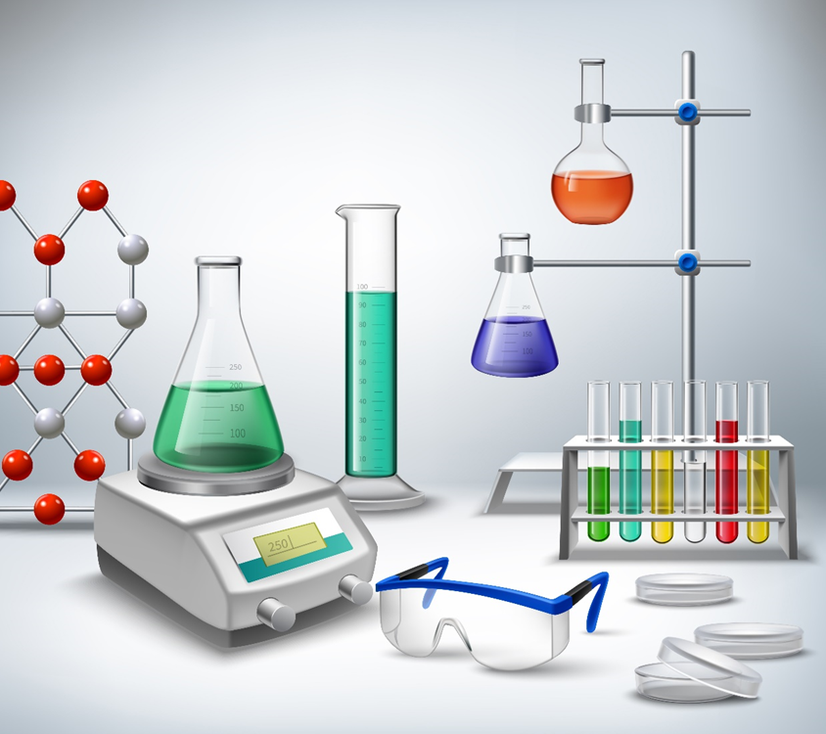
Units
  Be sure to list the units being measured
  Clarify whether the items measured are in metric or English units
  Specify which units you used
  Examples include:
    Ounces
    Pounds
    Grams
    Kilograms
Notes:
Reminder - during the food science experiments, be sure to list the units for the items being measured on your data sheets.

Slide 14


Slide 15
References and Resources
  Images:
    Shutterstock™ images. Photos obtained with subscription. (Slides 3, 4, 5, 6, 7, 8, 9, 10, 11, 13, 14)
  Textbook(s):
    Mehas, K. Y., & Rodgers, S. L. (2002). Food science: The biochemistry of food and nutrition. New York, NY: Glencoe/McGraw-Hill.
    Ward, J. D., & Ward, L. T. (2013). Principles of food science. Tinley Park, IL: Goodheart-Willcox Company.
  YouTube™:
    U.S. Switch to Metric System?
    'The Federal Eye' Ed O'Keefe answers a reader's question about U.S. efforts to switch to the metric system.
    http://youtu.be/xXK-QJ_9SLs

