Slide 1
Money Matters: Making Cents of It All
Dollars and Sense

Slide 3
What are some sources of credit?
Notes:
Ask this question, and allow for discussion.

Slide 4
Sources of Credit
Commercial bank
Credit card company
Credit union
Department store
Family and friends
Finance company
Furniture company
Life insurance company
Loan sharks
Pawn shop
Payday cash advance
Saving and loan association
Utility company
Notes:
Some sources of credit include:
Commercial bank
Credit card company
Credit union
Department store
Family and friends
Finance company
Furniture company
Life insurance company
Loan sharks
Pawn shop
Payday cash advance
Saving and loan association
Utility company
Lead students to classify each under one of the categories:
Sales credit – credit extended to purchase goods and services
Cash credit- credit used to borrow money
What are familiar sources of credit in the community?
What sources of credit provide cash credit?
What sources of credit provide sales credit?
What is a loan shark? There are also illegal lenders, more commonly referred to as "loan sharks," who operate without license or supervision and thrive on the business of low-income or credit-pressed consumers. The lowest interest rate commonly charged by a loan shark is 120 percent per year. The average rate is approximately 20 percent per week, which is 1,040 percent per year. High interest rates are not the only evil connected with illegal lenders.

Slide 5
Credit: Closed and Opened
Notes:
Consumer credit can be closed-end or open-end. Closed-end credit encompasses one-time loans for a specific time period. Open-end credit refers to loans available on an ongoing basis within set credit limits.

Slide 6
Closed-end Credit
Closed-end credit, or installment credit, is for a specific purpose and a set amount. The contract may include:
Amount of any required down payment
Finance charges
Number of payments
Payment schedule
Payment amounts
The total purchase amount
Total financed amount
Notes:
Closed-end credit, or installment credit, is for a specific purpose and a set amount. If you purchase a washing machine on closed-end credit, a credit contract will be executed to cover purchase and repayment terms. If you later decide to purchase a dryer, a new contract will be executed.
Mortgage loans, automobile loans and installment loans are examples of closed-end credit. When you apply for closed-end credit, a credit contract is executed which spells out specifics of the loan and repayment terms. For example, the contract may include the total purchase amount, amount of any required down payment, total financed amount, finance charges, number of payments, payment amounts and payment schedule.

Slide 7
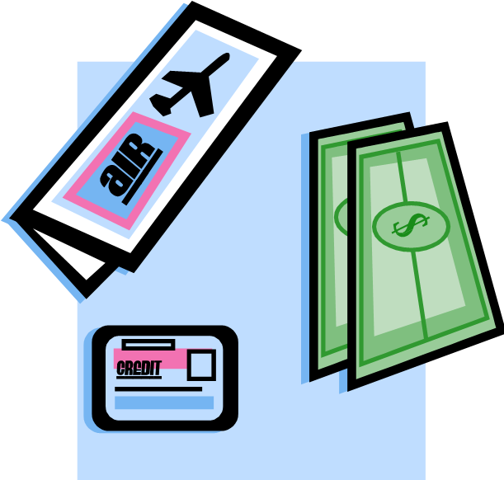
Common Forms of Installment Loans
Installment cash credit
Installment sales credit
Single-payment loan
Notes:
Common forms of installment loans:
Installment cash credit is a direct cash loan which is repaid with interest in monthly installments over a specific period of time. Consumers use installment cash credit to finance such personal expenses as vacations or home improvements.
Installment sales credit is a loan for the purchase of expensive goods or services. To obtain installment sales credit, the consumer usually makes a down payment or trade-in and signs a credit contract to repay the balance. Consumers often purchase high-priced merchandise like automobiles or major appliances through installment sales credit.
A single-payment loan is a loan which is repaid at a given time in a single lump-sum amount, which includes finance charges. A single-payment loan might be used to purchase a single item or meet a specific financial need.

Slide 8
Open-end Circuit
Open-end credit, or revolving credit, allows repeated loans up to a set maximum amount. As long as the total unpaid balance is below the maximum, additional purchases can be charged without having to reapply.
Regular charge accounts
Revolving charge accounts
Notes:
Open-end credit, or revolving credit, allows repeated loans up to a set maximum amount. As long as the total unpaid balance is below the maximum, additional purchases can be charged without having to reapply. If you purchase a washer on revolving credit and later want to purchase a dryer, the dryer purchase could be added to the same revolving credit account as long as the total unpaid balance does not exceed the maximum allowed. Regular charge accounts and revolving charge accounts are examples of open-end credit.
Regular charge accounts allow consumers to purchase goods and services on credit and pay in full within the specified time, usually twenty-five to thirty days after billing. Monthly statements are sent, and no finance charge is assessed if the bill is paid on time. Utility bills and some store charge accounts are examples of regular charge accounts.
Revolving charge accounts give consumers the choice of paying in full or paying at least a specified minimum portion of the unpaid balance each month. If payment is made in full on time, there is no finance charge. If a balance is carried over, a finance charge is applied to the unpaid balance. The most common revolving charge accounts are credit cards issued by department stores, national retailers or petroleum companies and banks.

Slide 9
What are the advantages of using credit?
Notes:
Ask this question, and allow for discussion.

Slide 10
Advantages of Using Credit
Allows consumers to take advantage of sales or special promotions
Builds consumers credit score/history
Enables purchase of items not otherwise affordable
Facilitates ordering by mail or Internet
Helpful when making travel reservations
Helps with emergencies
May be used to finance education
Offers convenience
Permits immediate consumption
Notes:
Allows consumers to take advantage of sales or special promotions
Builds consumers credit score/history
Enables purchase of items not otherwise affordable
Facilitates ordering by mail or Internet
Helpful when making travel reservations
Helps with emergencies
May be used to finance education
Offers convenience
Permits immediate consumption

Slide 11
What are the disadvantages of using credit?
Notes:
Ask this question, and allow for discussion.

Slide 12
Disadvantages of Using Credit
Encourages impulse spending
Fuels the temptation to overspend
If improperly used, can lead to serious problems, including repossession of property or bankruptcy
Increases the risk of identity theft
Is costly
Reduces financial flexibility in personal money management
Ties up future income
Notes:
Encourages impulse spending
Fuels the temptation to overspend
If improperly used, can lead to serious problems, including repossession of property or bankruptcy
Increases the risk of identity theft
Is costly
Reduces financial flexibility in personal money management
Ties up future income
How much credit is too much? (For example, two guidelines might be a twenty percent of net income limit and the debt-to-income ratio.)
Where can you turn when you are in over your head in credit debt?

Slide 13
Credit Cards, Debit Cards and Gift Cards
(click on picture)
Notes:
Credit, debit and gift cards have made the access to credit more convenient, but they come with terms and conditions that consumers should understand. Laws that went into effect in 2010 provide added protection to consumers.
Minimum Payments on Credit Cards
This video shows what happens when someone makes just the minimum payment on a credit card balance.
http://bcove.me/2h4a5k2s

Slide 14
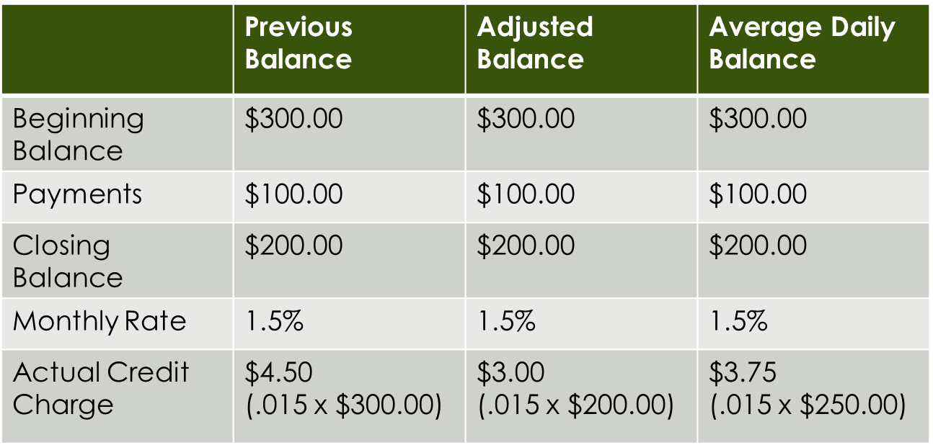
Credit Cost Comparison
* Assuming that the payment was made in the middle of the month, the average daily balance would be $250.00
Notes:
A revolving charge account enables a customer to charge up to a stated limit. The customer pays a certain amount on his account each month. Interest is charged on the unpaid balance. Although most businesses charge a similar monthly rate, the actual credit will vary depending on how the customer’s monthly balance is determined. Three common methods are to use the previous balance before any payments have been deducted, the adjusted balance after deducting payments, or the average daily balance on the account. Actual charges for these three methods are compared on the chart.

Slide 15
How can you establish credit?
Notes:
Ask this question, and allow for discussion.

Slide 16
Establishing Credit
Apply for a gasoline credit card
Apply for a small credit account at a local retail store at which you shop
Get a job
Open a checking account, and manage it carefully
Open a savings account, and make regular deposits
Notes:
Apply for a gasoline credit card. Use it occasionally. Repay and promptly pay in full.
Apply for a small credit account at a local retail store at which you shop. (You might begin with a layaway purchase.) Use the account to make small purchases for which you usually pay cash. Repay and promptly pay in full.
Get a job. Show that you can earn money and manage some income.
Open a checking account, and manage it carefully. Be sure to avoid overdrafts.
Open a savings account, and make regular deposits.
As you prove you can manage credit, you will become eligible for larger and varied types of credit. Develop the habit of using credit sparingly, always considering up front whether you can repay promptly.

Slide 17
The Four Cs of Credit
Capacity
Capacity refers to earning power of regular income available to repay debts.
Capital
Capital refers to financial worth, including savings and property.
Notes:
The Four Cs of Credit explain the relation of an individual’s capacity, capital, character and collateral to that individual’s credit rating (a creditor’s evaluation of a consumer’s willingness and ability to repay debts). You may opt to provide examples of credit applications for students to examine and identify information requested that helps the creditor evaluate each of the four “Cs.”
Capacity refers to earning power of regular income available to repay debts. The debt-to-income ratio, which is the total monthly debt payment divided by net take-home pay, is an indicator of an individual’s capacity to repay new debts. Questions on the credit application related to occupation, income, length of employment and other debts which may reduce monthly income help the creditor evaluate the applicant’s capacity to repay the debt.
Capital refers to financial worth, including savings and property. The creditor is looking for evidence that the applicant possesses things of value and is thus more likely to be able to repay the debt. Information on the credit application related to savings accounts, other investments or home ownership are indicators of capital.

Slide 18
The Four Cs of Credit
Character
Character refers to a person’s reputation for honesty and reliability as demonstrated through stable credit history.
Collateral
Collateral refers to items of value, such as a house, boat or car, that lenders may require in return for a loan in the event the loan is not repaid.
Notes:
The Four Cs of Credit
Character refers to a person’s reputation for honesty and reliability as demonstrated through stable credit history. A credit application will ask for credit references to learn where credit has previously been granted. Length of time at a job or a residence are indicators of stability. Through a credit investigation, the creditor will learn information such as how much credit has previously been extended and whether the applicant pays bills on time.
Collateral refers to items of value that lenders may require in return for a loan in the event the loan is not repaid.

Slide 19
What are the responsibilities of credit users?
Notes:
Ask this question, and allow for discussion.

Slide 20
Responsibilities of Credit Users
Be aware of the promises you make in signing any credit agreement.
Borrow the smallest amount needed, not the most the lender or dealer will loan.
Compare the cost of interest to other things you could do with the money.
Do not borrow unless it is necessary and will enable you to make money.
Do not let easy credit cause you to buy things you would not otherwise consider buying.
Recognize and accept the penalty outlined in the contract for failure to fulfill the promise.
Notes:
Responsibilities of Credit Users
Be aware of the promises you make in signing any credit agreement.
Borrow the smallest amount needed, not the most the lender or dealer will loan.
Compare the cost of interest to other things you could do with the money.
Do not borrow unless it is necessary and will enable you to make money.
Do not let easy credit cause you to buy things you would not otherwise consider buying.
Recognize and accept the penalty outlined in the contract for failure to fulfill the promise.

Slide 21
Responsibilities of Credit Users
Know what you are borrowing and signing. Read carefully any contract that must be signed, and be sure you understand it.
Let the creditor know if, for any reason, you cannot meet the payment.
Pay on time according to the terms of the contract.
Pay the late charge written in the contract for late payments.
Shop for the lowest annual percentage rate.
Think of your overall financial state.
Notes:
Responsibilities of credit users include:
Know what you are doing and signing. Read carefully any contract that must be signed, and be sure you understand it.
Let the creditor know if, for any reason, you cannot meet the payment.
Pay on time according to the terms of the contract.
Pay the late charge written in the contract for late payments.
Shop for the lowest annual percentage rate.
Think of your overall financial state.
Why is credit card use a serious problem for many young adults?

Slide 22
What are the responsibilities of creditors?
Notes:
Ask this question, and allow for discussion.

Slide 23
Responsibilities of Creditors
Give the credit customer a copy of the contract.
Look into the customer’s ability and willingness to repay before giving credit.
Pass on to the customer any money over the amount owed on any item after repossession and sale of property or collateral.
State credit terms clearly and correctly to follow laws controlling the giving of credit.
Early payoffs, return any interest charges that are reimbursable under the terms of any early payoff provisions.
Write in all credit terms before the contract is signed.
Notes:
Responsibilities of creditors include:
Give the credit customer a copy of the contract.
Look into the customer’s ability and willingness to repay before giving credit.
Pass on to the customer any money over the amount owed on any item after the repossession and sale of property or collateral.
State credit terms clearly and correctly to follow laws controlling the giving of credit.
Early payoffs, return any interest charges that are reimbursable under the terms of any early payoff provisions.
Write in all credit terms before the contract is signed.
Summarize credit guidelines for both purchaser and seller. Emphasize the importance of clearly understanding all terms of the contract before entering into any credit agreement.

Slide 24
Dealing with Debt Collectors
(click on picture)
Notes:
Dealing with Debt Collectors
If you're behind on payments, you'll probably be hearing from debt collectors. Federal law gives you certain rights in dealing with debt collectors. It's important to understand those rights when communicating with them.
http://bcove.me/t6s6l7lf
What consumer credit legislation protects consumers when they use credit?
What are the common examples of credit card fraud? What precautions can prevent you from being a victim of credit card fraud?

Slide 25
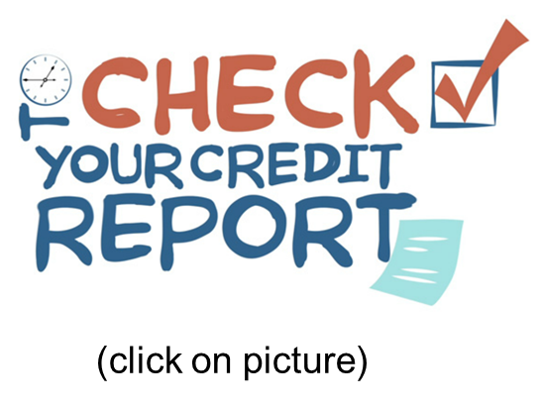
Credit Bureau/Credit-Reporting Agency
What is a credit bureau or credit-reporting agency?
These companies do two things:
Compile credit histories on prospective borrowers
Provide credit reports to lenders
Notes:
What is a credit bureau or credit-reporting agency?
These companies do two things: compile credit histories on prospective borrowers and provide credit reports to lenders.
Information in a credit report may include payment habits, number of credit accounts, balance of accounts and length and place of employment. Lenders use these reports when making decisions on extending credit.
Free Credit Reports
The Fair Credit Reporting Act (FCRA) requires each of the nationwide credit reporting companies — Equifax, Experian and TransUnion — to provide you with a free copy of your credit report, at your request, once every twelve months. The FCRA promotes the accuracy and privacy of information in the files of the nation’s credit reporting companies. The Federal Trade Commission (FTC), the nation’s consumer protection agency, enforces the FCRA with respect to credit reporting companies.
A credit report includes information on where you live, how you pay your bills and whether you’ve been sued or have filed for bankruptcy. Nationwide credit reporting companies sell the information in your report to creditors, insurers, employers and other businesses that use it to evaluate your applications for credit, insurance, employment or renting a home.
You can order a free credit report:
On the Internet: www.annualcreditreport.com
On the phone: call 1-877-322-8228
By mail - complete the Annual Credit Report Request Form found at: https://www.annualcreditreport.com/cra/requestformfinal.pdf - PDF 41k (PDF Help) and mail to: Annual Credit Report Request Service P.O. Box 105281 Atlanta, GA 30348-5281
Check Your Credit Report
An important message from the Federal Trade Commission.
http://bcove.me/mwbzp3ui

Slide 26
Questions?

Slide 27
References and Resources
Images:
Microsoft Clip Art: Used with permission from Microsoft™. (Slides 3, 4, 5, 6, 7, 8, 9, 10, 11, 12, 15, 16, 17, 18, 19, 20, 21, 22 and 23)
Photos obtained through a license with Shutterstock™.com. (Slide 1)
Textbooks:
Campbell, S. R. (2010). Foundations of personal finance. Tinley Park, IL: Goodheart-Willcox.
Madura, Jeff, K. Casey Michael, and Sherry Roberts J. (2010). Annotated teacher’s edition to personal financial literacy. Saddle River, NJ: Pearson Education.
Websites:
Business and Money Source: The Wall Street Journal, Classroom Edition Articles on money and economics . http://classroom.wsj.com/business?mod=CRE_topnav_business_main

Slide 28
References and Resources
Decision-Making Skills and Techniques Source: Time Management Guide We use our decision-making skills to solve problems by selecting one course of action from several possible alternatives. http://www.time-management-guide.com/decision-making-skills.html
Decision Making-Skills Source: Mind Tool A systematic approach to decision-making will help you address the critical elements that result in a good decision. http://www.mindtools.com/pages/article/newTED_00.htm
Economy 101: What’s It All About Source: Practical Money Skills Understanding money and the economy. http://www.practicalmoneyskills.com

Slide 29
References and Resources
Plus: The Decision-Making Process Source: Ethics Resource Center Explains the six steps of the decision-making process. http://www.ethics.org/resource/plus-decision-making-process
Six Thinking Hats Source: Mind Tools Looks at a decision from all points of view. http://www.mindtools.com/pages/article/newTED_07.htm
TheMint.org Tips and tools for managing money for teens. http://www.themint.org/teens

Slide 30
References and Resources
Videos:
Check Your Credit Report An important message from the Federal Trade Commission. http://bcove.me/mwbzp3ui
Dealing with Debt Collectors If you’re behind on payments, you’ll probably be hearing from debt collectors. Federal law gives you certain rights in dealing with debt collectors. It’s important to understand those rights when communicating with them. http://bcove.me/t6s6l7lf
Minimum Payments on Credit Cards This video shows what happens when someone makes just the minimum payment on a credit card balance. http://bcove.me/2h4a5k2s

