Slide 1
More Power To You!
The Energy in Food
  Food Science

Slide 3
Food Chain
  The series of processes by which food is grown or produced, sold and eventually consumed
Notes:
Organisms get food from other organisms and from the environment.
The food chain is a flow of food energy from simpler to more complex organisms.

Slide 4
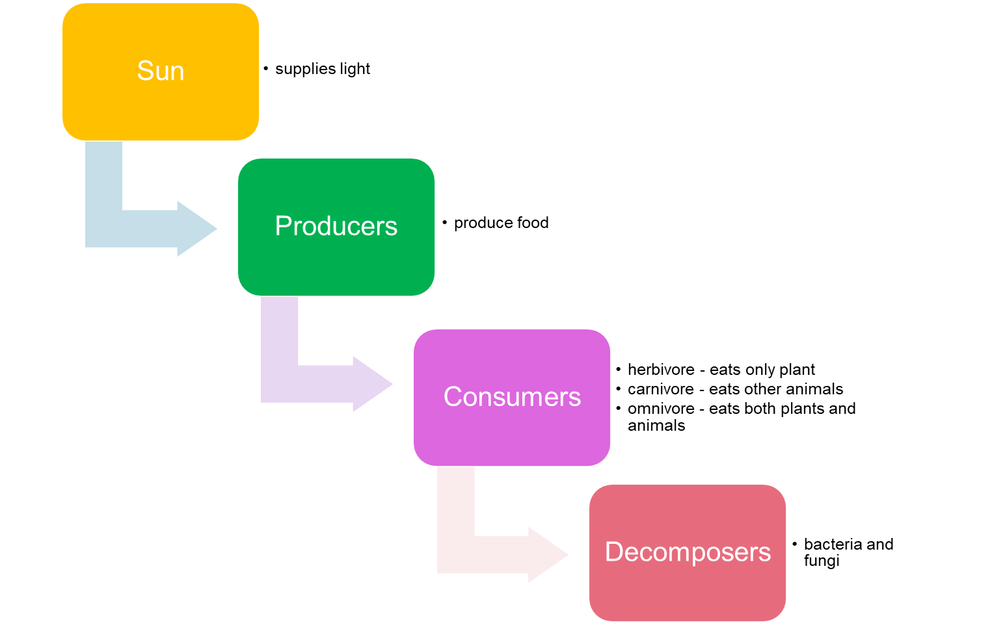
Notes:
There are four main components to the food chain.
The sun supplies light that is needed to make food.
The producers make or produce food.
Consumers must eat other organisms to survive.
A herbivore only eats plants such as cows and sheep
A carnivore eats other animals such as cats, hawks and wolves
An omnivore eats both plants and animals such as chickens, pigs and humans
Decomposers break down dead matter and return the nutrients to the environment such as bacteria and fungi.

Slide 5
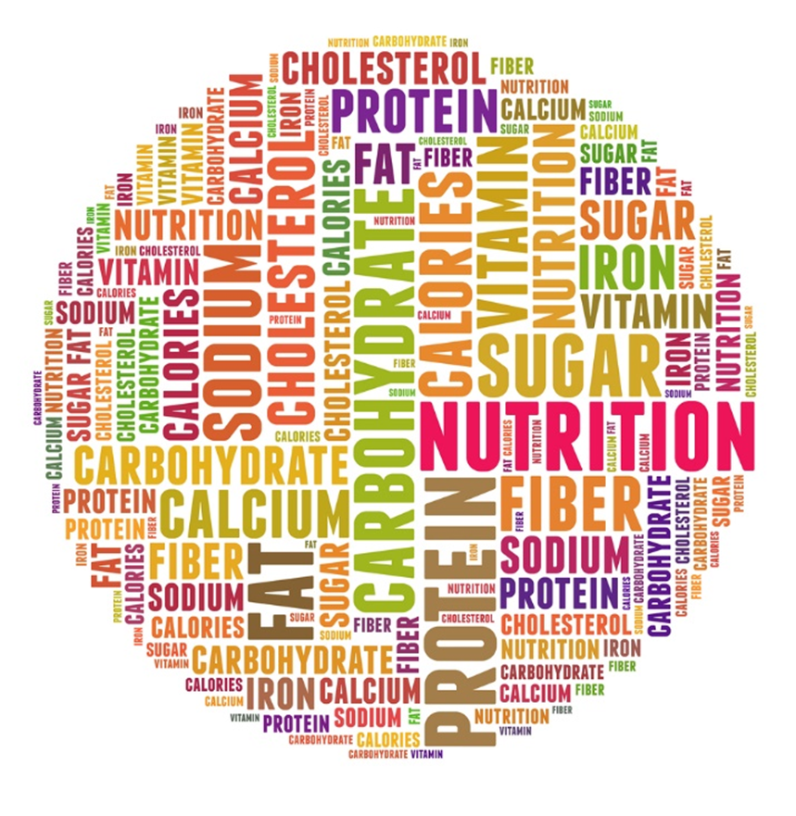
How Does Food Provide Energy?
  In nutrients
  Carbohydrates
  Fats
  Protein
  Calorie
  A unit of energy supplied by food
Notes:
Food provides energy in the form of calories that give our bodies fuel to perform all functions from the most basic like breathing to more complicated activities.
We need a minimum amount of calories from food to sustain basic metabolic functions and more to carry out physical activities.
Nutrients are a substance that provides nourishment essential for growth and the maintenance of life.

Slide 6
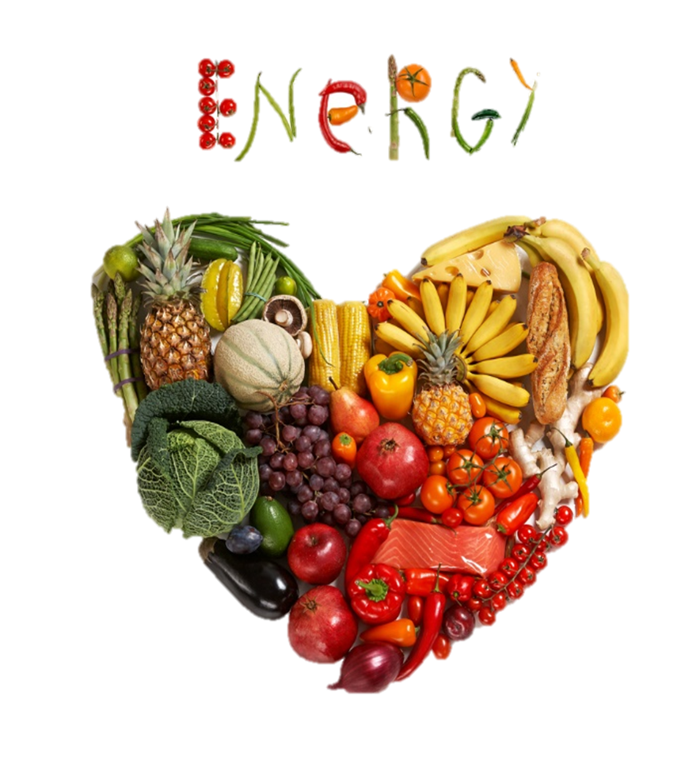
Energy and Food
  Energy Requirements
  Body Mass Index
Notes:
The more active we are, the more food we need.

Slide 7
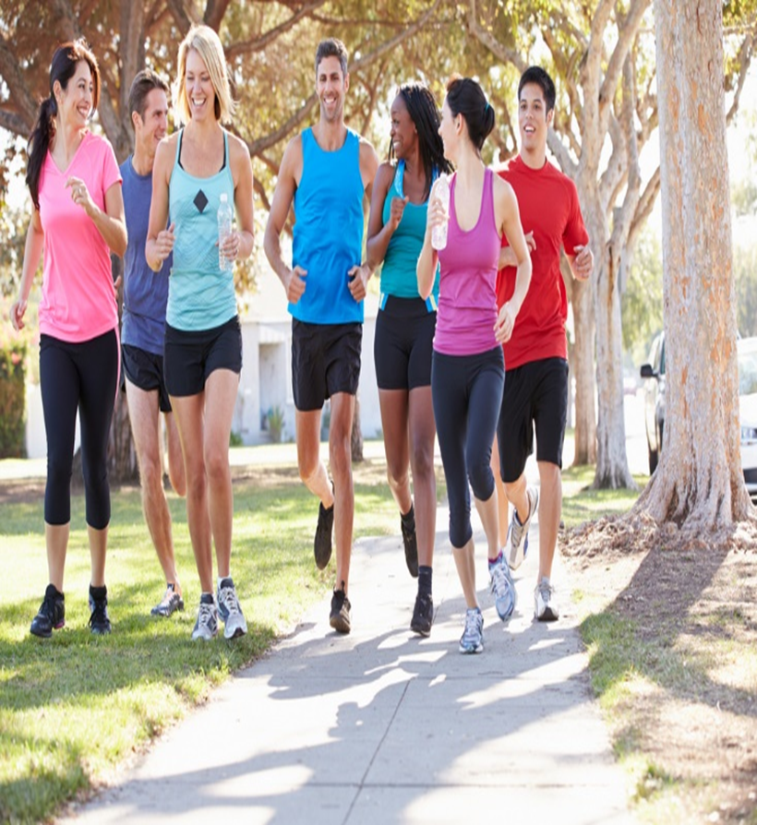
Energy Requirements
  Adults (18 to 64 years)
    2 ½ hours each week
  Children and adolescents (6 to 17 years)
    60 minutes or more each day
  Young children (2 to 5 years)
    No specific recommendation but should be active each day
Notes:
Physical activity is generally safe for everyone.
The health benefits gained from being active are far greater than the chances of getting hurt.

Slide 8
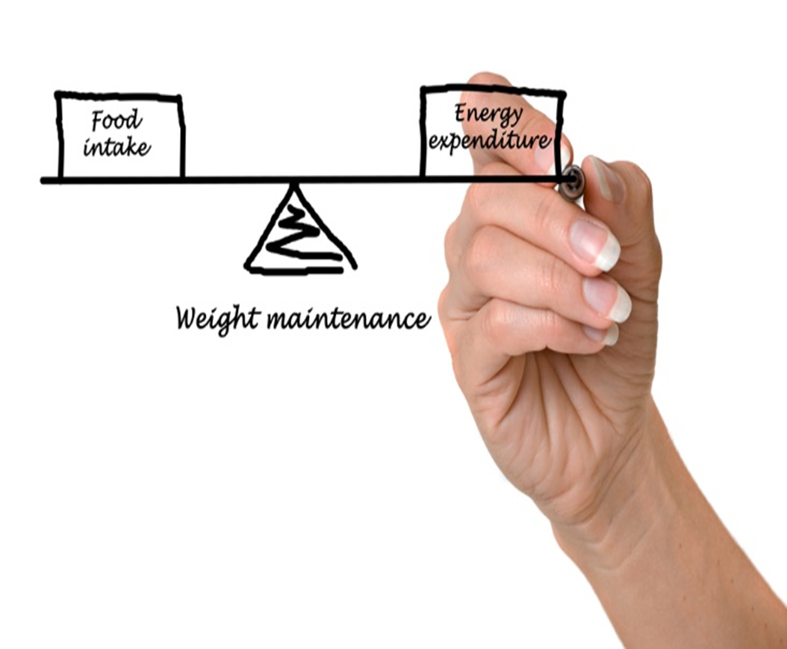
Energy Imbalances
  Same amount of calories + same amount of activity = energy balance
    Weight is maintained
  More calories – less activity = energy imbalance
    Could lead to weight gain
Notes:
Eating the same amount of calories and exerting physical activity equals an energy balance.
If you eat more calories than exerting physical activity equals an energy imbalance which could lead to weight gain.
Eating fewer calories and increasing physical activity could mean weight loss.

Slide 9
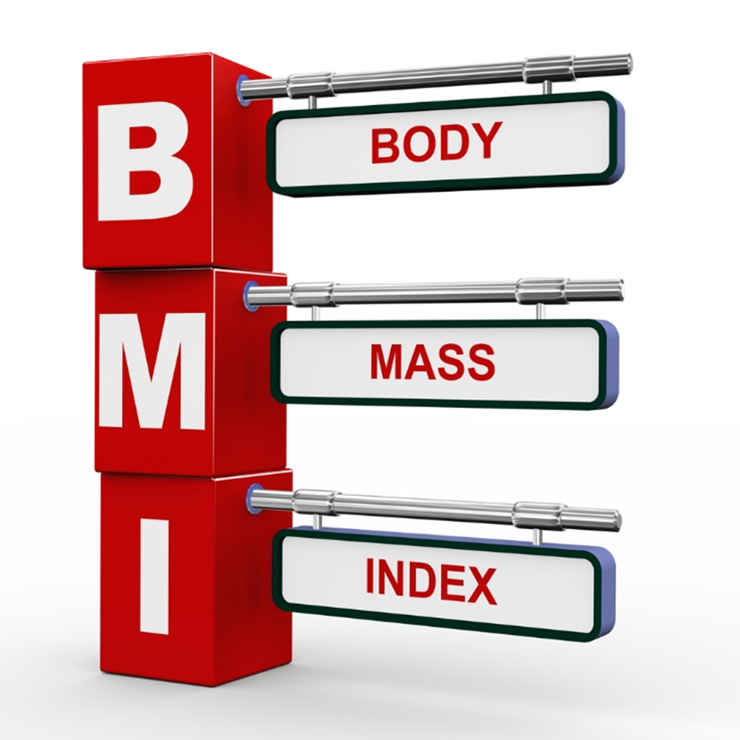
Body Mass Index
  BMI - A ratio that allows you to assess your body size in relation to your height and weight
  Formula:
    Weight (lb) / [height (in)]2 x 703
    Calculate BMI by dividing weight in pounds (lbs) by height in inches (in) squared and multiplying by a conversion factor of 703
Notes:
BMI is a fairly reliable indicator of body fatness for most people.
BMI can be considered an alternative for direct measures of body fat.
It is an inexpensive and easy-to-perform method of screening for weight categories that may lead to health problems.
What is your BMI? We will figure this out later in the lesson.

Slide 10
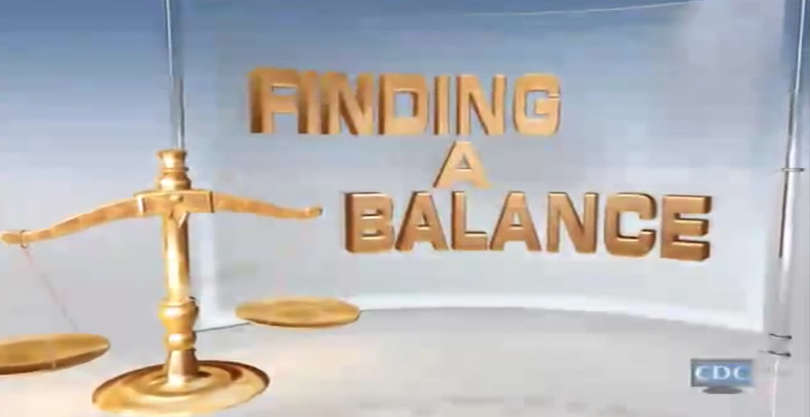

Notes:
Click on hyperlink to view video:
Finding Balance
More than one third of U.S. adults are obese. Weight gain occurs when you consume more calories than your body uses. Reaching and maintaining a healthy weight will help you prevent and control many diseases and conditions. The key is FINDING A BALANCE in your lifestyle that includes healthy eating and regular physical activity.
http://www.cdc.gov/CDCTV/FindingBalance/index.html

Slide 11
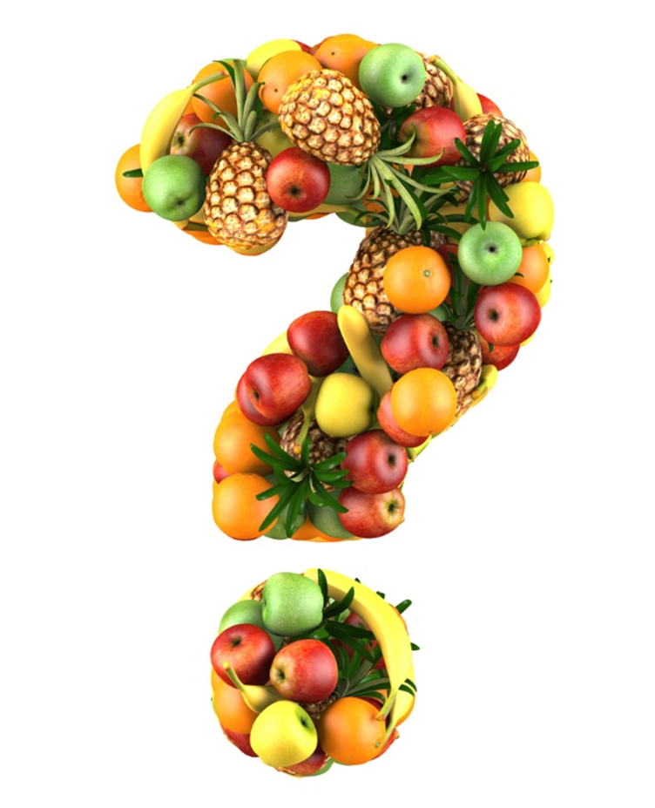

Slide 12
References and Resources
  Images:
    Shutterstock™ images. Photos obtained with subscription. (Slides 1, 5, 6, 7, 8, 9, 11)
  Textbooks:
    Duyff, R. L. (2010). Food, nutrition & wellness. Columbus, OH: Glencoe/McGraw-Hill.
    Food for today. (2010). Woodland Hills, CA: McGrawHill/Glencoe.
    Mehas, K. Y., & Rodgers, S. L. (2002). Food science: The biochemistry of food and nutrition. New York, NY: Glencoe/McGraw-Hill.
  Websites:
  ChooseMyPlate.gov
  Physical activity is important for everyone, but how much you need depends on your age.
  http://www.choosemyplate.gov/physical-activity/amount.html
  Healthy Weight - it's not a diet, it's a lifestyle!

Slide 13
References and Resources
  When it comes to weight loss, there's no lack of fad diets promising fast results. But such diets limit your nutritional intake, can be unhealthy, and tend to fail in the long run.
  http://www.cdc.gov/healthyweight/index.html
  Video:
  Finding Balance
  More than one third of U.S. adults are obese. Weight gain occurs when you consume more calories than your body uses. Reaching and maintaining a healthy weight will help you prevent and control many diseases and conditions. The key is FINDING A BALANCE in your lifestyle that includes healthy eating and regular physical activity.
  http://www.cdc.gov/CDCTV/FindingBalance/index.html

