Slide 1
My World –
My Future

Slide 3
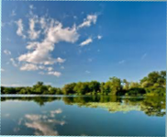
Conservation
  Protection of valued resources:
    the preservation, management, and care of natural and cultural resources
  Protection from change:
    the keeping or protecting of something from change, loss, or damage the keeping or protecting of something
Notes:
Conservation protection of valued resources: the preservation, management, and care of natural and cultural resources or protection from change: the keeping or protecting of something from change, loss, or damage. Conservation can start at home by conserving the electricity, gas and water we use in our homes. Let’s brainstorm and write down ways we can conserve at home.
Where can we go to learn more about conservation?
What do you consider to be valued resources?
What are some things we can do to protect our resources?
How do we lose or damage our resources?
How will we protect from change or loss?
What do we do if we see that people or a company is abusing our resources?

Slide 4

Environment
  The complex of physical, chemical, and biotic factors (as climate, soil, and living things) that act upon an organism or an ecological community and ultimately determine its form and survival
Notes:
Environment-the complex of physical, chemical, and biotic factors (as climate, soil, and living things) that act upon an organism or an ecological community and ultimately determine its form and survival
How does what we eat, drink, and wear effect our environment?
How long does something last that you put into the trash?
Do you know where your trash goes?
Have you ever been to a landfill? If so what was it like? If not can you imagine what it would look like? Have students think about how much trash they discard daily and multiply that by the people on their block, street, etc.
How are landfills different around the world?
What happens to the chemicals and liquid that we throw away in our garbage?
A picture of landfill has been added to the PowerPoint.

Slide 5
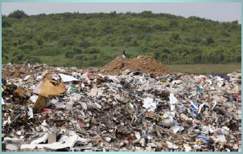
Where does your garbage go?
Notes:
Allow students to brainstorm the question. What is a landfill? Have you ever been to a landfill before? Waste from packaging materials take up a lot of space in the landfill. You can help reduce the impact it makes on our environment by following the saying: reduce, reuse and recycle. We will complete an assignment on the three R’s later in this lesson.

Slide 6
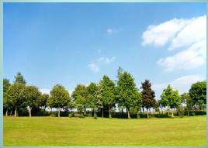
Living: Has life
Notes:
What are some examples of things that are living? We have a responsibility to help keep our world clean and healthy. We need to keep our air and water supply clean so that living things on earth, have a chance to grow and thrive.

Slide 7
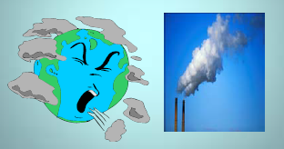
Reduce Pollution
  You can help reduce air and water pollution.
Notes:
Reduce air pollution by walking or riding your bicycle instead of driving. If you have to drive, drive your car efficiently by planning the most efficient route to your destination. Carpool with friends and family members.
You can protect the water by avoiding dumping wastes such as oil and other toxic materials into the water. Do not dump them in the sewer or ground. Why?

Slide 8

Resource Consumption
  The process of using natural resources, materials, or finished products to satisfy human wants or needs
Notes:
List some things that we need or want?
What do you think it requires getting those things to you? In order to obtain our needs and wants, we must use nonrenewable (oil, coal and natural gas are called fossil fuels) and renewable energy sources (sources of energy that cannot be used up or that can be replaced such as water, wind, solar energy, wood and solid wastes). Which of the nonrenewable resources should we try to conserve? Why? Which of the renewable energy resources is the most reliable? What energy sources does it take to make a loaf of bread? The clothes you are wearing? How can we conserve these energy sources?

Slide 9

Resources are things found in nature that are useful to humans, such as trees and fish
Notes:
What are some natural resources that we have other than the trees, and fish?
What are some natural resources that we use every day just to do the everyday things around the house?

Slide 10

Climate Change
  A change in long-term weather pattern
  (including precipitation, temperature, and wind)
Notes:
Climate change—a change in long-term weather patterns (including precipitation, temperature, and wind) over time
How has the weather patterns changed since you were born?
How has the weather been differently just in the last couple of years?

Slide 11

Population
  The total number of people living in a country, city, or other defined area
Notes:
Population – the total number of people living in a country, city, or other defined area
How many people live in your city? ...Your state? ... Your nation? The world?
How many people do you think will be in the world in 10, 20 or even 50 years from now?
Will we have enough food to feed that amount of people?
Who will grow the food if we keep turning the farmland and grazing land into housing?
What happens to the animals that we displace?
An increase of human population in the world has also increase the environmental problems. One factor that has contributed to an increase of population is better nutritional aspects on humans. There are more humans living on earth and our limited resources are being tested and stretched all the time. Famines may be a greater problem in the future.

Slide 12
How Do These Issues Affect You? Your Future?
Notes:
Sustainability—meeting current needs without limiting the ability of people to meet their needs in the future
How do we meet the needs of our people now without jeopardizing our Future resources?
Do you need everything that you have in your home?
How much of what you buy today will you use in the future?
Allow time for discussion.

Slide 13
Trends and Issues
  Local
  National
  Worldwide
Notes:
Introduce Research Project. Students will select either a local, national or worldwide trend and issue which directly affects our environment. Provide students with instructions for conservation research project which will consist of a visual and oral presentation. Review the components of the rubric with the class.
Students will work collaboratively in teams of two and research ways to conserve energy at home, school and work. The students will create a poster or slide presentation depicting ways to conserve energy for the future.

Slide 14
Questions?

Slide 15
References and Resources
  Website for educators and students about recycling, composting and waste reduction.
  http://www.kidsrecycle.org/overview.php
  The network for educators interested in energy resources and uses
  http://energyteachers.org/projects.php
  SECO partners with Texas consumers, businesses, educators and local governments to reduce energy costs and maximize efficiency.
  http://www.seco.cpa.state.tx.us/
  Doing your part at home and at work.
  http://www.tceq.state.tx.us/
  Website for students to create mixed media in a poster.
  http://www.glogster.com/•http://www.achievetexas.org/
  AchieveTexas which is an education initiative designed to prepare students for a lifetime of success. It allows students to achieve excellence by preparing them for secondary and postsecondary opportunities, career preparation and advancement, meaningful work, and active citizenship.

