Slide 1
Nutrients and Beyond!
  The Six Nutrient Groups

Slide 3

Nutrition
  The study of food components and their use by the body to sustain life and health

Slide 4

Nutrients
  Water
  Carbohydrates
  Fats
  Proteins
  Vitamins
  Minerals

Slide 5

Water
  Main component of many foods
  Influences texture, appearance and taste of food
  Maintains body temperature
  Transports nutrients and waste

Slide 6

Carbohydrates
  Make up the bulk of the biomass in food
  Major source of energy for humans
  Provide reserve energy store for all living things
  Form the vital structure of living cells

Slide 7
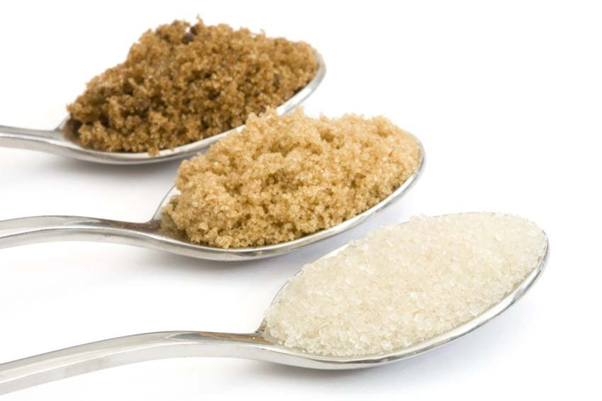
Carbohydrates - Simple
  Sugars
  Monosaccharides
    Fructose
    Glucose
    Galactose
  Disaccharides
    Sucrose
    Maltose
    Lactose

Slide 8

Carbohydrates - Complex
  Also called polysaccharides or macromolecules
  Types
    Starches
    Cellulose
    Carbohydrate gums and pectins

Slide 9

Fats
  Play an important role in food
  preparation and general health
  Have a place in a healthful diet
  Key is to keep everything in balance
  Lipids are insoluble in water and have a greasy feel
    Fats
    Oils
    Shortening

Slide 10

Proteins
  Complex molecules
  Needed for:
    Growth and repair of body tissue
    Fighting disease
    Fluid and electrolyte balance
    pH balance
    Regulating body functions

Slide 11

Vitamins – Fat-soluble
  Vitamins A, D, E, K
  Generally found in fats and oils in foods
  Cannot be easily excreted
  Stored in the liver or fatty tissues

Slide 12

Vitamins – Water-Soluble
  B vitamins and vitamin C
    B1 (Thiamin)
    B2 (Riboflavin)
    B3 (Niacin)
    B6 (Pyridoxine)
    Folate, folic acid, folacin
    B12 (Cyanocobalamin)
    Pantothenic acid
    Biotin
    Vitamin C (Ascorbic acid
  Cannot be stored in the body
  Excess quantities excreted

Slide 13
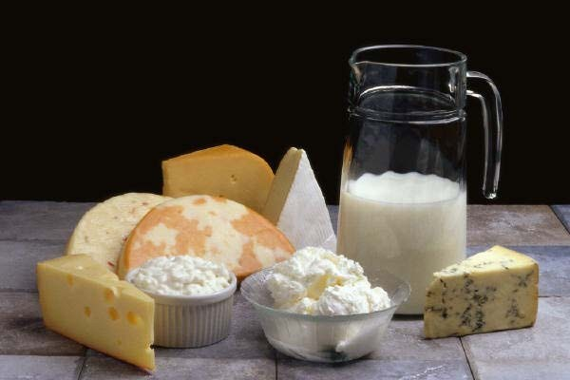
Major Minerals
  Calcium
  Phosphorus
  Magnesium
  Sodium, Chloride and Potassium
  Simplest chemical structure
  Minerals are elements
  Make up about 2.3 kg of the mass of the average adult

Slide 14
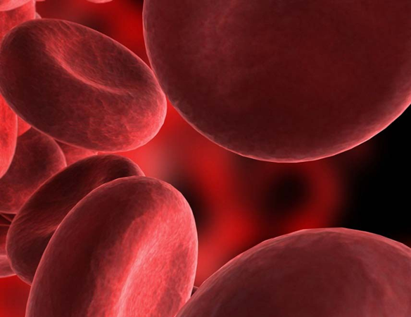
Trace Minerals
  Iron
  Iodine
  Zinc
  Fluoride
  Copper
  Manganese
  Selenium
  Chromium
  Also called microminerals
  Need less than 100 mg per day

Slide 15
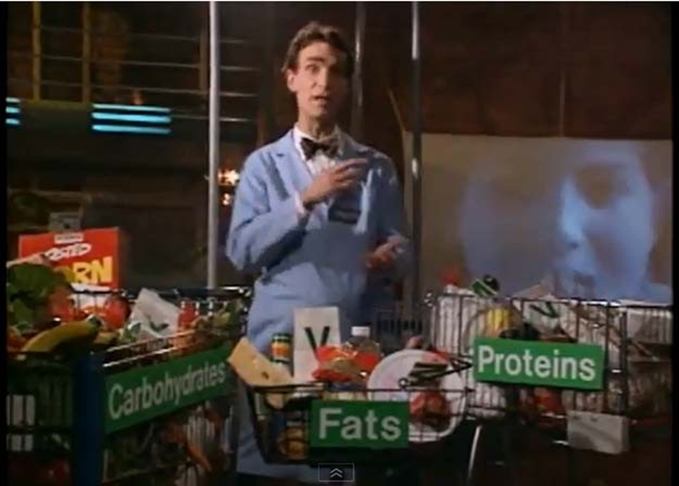
Bill Nye – Nutrition
(click on link)

Slide 16

Questions?

Slide 17
References and Resources
  Images:
    Microsoft Office Clip Art: Used with permission from Microsoft.
  Textbooks:
    Duyff, R. L. (2010). Food, nutrition & wellness. Columbus, OH: Glencoe/McGraw-Hill.
    Ward, J.D., & Ward, L.T. (2013). Principles of food science. Tinley Park, IL: Goodheart-Willcox Company.
  YouTube™ video:
    Bill Nye – Nutrition
    Bill Nye, the Science guy discusses nutrients http://youtu.be/8j7VwLhMIlQ

