Slide 1
Nutrition Science for Life!

Slide 3
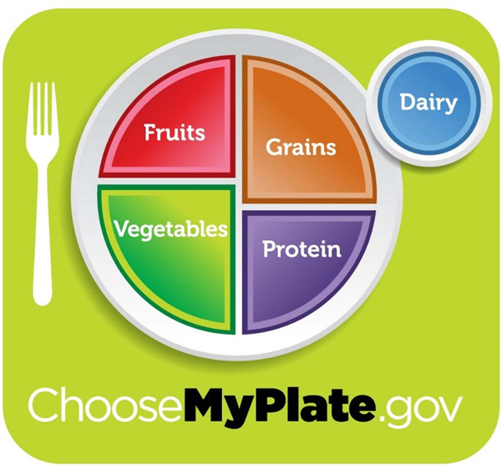
MyPlate
  Fruits
  Vegetables
  Grains
  Protein
  Foods
  Dairy

Slide 4
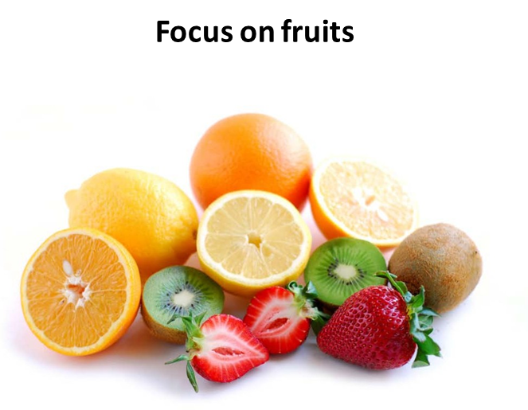
Fruits
  Any fruit or 100% fruit juice
  May be:
    Fresh
    Canned
    Frozen
    Dried
    Whole
    Cut-up
    Pureed

Slide 5
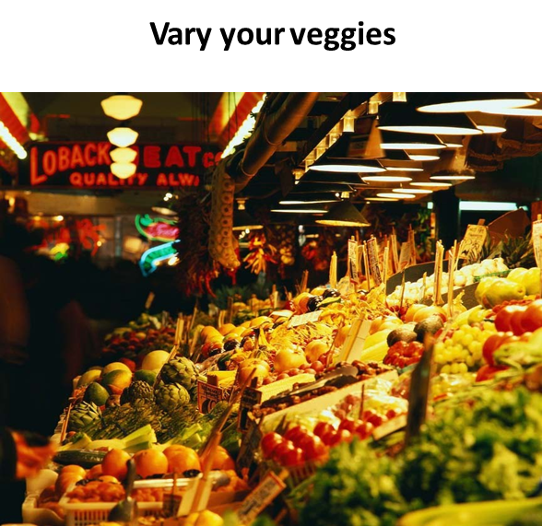
Vegetables
  Any vegetable or 100% vegetable juice
  May be:
    Raw
    Cooked
    Fresh
    Frozen
    Canned
    Dried/dehydrated
    Whole
    Cut-up
    Mashed

Slide 6
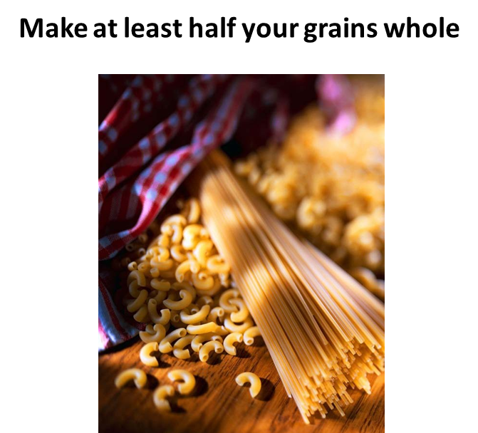
Grains
  Any food made from wheat, rice, oats, cornmeal, barley or another cereal grain is a grain product
  Grains are divided into 2 subgroups:
    Whole Grains
    Refined Grains
  Whole grains contain the entire grain kernel ― the bran, germ and endosperm
  Refined grains have been milled, a process that removes the bran and germ

Slide 7
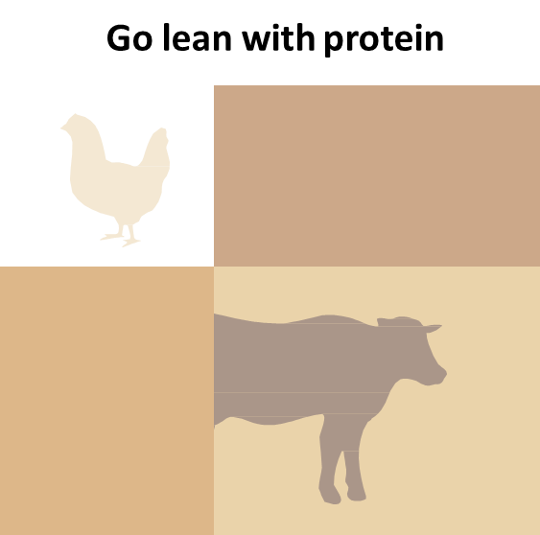
Protein Foods
  All foods made from:
    Meat
    Poultry
    Seafood
    Beans and peas
    Eggs
    Processed soy products
    Nuts and seeds

Slide 8
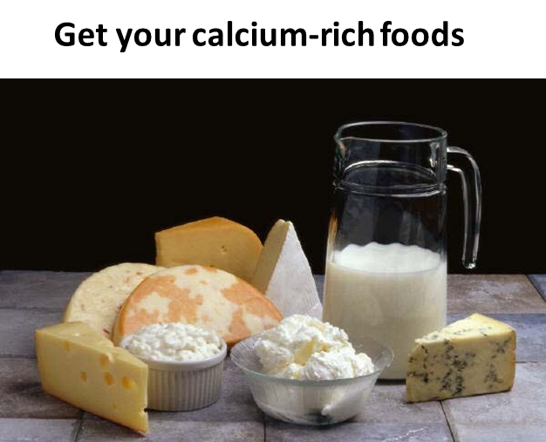
Dairy
  All fluid milk products and many foods made from milk are considered part of this food group
  Most Dairy Group choices should be fat-free or low-fat
  Foods made from milk that retain their calcium content are part of the group
  Foods made from milk that have little to no calcium, such as cream cheese, cream and butter, are not
  Calcium-fortified soymilk (soy beverage) is also part of the Dairy Group

Slide 9
Empty Calories
  OILS

Slide 10

Oils
  Oils are fats that are liquid at room temperature such as vegetable oils used in cooking
  Oils come from many different plants and from fish
  Oils are NOT a food group, but they provide essential nutrients, therefore, oils are included in USDA food patterns

Slide 11

DIETARY GUIDELINES FOR AMERICANS 2010
  Build a healthy plate
  Cut back on foods high in solid fats, added sugars and salt Eat the right amount of calories for you
  Be physically active your way

Slide 12

  How to Follow the USDA MyPlate Dietary Guidelines

Slide 13

Questions?

Slide 14
References and Resources
  Images:
    Microsoft Office Clip Art: Used with permission from Microsoft.
  Textbooks:
    Duyff, R. L. (2010). Food, nutrition & wellness. Columbus, OH: Glencoe/McGraw-Hill.
    Ward, J.D., & Ward, L.T. (2013). Principles of food science. Tinley Park, IL: Goodheart-Willcox Company.
  YouTube™:
    How to Follow the USDA MyPlate Dietary Guidelines
    The U.S. Department of Agriculture's nutrition guidelines are now called MyPlate. Here's how to adhere to the USDA recommendations. http://www.youtube.com/watch?v=87xBZisdodY&feature=share&list=PLE46C880632416C6D
  Websites:
    Dietary Guidelines for Americans
    The cornerstone of Federal nutrition policy and nutrition education activities http://www.cnpp.usda.gov/dietaryguidelines.htm
    U.S. Department of Agriculture. ChooseMyPlate.gov Website. Washington, DC.
    http://www.choosemyplate.gov/food-groups/fruits.html Accessed November, 2013.

