Slide 1
Nutritional Needs: Infancy to Toddler
Child Development

Slide 3
What is an age-appropriate diet for children?
Notes:
An age-appropriate diet is one that provides adequate nutrition, is appropriate for a child's state of development, and can help prevent childhood obesity.
What are some examples of age-appropriate diets for children, infant to toddler?

Slide 4
Infant and Newborn Nutrition
Food provides the energy and nutrients that babies need to be healthy
Infants usually start eating solid foods between four and six months of age
Notes:
Food provides the energy and nutrients that babies need to be healthy. For a baby, breast milk is best. It has all the necessary vitamins and minerals. Infant formulas are available for babies whose mothers are not able or decide not to breastfeed.
Infants usually start eating solid foods between four and six months of age. If you introduce one new food at a time, you will be able to identify any foods that cause allergies in your baby. Some foods to stay away from include eggs, honey, peanuts (including peanut butter) and other tree nuts.

Slide 5
Birth to Four Months of Age
During the first four to six months of life, infants need only breast milk or formula to meet all their nutritional needs
Never give an infant honey
Notes:
During the first four to six months of life, infants need only breast milk or formula to meet all their nutritional needs.
If breastfeeding, a newborn may need to nurse 8 - 12 times per day (every two to four hours), or on demand. By four months, the baby is likely to cut back to four to six times per day; however, the quantity of breast milk consumed at each feeding will increase.
Formula-fed babies may need to eat about six to eight times per day, starting newborns with two to three ounces of formula per feeding (for a total of 12 - 24 ounces per day). As with breastfeeding, the number of feedings will decrease as the baby gets older, but the amount of formula will increase to approximately six to eight ounces per feeding.
Never give honey to an infant, as it may contain the spores that cause botulism. An infant's immune system is not fully developed to fight off this disease.
Although an infant may sleep through the night, waking to feed may be necessary if the infant is not eating enough during the day or if he or she is underweight. Routine check-ups with a physician to monitor the child's growth will ensure he or she is eating adequately during the day. A doctor or dietitian will inform parents if waking to feed is recommended.

Slide 6
Four to Six Months of Age
Development to indicate an infant is ready to eat solid foods:
The baby can sit up with some support
The baby has good control of head and neck
The birth weight has doubled
Notes:
At four to six months of age, an infant should be consuming 28 - 45 ounces of formula per day and is often ready to start the transition to solid foods. Starting solids too soon may cause the infant to choke if he or she is not physically ready.
There are several developmental milestones to indicate an infant is ready to eat solid foods:
The baby can show fullness by turning the head away or by not opening the mouth
The baby begins showing interest in food when others are eating.
Start solid feedings with iron-fortified baby rice cereal mixed with breast milk or formula to a thin consistency. The cereal may be mixed to a thicker consistency as the baby learns to control it in his mouth. Initially, offer cereal two times per day in servings of one to two tablespoons (dry amount, before mixing with formula or breast milk).
Gradually increase to three to four tablespoons of cereal. Cereal should not be given in a bottle unless a doctor or dietitian recommends it, for example, for reflux.
Once the baby is eating rice cereal routinely, iron-fortified instant cereals may be introduced. Only introduce one new cereal per week. Intolerance or allergy can be monitored.
Never put a child to bed with a bottle as this can cause bottle mouth, resulting in tooth decay. Use plain water if a bottle is necessary. Discuss the water with a physician. (In some cases, use of excess water can lead to seizures in children.)

Slide 7
Six to Eight Months of Age
For strained fruits and vegetables, introduce one at a time, waiting two to three days in between to check for any allergic reaction.
Notes:
Continue to offer breast milk or formula three to five times per day. Cow's milk is not recommended by the American Academy of Pediatrics for children under one year old.
The baby will begin drinking less formula or breast milk once solid foods become a source of nutrition.
After a baby has tried a variety of different baby cereals, try strained fruits and vegetables.
For strained fruits and vegetables, introduce one at a time, waiting three to five days in between to check for any allergic reaction.
Start with plain vegetables such as green peas, potatoes, carrots, sweet potatoes, squash, beans and beets; and plain fruits such as bananas, applesauce, apricots, pears, peaches and melon.
Some dietitians recommend introducing a few vegetables before fruits, as the fruit's sweetness may make a less-sweet food such as vegetables less appealing.
Give fruits and vegetables in two-to three-tablespoon servings, and offer about four servings per day.
Amounts of fruits and vegetables eaten per day will vary between two tablespoons and two cups depending on the size of the child and how well the child eats fruits and vegetables. The consistency of foods offered may be gradually changed as the child acclimates.
Finger foods may be offered in small amounts, but avoid foods such as apple chunks or slices, grapes, hot dogs, sausages, peanut butter, popcorn, nuts, seeds, round candies, and hard chunks of uncooked vegetables that may cause choking.
Soft cooked vegetables, washed and peeled fruits, graham crackers, melba toast and noodles are good finger foods. Salty or sugary foods are not recommended. Teething foods, such as toast strips, unsalted crackers, bagels, and teething biscuits may also be introduced at this time.

Slide 8
Eight to Twelve Months of Age
A baby is ready to try strained or finely chopped meats
Offer one new meat per week
Notes:
Breast milk or formula should be offered three to four times per day at this age. Cow's milk is not recommended by the American Academy of Pediatrics for children under one year old.
At 8 - 12 months of age, a baby will be ready to try strained or finely chopped meats. For breastfed infants, start meats at eight months of age (breast milk is not a rich source of iron, but infants have adequate iron stores to last until eight months of age when iron-rich foods such as meats can be given).
As with other foods, offer only one new meat per week in three to four tablespoon servings. Use strained and finely ground meats, frankfurters or meat sticks. Serving sizes for fruits and vegetables increase to three to four tablespoons, four times per day. Eggs may be given three to four times per week, but only the yolk until the baby is one year old, as some babies are sensitive to egg whites.
By the age of one, most children are off the bottle. If the child still uses a bottle, it should contain water only.

Slide 9
One Year of Age
A one year old should be getting much of their nutrients from:
Breads and grains
Dairy group
Fruits and vegetables
Notes:
After a baby is one year old, whole milk may replace breast milk or formula. Children under the age of two should not be given low-fat milk (2%, 1%, or skim) as they need the additional calories from fat to ensure proper growth and development.
Children under the age of one should not be given whole milk as it has been shown to cause low blood counts. Cheese, cottage cheese, and yogurt, however, may be given in small amounts.
The one-year-old child should be getting much of his or her nutrition from meats, fruits and vegetables, breads and grains, and the dairy group, especially whole milk.
Providing a variety of foods will help to ensure enough vitamins and minerals. Toddlers do not grow as rapidly as babies do, so their nutritional needs relative to their size decrease during the second year of life. Although they continue to gain weight, they no longer double their weight as infants do.
Keep in mind, however, that toddlers are becoming more and more active as they learn to crawl and walk. Toddlers and small children will usually eat only small amounts at one time, but will eat frequently (4 - 6 times) throughout the day, so snacking is strongly encouraged.

Slide 10
Feeding Tips
Feeding solids too early is not recommended and can result in overfeeding
Offer only one new food at a time. Offer the new foods for a few days
Notes:
A fussy baby may need attention rather than food.
Caffeine products are not recommended (soft drinks, coffee, tea, chocolate).
Do not feed solids in a bottle.
Feeding sweets or sweetened beverages is not recommended because they will spoil the appetite and contribute to tooth decay.
If a child dislikes a food, try giving it again later.
Offer only one new food at a time. Offer the new food for a few days. Watch for allergic reactions (hives, vomiting, diarrhea).
Salt, sugar and strong spices are not recommended.
Water can be offered between feedings.

Slide 11
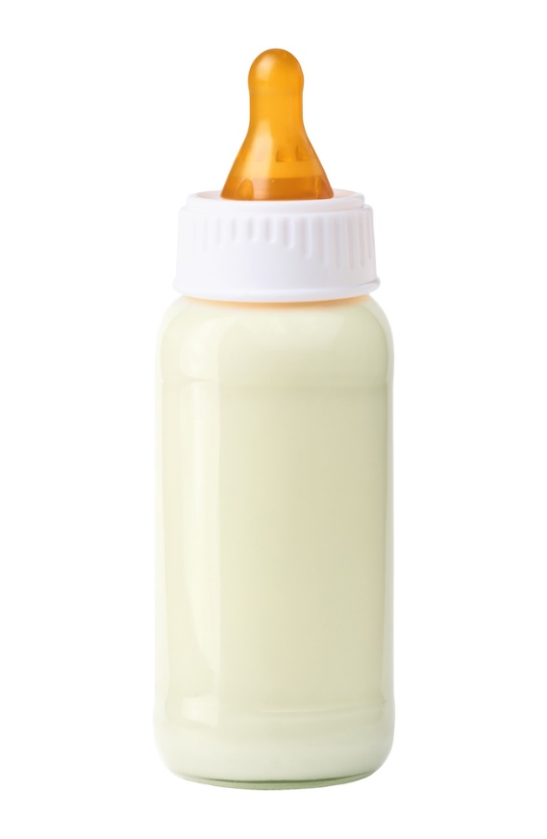
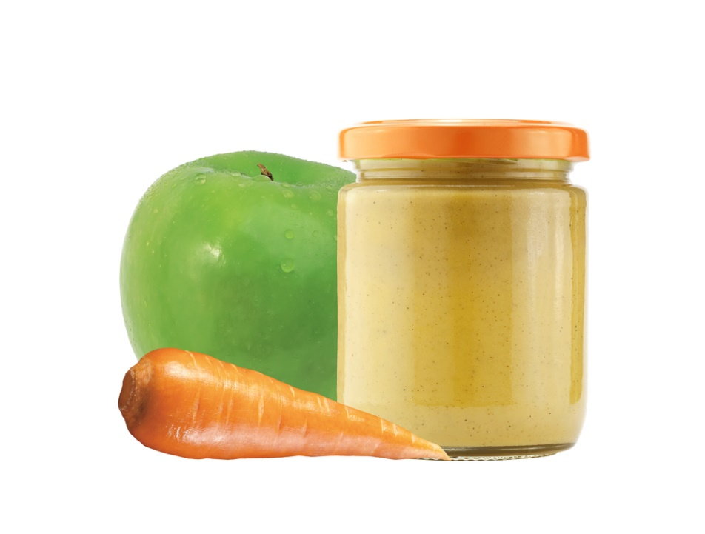
Tips During Mealtime
A baby put in bed with a bottle can develop bottle mouth.
Feed the baby directly from the jar only if you use the entire jar contents.
Notes:
Feed the baby directly from the jar only if you use the entire jar contents; otherwise use a dish to prevent contamination with foodborne illness.
Opened containers of baby's food should be covered and stored in a refrigerator for no longer than two days.
Use a small spoon to feed the baby.
A baby put to bed with a bottle (milk, fruit juice or sweetened beverage) can develop bottle mouth, resulting in tooth decay. Use plain water if a bottle is necessary.
Avoid foods that may cause the baby to choke -- popcorn, nuts, potato chips, whole kernel corn, berries, grapes, hot dogs, raw vegetables, raisins and dry flake cereals.

Slide 12
Two Years and Older
After the age of two, it is recommended that diets:
Are moderately low in fat
Provide nutrient-dense foods
Contain a variety of foods from each food group
Notes:
Throughout childhood and adolescence, it is important that the diet includes a variety of foods for proper development. The principles of the food guide plate apply to a child's diet as well as an adult's, although portions and number of servings per day are obviously less for children.
After the age of two, it is recommended that the diet be moderately low in fat, as diets high in fat may contribute to heart disease, obesity and other health problems later in life.
In areas where water is not fluoridated, fluoride supplementation is recommended. A diet that contains a variety of foods from each of the food groups (breads and grains, meats, fruits and vegetables and dairy) will help prevent nutrient deficiencies.
Both the American Medical Association and the American Dietetic Association recommend that healthy children should get all their nutrients from foods rather than vitamin supplements.
The nutrients that are most likely to be deficient in a child's diet are calcium, iron, vitamin C, vitamin A, folic acid and vitamin B6. The American Academy of Pediatrics does not support routine supplementation for normal, healthy children. However, there is no significant risk if a parent wishes to give his or her child a standard pediatric multivitamin.
Children who consume little or no dairy products are at particular risk for calcium deficiency that can interfere with bone growth and development. Foods that are good sources of calcium include low-fat or nonfat milk, yogurt and cheeses. Other foods such as broccoli, cooked greens, and canned salmon (with bones) will also provide a source of calcium in the diet; however, it is often difficult to get children to consume adequate quantities of these foods.
Iron requirements vary by age, rate of growth, iron stores, increasing blood volume and rate of absorption from food sources. Adolescent girls will have increased iron needs due to menstrual losses. Food sources of iron include meat, fish, poultry, iron-fortified cereals, spinach greens and dried beans and peas.

Slide 13
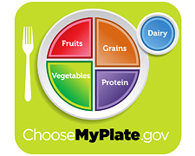
MyPlate
Put the plan into action by:
Choosing healthy beverages and snacks
Limiting the amount of empty calories
Providing healthy eating habits
Serving small portions
Source: ChooseMyPlate.gov
Notes:
MyPlate, the government’s newest symbol for healthy eating, uses a dinner plate icon as a simple visual reminder of what to serve yourself and your family for meals and at snack time.
MyPlate is useful for promoting healthy eating habits in more ways than one. It’s colorful, so kids and adults are attracted to it, and a plate is an icon that everyone understands. In addition to the plate, a circle at the side of the plate, labeled “dairy,” alerts you to include eight ounces of fat-free or low-fat (1%) milk or yogurt with meals and snacks. The MyPlate program reflects the suggestions for healthy foods made in the 2010 Dietary Guidelines for Americans.
The Plan shows what and how much a child should eat to meet his or her needs. Use the Plan as a general guide to help feed a toddler. A daily food plan shows what and how much a child should eat to meet his or her needs. You can create an eating plan for a toddler using the SuperTracker's MyPlan. You will be asked to create a profile using your child’s information. You can register to save the profile if you want to. Use the Plan as a general guide to help you feed a child.
Do not be concerned if the toddler does not eat the exact amounts suggested. Each child's needs may differ from the average, and appetites can vary from day to day. Try to balance the amounts over a few days or a week. A child’s doctor can track his or her height and weight over time to identify specific needs.
While the amount eaten daily may vary, the average amounts over time should be similar to this plan. Food plans are based on average needs by age and activity level. A toddler’s food needs also depend on how fast he or she is growing and other factors.

Slide 14
Start with Small Portions
Don't insist that children finish all the food on their plates
Teach them to take small amounts at first
Use smaller bowls, plates and utensils for your child to eat with
Notes:
Eating food:
Don't insist that children finish all the food on their plates. Let the child know it's okay to only eat as much as he or she wants at that time.
Make sure food isn't too hot for children to eat.
Offer a toddler small, easy-to-eat amounts to make eating easy and more enjoyable.
Teach children to take small amounts at first. Tell them they can get more if they are still hungry.
Use smaller bowls, plates and utensils for the child to eat with.
Serving food:
As children are able, allow them to serve themselves.
Even a three- to five- year-old can practice serving from small bowls that are held for him or her. The child can learn new skills and feel "all grown up.“
Serve foods that are "too hot" for the child to serve themselves safely (for example, soups). Ask the child how much he or she wants.

Slide 15
Nutritional Needs of Toddlers
The nutritional needs of toddlers vary from child to child
They should consume 1,000 to 1,400 calories per day
Notes:
The nutritional needs of toddlers vary from child to child. Their nutritional needs are based on factors such as their height, activity level and how their bodies burn calories, but in general they should consume 1,000 to 1,400 calories per day if they are moderately active or active and only 1,000-1,200 calories if the toddler is sedentary.
It is important to offer foods containing all of the essential nutrients to ensure proper growth and development. Variety in food offerings is essential to help children develop a liking for new tastes and textures. Toddlers should also continue to consume whole milk to ensure that adequate dietary fat is consumed.
For additional information on nutritional guidelines for toddlers, visit:
http://kidshealth.org/parent/nutrition_center/healthy_eating/toddler_food.html

Slide 16
Behavioral Eating Milestones
Two-Year-Olds:
Can use a spoon and drink from a cup
Develop likes and dislikes
Experience slower growth and appetite drops
Three-Year-Olds:
Are comfortable using fork and spoon
Make simple either/or food choices, such as a choice of apple or orange slices
Pour liquid with some spills
Notes:
The toddler and preschool years are an important time for developing healthy habits for life. From the ages of two to five, children grow and develop in ways that affect behavior in all areas, including eating. The timing of these milestones may vary with each child.
Two-Year-Olds:
Can be very messy
Can use a spoon and drink from a cup
Develop likes and dislikes
Experience slower growth and appetite drops
May suddenly refuse certain foods
Three-Year-Olds:
Can follow simple requests such as “Please use your napkin”
Are comfortable using a fork and spoon
Like to imitate cooking
Make simple either/or food choices, such as a choice of apple or orange slices
May suddenly refuse certain foods
Pour liquid with some spills
Start to request favorite foods

Slide 17
How to Feed a Toddler
(click on picture)
Notes:
Learn how to feed a toddler so that most of the food ends up on the child, not on him.
How to Feed a Toddler
Your two-year-old is beyond pureed peas and bits of cereal. Now what? They can eat just about anything.
https://youtu.be/VV98HwqlQ7A

Slide 18
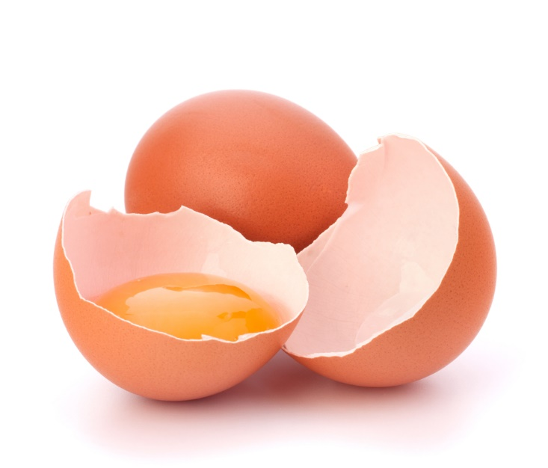
Food Safety for Toddlers
Some foods are more likely to cause foodborne illness. Avoid serving your toddler the following foods:
Raw or partially cooked eggs or food containing raw eggs
Raw sprouts
Raw or undercooked meat, poultry, fish and shellfish
Unpasteurized juices
Unpasteurized (raw) milk or any products made from unpasteurized milk
Unwashed fruits or vegetables
Notes:
Toddlers' immune systems are still developing.
This makes it easier for them to become ill. That's why it's important to follow the recommended food safety guidelines.
The Food and Drug Administration has these guidelines for keeping food safe to eat:
CLEAN: Wash hands and surfaces often.
SEPARATE: Don't cross-contaminate. For example, after cutting meat, wash the knife before using it to cut vegetables.
COOK: Cook to proper temperature using a food thermometer.
CHILL: Refrigerate promptly.
In addition, follow these specific guidelines for toddlers:
Avoid common foods that cause foodborne illness
Avoid foods that can be choking hazards
Serving seafood to a toddler
Stress the importance of hand washing

Slide 19
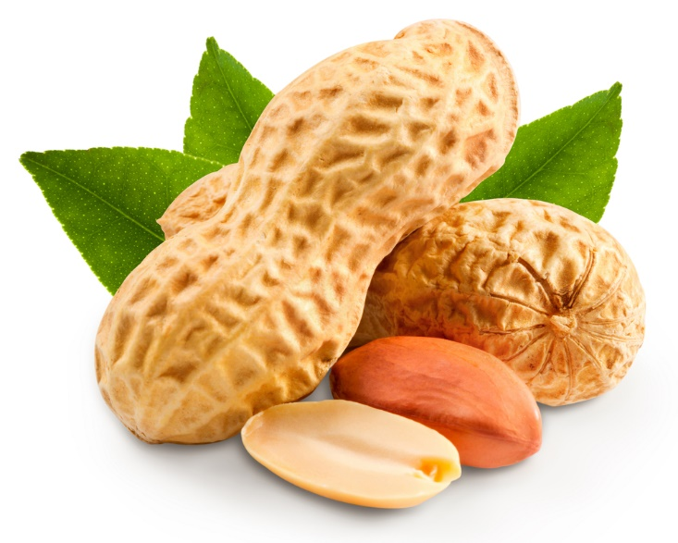
Food Hazards for Toddlers
Foods that may be choking hazards:
Carrot sticks or baby carrots
Chewing gum
Chips
Peanuts
Popcorn
Round slices of hotdogs or sausages
Notes:
Some foods are easy for a toddler to choke on when swallowing them. These include foods that are round and about the size of the throat or the size of a nickel. Prevent choking by avoiding these foods or cutting them in small pieces no larger than one-half inch (½”).
Additional foods that may be choking hazards:
cherry tomatoes
hard candy
large pieces of raw fruits and vegetables
tough meat
whole grapes
To prevent choking:
Cook carrots or celery sticks until slightly soft, grate them, or cut them into small pieces or thin “matchsticks.”
Cut food for your toddler into pieces no larger than one-half inch (½”), and teach him or her to chew their food well.
Cut meat and chicken across the grain into small pieces.
Ensure the toddler eat at the table, or at least while sitting down. Do not let them run, walk, play or lie down with food in his or her mouth.
Keep a watchful eye on toddlers while they eat.
Slice grapes, cherry tomatoes and other round foods in half.
Slice hotdogs and sausages lengthwise.
Spread peanut butter thinly on bread or crackers. A thick “glob” of peanut butter can cause choking.

Slide 20
Hand Washing Tips for Toddlers
Toddlers should wash hands:
After coughing or sneezing
After playing with pets or visiting a petting zoo
After using the bathroom
Before and after handling food or eating
Whenever they are dirty
Notes:
Hand washing is one of the most important ways to keep toddlers from getting sick.
Toddlers are much less likely to get sick if they wash their hands properly. Plus, it may become a healthy habit for life! Children should wash their hands with warm water and soap for 20 seconds each time.
Additional tips:
Have the child pick out a special hand washing soap.
Help the toddler reach the sink easily by placing a stool in front of the sink to stand on.
Make hand washing fun!
Sing “Twinkle, Twinkle, Little Star” or the “Alphabet Song” through while washing hands to make sure the child is washing long enough.

Slide 21
Seafood Safety for Toddlers
Seafood (fish and shellfish) can be part of a healthy diet for toddlers.
Herring
Pollock
Salmon
Sardines
Trout
Notes:
Seafood (fish and shellfish) can be part of a healthy diet for toddlers.
Omega-3 fats in seafood have important health benefits for young children. These benefits can outweigh concerns about chemicals that may also be in seafood. Learn about making wise choices below.
The nutritional value of seafood is of particular importance in early childhood. Seafood provides important nutrients like omega-3 fats. Omega-3 fats from seafood are healthy fats shown to improve the development of the nervous systems of young children. Seafood choices that are higher in omega-3s include salmon, herring, mussels, trout and Pollock.
A toddler or preschooler should not eat fish high in mercury like shark, swordfish, tilefish and King mackerel.
Canned “white” tuna (albacore) is higher in mercury than the “light” variety; limit canned white tuna to fewer than six ounces per week.

Slide 22
Review
What is an age-appropriate diet for a child under the age of one?
What is an age-appropriate diet for a toddler?
How can a parent use ChooseMyPlate to plan meals for a toddler?
Name four foods an individual should avoid serving a toddler.
What are three hand washing tips for toddlers?

Slide 23
Questions?

Slide 24
References and Resources
Images:
Photos obtained through a license with Shutterstock.com™. (Slides 1, 3, 4, 5, 6, 7, 8, 9, 10, 11, 12, 14, 15, 17, 18, 19, 20, 21 and 23)
ChooseMyPlate.gov. (Slide 13)
Textbook:
Decker, C. (2011). Child development early stages through age 12. (7th ed.). Tinley Park: Goodheart-Willcox Company, Inc.
Websites:
Bright Futures Giving your baby the best nutrition (birth to five months) http://www.brightfutures.org/nutritionfamfact/pdf/ColorEng/INB5color.pdf
Cut Back of Your Kid's Sweet Treats 10 tips to decrease added sugar. Nutrition Education Series. http://www.choosemyplate.gov/food-groups/downloads/TenTips/DGTipsheet13CutBackOnSweetTreats.pdf

Slide 25
References and Resources
Websites:
Medline Plus Age-appropriate diet for children http://www.nlm.nih.gov/medlineplus/ency/article/002455.htm
Nutrition Education of Texas Teaching Nutrition: Background information about nutrition, nutrients and healthy eating habits. Topics include nutrients, food safety, selecting a balanced diet, nutritional needs during the lifecycle, nutrition and health. http://netx.squaremeals.org/teaching_nutrition.html
Nutrition.gov Nutrition Information for you http://www.nutrition.gov/life-stages/infants
United States of Department of Agriculture The Centers for Disease Control (CDC), National Center for Health Statistics created these charts with direction from the FNS Supplemental Food Programs Division. http://wicworks.nal.usda.gov/assessment-tools/growth-charts/wic-growth-charts

Slide 26
References and Resources
YouTube™:
How to Feed a Toddler Learn how to feed a toddler so that most of the food ends up in the child, not on him. http://youtu.be/VV98HwqlQ7A

