Slide 1
Pastabilities
The Ins and Outs about Pasta
Notes:
Pasta belongs in the grains food group. It can be made from a variety of grains.
Have students name grains they are familiar with.
Pasta is a complex carbohydrate that can be a part of a healthy diet.

Slide 3
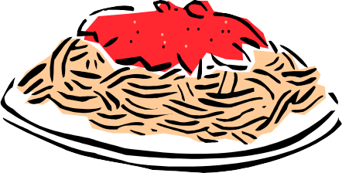
How We Use Pasta
  Appetizers
  Entrées
  Side Dishes
  Salads
  Desserts
Notes:
We are most familiar with pasta as an entrée. Most of us are very familiar with macaroni and cheese! Pasta can be used in virtually any part of a meal. What are some of your favorite pasta dishes? What pasta dishes are prepared in your home?

Slide 4
Basic Pasta Dough
  Contains flour, salt, egg and liquid (oil)
  Produces a stiff dough
  Can be stretched, rolled, and cut into shapes
  Often made of semolina flour
Notes:
Basic pasta dough contains 4 basic ingredients: flour (most often Semolina flour or ½ semolina and ½ all purpose flour), and eggs. Some recipes will call for salt and a liquid – usually olive oil. The dough is stiff so it can be stretched to various lengths and thicknesses without tearing.

Slide 5
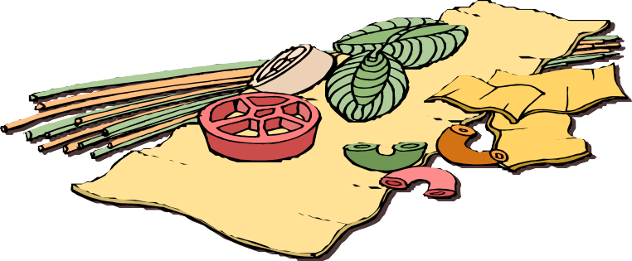
Fresh vs. Dried
  Fresh – cooks quickly, short shelf life
  Dried – longer cook time, long shelf life
  Both – cook to al dente stage
Notes:
The most common forms of pasta are fresh and dried. Although you can find frozen pasta in the grocery store, fresh pasta is typically in the refrigerator section. Pasta should be selected depending on your personal preference and need. If you plan to store the product, it’s best to buy dried pasta. If you are going to use it within a short amount of time, you may want to purchase fresh pasta. Regardless of which type of pasta you select, when preparing, always cook to the “al dente” stage. Refer to word wall for definition.

Slide 6

Fresh Pasta Dough
  4 ingredients; flour, salt, water, egg
  Resting stage most important – 15 to 20 minutes
  Cook, store in refrigerator or freeze freshly prepared pasta
Notes:
When you have the opportunity, make fresh pasta. It only takes a few ingredients.
The pasta dough will be gently kneaded.
It is very important to let the dough rest. This will allow the dough to relax and stretching the dough, as it is rolled, will be easier. When the dough is ready, it can be stored in the refrigerator or freezer. Many chefs prefer to cook pasta shortly after it has been rolled, cut or shaped.

Slide 7
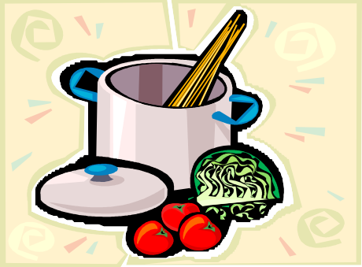
Cooking Tips
  4 – 6 quarts of water for every pound of pasta
  Add pasta to boiling water
  Stir occasionally
  Oil and salt?
  Taste to determine doneness
Notes:
Pasta needs to be cooked in a large amount of water, typically 4 to 6 quarts for every pound of pasta.
Add the pasta to boiling water– and keep the water boiling! This allows for movement, allowing less opportunity for the pasta to stick together.
Occasionally stirring gently can also help prevent sticking. Some chefs add a small amount of olive oil to help prevent sticking and add flavor.
Adding oil to the water or to the pasta after it is cooked can prevent sauce from sticking to the noodles. Salt that is added is primarily for flavor.
Taste the pasta for doneness. It should be firm to the bite (al dente). If you are serving hot pasta, it is not necessary to rinse the pasta.
If pasta is going to be served cold or in a salad, you may want to rinse it to remove some of the starch.

Slide 8
References/Resources
  Textbooks:
    Glisslen,Wayne, Professional Cooking, John Wiley & Sons inc., New Jersey, © 2011, Chapter 19
    Johnson & Wales University, Culinary Essentials, Glencoe/McGraw Hill, © 2002, Chapter 25
    National Restaurant Association, Foundations of Restaurant Management and Culinary Arts – Level 1, Prentice Hall, New York, ©2011, Chapter 11, Section 3
  Websites:
    National Pasta Association – All About Pasta
    http://www.ilovepasta.org

