Slide 1
Making a Difference:
Personal Care Services

Slide 3
What are personal care services?
Notes:
Personal care professionals help people with their personal appearance including styling hair, giving manicures, providing facial treatments and giving makeup advice. They also provide health and fitness training.
Have you ever used one or more of these personal care services? What kind of services did you receive?

Slide 4
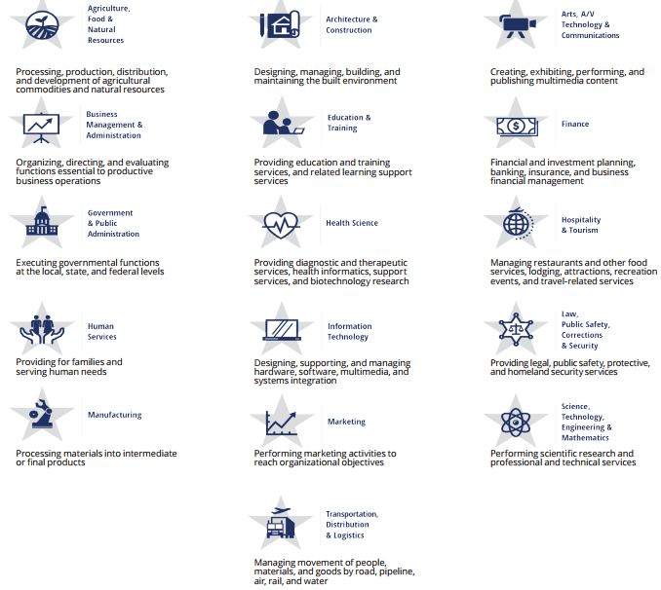
16 Career Clusters
Notes:
The 16 career clusters identified by the U.S. Department of Education classify workforce preparation programs that are obtained through career and technical education.
What cluster do you think Personal Care Services falls under?
Have students read the descriptors for each cluster.

Slide 5

Human Services
Notes:
Principles of Human Services falls under the Human Services cluster.
As a student in Principles of Human Services, do you feel you are providing for families and serving human needs? How? It takes a unique individual to work in Human Services. There are many occupations in the cluster that pay well, but most people don’t do it for the money. They have a deep desire to help other people.

Slide 6
Human Services Program of Study
  Consumer Services
  Counseling and Mental Health Services
  Early Childhood Development and Services
  Family and Community Services
  Personal Care Services
Notes:
Each cluster has various programs of study.
We have already established that Principles of Human Services is in the Human Services career cluster.
What program of study do you think it follows?
It is categorized under the Early Childhood Development and Services Program of Study. However, it can be applied to Consumer Services, Counseling and Mental Health Services, Family and Community Services and Personal Care Services. Have students brainstorm how Principles of Human Services can be applied to the other programs of study.
For this lesson, we are going to focus on Personal Care Services. According to AchieveTexas, the Texas Department of Licensing and Regulation maintains a database of more than 184,000 licensed cosmetologists and 23,500 salons.

Slide 7
Personal Care Services
Cosmetologists
Electrolysis Technicians
Funeral Directors/Morticians
Nail Technicians, Manicurists and Pedicurists
Skin Care Specialists/Estheticians
Notes:
Personal care professionals help people with their personal appearance including styling hair, giving manicures, providing facial treatments and giving makeup advice. They also provide health and fitness training. Additional occupations include:
Barbers
Companions
Electrologists
Embalmers
Funeral directors/morticians/attendants
Hairdressers and hairstylists
Personal and home care aides
Personal trainers
Spa attendants
Massage therapists

Slide 8

Careers in Personal Care Services
Employment in this area is anticipated to grow by 27 percent over the next decade.
This growth will add more than 1.3 million jobs
Notes:
According to the Bureau of Labor Statistics, employment in personal care service occupations is anticipated to grow by 27 percent over the next decade, adding more than 1.3 million jobs. What factors contribute to this growth?
As consumers become more concerned with health, beauty and fitness, the number of cosmetic and health spas will rise, causing an increase in demand for workers in this group. The personal care and service group contains a wide variety of occupations; however, two of them—personal care aides and childcare workers—will account for nearly two-thirds of the group’s new jobs.
Personal and home care aides will experience increased demand as a growing number of elderly people require assistance with daily tasks.
What are other occupations in the personal care service industry?

Slide 9

Texas Department of Licensing and Regulation (TLDR) Requirements
TDLR application
Student permits
Licensing requirements
Technical skills
Interpersonal skills
Communication skills
Student assets
General school policies
Course requirements
Ethical and legal conduct
Notes:
Teacher note: If you are at a school that does not offer cosmetology courses, go ahead and share this information with the students. This might be a good opportunity to open up a dialog with the students about interest in a cosmetology program at your school.
If you decide to enroll in the cosmetology program offered at school, there are steps you must take:
TDLR application: Students must complete this application and pay $25.00 by money order or credit card before they can begin to use a time clock to track student hours.
Student permits: TDLR Law, Sec. 1602.266
The department shall require a student enrolled in a school of cosmetology in this state to hold a permit stating the student’s name and the name of the school. The permit shall be displayed in a reasonable manner at the school.
The department shall issue a student permit to an applicant who submits an application to the department for a student permit accompanied by the required fee.
Licensing requirements: 1500 total clock hours
One thousand (1000) clock hours in the school
Five hundred (500) academic hours awarded upon graduation and completion of 1000 lab/class hours
Required practical applications
Mastery of the written and practical state exam
Technical skills: A small percentage (about 15%) of your success. Technical skills can include sterilization and sanitation procedures, hair care, nail care and skin care.
Interpersonal (people) and communication skills – 85% of your success
Personal image and hygiene
Goal setting
Reliability and punctuality
Communication
Sales capability
Student assets
Aspiration
Teamwork
Determination
Dedication
General school policies
Clocking procedures
Lockers
Dress code
Standards of conduct
Campus student handbook or student conduct code
Course requirements
Course of study handout
Course outline/syllabus
Grading policy
Ethical and legal conduct

Slide 10
Salon Rules and Regulations
Licensed employees
Sanitation
Business license
Hazardous chemical management
Notes:
Operating a beauty salon isn't as relaxing as visiting one. Have you ever thought of operating your own beauty salon? What rules and regulations do you think apply to operating a beauty salon?
Many rules and regulations apply to the industry to ensure safety, responsible business practices and compliance with the law. Rules and regulations depend on what type of beauty salon you're operating and where your business is located, as they are set by state boards and city codes. The rules for hair salons are different than those for nail salons. What are the rules for our city?
Licensed employees - To ensure that your clients receive the best service, make sure your employees have the proper education and training to be qualified at their trade. Most states require beauty school graduates to pass an exam and earn a license to practice in their profession. We have already discussed the requirements for a Texas license.
Sanitation – Sanitation must be a top priority for a beauty salon to meet industry and client cleanliness standards. Many bacteria can be found in salons, making certain sanitation practices standard for all types of beauty salons. Every product, appliance or tool that comes in contact with a client must be disinfected and sanitized. What are some sanitation practices you have or have not observed in a salon?
Business license – Your business must obtain the proper licenses and certificates to meet legal standards. When opening or operating a spa, you must get all the licenses required by your state.
Hazardous chemical management - Employers and workers can take steps to protect health when working with products that contain potentially hazardous chemicals.

Slide 11
Skills Needed in Cosmetology
Communication skills
Clerical development
Customer service
Personal qualities
Salon fundamentals
Salon management
Notes:
Communication skills
Client communication: Direct the conversation. Do not gossip or complain. Do not talk about personal issues, politics or religion. Talk about beauty and fashion. Be a good listener.
In-salon communication with co-workers. The same as above applies.
Discuss the importance of communicating effectively with co-workers.
Clerical development
Have clients complete an intake form – also called a client questionnaire or consultation card. This can be a good tool to open up communication lines and build an excellent relationship with your clients.
Customer service
Keeping your clients happy and providing them with the best customer service should be your number one priority.
Personality qualities
Project a positive attitude
Manners: Good human relations, kind and considerate
Maintain professional appearance, personal hygiene and behavior
Demonstrate correct client care and professionalism at all times
Project professionalism, confidence and enthusiasm when providing information
Your personal qualities play an important role in how your non-verbal communication is perceived by your clients.
Salon fundamentals
Provide good customer service
Demonstrate respect to clients
Explaining treatment/service/product to the clients
Demonstrate good communication skills
Salon management
Salon manager is a potential career path for a cosmetologist, but it requires a very different skill set. What are some responsibilities as a manager?
Some answers could include:
Having an aptitude for math and accounting
Being able to read documents such as profit and loss statements
Understanding marketing
Keeping clients and employees happy

Slide 12
Communication Skills Needed in Cosmetology
(click on picture)
Notes:
Five Tips for building better communication skills in the salon
Today’s salon guests are very sophisticated and fashion aware. Here are five tips that can help build better communication in your salon behind the chair.
http://youtu.be/pzLIKoxwKnY

Slide 13
Tips for Client Follow-Up
(click on picture)
Notes:
Q & A with Sam Villa: Tips for client follow-up
Following up with your clients is critical, especially when you are a new stylist trying to build up your clientele base.
http://youtu.be/JkwopwmimWk

Slide 14
Technology and Personal Care Services

Slide 15

Technology and Personal Care Services
Some ways of using technology include:
Creating a functional website
Offering gift certificates online
Following up with a phone call, text, e-mail or letter
Providing a way for your clients to book 24/7
Providing televisions and Wi-Fi in your salon
Notes:
There are many ways to use technology to provide good personal care services in the field of cosmetology.
Have an up-to-date website that is functional and eye-catching. What features should be included on a website?
Address
Coupons
Gift certificates
Hours of operation
Map to the facility
Methods of payment accepted
Phone number
Pictures of different hair styles and color treatments
Policies
Services offered and prices
Specials and packages
Staff and their information
Be knowledgeable about your clients and their individual needs. Take time to know and remember if your customer has dry hair, oily hair or permed hair. Offer products that are going to enhance his or her appearance. You may have a database online to record your client’s information.
Offer gift certificates for your personal care services. This will save your client time and energy. You may provide this service on your website.
Provide good customer service on the phone, at your place of business and in your client’s home. Train salon staff on how to greet clients over the phone and in person. Conduct thorough consultations, especially for new clients. Consultations provide stylists with information to better service the clients and offer clues to which products to recommend. Follow up every visit with a phone call, a note in the mail or an e-mail to ensure customer satisfaction. Address negative complaints immediately by inviting the customer back for an opportunity to make things right.
For your client’s convenience, provide online booking 24/7.
Offer special occasion packages such as wedding day packages, prom packages or packages for other occasions. Display this information on your website.
Design your salon around a theme that makes it memorable for your clients. Pick a color scheme with two to three colors. Select furniture that has style and is functional and easy to keep clean. Place televisions in your salon to keep your clients engaged, and select programs that will interest them. Providing free Wi-Fi in your salon can be an added bonus for your clients.

Slide 16

Modern Methods of Advertising Your Salon
Broadcast
Cell phone and mobile
Online
Outdoor
Print
Product placement
Notes:
You can use technology in the form of advertising you choose for your salon. Advertising can be found in:
Broadcast advertising – A mass-market form of communication including television and radio, broadcast advertising has, until recently, been the most dominant way to reach a large number of consumers. Television, radio and newspapers frequently provide information comparing various products and services and their sources.
Cell phone and mobile advertising – This type of advertising uses cell phones, iPads, Kindles, Nooks and other portable electronic devices with Internet connectivity. Current trends in mobile advertising involve major use of social media such as Twitter and Facebook.
Online advertising (digital) - If you see an advertisement via the Internet (World Wide Web), it is classified as online advertising. In fact, there are ads on most websites you visit, as they are the primary revenue driver for the Internet.
Outdoor advertising - Also known as out-of-home (OOH) advertising, this is a broad term that describes any type of advertising that reaches the consumer when he or she is outside of the home.
Print advertising – If an advertisement is printed on paper, be it newspapers, magazines, newsletters, booklets, flyers, direct mail or anything else that would be considered a portable printed medium, it falls under the banner of print advertising.
Product placement advertising - In a nutshell, product placement is the promotion of branded goods and services within the context of a show or movie, rather than as an explicit advertisement.
How many methods of advertising used by salons have you seen or heard today?
What were the methods?
Did the advertising methods have an impact on you as a client? How?

Slide 17
Media to Target the Client Population
Social media gives salons opportunities to create an ongoing conversation with customers and potential clients.
Social Media
Tweets
Hash tags
Notes:
Social media marketing - Social media gives salons opportunities to create an ongoing conversation with customers and potential clients. Tweet openings created by last-minute cancellations. Offer discounts on hard-to-sell products and services. Create a hash tag for your specials so that clients know where to find deals. Post before and after pictures of hairstyles on Facebook. Offer one free Monday morning manicure to customers who like you on Facebook. The buzz built through word of mouth will lead to more customers.
What are some other ways a salon could use social media to promote its services?
What are some other ways a salon could use social tweets to promote its services?
What are some other ways a salon could use hash tags to promote its services?

Slide 18
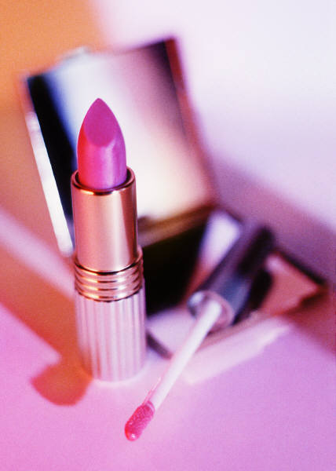
Virtual Hairstyle and Makeover
(click on picture)
Notes:
With the use of a virtual hairstyle and makeover program, salons can assist clients in determining a new look, make-up application or hair style.
Teacher note: You may opt to use the models on the website or upload a picture of yourself.
How is the use of this technology going to benefit clients?
Marie Claire
Virtual Hairstyle and Makeover
http://www.marieclaire.com/hair-beauty/trends/virtual-hairstyle-makeovers

Slide 19
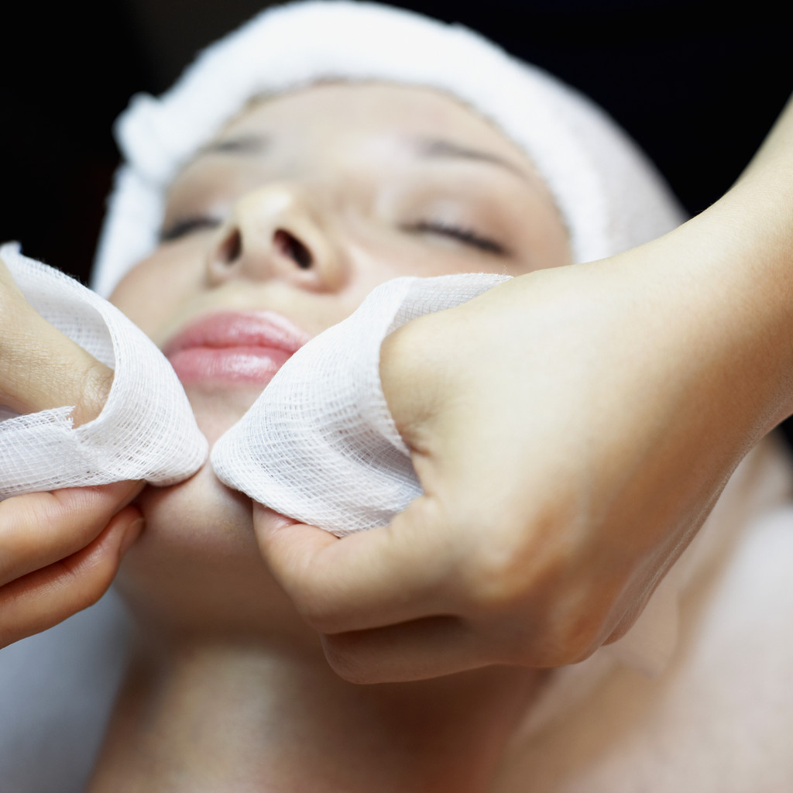
Technology and Cosmetology
Permanent hair styling technology
Fingernail technology
Skin care technology
Notes:
Permanent hair styling technology - Over the years, a number of technological applications have been used, some seriously damaging the hair. Today, cosmetologists employ the "digital perm," which uses chemicals without using heat styling.
Fingernail technology - Cosmetologists responsible for finger and toenail care have specialized technology to assist them. While it is still a finger-by-finger or toe-by-toe procedure, cosmetologists work in a far more sterilized area than previously and are trained to identify nail diseases and infections. They also have technically-advanced acrylic wraps and more specialized tools.
Skin care technology - Skin care cosmetologists use a variety of technologies to perform such techniques as steam extraction, chemical peels and microdermabrasion. They also perform hair removal with warm wax.

Slide 20

Questions?

Slide 21
References and Resources
Articles:
Advertising Ideas for Salon Services
An effective advertising strategy is vital to making your salon a success.
http://www.ehow.com/list_6819694_advertising-ideas-salon-services.html
How To Make a Flyer for a Beauty Salon
A flyer can help attract potential customers.
http://www.ehow.com/how_6595829_make-flyer-beauty-salon.html
How to Make a Flyer in Microsoft® Word
Flyers are useful, low-cost advertising tools, and you can use Microsoft® Word to create flyers to your liking.
http://www.ehow.com/how_4903668_flyer-microsoft-word.html
Images:
Microsoft Clip Art: Used with permission from Microsoft.
Textbooks:
lpert, Arlene, and Milady Publishing Company. Miladys standard cosmetology 2004. Milady Pub Corp, 2002.

Slide 22
References and Resources
Websites:
AchieveTexas in Action
A college and career planning guide.
http://www.achievetexas.org/2010%20Guides/71711%20Hum_comp_np.pdf
Bureau of Labor Statistics
Personal Care and Service Occupations
http://www.bls.gov/ooh/personal-care-and-service/home.htm
TDLR Law and rules
http://www.license.state.tx.us
YouTube™:
Avalon Hair Salon
A Paul Mitchell focus salon
http://www.avalonhairdesignandspa.com/
Five Tips for building better communication skills in the salon
Today’s salon guests are very sophisticated and fashion aware. Here are five tips that can help build better communication in your salon behind the chair.
http://youtu.be/pzLIKoxwKnY
Marie Claire
Virtual Hairstyle and Makeover
http://www.marieclaire.com/hair-beauty/trends/virtual-hairstyle-makeovers
Q & A with Sam Villa: Tips for client follow-up
Following up with your clients is critical, especially when you are in new stylist trying to build up your clientele base.

