Slide 1
Personality Disorders

Slide 3
What is a personality disorder?
  An enduring pattern of maladaptive behavior
  Features of these disorders usually become recognizable during adolescence or early adult life
  Should not be confused with personality trait
Notes:
-A personality trait is an individual quality that makes one person different from another, but does not constitute abnormal or dysfunctional behavior & never reaches the threshold of personality disorder.

Slide 4
Three Types of Personality Disorders:
  Cluster A
  Cluster B
  Cluster C
Notes:
Cluster A: eccentric, withdrawal behavior
Cluster B characteristics: dramatic, emotional, erratic/explosive, likes to be center of attention
Characteristics Cluster C: anxious, fearful

Slide 5
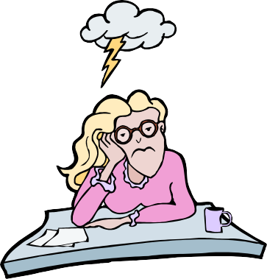
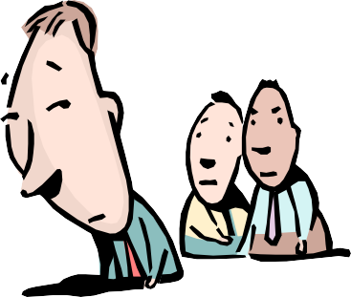
Cluster A
  Paranoid
  Schizoid
  Schizotypal
Notes:
Paranoid disorder: this disorder is characterized by the irrational suspicion of others
Schizoid disorder: shows a lack of interest in social events and relationships, avoids time with others
Schizotypal disorder: shows odd behavior of unnatural thinking

Slide 6

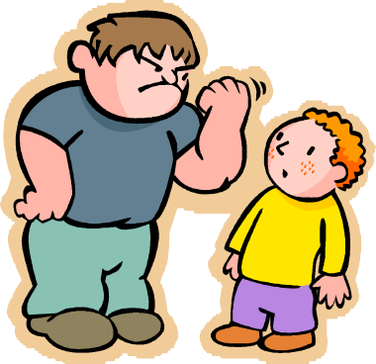

Cluster B
  Antisocial
  Borderline
  Histrionic
  Narcissistic
Notes:
Antisocial disorder: does not care about the law or the rights of others
Borderline disorder: thinking is extreme on either end, lack of stability in relationships, identity, and behavior patterns.
Histrionic disorder: attention-seeking behavior that includes sexual seductiveness and emotions inappropriate in typical society.
Narcissistic disorder: pervasive patterns of grandiosity, need for attention, and a lack of empathy for others.

Slide 7
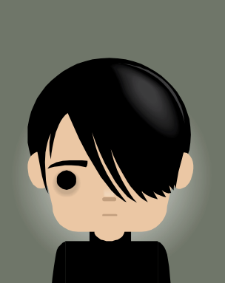
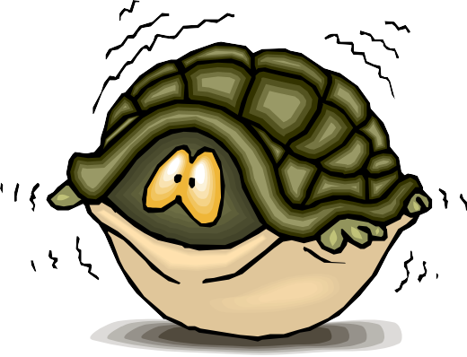
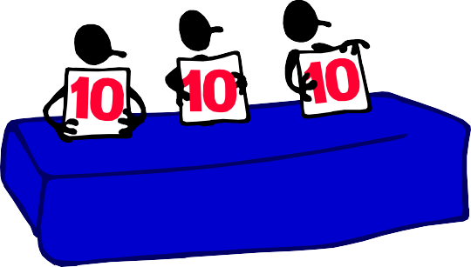
Cluster C
  Avoidant
  Dependent
  Obsessive-Compulsive
Notes:
Avoidant disorder: lack of social drive, low self-esteem, extremely sensitive to criticism.
Dependent disorder: pervasive psychological dependence on other individuals
Obsessive-compulsive personality disorder: shows a strict conformity to rules, moral codes and order.

Slide 8
OCD
  Don’t confuse Obsessive-Compulsive Personality Disorder with Obsessive-Compulsive Disorder (OCD)
  Obsessive-Compulsive Personality Disorder individuals are “neat-freaks”
Notes:
•Individuals with OCD have obsessions and compulsions that are held in place by rituals, superstitions, and fears.

Slide 9
Disruptive Behavior Disorders
  Temper Tantrums
  Physical Aggression
  Excessive argumentativeness
  Stealing
  Defiance
  Resistance to authority
Notes:
Disruptive behavior disorders are among the easiest to identify of all coexisting conditions because they involve behaviors that are readily seen. They first attract notice when they interfere with school performance or family and peer relationships, and frequently intensify over time.

Slide 10
Personality Disorder Basics
  What is a "personality disorder"?
  What are "Cluster A" personality disorders?
  What are "Cluster B" personality disorders?
  What are "Cluster C" personality disorders?
Notes:
Search the internet for Rhoda Hahn (Psychiatrist) expert video advice.

Slide 11
Treatment
  May include individual, group, or family psychotherapy.
  Medications may be helpful in relieving some symptoms.
  Behavior and cognitive therapies may be helpful in resolving symptoms or traits.
Notes:
The more you learn about personality disorders the more you will understand that they are illnesses, with causes and treatments. People can improve with proper care. By seeking out information, you can recognize the signs and symptoms of a personality disorder and help yourself or someone you know live a healthier more fulfilling life.

Slide 12
References/Resources
  Website:
    Personality Disorders
    Source: Medline Plus
    Trusted health information for you
    https://medlineplus.gov/personalitydisorders.html
    Types of Personality Disorders
    Source: Mental Help America
    Personality disorders and clusters of personality disorders
    http://www.mentalhealthamerica.net/conditions/personality-disorder

