Slide 1
Piggy Bank vs. Bank
Choosing and Maintaining Your Account

Slide 3
Banking Services
  Use your Quick Write handout to briefly explain the services provided by banks.

Slide 4
Types of Accounts
  Individual Account
    A bank account in the name of one person.
  Joint Account
    A bank account in the names of two or more persons or parties and subject to withdrawals by each.
  Savings Account
    A bank account on which interest is paid, traditionally one for which a bankbook is used to record deposits, withdrawals, and interest payments.
    Interest- A sum paid to the account holder by the bank for the use of money or for borrowing money.

Slide 5
When choosing a bank, you must consider:
  Location
    Office hours, ATM availability, branch offices
  Type of Account
    Make sure they are able to provide the services you need
  Restrictions
    Fund insurance, balance requirements, holds on deposits

Slide 6
When choosing a bank, you must consider:
  Fees
    Monthly, check, ATM use, check printing, account information, overdraft, stop-payment, cashiers checks
  Interest
    Rates, compounding type, minimum balance
  Special Features
    Direct deposit, automatic bill pay, online banking, overdraft protection, possibility for free banking

Slide 7

Checking Account Research
  With a partner complete the Checking Account Research handout for two different banking institutions.
  You will present your findings to the class at the beginning of the next class.

Slide 8
Opening an Account
  Complete application at branch location or online
  Make sure you have:
    Valid form of identification
    Proof of Residency
    Money to deposit into the account

Slide 9
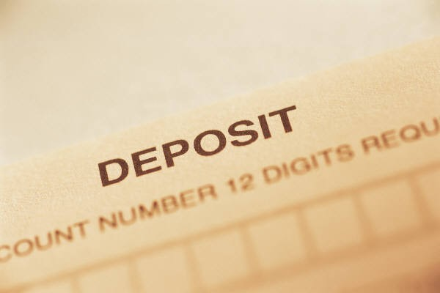
Making a Deposit
  Deposits can be completed at the branch office with a teller or at an automated teller machine, or ATM.
    Before making a deposit, make sure all checks have the proper endorsements and a deposit slip has been completed.

Slide 10
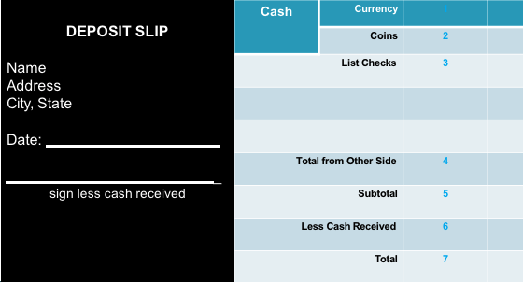
Making a Deposit

Slide 11
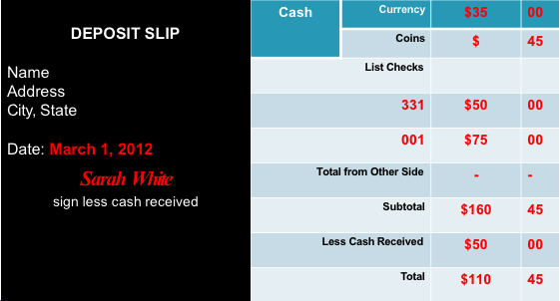
Deposit Practice

Slide 12
Withdrawing Money
  Teller/ATM
    Allows the account holder to withdraw cash at a branch location or ATM.
  Debit/Credit Purchase
    Use a card to electronically purchase goods.
  Check Purchase
    Write a check to cover the cost of your purchase. The check is deposited and processed then taken out of the account.

Slide 13
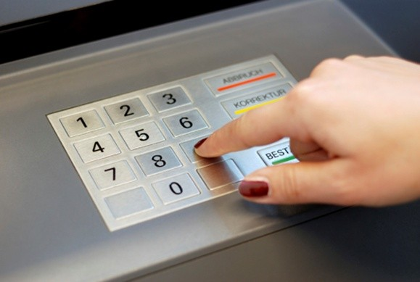
Withdrawing Money
  Teller/ATM
    Insert your card into the ATM.
    Enter your PIN number and follow on-screen prompts.
    Make sure you get a receipt for your records.
      If using an ATM that is not associated with your bank, you will be charged extra fees. These fees will be noted on your receipt.

Slide 14
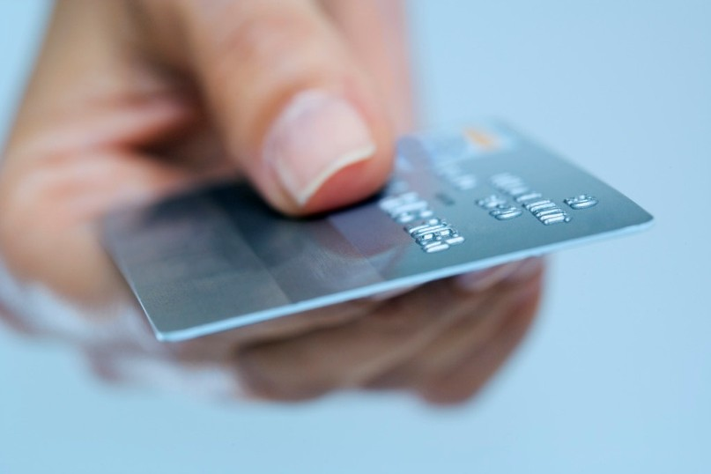
Withdrawing Money
  Debit/Credit Purchase
    Swipe debit card through the machine.
    Enter PIN number and follow on-screen prompts to complete transaction.

Slide 15

Withdrawing Money
  Check Purchase
    Use pen to fill out check completely.
    It is best to complete check in cursive to prevent changes from being made to the check. (It is easier to changes to writing when it is in print.)

Slide 16
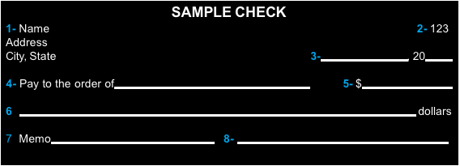
Parts of a Check

Slide 17
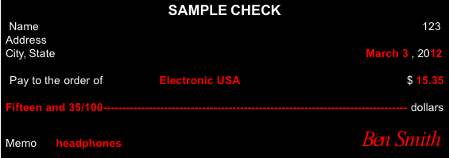
Check Writing Practice

Slide 18

Maintaining Your Account
  Make sure you have enough money in your account for your purchases.
    Record and balance your deposits and withdraws.

Slide 19
Maintaining Your Account
  Write all deposits and withdraws in your check registry to make sure you don't spend more than you have available.
  Complete the rows with the appropriate information.
  The first row will contain the date you opened your account and the amount you deposited.
  When making a deposit, you will ADD the amount to the balance listed in the previous row.
  When making a transaction, you will SUBTRACT the amount from the balance listed in the previous row.

Slide 20
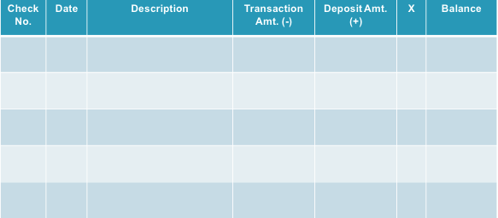
Check Registry

Slide 21
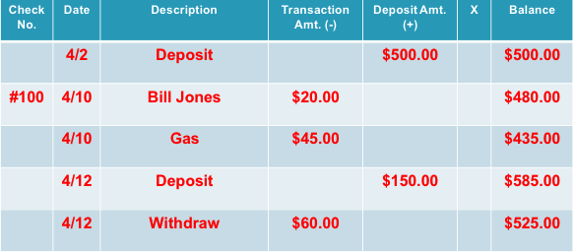
Check Registry Practice

Slide 22
References/Resources
  Images:
    Microsoft Office Clip Art: Used with permission from Microsoft
  Websites:
    Interactive check writing activity
    http://www.themint.org/kids/writing-a-check.html
    Practical Money Skills
    https://www.practicalmoneyskills.com
    Practical Money Skills-Debit Card Information
    https://www.practicalmoneyskills.com/downloads/pdfs/PMS_Guide_DebitCard.pdf

