Slide 1
Play with ME!

Slide 3
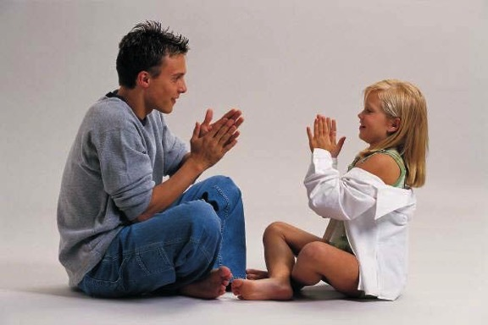
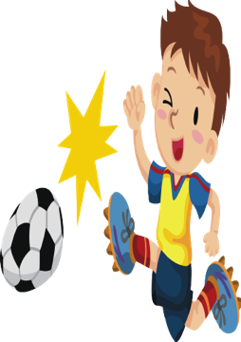
Play with ME!
  Playing with children helps them develop in many different ways.
Notes:
It helps their physical, intellectual, emotional and social development. Through play, children learn to interact with the world, people, their surrounding and objects. Children can learning about the world and themselves through play. Children need their parents, adults, sibling and other caregivers to encourage creativity and self expression.

Slide 4

Play with ME!
  You do not have to spend a lot of money on toys for children to learn and develop.
  What are some items around your house that a child could play with?
Notes:
Parents and caregivers need to give children their time, space and materials for play. It does not have to cost a lot to make an educational toy. Make a list of 10 items you have around your house that you could make into a play toy for a child. Example: a cookie cutter could be used to cut our clay shapes to teach a child about shapes.

Slide 5
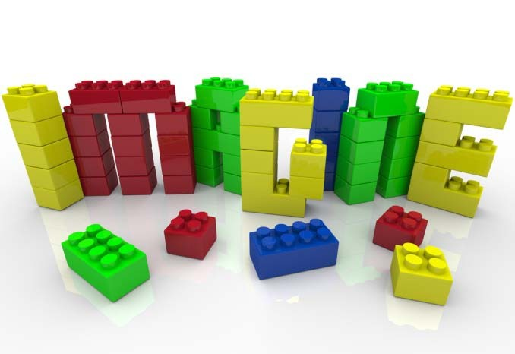
Play with ME!
  Make sure toys are developmentally appropriate for children.
  You do not want to give a 3 year old child a toy that is intended for a 10 year old child.
Notes:
Play can help a child develop physically. What are some examples? Ask class for examples.(tricycle, jungle gym, balls etc.) Play helps children learn concepts about their physical world; trees, plants, water, animals, shopping, etc. Through play, children learn logical concepts such as pretend play; playing school, repair man, grocery shopping, fireman, etc. What are some toys that appropriate for 3 year olds? 5 year olds? 8 year olds? 10-12 year olds? What are some safety features to look for in a toy for a three year old?

Slide 6
Play with ME!
  Make sure toys are safe for children.
  Toys with broken or missing pieces should be thrown away.
  Toys that have small parts should not be given to small children.
Notes:
Ask students why you should throw away broken toys and why toys with small parts should not be given to children. Brainstorm with your group to compile a list of safety rules/features when selecting toys for children.

Slide 7



Play with ME!
  What age group do you think these toys might be appropriate for?
Notes:
Symbol-type play helps a child prepare for the more abstract concepts such a writing and language. Children pretend with dolls by feeding, dressing and caring for them. Children may develop many props to use in pretend situations. Play can also help a child develop their language. What toys are available to help babies start forming their first sounds? Why are talking books helpful in developing a child’s language? Make sure the toys are appropriate for the child’s age, physical and mental abilities.

Slide 8
References/Resources
  Website:
    www.naeyc.org
    National Association for the Education of Young Children. Has different articles and information on children.

