Slide 1
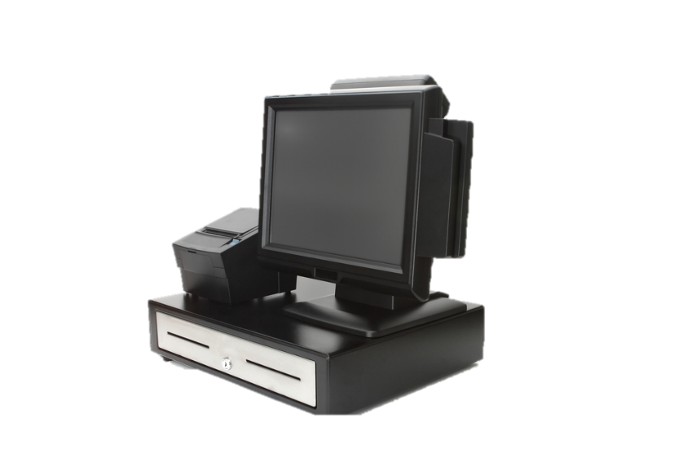
Point-of-Sale Systems in the Foodservice Industry
Culinary Arts, Restaurant Management

Slide 2
Copyright
Copyright © Texas Education Agency, 2015. These Materials are copyrighted © and trademarked ™ as the property of the Texas Education Agency (TEA) and may not be reproduced without the express written permission of TEA, except under the following conditions:
1) Texas public school districts, charter schools, and Education Service Centers may reproduce and use copies of the Materials and Related Materials for the districts’ and schools’ educational use without obtaining permission from TEA.
2) Residents of the state of Texas may reproduce and use copies of the Materials and Related Materials for individual personal use only, without obtaining written permission of TEA.
3) Any portion reproduced must be reproduced in its entirety and remain unedited, unaltered and unchanged in any way.
4) No monetary charge can be made for the reproduced materials or any document containing them; however, a reasonable charge to cover only the cost of reproduction and distribution may be charged.
Private entities or persons located in Texas that are not Texas public school districts, Texas Education Service Centers, or Texas charter schools or any entity, whether public or private, educational or non-educational, located outside the state of Texas MUST obtain written approval from TEA and will be required to enter into a license agreement that may involve the payment of a licensing fee or a royalty.
For information contact: Office of Copyrights, Trademarks, License Agreements, and Royalties, Texas Education Agency, 1701 N. Congress Ave., Austin, TX 78701-1494; phone 512-463-7004; email: copyrights@tea.state.tx.us.
Copyright © Texas Education Agency, 2015. All rights reserved.

Slide 3
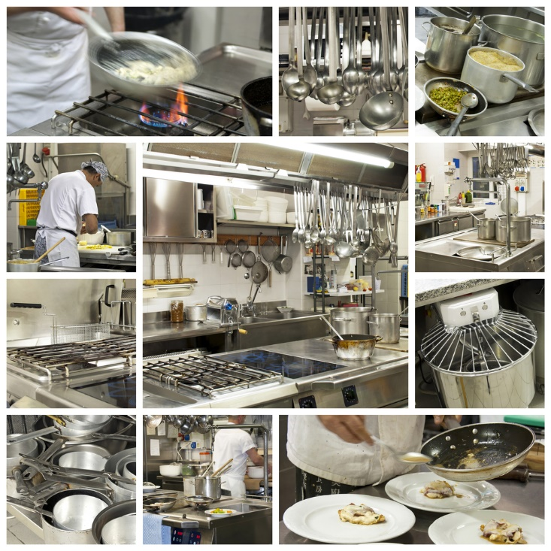
Technology in Foodservice
Copyright © Texas Education Agency, 2015. All rights reserved.
Notes:
Has created more efficient ways to work
Technology in foodservice has made a positive impact in the industry.

Slide 4
Technology in the kitchen
Communications
Equipment
Management
Copyright © Texas Education Agency, 2015. All rights reserved.
Notes:
Foodservice employees must be able to use the latest technology for the industry.

Slide 5
Communications Technology
Allows chefs and managers to monitor more than one area with:
Cell phones
Pagers
Videos
Walkie-talkies
Copyright © Texas Education Agency, 2015. All rights reserved.
Notes:
Allowing the use of wireless communication has allowed chefs and managers to be more effective in their jobs.

Slide 6
Equipment Technology
Food is cooked faster and better
More accurate and efficient
Programmable cooking cycles
Provides cooks with instructions on cooking techniques
Copyright © Texas Education Agency, 2015. All rights reserved.
Notes:
Convection ovens, food processors, induction cooking and microwaves have changed the kitchen environment.
What would once take many cooks to do by hand, now allows one cook to use new technology to save labor costs and become more efficient.

Slide 7
Management Technology
Ability to make more money is improved
Creates more efficient ways to work
Manages labor and inventory tasks with software programs for:
Spreadsheets
Word processing
Copyright © Texas Education Agency, 2015. All rights reserved.
Notes:
Some workplace documents that managers use computers for are:
cash flow projections
inventory
purchase orders
tax forms
time sheets
work schedules

Slide 8
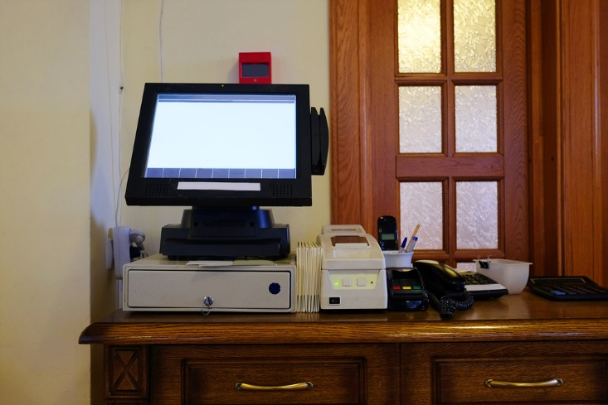
Point-of-sales system
Copyright © Texas Education Agency, 2015. All rights reserved.
Notes:
The POS system has become essential in the foodservice industry.

Slide 9
Point of Sales System (POS)
Copyright © Texas Education Agency, 2015. All rights reserved.
Notes:
Point of Sales System (POS) - A computerized system for recording an order at the place where the order is taken
The POS has improved the accuracy of the menu orders.
It allows servers to take and send orders to the kitchen.

Slide 10
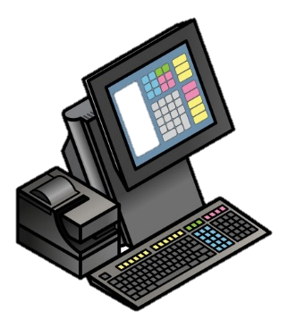
POS Systems
Calculates charges and taxes
Keeps track of menu items sold
Processes credit cards
Records payments
Sends orders to kitchen
Tracks inventory
Can handle:
Accounting
Employee
Scheduling
Time clock
Payroll
Sales reports
Copyright © Texas Education Agency, 2015. All rights reserved.
Notes:
The POS system has increased employee efficiency and overall company productivity.
These are a few of the tasks a point-of-sale system will be able to do.
Most systems are personalized for each business.

Slide 11
Lap up technology to stay relevant with customers
(click on link)
(image from video)
Copyright © Texas Education Agency, 2015. All rights reserved.
Notes:
Click on hyperlink to view video:
Lap up technology to stay relevant with customers
Hudson Riehle, National Restaurant Association senior vice president of research and knowledge, explains why integration of restaurant technology can help brands stay relevant. https://youtu.be/GXsPaEVeo1w

Slide 12
Copyright © Texas Education Agency, 2015. All rights reserved.
Notes:
What does this quote mean to you?

Slide 13
Let’s Review!
What has technology done for the foodservice industry?
How has technology improved the equipment in the kitchen?
How has technology improved the managing of the business?
Do you think a point-of-sale system is easy to use?
What do you think will be the next technology trend in foodservice?
Copyright © Texas Education Agency, 2015. All rights reserved.
Notes:
Answers to the questions are found within the slide presentation or may vary with class discussion.

Slide 14
Copyright © Texas Education Agency, 2015. All rights reserved.
Notes:
Questions?

Slide 15
References and Resources
Article:
The impact of technology on foodservice
Operators say technology has made their work lives easier.
http://www.foodservicedirector.com/research/big-picture/articles/impact-technology-foodservice?page=0%2C0
Images:
Shutterstock™ images. Photos obtained with subscription. (Slides 1, 3, 4, 5, 6, 7, 8, 9, 10, 12, 13)
Microsoft™ clip art image – slide 14
Textbooks:
Culinary essentials. (2010). Woodland Hills, CA: Glencoe/McGraw-Hill.
Draz, J., & Koetke, C. (2014). The culinary professional. Tinley Park, IL: Goodheart-Willcox Company.
Foundations of restaurant management & culinary arts. (2011). Boston, MA: Prentice Hall.
YouTube™:
Lap up technology to stay relevant with customers
Hudson Riehle, National Restaurant Association senior vice president of research and knowledge, explains why integration of restaurant technology can help brands stay relevant.
https://youtu.be/GXsPaEVeo1w
Copyright © Texas Education Agency, 2015. All rights reserved.

