Slide 1

Do You Know How Food Portions Have
Changed in 20 Years?
National Heart, Lung, and Blood Institute
Obesity Education Initiative

Slide 2
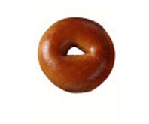
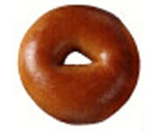
BAGEL
20 Years Ago
Today
140 calories
3-inch diameter
How many calories
are in this bagel?

Slide 3
BAGEL
20 Years Ago
Today
140 calories
3-inch diameter
350 calories
6-inch diameter
Calorie Difference: 210 calories

Slide 4

Maintaining a Healthy Weight is a Balancing Act
Calories In = Calories Out
How long will you have to rake leaves in order to burn the extra 210 calories?*
*Based on 130-pound person

Slide 5

Calories In = Calories Out
If you rake the leaves for 50 minutes you will burn the extra 210 calories.*
*Based on 130-pound person

Slide 6
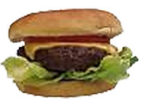
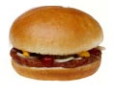
CHEESEBURGER
20 Years Ago
Today
333 calories
How many calories are in today’s cheeseburger?

Slide 7
CHEESEBURGER
20 Years Ago
Today
333 calories
590 calories
Calorie Difference: 257 calories

Slide 8
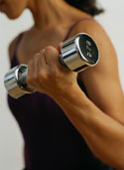
Maintaining a Healthy Weight is a Balancing Act
Calories In = Calories Out
How long will you have to lift weights in order to burn the extra 257 calories?*
*Based on 130-pound person

Slide 9
Calories In = Calories Out
If you lift weights for 1 hour and 30 minutes,
you will burn approximately 257 calories.*
*Based on 130-pound person

Slide 10
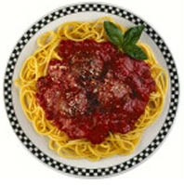
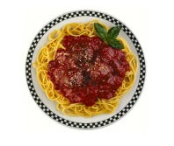
SPAGHETTI AND MEATBALLS
20 Years Ago
Today
500 calories
1 cup spaghetti with sauce and 3 small meatballs
How many calories do you think are in today's portion of spaghetti and meatballs?

Slide 11
SPAGHETTI AND MEATBALLS
20 Years Ago
Today
500 calories
1 cup spaghetti with sauce and 3 small meatballs
1,025 calories
2 cups of pasta with sauce and 3 large meatballs
Calorie Difference: 525 calories

Slide 12
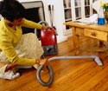
Maintaining a Healthy Weight is a Balancing Act
Calories In = Calories Out
How long will you have to houseclean in order to burn the extra 525 calories?*
*Based on 130-pound person

Slide 13
Calories In = Calories Out
If you houseclean for 2 hours and 35 minutes,
you will burn approximately 525 calories.*
*Based on 130-pound person

Slide 14

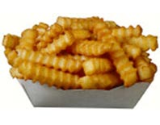
FRENCH FRIES
20 Years Ago
Today
210 Calories
2.4 ounces
How many calories are in
today’s portion of fries?

Slide 15
FRENCH FRIES
20 Years Ago
Today
210 Calories
2.4 ounces
610 Calories
6.9 ounces
Calorie Difference: 400 Calories

Slide 16
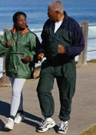

Maintaining a Healthy Weight is a Balancing Act
Calories In = Calories Out
How long will you have to walk leisurely in order to burn those extra 400 calories?*
*Based on 160-pound person

Slide 17
Calories In = Calories Out
If you walk leisurely for 1 hour and 10 minutes
you will burn approximately 400 calories.*
*Based on 160-pound person

Slide 18
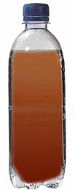

SODA
20 Years Ago
Today
85 Calories
6.5 ounces
How many calories are in today’s portion?

Slide 19
SODA
20 Years Ago
Today
85 Calories
6.5 ounces
250 Calories
20 ounces
Calorie Difference: 165 Calories

Slide 20
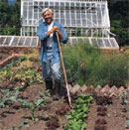
Maintaining a Healthy Weight is a Balancing Act
Calories In = Calories Out
How long will you have to work in the garden to burn those extra calories?*
*Based on 160-pound person

Slide 21
Calories In = Calories Out
If you work in the garden for 35 minutes,
you will burn approximately 165 calories.*
*Based on 160-pound person

Slide 22
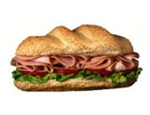
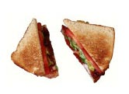
TURKEY SANDWICH
20 Years Ago
Today
320 calories
How many calories are in today’s turkey sandwich?

Slide 23
TURKEY SANDWICH
20 Years Ago
Today
320 calories
820 calories
Calorie Difference: 500 calories

Slide 24
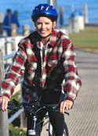
Maintaining a Healthy Weight is a Balancing Act
Calories In = Calories Out
How long will you have to ride a bike in order to burn those extra calories?*
*Based on 160-pound person

Slide 25
Calories In = Calories Out
If you ride a bike for 1 hour and 25 minutes,
you will burn approximately 500 calories.*
*Based on 160-pound person

Slide 26

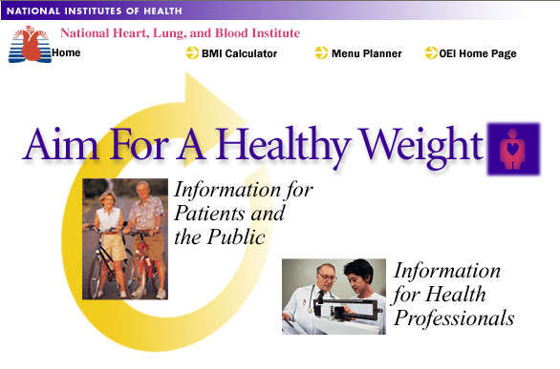
Thank you for participating in
Portion Distortion!
For more information about Maintaining a Healthy Weight
visit www.nhlbi.nih.gov

