Slide 1
Do You Know How Food Portions Have Changed in 20 Years?
National Heart, Lung, and Blood Institute
Obesity Education Initiative

Slide 2
COFFEE
20 Years Ago
Coffee (with whole milk and sugar)
Today
Mocha Coffee (with steamed whole milk and mocha syrup)
45 calories
8 ounces
How many calories
are in today's coffee?

Slide 3
COFFEE
20 Years Ago
Coffee (with whole milk and sugar)
Today
Mocha Coffee (with steamed whole milk and mocha syrup)
45 calories
8 ounces
350 calories
16 ounces
Calorie Difference: 305 calories

Slide 4
Maintaining a Healthy Weight is a Balancing Act
Calories In = Calories Out
How long will you have to walk in order to burn those extra 305 calories?*
*Based on 130-pound person

Slide 5
Calories In = Calories Out
If you walk 1 hour and 20 minutes, you will burn approximately 305 calories.*
*Based on 130-pound person

Slide 6
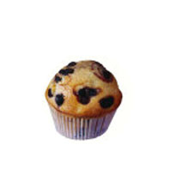
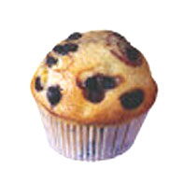
MUFFIN
20 Years Ago
Today
210 calories
1.5 ounces
How many calories are in today’s muffin?

Slide 7
MUFFIN
20 Years Ago
Today
210 calories
1.5 ounces
500 calories
4 ounces
Calorie Difference: 290 calories

Slide 8
Maintaining a Healthy Weight is a Balancing Act
Calories In = Calories Out
How long will you have to vacuum in order to burn those extra 290 calories?*
*Based on 130-pound person

Slide 9
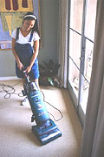
Calories In = Calories Out
If you vacuum for 1 hour and 30 minutes you will burn approximately 290 calories.*
*Based on 130-pound person

Slide 10
PEPPERONI PIZZA
20 Years Ago
Today
500 calories
How many calories are in two large slices of today’s pizza?

Slide 11
PEPPERONI PIZZA
20 Years Ago
Today
500 calories
850 calories
Calorie Difference: 350 calories

Slide 12
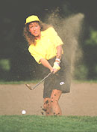
Maintaining a Healthy Weight is a Balancing Act
Calories In = Calories Out
How long will you have to play golf (while walking and carrying your clubs) in order to burn those extra 350 calories?*
*Based on 160-pound person

Slide 13
Calories In = Calories Out
If you play golf (while walking and carrying your clubs) for 1 hour you will burn approximately 350 calories.*
*Based on 160-pound person

Slide 14
CHICKEN CAESAR SALAD
20 Years Ago
Today
390 calories
1 ½ cups
How many calories are in today’s chicken Caesar salad?

Slide 15
CHICKEN CAESAR SALAD
20 Years Ago
Today
390 calories
1 ½ cups
790 calories
3 ½ cups
Calorie Difference: 400 calories

Slide 16
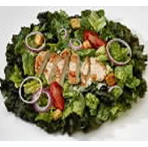
Maintaining a Healthy Weight is a Balancing Act
Calories In = Calories Out
How long will you have to walk the dog in order to burn those extra 400 calories?*
*Based on 160-pound person

Slide 17
Calories In = Calories Out
If you walk the dog for 1 hour and 20 minutes, you will burn approximately 400 calories.*
*Based on 160-pound person

Slide 18
POPCORN
20 Years Ago
Today
270 calories
5 cups
How many calories
are in today’s large
popcorn?

Slide 19
POPCORN
20 Years Ago
Today
270 calories
5 cups
630 calories 11 cups
Calorie Difference: 360 calories

Slide 20
Maintaining a Healthy Weight is a Balancing Act
Calories In = Calories Out
How long will you have to do water aerobics in order to burn the extra 360 calories?*
*Based on 160-pound person

Slide 21
Calories In = Calories Out
If you do water aerobics for 1 hour and 15 minutes you will burn approximately 360 calories.*
*Based on 160-pound person

Slide 22
CHEESECAKE
20 Years Ago
Today
260 calories
3 ounces
How many calories are in
today’s large portion of
cheesecake?

Slide 23
CHEESECAKE
20 Years Ago
Today
260 calories
3 ounces
640 calories
7 ounces
Calorie Difference: 380 calories

Slide 24
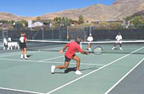
Maintaining a Healthy Weight is a Balancing Act
Calories In = Calories Out
How long will you have to play tennis in order to burn those extra 380 calories?*
*Based on 130-pound person

Slide 25
Calories In = Calories Out
If you play tennis for 55 minutes you will burn approximately 380 calories.*
*Based on 130-pound person

Slide 26
CHOCOLATE CHIP COOKIE
20 Years Ago
Today
55 calories
1.5 inch diameter
How many calories are in today’s large cookie?

Slide 27
CHOCOLATE CHIP COOKIE
20 Years Ago
Today
55 calories
1.5 inch diameter
275 calories
3.5 inch diameter
Calorie Difference: 220 calories

Slide 28
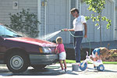
Maintaining a Healthy Weight is a Balancing Act
Calories In = Calories Out
How long will you have to wash the car to burn those extra 220 calories?*
*Based on 130-pound person

Slide 29
Calories In = Calories Out
If you wash the car for 1 hour and 15 minutes you will burn approximately 220 calories.*
*Based on 130-pound person

Slide 30
CHICKEN STIR FRY
20 Years Ago
Today
435 calories
2 cups
How many calories are in today’s chicken stir fry?

Slide 31
CHICKEN STIR FRY
20 Years Ago
Today
435 calories
2 cups
865 calories
4 ½ cups
Calorie Difference: 430 calories

Slide 32
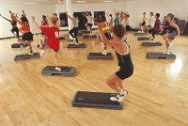
Maintaining a Healthy Weight is a Balancing Act
Calories In = Calories Out
How long will you have to do aerobic dance to burn those extra 430 calories?*
*Based on 130-pound person

Slide 33
Calories In = Calories Out
If you do aerobic dance for 1 hour and 5 minutes you will burn approximately 430 calories.*
*Based on 130-pound person

Slide 34
Thank you for participating in
Portion Distortion II!
For more information about Maintaining a Healthy Weight
visit www.nhlbi.nih.gov

