Slide 1
Positive Guidance is the Key

Slide 3
Positive Guidance
  Children often misbehave for attention
  A few terms to remember:
    consistency
    discipline
    example
    self-discipline
Notes:
Refer to word wall for term definition. Ask students to give examples of a time when they misbehaved and how their parents handled the situation. What it a positive or negative?

Slide 4
Positive Statements
  Clearly state what is expected; it helps the child to get started
  Phrase all requests in a positive manner
Notes:
Example: Say, “Let’s walk to the blocks.” instead of “Don’t run to the blocks.”

Slide 5
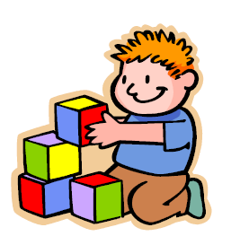
Redirection
  Redirection gets the child to focus on something else
Notes:
If a child gets angry in the block center, lead her/him to a different center and introduce a new activity

Slide 6
Limited Choices
  Do not give a child unlimited choices
  Only give choices that are available
Notes:
Ask, “Would you like water or milk” instead of “What do you want to drink?”

Slide 7
Time Out
  Should be a place with no distractions
  Should be a last option with limited use
  Should help eliminate yelling/screaming on part of parents
Notes:
Time in time out should be in relation to child’s age. A 3 year old should spend no more than 3 minutes in time out

Slide 8
Resources
  Website:
    Child Development Institute Useful information on positive parenting guidance.
    http://www.childdevelopmentinfo.com/parenting/

