Slide 1
Preparing for YOUR FUTURE!
  Education and Training Career Cluster

Slide 3

My Future
  What plans do you have?
Notes:
What do you want to do want to do after high school? Do you have plans to go to college, or straight to work?

Slide 4

College Statistics
  50 – 70 percent of students change their majors at least one time
  Most students change majors at least three times before graduation
Notes:
According to The University of La Verne 50 – 70 percent of students change their majors at least one time during college and most students change their major at least three times before graduation.
Why do you think this occurs?
According to a study conducted by National Association of Colleges and Employers (NACE), 66% of students choose their major based on a career in which they are interested, 12% say they “drifted” into a major, 9% say they were inspired by a particular teacher or professor, 7% chose a major based on earning potential and 6% say they were influenced by friends and family.

Slide 5

Why Do I Care?
  Why should I begin planning now for my future?
Notes:
So as a high school freshman, why should you care about your future after high school, if statistics show you will most likely change your major?
Allow for student discussion of the question.

Slide 6

Benefits of Planning
  Begin doing what you love
  Cost effective
  Graduate on time
  Qualify for grants and scholarships
Notes:
The answer to the question, “Why should I plan now if chances are I will change my major anyhow in college?” is simple. Creating a plan in high school and weighing your options allows you to pick the college major or career choice you are truly interested in. Exploring your options during high school allows you to save both time and money while in college because you are able to graduate on time and not spend extra time, and thus extra money, in school. Preparing during high school can also help you qualify for free money – grants and scholarships – for college. Grants and scholarships may also be obtained by being involved in career and technical student organizations (CTSOs), maintaining good grades and involving yourself in community service. Last, but not least, you are able to begin a career doing what you are passionate about immediately!
If you are interested in a career in education, continue taking courses in this pathway. With careful planning, it can lead you to the road of being an educator.

Slide 7
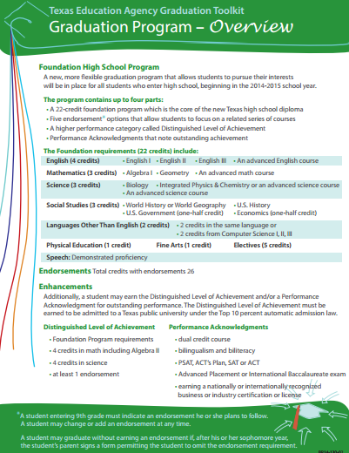

Texas Graduation Program
Notes:
Teacher note: Click on the picture and once you are on the website, you will find the Graduation Program – Overview on page 3.
The Texas Education Agency (TEA) has identified the following courses to be required by all Texas public high school graduates on the recommended plan. The Foundation High School Program is the basic 22-credit graduation program for Texas public school students.
Even though these are the required courses set forth by the TEA, you can choose which courses are geared toward your post high school plans. For example, if you are interested in teaching English courses, you might consider taking advanced level English courses during high school to prepare yourself for college level courses in literature.
Texas Education Agency
Graduation Toolkit - Information for Planning Your High School Years and Beyond
http://www.depts.ttu.edu/ttuisd/Files/pdf/14Grad-toolkit-booklet.pdf

Slide 8
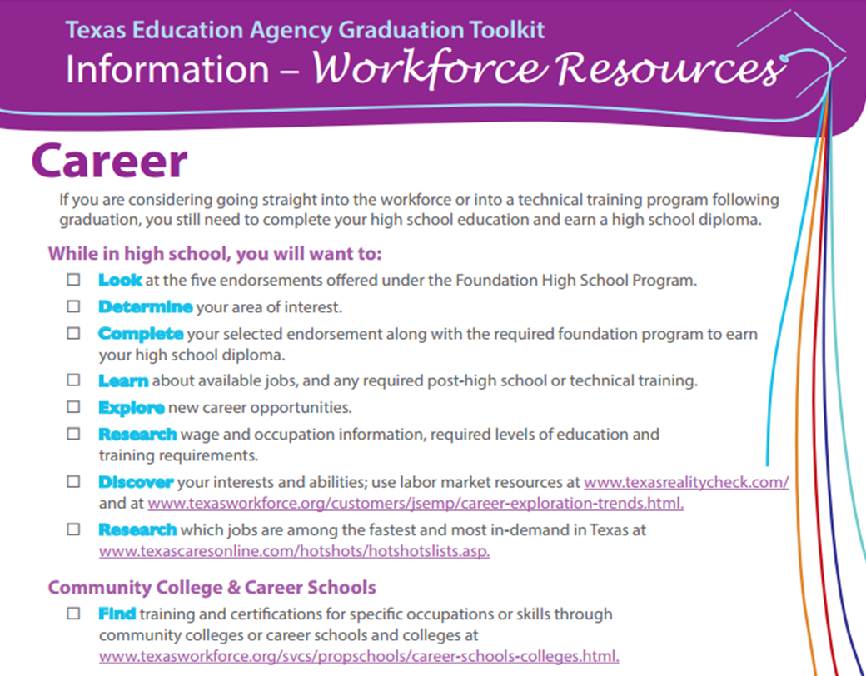
Planning for Your Future
Notes:
Teacher note: Read and discuss the information on the slide. You may opt to visit the websites on the slide for additional resources and information.
Texas Education Agency (TEA)
TEA Graduation Toolkit: Information for Planning Your High School Years and Beyond.
http://www.depts.ttu.edu/ttuisd/Files/pdf/14Grad-toolkit-booklet.pdf

Slide 9
Choosing the Right Courses
  Advanced Placement (AP)
  Appropriate core courses
  Career and Technical Education (CTE)
  Dual credit
  Early college
  Electives
  Relevance
  Rigor
Notes:
As you plan out your next three year in high school, make a plan with the future in mind. Choose courses that display rigor, meaning classes that are challenging to you. Yes, it is easy to choose courses that are “easy” and may be a “GPA boost”, but these courses will not challenge and prepare you for life beyond high school. Next, consider the relevance of each course you select – what do you hope to gain from the course? How will it benefit you in your future career plans?
Courses that will provide you with rigor and relevance are Advanced Placement (AP), dual credit and early college courses. Taking part in these courses can help prepare you for college by giving you college credits while still enrolled in high school.
As you choose your core courses, choose them with your career in mind. You will most likely get the most career exploration from your career and technical (CTE) and elective courses because these are the courses that allow you to try out new careers. In Education and Training, you will be able to work with children side-by-side a mentor teacher and determine if teaching is truly for you. Choose electives that will benefit you during this journey.

Slide 10
Career and Technical Education (CTE) Courses
  Principles of Education and Training
  Human Growth and Development
  Instructional Practices in Education and Training
  Practicum in Education and Training
Notes:
In the Education and Training career cluster there are four courses designed to help you prepare for a career in the teaching field. Each course builds on the previous creating a foundation of knowledge for you as a future teacher, principal, counselor or educational support staff. As you go throughout your CTE courses, take vigorous notes on the different careers you explore. Ask yourself questions such as, “Is this career the right one for me?”
CTE courses also provide you with career training while in high school to help prepare you for the future. Some courses even provide you with a certificate after course completion, such as a CPR/First Aid certificate.

Slide 11

Additional CTE Electives
  Recommended sequence will depend on decisions made by each district.
    Child Development
    Dollars and Sense
    Lifetime Nutrition and Wellness
Notes:
Additional CTE electives contribute to the foundation of knowledge you will learn during your CTE courses. Explore the courses your school has to offer. Ask counselors, teachers and other students about the curriculum and sign up for courses that will benefit you in your journey in the education field. If interested in Early Childhood Education, Child Development is a beneficial course to education students because it teaches the foundations of how children interact, why they behave the way they do and how teachers can best educate them.
Dollars and Sense focuses on consumer practices and responsibilities, the money management process, decision- making skills, impact of technology, and preparation for human services careers.
Lifetime Nutrition and Wellness teaches the importance of a healthful lifestyle. Future educators can benefit from this course by learning how the body responds to food, fitness and adolescence.
Teachers: Pass out copies of your student course selection guides, or teach students how to access the guide online. Allow students to explore the courses that are offered on your campus.

Slide 12

A Look at the Future
  Compare and contrast plans for the future.
    Education
    Jobs
    Training
Notes:
While you are still in high school, it is a great idea to begin exploring your options for the future.
What will you do after high school? Will you go straight to work, or will you begin some type of training or educational program?

Slide 13

What are your postsecondary educational options?
Notes:
Postsecondary educational options can include:
Apprenticeship
Four-year college/university
Technical school
Two-year community college
What is an apprenticeship? Apprenticeship is a combination of on-the-job training and related instruction in which workers learn the practical and theoretical aspects of a highly skilled occupation. Apprenticeship programs can be sponsored by individual employers, joint employer and labor groups, and/or employer associations.

Slide 14
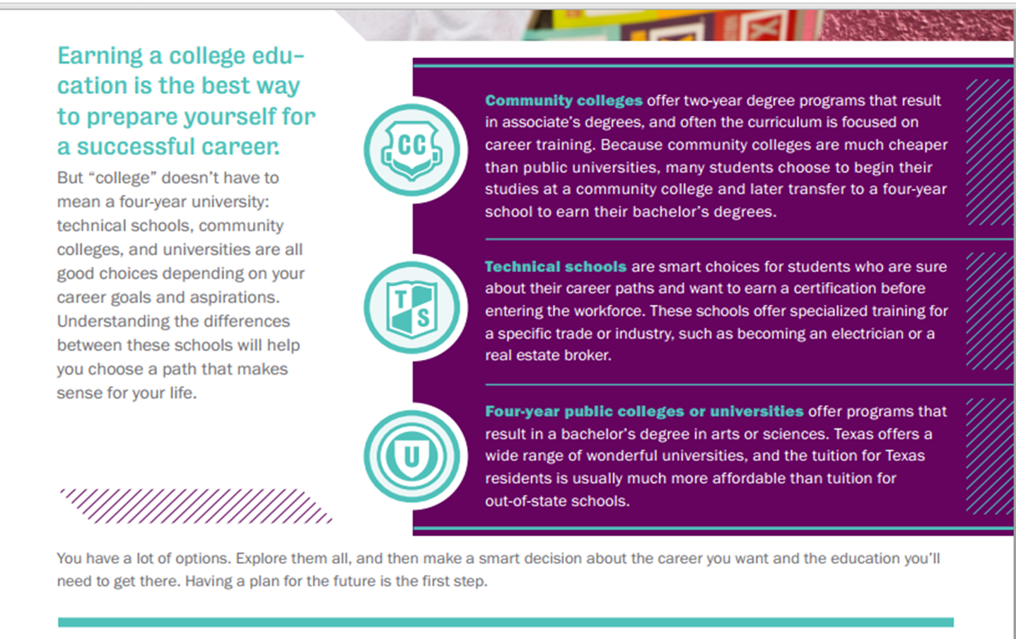
Postsecondary Educational Options
Notes:
Postsecondary programs include:
Community colleges that offer associate degrees and credits that transfer to universities.
Technical Schools that provide skill development and certifications or licenses.
Universities that provide education for bachelor degrees and advanced studies for masters and doctoral degrees.
Online programs are increasingly available for all or part of the requirements for degrees.
Most public school teachers need to have a bachelor’s degree from an accredited university and successful completion of licensing exams.
Generation TX
College Planning Guide.
http://gentx.org/wp-content/uploads/2012/06/GenTX_CollegePlanningGuide.pdf

Slide 15


Technical School or Community College
Notes:
Consider a technical school or community college
Helpful info from NextStepU.com about attending a technical school or community college after high school.
http://youtu.be/DbnOqvovHiE

Slide 16
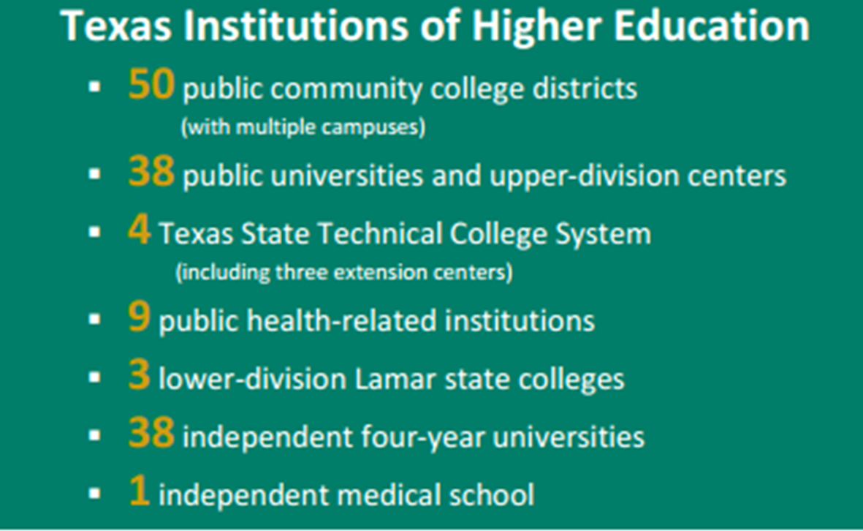
Texas Institutions of Higher Education
Notes:
As a Texas resident, you have an abundance of educational options. Texas has increased total enrollments in higher education by more than 537,000 students since 2000. During this time, enrollments for Hispanics and African Americans have doubled.
Texas Higher Education Coordinating Board
Closing the Gaps by 2015 was adopted by the Texas Higher Education Coordinating Board in 2000 to focus state policy on the goal of creating parity in educational attainment and quality between Texas and peer states like California, New York and Massachusetts.
http://www.thecb.state.tx.us/reports/PDF/3052.PDF?CFID=20983454&CFTOKEN=40957335

Slide 17
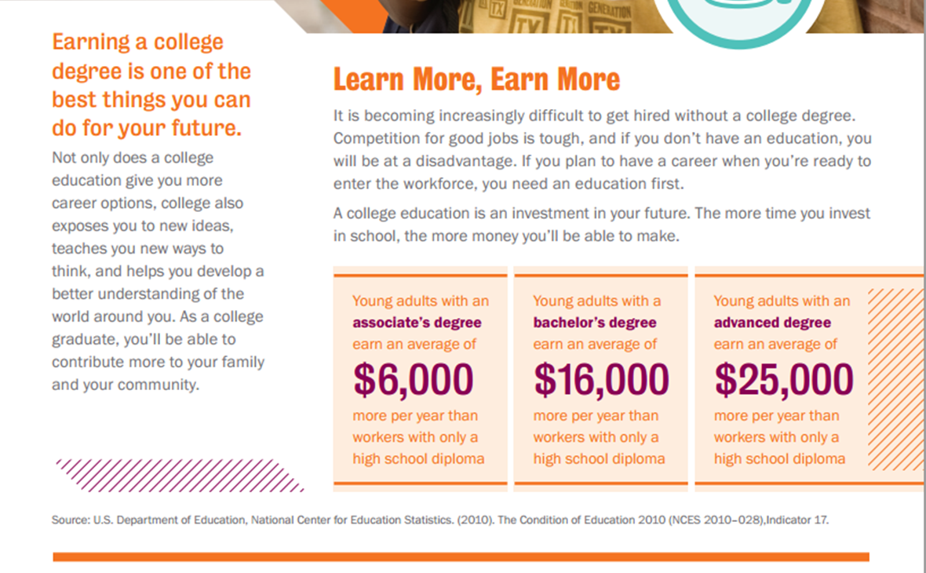
Learn More, Earn More
Notes:
Do you want to earn $6000.00 or $25,000.00 more per year than workers with only a high school diploma?

Slide 18
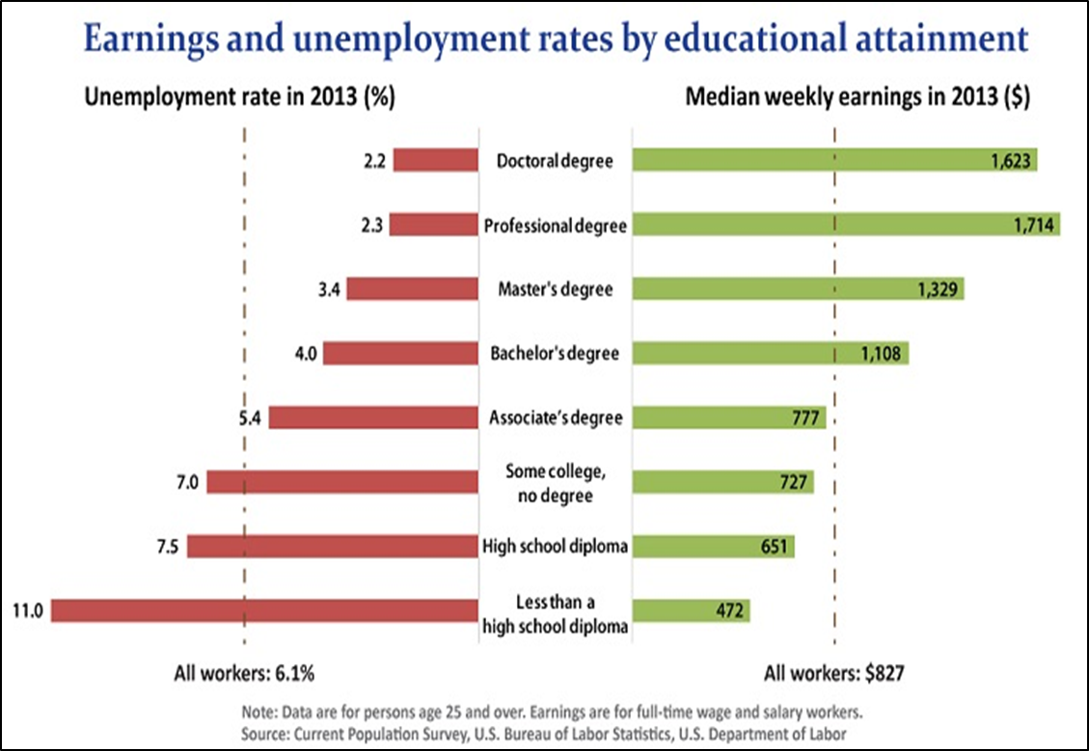
Statistics
Notes:
The Bureau of Labor Statistics said there is a direct link between the amount (and lack thereof) of education to the median salary earned and unemployment rates. Knowing this in mind, it is imperative to receive some type of education after high school.

Slide 19

Steps to Get Started

Slide 20

Learning About Yourself
  Assessing your personal factors:
    Abilities
    Aptitudes
    Goals
    Interests
    Likes and dislikes
    Personality traits
    Values
Notes:
Dreams are great. Goals are important. But, putting the plan into writing is the best way to help you sort through all of the information, your interests, abilities, required classes, electives, extracurricular activities, work, service learning and other factors to find the path to the best career.
What are your abilities? Abilities are skills that you learn and develop. Everyone has certain abilities due to training, practice and knowledge. What skills do you have that would help you succeed after graduating from high school?
What are your aptitudes? Aptitudes are your natural talents. Do you bake well? Play an instrument? Work well with children? Are a technology wizard?
What are your goals? What are your work-related goals?
What things are you really interested in?
Do you know your likes and dislikes?
What are your positive personality traits? Negative?
What are your values?
Why should your personal factors be considered when planning for your future? Taking time to assess your personal factors will help you achieve better success in life and in finding your ideal career.

Slide 21

What Career Should I Choose?
Notes:
What Career Should I Choose?
Choosing a career can be a big decision for sure. In order to get it right you need to answer these three important questions.
http://youtu.be/AgyjmO9h-6k

Slide 22

What is a career portfolio?
Notes:
What is a career portfolio? When should you start your career portfolio?
A career portfolio gives you a visual and tangible way to represent your credentials, skills, and achievements.

Slide 23
Your Career Portfolio
  Port means that a person’s credentials are portable and transportable:
    Convenient and manageable
    Experience, interests, achievements, goals and capabilities
  Folio means a packaging of one’s credentials through photographs:
    Reproduced evidence, work samples, videos, audio and other formats
Notes:
Port means that a person’s credentials are portable, transportable, convenient and manageable. They provide an image or picture of one’s experience, interests, achievements, goals and capabilities.
Folio means a packaging of one’s credentials through photographs, reproduced evidence, work samples, videos, audio and other formats.
Your career portfolio is a selling tool for you! A portfolio is always changing and evolving. What does this mean?
Note to teacher: Show the students a sample career portfolio you have and discuss its contents. You can briefly introduce the components of a career portfolio at this time.

Slide 24
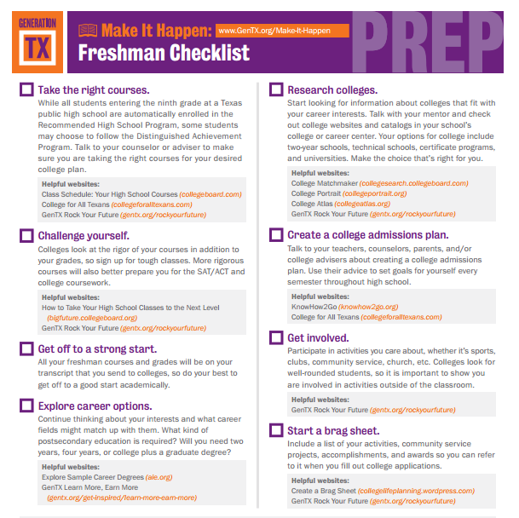

Freshman Checklist
Notes:
This checklist will help you navigate the process and prepare yourself for college and a career. Discuss each component of the checklist.
Take the right courses
Challenge yourself
Get off to a strong start
Explore career options
Research colleges
Create a college admission plan
Get involved
Start a brag sheet
Teacher note: You can download a PDF copy and distribute to the freshman. You may also download checklists for sophomore, junior and senior students at http://gentx.org/make-it-happen/sophomore-prep-checklist/
Generation TX
Whether you choose a four-year university, a community college, or a career college, you’ll have to do some legwork to make your goal a reality. You don’t have to figure it out all alone though.
http://gentx.org/wp-content/uploads/2012/08/04_Freshman_Prep_Checklist.pdf

Slide 25


AchieveTexas
Notes:
AchieveTexas is an invaluable tool for teachers to showcase careers in the sixteen career clusters. You can contact Karen Alexander for additional information and resources or visit:
AchieveTexas
AchieveTexas College and Career Initiative is an education initiative designed to prepare students for a lifetime of success. It allows students to achieve excellence by preparing them for secondary and postsecondary opportunities, career preparation and advancement, meaningful work, and active citizenship.
http://www.achievetexas.org/

Slide 26


Slide 27
References and Resources
  Images:
    Photos obtained through a license with Shutterstock.com™. (slides 3, 4, 5, 6, 11, 12, 13, 15, 19, 21, 21, 22 and 26)
  Textbooks:
    Diaz, C., Pelletier, C. & Provenzo, Jr., E. (2006). Touch the future: teaching! Boston, MA: Pearson Education, Inc.
    Kauchak, D. & Eggen, P. (2014). Introduction to teaching: becoming a professional. (Fifth ed.). Saddle River, NJ: Pearson Education, Inc.
    Morrison, G. (2012). Early childhood education today. (Twelfth ed.). Upper Saddle River, NJ: Pearson Education, Inc.
  Websites:
    Bureau of Labor Statistics
    Employment Projections. (2014).
    http://www.bls.gov/emp/ep_chart_001.htm

Slide 28
References and Resources
    FastWeb
    Find colleges, universities, scholarships and more at FastWeb.
    http://www.fastweb.com
    Finding Your College Fit
    Find the right college for you by doing a college search at Big Future.
    https://bigfuture.collegeboard.org/find-colleges/how-find-your-college-fit
    Generation TX
    College Planning Guide.
    http://gentx.org/wp-content/uploads/2012/06/GenTX_CollegePlanningGuide.pdf
  Websites:
    Generation TX
    Whether you choose a four-year university, a community college, or a career college, you’ll have to do some legwork to make your goal a reality. You don’t have to figure it out all alone though.

Slide 29
References and Resources
    http://gentx.org/wp-content/uploads/2012/08/04_Freshman_Prep_Checklist.pdf
    Ten Steps to Picking the Right College
    U.S. News details ten steps to guide students to picking the right college.
    http://www.usnews.com/education/best-colleges/articles/2011/04/04/10-steps-to-picking-the-right-college
    Texas Education Agency (TEA)
    TEA Graduation Toolkit: Information for Planning Your High School Years and Beyond.
    http://www.depts.ttu.edu/ttuisd/Files/pdf/14Grad-toolkit-booklet.pdf
    Texas Higher Education Coordinating Board
    Closing the Gaps by 2015 was adopted by the Texas Higher Education Coordinating Board in 2000 to focus state policy on the goal of creating parity in educational attainment and quality between Texas and peer states like California, New York and Massachusetts.
    http://www.thecb.state.tx.us/reports/PDF/3052.PDF?CFID=20983454&CFTOKEN=40957335

