Slide 1
Preventing Infections in the Salon Environment
  Cosmetology I, Cosmetology II

Slide 3
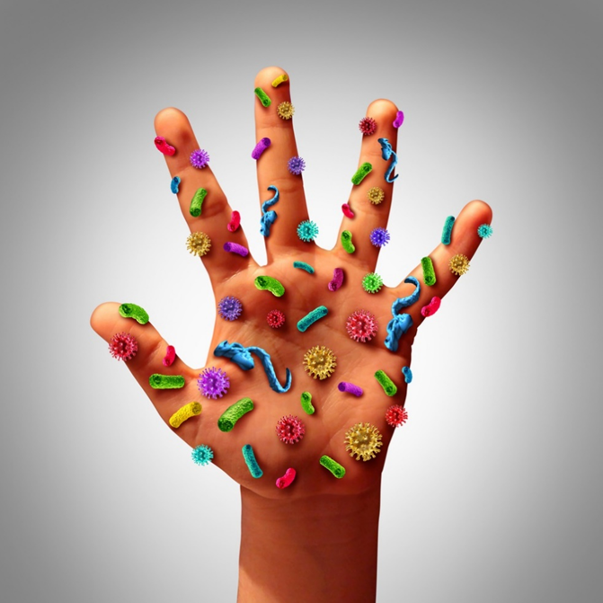
What is an Infection?
  The invasion of body tissues by disease-causing pathogens
Notes:
In the salon environment, infections can be a problem if proper procedures are not followed.
It is up to you to prevent infections in the salon.

Slide 4
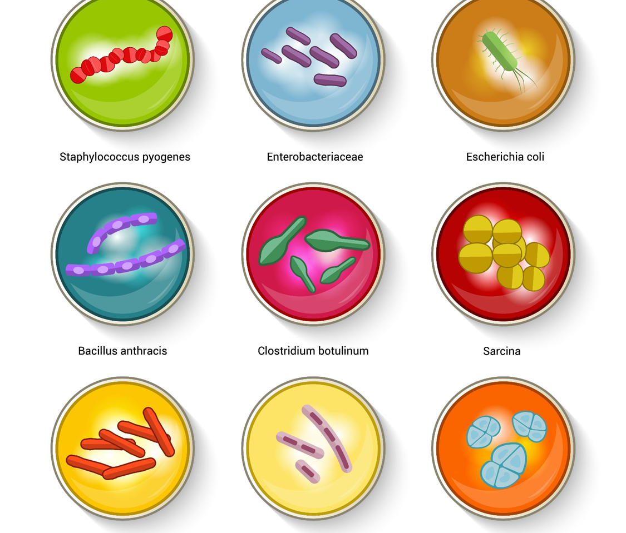
Types and Classifications of Bacteria
  Bacteria and Viruses
Notes:
Infections can be transferred through salon tools that have been contaminated and not properly disinfected.

Slide 5
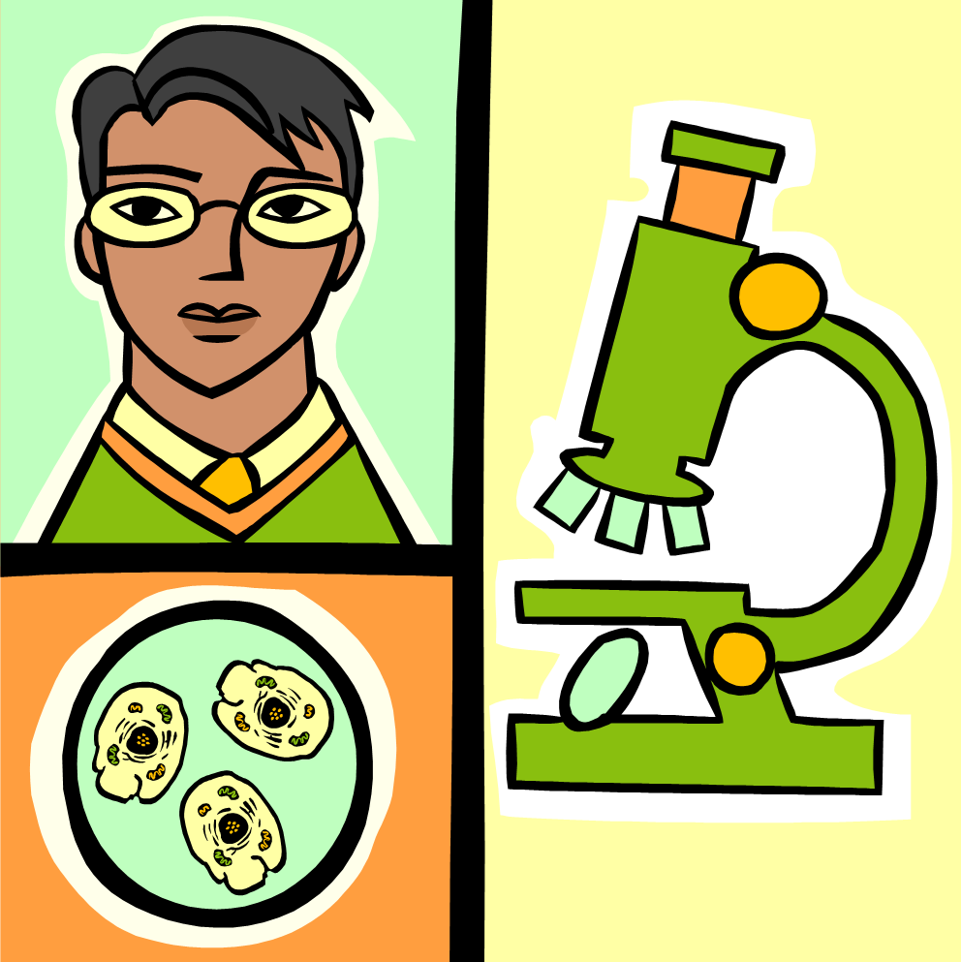
Bacteria
  One celled microorganisms that have both plant and animal characteristics
  Microscopic in size
  Can exist almost anywhere
Notes:
Bacteria can exist on skin, in water, in the air, in decayed matter, on environmental surfaces, in body secretions, on clothing or under the free edge of nails.

Slide 6
Types of Bacteria
  Nonpathogenic
    Harmless bacteria
      Yogurt, cheese, medicines
  Pathogenic
    Harmful bacteria
    Cocci
    Staphylococci
    Streptococci
    Diplococci
    Bacilli
    Spirilla
Notes:
Nonpathogenic: Helpful or harmless bacteria that perform useful functions such as decomposing refuse and improving soil fertility. They help metabolize food, protect against microorganisms and stimulate immune response.
Pathogenic: Harmful and disease producing when they invade plant or animal tissue.
Cocci: Round-shaped bacteria that appear singly (alone) or in groups:
– Staphylococci: Pus-forming bacteria that grow in clusters like grapes; cause abscesses, pustules, and boils.
– Streptococci: Pus-forming bacteria arranged in curved lines resembling a string of beads; cause infections such as strep throat and blood poisoning.
– Diplococci: Spherical bacteria that grow in pairs and cause diseases such as pneumonia.
Bacilli: Short, rod-shaped bacteria. They are the most common bacteria and produce diseases such as tetanus (lockjaw), typhoid fever, tuberculosis, and diphtheria.
Spirilla: Spiral or corkscrew-shaped bacteria. They are divided into subgroups: Treponema pallidum, which causes syphilis (a sexually transmitted disease - STD); or Borrelia burgdorferi, which causes Lyme disease.
We will learn more about these later in the lesson.

Slide 7
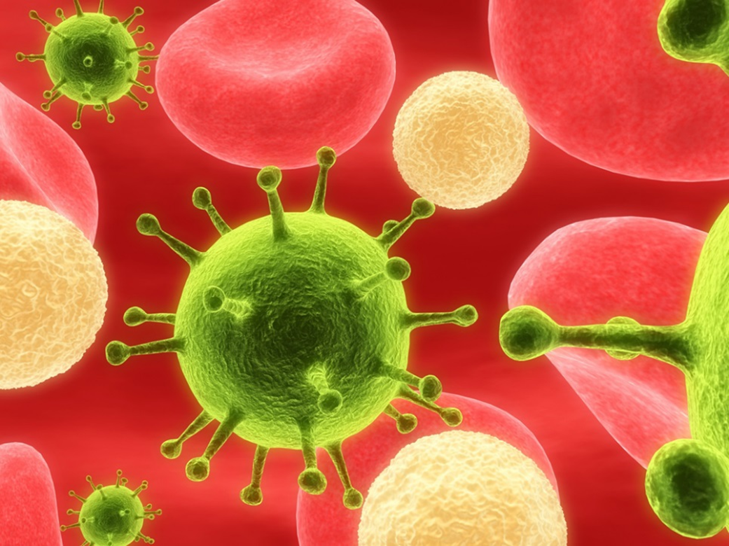
Viruses
  Live by penetrating and taking over cells
  Resistant to antibiotics
  Some vaccines are available
  Common virus in salons
  HPV-Human Papilloma Virus
Notes:
A virus is a parasitic submicroscopic particle that infects and resides in the cells of a biological organism; capable of replication only by taking over the host cell’s reproductive function; cannot reproduce without a host cell; hard to kill; antibiotics do not affect them; some vaccines are available.
A common viral infection often seen in salons is the Human Papilloma Virus (HPV), also known as plantar warts. This virus is difficult to kill and usually infects the bottom of the foot resembling small black dots clustered in groups. HPV is highly contagious and can be passed from pedicure client to pedicure client by dirty implements and foot baths. Refer this client to a physician before performing services.

Slide 8

Hepatitis and AIDS
  Bloodborne Pathogens
Notes:
Bloodborne pathogens are disease-causing microorganisms that are carried through the body in the blood or body fluids.

Slide 9
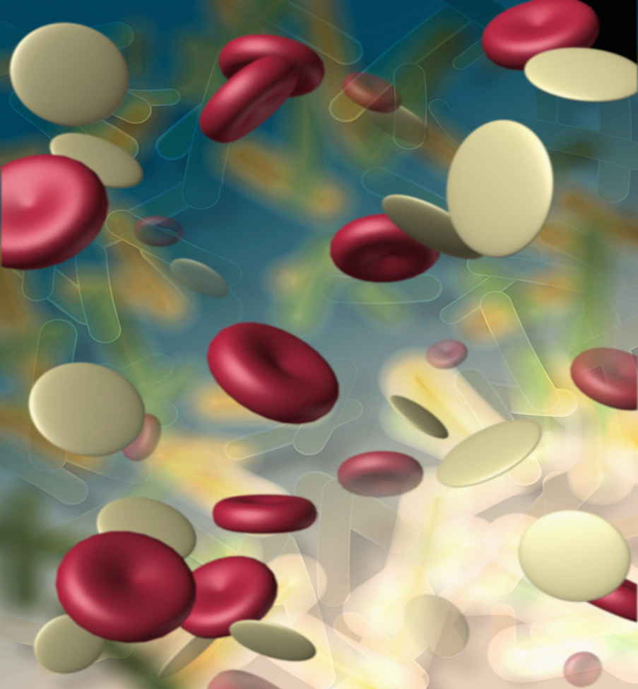
Bloodborne Pathogens
  Carried in the body by blood or body fluids
    Hepatitis A
    Hepatitis B
    Hepatitis C
    Human Immunodeficiency Virus (HIV)
Notes:
Hepatitis and HIV are bloodborne pathogens.
Hepatitis - Disease marked by inflammation of the liver and caused by a bloodborne virus similar to HIV/AIDS in transmission. It is present in the body fluids of an infected individual.
Hepatitis A, B and C are of concern to a salon.
Human Immunodeficiency Virus (HIV) - the virus that causes AIDS (Acquired Immune Deficiency Syndrome). AIDS breaks down the body’s immune system. Passed through blood and body fluids.

Slide 10
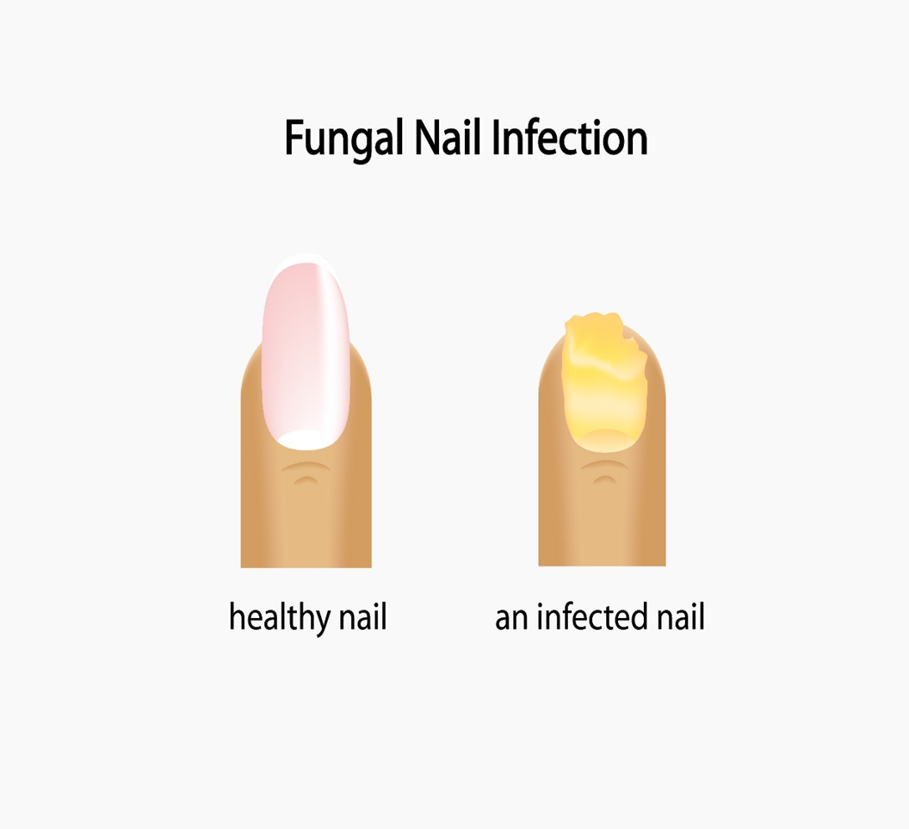
Fungi
  Microscopic plant parasites that include molds, mildews and yeasts
    Tinea barbae
      (barber’s itch)
    Tinea capitis
    Tinea pedis
Notes:
Fungi can produce contagious diseases such as ringworm.
Tinea barbae- a superficial fungal infection that commonly affects the bearded areas of the face, neck, or around the scalp. Most common in older males.
Tinea capitis- fungal infection of the scalp characterized by red papules, or spots, at the opening of the hair follicles.
Tinea pedis- ringworm infection of the foot. More common on feet than hands.

Slide 11
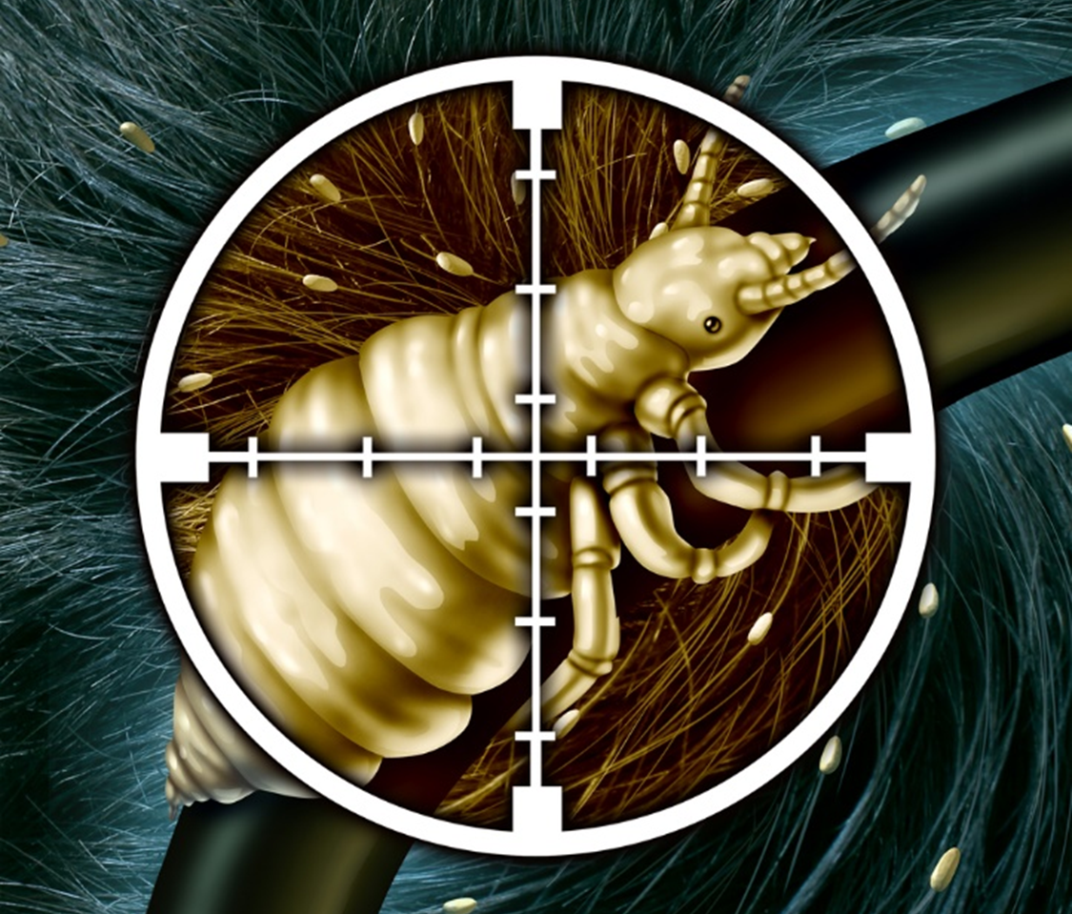
Vegetable and Animal Parasites
Notes:
Parasites are organisms that grow, feed, and shelter on or in another organism, while contributing nothing to the survival of that organism.
They can live inside humans and animals.
They are also found in food, on plants, trees and in water.
External parasites include ticks, fleas and mites.

Slide 12
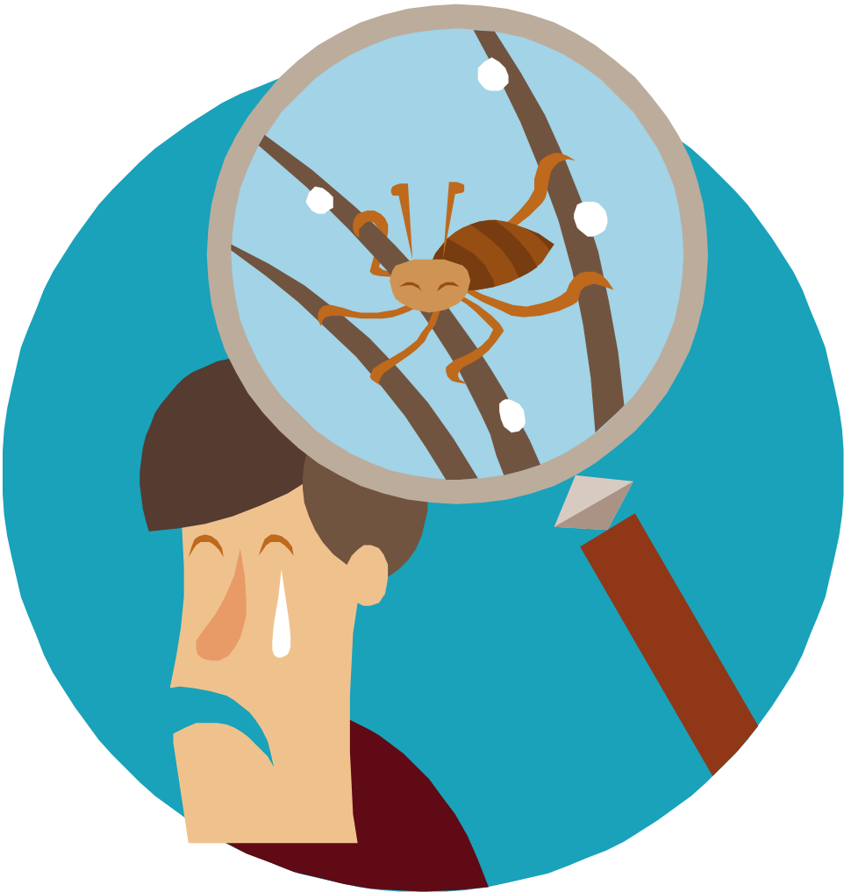
Parasites
  Organisms that need a host to survive
  Can live on or inside of humans and animals
    Pediculosis capitis (head lice)
    Scabies (itch mite)
    Both contagious
Notes:
Head lice are a type of parasite and are contagious.
Scabies are caused by the itch mite which burrows under the skin.
Clients with parasitic infections should not be serviced in the salon. They should be referred to a physician.

Slide 13
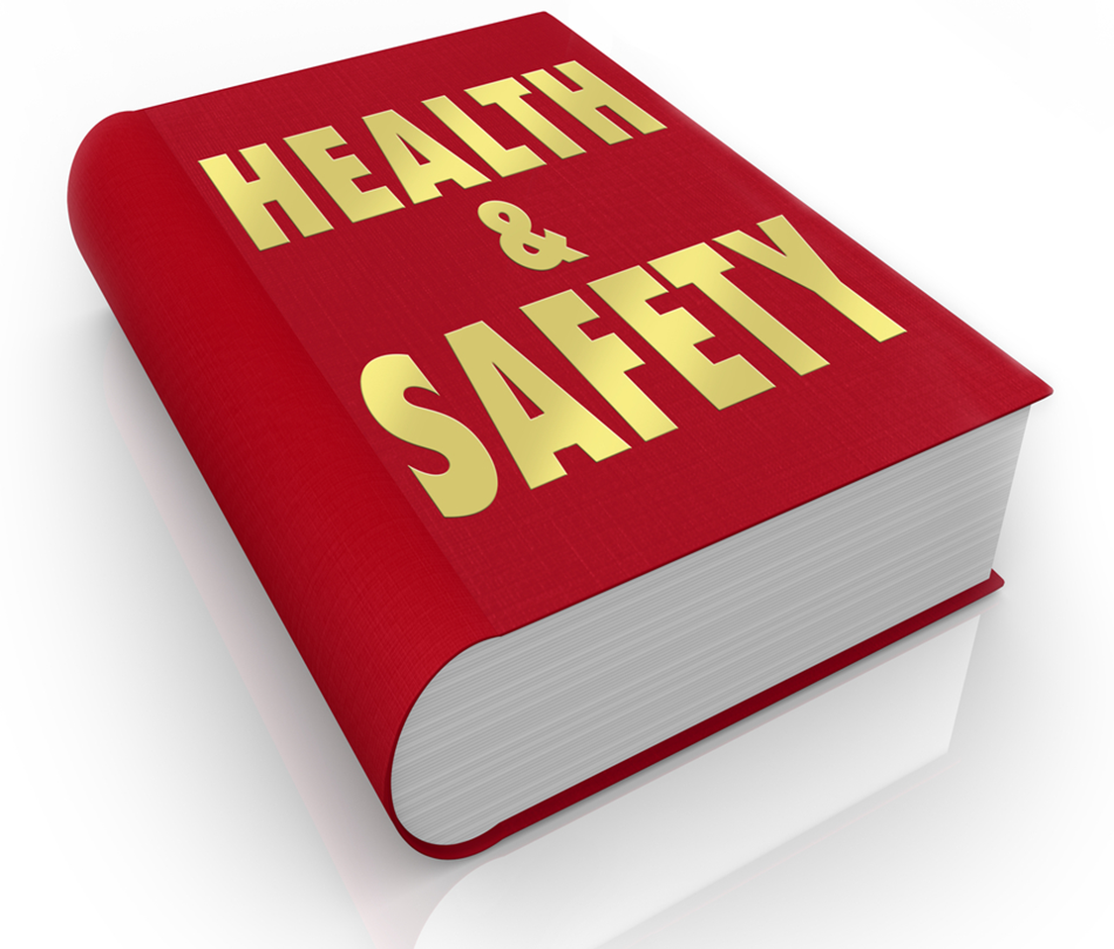
Universal Precautions
  Agencies and Responsibilities
Notes:
Occupational Safety and Health Administration sets safety standards and precautions that protect salon employees.

Slide 14
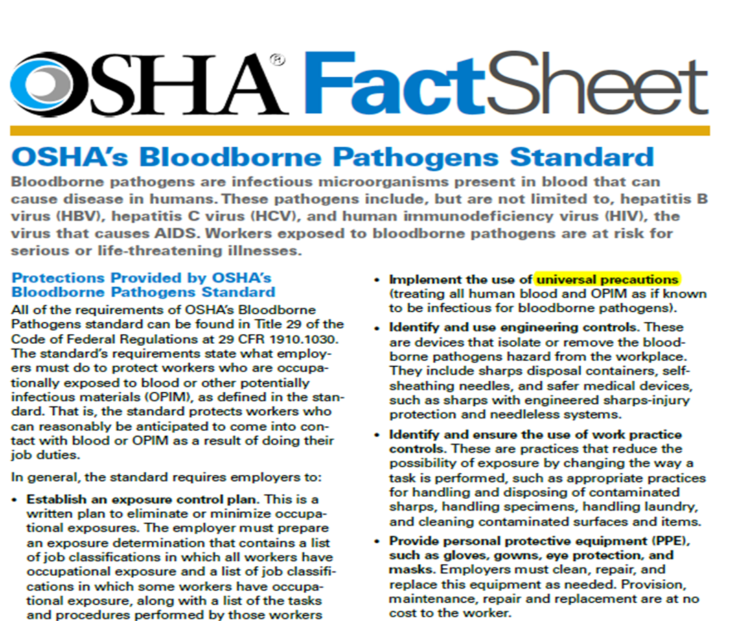
OSHA’s Bloodborne Pathogens Standards
  Treat all human blood and other potentially infectious material (OPIM) as if known to be infectious for bloodborne pathogens
Notes:
Distribute the OSHA Fact Sheet OSHA’s Bloodborne Pathogens Standard (see All Lesson Attachments tab) so that students may read and understand how they should treat all human blood and other potentially infectious materials.

Slide 15
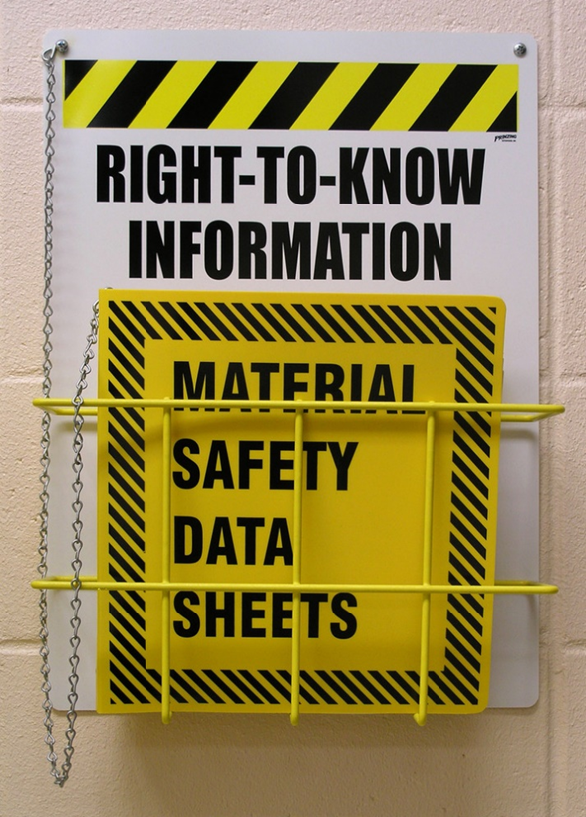
Federal Agencies
  Occupational Safety and Health Administration (OSHA)
    Occupational Safety and Health Act of 1970
      Hazard Communication Standard (HCS)
        Material Safety Data Sheet (MSDS)
  Environmental Protection Agency (EPA)
Notes:
The Occupational Safety and Health Administration (OSHA) was created as part of the U.S. Department of Labor to regulate and enforce safety and health standards to protect employees in the workplace. It also addresses issues relating to the handling, mixing, storing and disposing of products.
Occupational Safety and Health Act of 1970 regulates employee exposure to potentially toxic substances and informs them of possible hazards of materials used in the workplace. This regulation created the HCS.
Hazard Communication Standard (HCS) requires that chemical manufacturers and importers assess and communicate the potential hazards associated with their products.
Material Safety Data Sheets are a result of the HCS. It contains information compiled by the manufacturer about product safety, including the names of hazardous ingredients, safe handling and use procedures, precautions to reduce the risk of accidental harm or overexposure, and flammability warnings.
The MSDS also provides useful disposal guidelines and medical and first aid information.
The Environmental Protection Agency (EPA) registers all types of disinfectants sold and used in the United States.
Display several MSDS sheets from chemicals used in the salon for students to see.

Slide 16
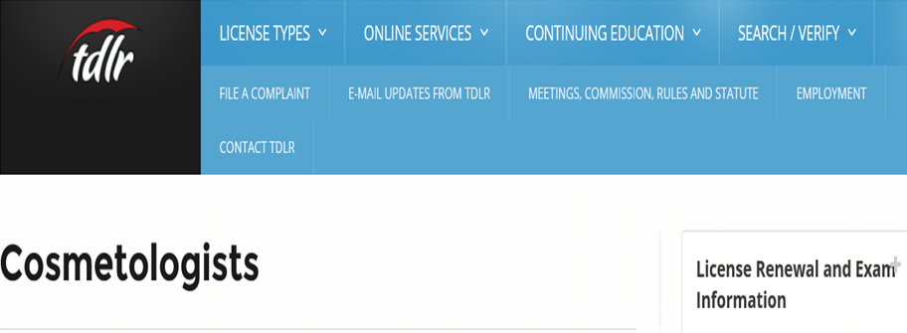

State Agency
  Texas Department of Licensing and Regulation (TDLR)
    TDLR's Mission
      The mission of the Texas Department of Licensing and Regulation is to honor the trust of all Texans, ensure public safety and consumer protection, and provide a fair and efficient regulatory environment.
      http://www.tdlr.texas.gov/
Notes:
State regulatory agencies exist to protect salon professionals and to protect consumers’ health, safety, and welfare while they receive salon services.
They also include licensing agencies, state boards of cosmetology, commissions and health departments.

Slide 17
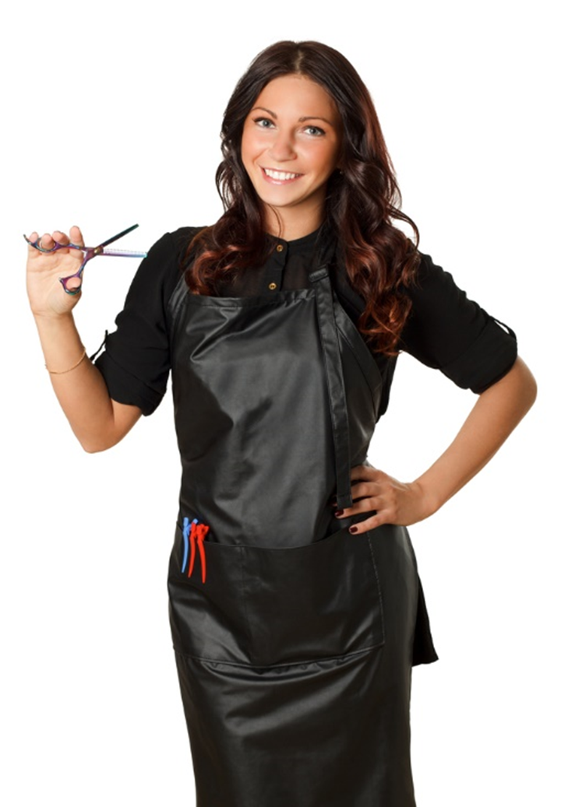
Responsibilities
  Never take shortcuts for cleaning and disinfecting
  Follow state and federal laws
  Keep your license current
  Check TDLR website frequently for updates to rules and regulations
Notes:
It is your responsibility to protect you and your client’s health and safety.

Slide 18
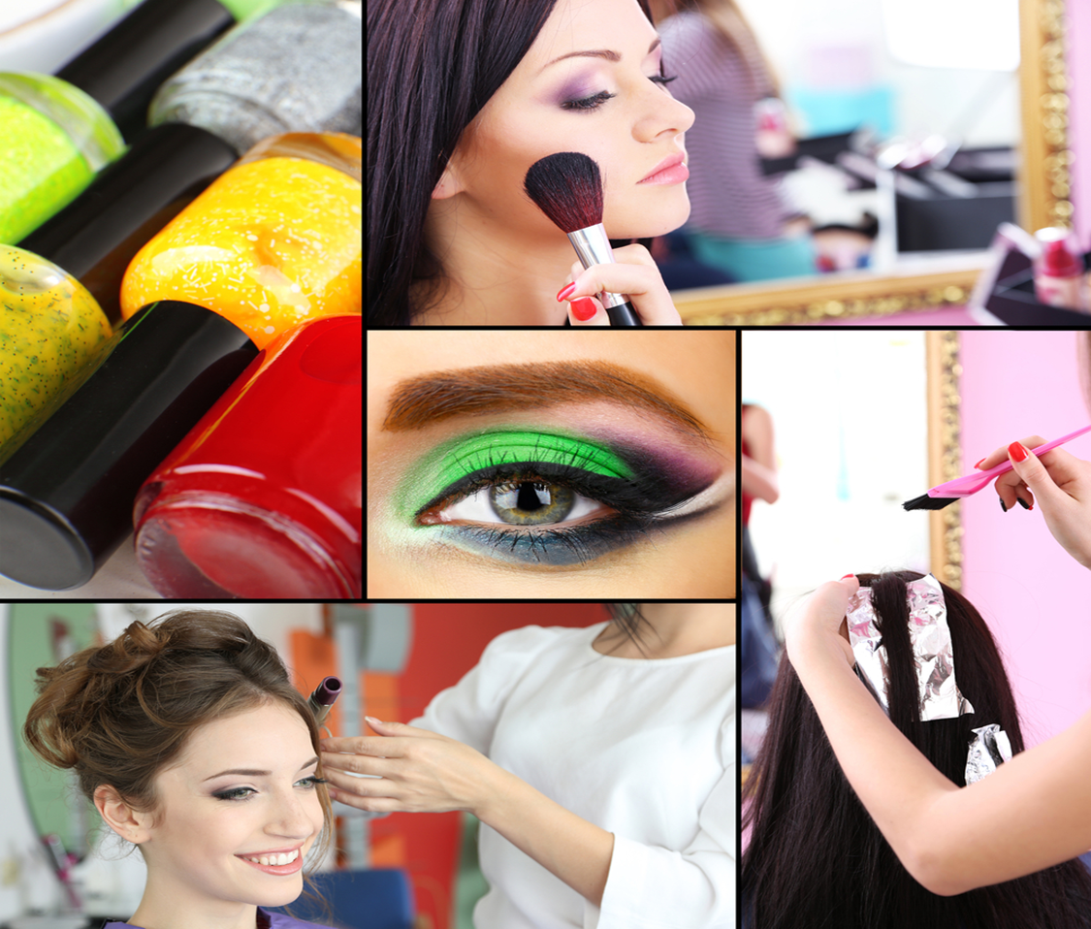
Cosmetology Services in a Safe Environment
  Decontamination Methods
Notes:
Proper decontamination can prevent the spread of disease caused by exposure to potentially infectious materials on an item’s surface.
Decontamination - the removal of blood or other potentially infectious materials on an item’s surface and the removal of visible debris or residue such as dust, hair, and skin.

Slide 19
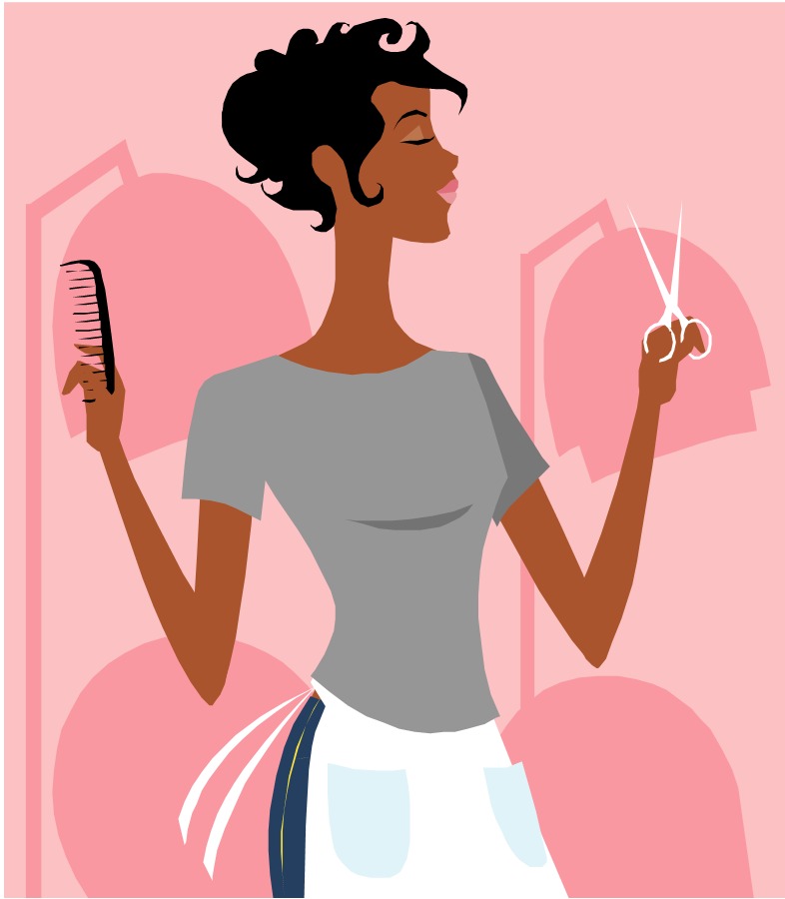
Decontamination Method #1
  Two step process
    Cleaning tools
      Wash with soap and warm water, then scrub with a clean and disinfected nail brush
      Use an ultrasonic unit
      Use a cleaning solvent
    Disinfect
Notes:
When cleaning used implements, you must remove all visible dirt and debris (contaminants) from tools, implements and equipment by washing with liquid soap and warm water and by using a clean and disinfected nail brush to scrub any grooved or hinged portions of the item.
Disinfection eliminates MOST, but not all, microorganisms on nonliving surfaces. Disinfectants are not effective on bacterial spores. Disinfectants should have an EPA registered number on the label and directions should be followed on mixing and usage. Remember that disinfectants should not be used on hair, skin, or nails as an allergy can be developed. Disinfection is effective on most reusable items such as combs, shears, nippers and equipment. Porous or disposable items should be thrown away or given to the client to take home as they cannot be disinfected or reused on another client.

Slide 20

Decontamination Method #2
  Two step process
    Cleaning tools
    Sterilizing
      Autoclaves
Notes:
The cleaning process is the same as decontamination method #1
Sterilization is the process that completely destroys ALL microbial life, including spores.
The most effective form of sterilization uses high-pressure steam equipment called an autoclave.
Steam alone is not enough. Dirty implements cannot be properly sterilized without being properly cleaned/sanitized first.

Slide 21

Disinfectants
  Appropriate for salon use:
    Quaternary Ammonium Compounds (quats)
    Phenolics
    Bleach
Notes:
Quats are disinfectants that are very effective when used properly in the salon. They usually disinfect implements in 10 minutes but prolonged exposure can cause dulling or damage to implements. Example of a quat is Barbacide.
Phenolic disinfectants are powerful tuberculocidal disinfectants. They contain formaldehyde, have a high pH, and cause damage to the skin and eyes. Phenolics are known carcinogens and are not environmentally friendly so they should be treated carefully. They can damage plastic and rubber and can rust certain metals.
Household bleach, 5.25% (sodium hypochlorite), is an effective disinfectant as well. Using bleach too much can damage metals and plastics. To be effective, the bleach must have an EPA-registration number and diluted properly to a 10% solution-9 parts water to 1 part bleach.
Fumigants are no longer used in the salon in the state of Texas because they contain formaldehyde and emit a formaldehyde gas.

Slide 22
Choosing a Disinfectant
  Be readily available
  EPA approved and environmentally friendly
  Inexpensive
  Must be efficacious
  Nontoxic and nonirritating
  No odor and noncorrosive
  Sustainable for at least a week or more
Notes:
Efficacious – the ability to produce an effect; the effectiveness with which a disinfecting solution kills organisms when used according to the label instructions.
The disinfectant solution should:
Last at least one week or more. It should not have to be changed out daily.
Must have an EPA registered number and should be able to be poured down the drain safely so as not to affect the environment.
Should be able to be purchased from different manufacturers.
Should not be expensive so the salon can afford to purchase it regularly.
Should not be irritating or nontoxic for use.
Should not have an odor that irritates and should not corrode implements.

Slide 23
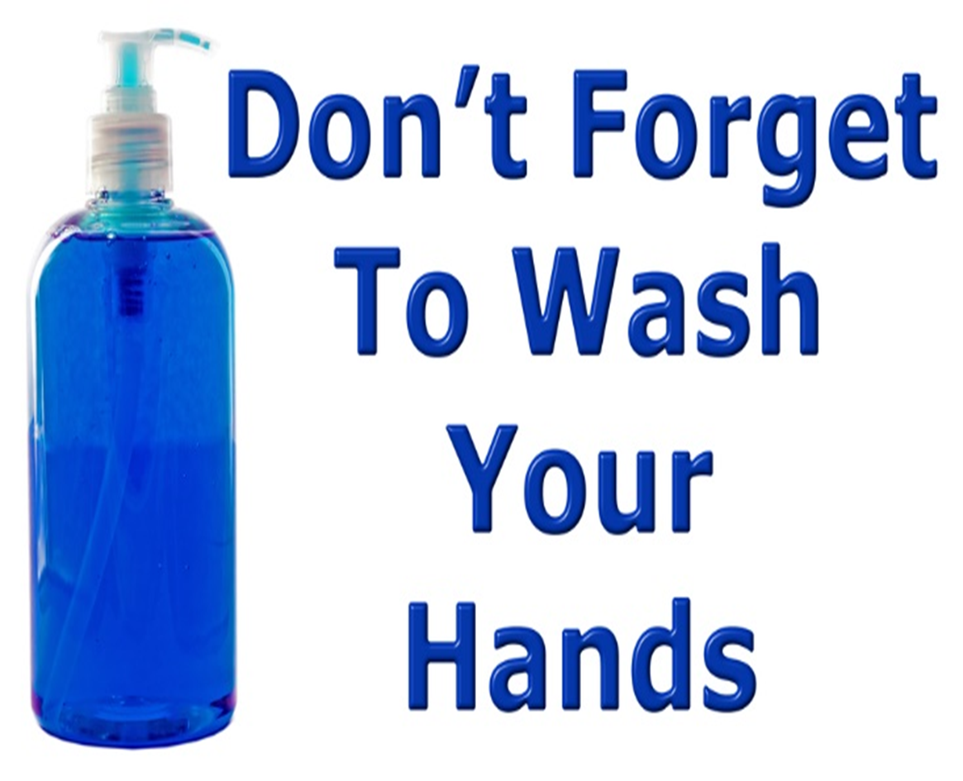
Notes:
Wash hands properly before and after working with a client.
This can prevent spreading germs from one person to another.
We will practice review the science of handwashing later in the lesson.

Slide 24
Review
  What is an infection?
  How can infections be transferred?
  Where can bacteria exist?
  Name a harmless bacteria
  What is a common viral infection in salons?
  How are hepatitis and HIV carried in the body?
  What are parasites?
  What are universal precautions?
  What are the steps for the decontamination method #1?
  What should you do before and after working with a client?
Notes:
The invasion of body tissues by disease-causing pathogens
Infections can be transferred through salon tools that have been contaminated and not properly disinfected.
Bacteria can exist on skin, in water, in the air, in decayed matter, on environmental surfaces, in body secretions, on clothing or under the free edge of nails.
Yogurt, cheese, medicines
A common viral infection often seen in salons is the Human Papilloma Virus (HPV), also known as plantar warts.
Passed through blood and body fluids.
Parasites are organisms that grow, feed, and shelter on or in another organism, while contributing nothing to the survival of that organism.
Treat all human blood and other potentially infectious material (OPIM) as if known to be infectious for bloodborne pathogens
Cleaning tools
Wash with soap and warm water, then scrub with a clean and disinfected nail brush
Use an ultrasonic unit
Use a cleaning solvent
Disinfect
Wash your hands!

Slide 25


Slide 26
References and Resources
  Images:
    Microsoft Office Clip Art: Used with permission from Microsoft. (Slides 5, 7, 9, 12, 19, 20, 21)
    Shutterstock™ images. Photos obtained with subscription. (Slides 1, 3, 4, 8, 10, 11, 13, 15, 17, 18, 23, 25)
  Textbook:
    Frangie, C. M. (2012). Milady standard cosmetology. Clifton Park, NY: Cengage Learning.
    Backe, J. (2016). Milady standard cosmetology. Clifton Park, NY: Cengage Learning.
    Salon fundamentals. (2012). Evanston, IL: Pivot Point International.
  Websites:
    Centers for Disease Control and Prevention (CDC)
    Keeping hands clean is one of the best ways to prevent the spread of infection and illness.
    http://www.cdc.gov/features/handwashing/

Slide 27
References and Resources
    Occupational Safety and Health Administration (OSHA)
    Nail Salon Workers: Stay Healthy and Safe While Giving Manicures and Pedicures
    https://www.osha.gov/pls/publications/publication.html
    Texas Department of Licensing and Regulations
    The leader in public service, customer satisfaction, and innovation
    http://www.tdlr.texas.gov/index.htm
    United States Environmental Protection Agency (EPA)
    Guidance from the EPA and the Centers for Disease Control and Prevention (CDC)
    http://www.epa.gov/pesticides/factsheets/pedicure.htm

