Slide 1
Principles of Information Technology
  Computer Hardware

Slide 3
TEKS Correlations (130)
  (4) The student demonstrates knowledge of the hardware components associated with information systems. The student is expected to:
  (A) identify the different computer classifications such as minicomputer, mainframe, and microcomputer;
  (B) identify major hardware components and their functions such as the central processor unit, input and output peripherals, and storage systems and devices.

Slide 4
Lesson Objectives
  Identify computer classifications
  Identify types and functions of various computer hardware devices
  Interpret the listed specifications of computer systems

Slide 5
Computer Classifications
  Computer System
    A collection of devices communicating with each other for data processing purposes:
  keyboard mouse
  monitor screen data processing hardware
  memory storage printer
  Mainframe
    A large computer system comprised of several pieces of hardware
    Can fill a large room or even a warehouse
    Used mostly by large businesses or corporations that need to process large amounts of data

Slide 6
Computer Classifications
  Microcomputer
    Computer system built on a smaller scale for single person use, sometimes referred to as a PC, which stands for Personal Computer
  Desktop
    A microcomputer that rests on a table or desk and is not meant to be portable but to remain at the original place of installation

Slide 7
Computer Classifications
  Laptop
    A much smaller version of the desktop which incorporates a flat-screen monitor, keyboard, mouse/touchpad, data processor, and memory storage in a compact case
    Approximately the size of a notebook, thus the nickname of “notebook” computer
    Battery operated
    Intended to be portable
  Laptop Dock
    A device built to reside on the desktop area, maintaining permanent connections to the printer and Internet, so that a laptop can just be placed on the dock rather than having to reconnect the wires to the printer and Internet every time it is moved

Slide 8
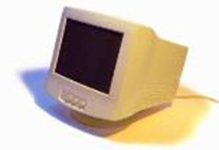
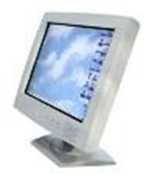
Computer Components
  Computer Monitor
    A device with a television-type screen that displays information relayed from the computer system
  CRT Monitor
    Cathode Ray Tube
    Older version monitor with a depth dimension about 12” that caused it to take up a lot of space on the desktop
  LCD Monitor
    Liquid Crystal Display
    Has a flat-screen appearance with a depth dimension about 3”

Slide 9
Computer Components
  Computer Keyboard
    A device with moveable keys representing the alphabet, numbers, symbols and frequently used commands used to input data into a computer system
  Qwerty Keyboard
    A keyboard that arranges the alphabet letters so that the letters qwerty are arranged in the upper left of the keyboard. This arrangement was initially designed to keep typewriter keys from jamming
  Ergonomic Keyboard
    Alphabet arrangement similar to the Qwerty keyboard
    The keys for the left hand are separated from the keys for the right hand to help prevent hand/wrist/arm cramps

Slide 10
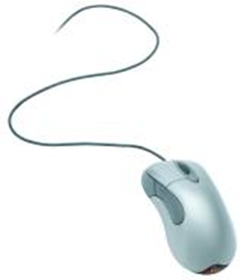
Computer Components
  Computer Mouse
    A device that connects to a computer system that allows the user to point and click to select items from the monitor screen
  Mechanical
    Older version with a rubber ball inside
    Inside had to be cleaned frequently
    Needed a pad on which to roll the rubber ball
  Optical
    Has a red beam of light that is directed out of the bottom of the mouse
    The reflected light bouncing off of the desktop surface is what causes the mouse to communicate with the computer system

Slide 11
Computer Components
  Wireless Devices
    A device that runs on batteries and has a transmitter that communicates with the computer system using an antenna-type receiver
  Wireless Keyboard or Mouse
    Runs on batteries
    Does not have a wire connection
    Communicates with a USB plug-in antenna
    Maintaining batteries for either device can become troublesome

Slide 12
Computer Components
  Printers
    A device that connects to a computer system that allows the user to create a hardcopy of the data displayed on the computer screen
  Inkjet Printer
    Sprays ink onto the paper to create text or images
    Uses a lot of ink to create good quality printouts
    Is usually slower in printing each page than a laser printer
    Ink cartridge replacements are more expensive than the printer itself

Slide 13
Computer Components
  Laser Printer
    A laser shines light onto a surface; the surface pulls toner onto it in the form of the text or image; then it is heated onto the paper
    Usually more expensive than inkjet printers

Slide 14
Computer Components
  Motherboard
    A device that is inside the case of the computer
    It is a flat, thin board with circuits welded on it
    It has connections to all the other devices that are inside the computer system
    It has connections to all the devices that are externally connected to the computer system
    Contains the CPU chip and ROM chip

Slide 15
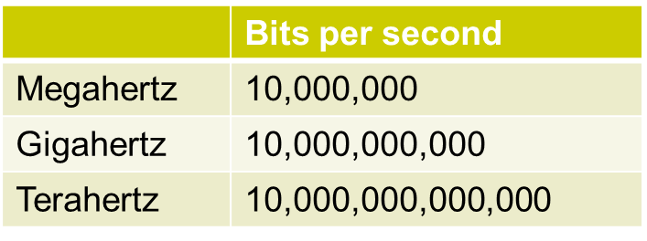
Computer Components
  CPU
    Central Processing Unit – a silicon chip
    Chip that transfers or processes ALL the data/information from one device to the other
    Speed or processing time of the chip is measured in hertz
    The latest and fastest cpu currently available is the Intel i7

Slide 16
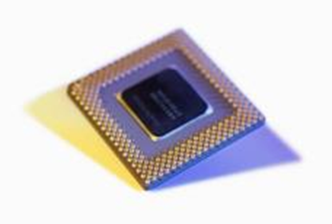
Computer Components
  ROM
    Read Only Memory – a silicon chip
    Information placed there at manufacture of motherboard is readable information only
    Information can not be changed at a later date
    Chip that contains the boot-up instructions of the computer
    These are basic boot-up instructions that remain the same no matter how many times you power-on or off.
    Therefore, these instructions do not need to be altered for the life of the computer system

Slide 17
Computer Components
  Hard Disc Drive
    Also called hard drive
    Device inside the computer case
    Is connected to the motherboard
    Contains a stack of discs that spin rapidly when functioning
    The operating system software (Windows or MAC) is stored in the memory of the hard drive
    Contains memory storage area to save files to
    Are measured by:
      How much information they can hold/ memory (bytes)
      How fast the discs spin (rpm)
      Common current systems: 3 Terabytes, 7200 rpm
    A user can also purchase hard drives that can connect externally/ USB port to the computer system

Slide 18
Computer Components
  RAM
    Random Access Memory - A small circuit board containing silicon chips that fits into slots on the motherboard
    A computer system can have more than 1 RAM card
    Each RAM card can hold a limited amount of information
    RAM is measured in:
      Speed (hertz): how fast it can process information
      memory space (bytes): how much information it can store at one time
    Current systems usually have approx. 4GB of RAM
    This is temporary memory that holds the document you are currently working on
    When the power to the computer or the program you are using shuts off, everything stored in RAM disappears
    Unless you saved your work to the hard disc drive or to another memory space, your work is lost

