Slide 1
Professionalism I
Are You a Cook or a Culinarian?

Slide 3
Professionalism begins with a positive attitude!
  Qualities of a professional
    Strong work ethic
    Responsible
    Flexible
    Honest
    Reliable
    Commitment to excellence
Notes:
Strong work ethic – a personal commitment to doing your very best as part of the team – no matter what your assignment – if you are the dish washer – be the BEST dishwasher ever! When you have a strong work ethic, you have a commitment to quality and excellence.
Responsible – being responsible is one of the most important qualities for success in any job. Showing up for work on time, becoming familiar with job expectations and carrying them out correctly and accepting the consequences for your actions and choices rather than blaming others.
Flexible - being able to adapt willingly to changing circumstances without complaining.
Honest – being truthful and loyal in your words and actions. For example, if you make a mistake don’t cover it up or blame someone else. Instead, admit your mistake and find out how to prevent making the same mistake in the future.
Reliable – be an employee that can be counted on. A reliable employee arrives at work on time, works full shifts, carries out assigned task with minimal supervision and takes on extra work if needed. Reliable employees are more likely to be promoted more quickly.
Committed - being committed is the quality that supports all your abilities and skills to build a strong work ethic. A strong commitment can set you apart as a valued employee. People who are committed to excellence are not willing to settle for work that’s “just good enough.”

Slide 4
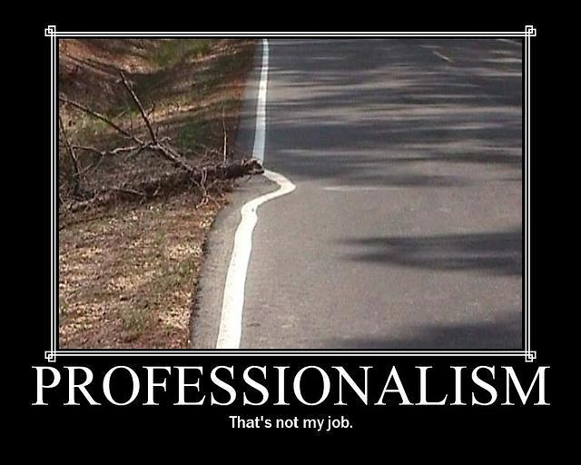
Notes:
Why do situations like this happen? Is this the kind of professionalism you would expect if you were the boss?
Reflect – Take a few minutes and develop your opinion about why this situation might have happened.
Pair – Pair up with one other person and
Share – your opinion. (Allow a few minutes for this discussion)
Ask some of the students to share...

Slide 5
What Does It Mean To Be a Culinary Professional?
Courteous, honest and responsible when dealing with co-workers and customers
Notes:
Culinary professionals are expected to be courteous, honest and responsible when dealing with co-workers and customers.

Slide 6
Recipe for
  Great Culinary Professional
    1 cup of Knowledge
    2 cups of Skill
    3 tablespoons of Taste
    4 ounces of Judgement
    5 pounds of Dedication
    Fill to the top with pride
Notes:
Wouldn’t it be easy if there were a recipe for making a great culinary professional?
The good news is that we know the basic ingredients:
knowledge
skill
taste
judgment
dedication
pride

Slide 7
Professional Culinarians
  Study the art of cooking
  Must learn and apply the foundations of the profession:
    handling ingredients and equipment
    performing traditional culinary
    techniques and recipes
Notes:
A culinarian is someone who studied and continues to study the art of cooking.
Professional culinarians must learn and apply the foundations of the profession:
handling ingredients and equipment
performing traditional culinary techniques and recipes

Slide 8

Culinary Professional
Artist
Scientist
Business Person
Culinary Explorer
Notes:
A culinary professional must wear many different hats – artist, scientist, business person and culinary explorer.

Slide 9
Attributes of a Culinary Professional
  Knowledge
    Identify, purchase, utilize and prepare a wide variety of foods
    Apply scientific and business principles
    Be “lifelong” learners
Notes:
Knowledge includes to:
identify, purchase, utilize and prepare a wide variety of foods
apply scientific and business principles
be “lifelong” learners

Slide 10
Attributes of a Culinary Professional
  Skills
    Practice and hands-on experience provide the skills necessary to produce quality
    foods consistently
    and efficiently
Notes:
Culinary schooling alone does not make a student a culinary professional.
Practice and hands-on experience provide the skills necessary to produce quality foods consistently and efficiently.
Even graduates of a culinary program need time and experience to develop and improve their skills.
Most graduates start in entry-level positions – so don’t be discouraged advancement will come.

Slide 11
Attributes of a Culinary Professional
  Aroma
  Flavor
  Taste
Notes:
It is critical for culinary professionals to understand how flavor, aroma and taste work. They must produce foods that taste great or the customer will not return.
Many things create aromas. Receptors are triggered in the nose that sends a message to the part of the brain responsible for emotional responses. That is why smells are connected to emotions. The aroma of spaghetti sauce cooking might spark a childhood memory for a person.
Flavor refers to all the sensations produced by whatever is in the mouth.
Taste refers to our ability to identify substances like foods, minerals and even poisons. Some bad-tasting substances are commonly added to dangerous chemicals to warn people away.
What is the difference between flavor and taste?

Slide 12
Taste
  Five Basic Tastes:
    Bitter
    Salt
    Sour
    Sweet
    Umami (Savory)
Notes:
Taste is highly subjective: everyone’s physical and cultural characteristics are different, so everyone has different personal preferences.
Age, vitamin deficiencies and genetic variations are just some of the reasons why a food will not taste the same to any two eaters.
The five basic tastes are:
bitter
salt
sour
sweet
umami (savory)
Researchers have determined that the tongue can also recognize other sensations besides taste:
astringency
calcium
fattiness
metal
minty-cool
numbness
spicy-hot
temperature
None of these are an actual taste, however, they affect a person’s perception of what they do taste and experienced chefs use all of these effects to create specific dishes.

Slide 13
Attributes of a Culinary Professional
  Judgement
    Sound judgment comes only from experience
    Learning from mistakes as well as successes is how everyone develops sound judgment
Notes:
It is important to have a since of pride about your work.
Pride extends to personal appearance in and around the kitchen.
Professionals are well groomed and dress in clean, ironed uniforms when working.

Slide 14
Attributes of a Culinary Professional
  Dedication
    Becoming a culinary professional is hard work… physically and mentally!
Notes:
Becoming a culinary professional is hard work.
The work is physically and mentally challenging.
The hours are usually long and the pace is frequently hectic.
Despite these pressures, the culinarian is expected to produce consistently fine foods that are properly prepared, seasoned, garnished and presented. This requires dedication!

Slide 15
Attributes of a Culinary Professional
  Pride
    It is important to have a sense of pride about your work.
Notes:
It is important to have a since of pride about your work.

Slide 16
List the 8 attributes of a Culinary Professional
Knowledge
Dedication
Pride
Skill
Flavor
Aroma
Taste
Judgment
Notes:
Word Wall
What are the 8 attributes of a Culinary Professional?
Give real world examples of each.

Slide 17
Questions?

Slide 18
References/Resources
  Textbooks:
    Johnson & Wales University, . Culinary Essentials. New York, New York: Glencoe, McGraw-Hill, 2002. Print.
    National Restaurant Association, . Foundations of Restaurant Management & Culinary Arts. Level One. Boston: Prentice Hall, 2011. Print.
  Website:
    The Professional Chef Uniform
    As a professional chef your uniform is your first line of defense for safety protection. Let’s review what a safely dressed chef looks like.
    http://youtu.be/4uPYHDwVwzU

