Slide 1
Professionalism II
Culinary Uniforms

Slide 3
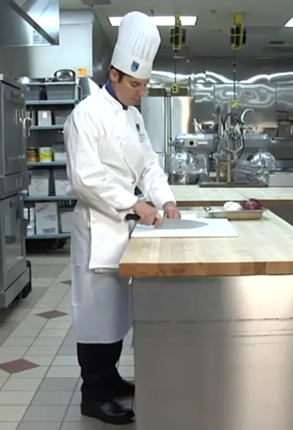
Pride
  A Professional Chef's Uniform
  (click on link)
(image from video)
Notes:
There is no mistaking a chef.
The chef's uniform includes:
a double-breasted white jacket
a tall white hat
Most people take this uniform for granted, but there are good reasons for each piece of clothing.
Click on hyperlink to view video:
A Professional Chef Uniform
As a professional chef your uniform is your first line of defense for safety protection. Let's review what a safely dressed chef looks like.
http://youtu.be/4uPYHDwVwzU

Slide 4
History
  During the middle 1800's, Chef
  Marie-Antoine Carême redesigned the uniforms that chefs wore
Notes:
During the middle 1800's, Chef Marie-Antoine Carême redesigned the uniforms that chefs wore.
Carême thought the color white would be best, since it showed cleanliness in the kitchen.
Also, Chef Carême thought of the idea of having different size toques - chefs wore the tall hats and the younger cooks wore shorter hats, more like a cap.
The taller the toque, the more prestigious the chef.
Carême himself wore one that was 18 inches tall!

Slide 5
History
  The typical chef's jacket is made of heavy white cotton
(image from video)
Notes:
The typical chef's jacket is made of heavy white cotton.
This fabric is important because it acts as insulation against the intense heat from stoves and ovens.
Also, the cloth is thick enough to prevent the chef from being hurt by hot liquids or spattering hot oil.
The jacket has knotted cloth buttons that withstand frequent washing better than plastic or wooden buttons.
Why do you think that most chef jackets are double breasted?
Since there are two rows of buttons, the chef can re-button the double-breasted jacket to hide the stained part!

Slide 6
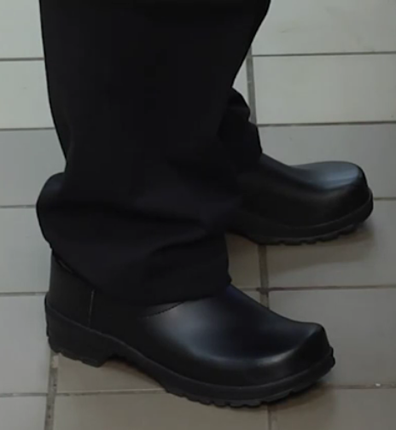
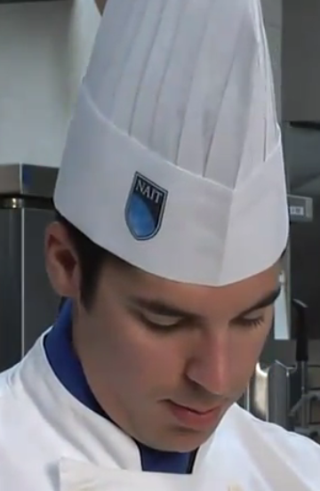
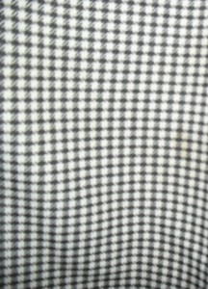
CHEF WEAR
  Black pants or "hounds tooth" black and white checked pants
  Non-skid, closed toed shoes
  Neckerchiefs - knotted in the front
  The most interesting part of the uniform is the tall white hat, called a "toque."
Notes:
Either black pants (common for executive chefs) or "hounds tooth" black and white checked pants.
The checkered pants hide lots of stains.
White neckerchiefs, knotted in the front. These were originally designed to absorb perspiration, since in the days before air conditioning, kitchens were unbelievable hot!
Nowadays, chefs wear the neckerchiefs to keep the tradition and finish the look of their uniforms.
The most interesting part of the uniform is the tall white hat, called a "toque."
Did you know…?
The 101 pleats on a traditional hat represent the number of way the wearer of the toque should be able to use eggs in a preparation.

Slide 7
You are young PROFESSIONALS!
  Creatively demonstrate what professionalism means to you
Notes:
Professionalism means many things as you have learned.
Creatively demonstrate what professionalism means to you.

Slide 8
What have you learned?
  What are the qualities of a professional?
  What does professionalism mean?
  Name the attributes of a professional culinarian
Notes:
Qualities a professional must have include:
a positive attitude on the job
staying power: requires physical and mental stamina
ability to work with people
eagerness to learn
a full range of skills
experience
dedication to quality
understanding of the basics
Professionalism means being courteous, honest, and responsible in one's dealings with customers and coworkers.
It also indicates that a person is maintaining standards for his or her work and behavior.
Professional culinarians have knowledge, skill, taste, judgment, dedication, pride, respect and personal responsibility.

Slide 9
Questions?

Slide 10
References/Resources
  Textbooks:
    Johnson & Wales University, . Culinary Essentials. New York, New York: Glencoe, McGraw-Hill, 2002. Print.
    National Restaurant Association, . Foundations of Restaurant Management & Culinary Arts. Level One.Boston: Prentice Hall, 2011. Print.
  Website:
    The Professional Chef Uniform
    As a professional chef your uniform is your first line of defense for safety protection. Let’s review what a safely dressed chef looks like.
    http://youtu.be/4uPYHDwVwzU

