Slide 1
Project Management
  Business Management

Slide 3
Examples of Business Projects
  Research projects
  Strategic planning
  Employee training
    New employee training
    Creating employee manuals
    Change in procedures
  Event planning
  Introducing a new product or service
Notes:
Businesses plan projects for a variety of different reasons. There may be projects to research expanding the business or adding another location. Long-term strategic planning is a project. Developing employee training programs are projects, and so are training new employees, creating employee manuals, or changing procedures. When a business plans an event, a project plan should be developed and followed. If a business wants to introduce a new product or service, this is a project as well.

Slide 4
Characteristics of a Project
Has a beginning and end date
Is temporary, not ongoing
Has a specific result or goal in mind
Notes:
Projects have specific characteristics for them to actually be classified as “projects.” Projects have a beginning and end date. They are not necessarily an everyday part of a job. Projects have a specific result or goal in mind. Projects are also temporary, not ongoing. If a project is completed, and later it is going to be performed again, the second time it is not considered a project. These characteristics are important because they separate projects from daily job activities.

Slide 5
Roles of the Project Manager
  Guides the development of the project plan
  Monitors the progress of the project
  Responsible for the communication plan and communicates with stakeholders
  Responsible for the risk management plan
Notes:
While the personnel structure of projects can vary, there typically will be a project manager who leads the project. He or she guides the development of the project plan and monitors the progress of the project through each phase. He or she is also responsible for the communication plan for all members of the project team—and communicating with all stakeholders as well.

Slide 6
Project Phase Flowchart
Initial
Planning
Execution
Closing
Notes:
Sometimes it is easier to visualize a project plan if it is in diagram format. Show students examples of flowcharts so they can see the steps involved in project plans. The specifics of a project plan will vary from project to project and company to company, but there are generally four phases: the initial start-up phase, the planning phase, the execution phase, and the project closing.

Slide 7
Phase One – The Initial Phase
  Define the project
  Determine end results or the goals to be accomplished by the end of the project, the project scope
    Should be specific
    Should be measurable
  Assemble a project team
Notes:
During the initial phase the project is defined. What is it exactly that you want to have happened by the end of the project? It must be specific and quantifiable. This is called the project scope. For example, a scope of “building a lot of new homes this year” is too general. However, a scope of “building three homes within 12 months, each costing $200,000” is much easier to focus on and measure the results of at the end of the time period. A project team is also selected and assembled at this point. Roles can be assigned as needed depending upon the size of the project.

Slide 8
Phase Two – The Planning Phase
  Obtaining resources needed
  Develop a budget
  Establish a timeline or schedule with major interval dates to keep the project on schedule
  Develop communication plan
  Develop a risk management plan to cover any contingencies
Notes:
The planning phase involves obtaining the necessary resources. These resources can include budgets, timelines, communication plans, and a risk management plan.

Slide 9
Phase Three – The Execution Phase
  Identify all tasks required to complete the project
  Accomplishing the specific tasks of the project
  Keeping in mind the interval dates for completion of major parts of the project
  Making changes to the plan as needed
Notes:
This phase is where the actual tasks are completed. This phase can also take the longest of the four phases. As tasks are completed, changes can be made to edit, add, or delete tasks to ensure project completion.

Slide 10
Phase Three (Continued)
  Task tracking methods:
PERT
Program Evaluation Review Technique, a critical path diagram developed by the Navy in the 1950’s
GANTT
A type of task scheduling bar graph developed by Henry Gantt in 1910
Notes:
Once the project team identifies each task required to complete the project, some type of visual representation should be created so the team members can see the progression of tasks. Two common methods are the PERT and the GANTT charts. Both can be completed manually or using a computer. Project teams will have to arrive at a consensus on which one to use. Show students sample charts on a computer so they can see what completed charts look like.

Slide 11
PERT Diagram Example
  The numbers indicate the order of the tasks to be completed. The arrows show the relationship between the tasks, and the task duration is below the arrows.
3
Assemble team
5
1
4-5 Days
Define scope
4
1 Week
2
Notes:
A PERT diagram represents the order of tasks to be completed during a project. It does visually show the order, as well as the time to complete the tasks and how they can relate to each other. If the project is complicated however, this type of diagram may be slightly more difficult to visualize.

Slide 12
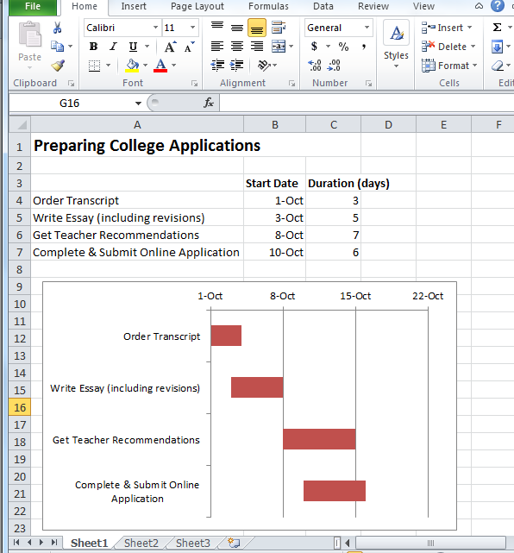
GANTT Chart Example
  List the tasks required to complete the project, their start dates, and how long it will take to complete the tasks.
  Look for online tutorials on how to prepare a GANTT chart in a spreadsheet software application.
Notes:
A GANTT chart is a visual representation of the schedule of tasks needed to complete a project. It serves basically the same purpose as a PERT diagram, but in a different format. The longer the bars, the more time it will take to complete the task. You can also see which tasks overlap other tasks. This is why it is very important to list the tasks in order when this type of chart is used. This type of chart may be easier to visualize for more complicated projects.

Slide 13
Phase Four – The Closing Phase
  Completion of project
  Evaluation of project successes and weaknesses
  Questions to ask
    On time?
    On budget?
    Results met?
Notes:
Reflection on the success or failure of the project occurs in this phase. The project is completed, but the process should be evaluated to determine what worked well and what results may not have been achieved. Important questions to ask are whether the project was completed on time, on budget, and the extent to which results were met. These may determine if the project is considered a success or failure.

Slide 14
Phase Four (Continued)
  Evaluation methods
    Discussion
    Online survey
    Paper survey
    Phone calls
    Data reflecting the level of customer or client satisfaction (if project is external)
Notes:
A project must undergo some type of evaluation to determine if the questions from the previous slide can be answered positively. There can be discussions among the stakeholders or surveys where aspects of the project can be rated. Phone calls can also be made to answer questions related to the project. Data should be gathered and presented to customers or clients if the project was an external one.

Slide 15
Communication Plan
  Who will receive project plan updates?
  What information will they receive?
  When will they receive updates?
  Location of team members
    If local, face-to-face or digital
    If distant, consider online application sharing and online scheduling to coordinate activities
Notes:
A communication plan details how information will be conveyed to all stakeholders who have an interest in the project. It must be determined who will receive the updates. Certain parties will need constant updates; other parties will only need periodic notifications. Determine what information is to be received by whom and how often the updates will take place. This communication format may vary depending upon if stakeholders are local or distant. Some communication can be face-to-face while some will need to be electronic. In this case, online application sharing can help with sending, reviewing, and updating documents.

Slide 16
Communication Plan Specifics
  Who (stakeholders)?
    Project team members
    Customers or clients
    Community members
  When (frequency)?
    Weekly
    Periodically as needed
  How (medium)?
    Meetings
    Monthly newsletter
    Website updates
Notes:
The communication plan is set up so all the parties that need to be informed about the status of the project will receive the appropriate information at the appropriate times and in the best method possible. This plan addresses stakeholders such as employees, customers or clients, and community members. Some stakeholders may need more frequent communication than other members. In some cases meetings provide information, while in other instances newsletters or website updates will suffice.

Slide 17
Status Report
  Can be included as part of a communication plan
  Verifying progress compared to schedule
    On-track in what areas
    Behind in what areas
    Ahead in what areas
  Unexpected delays or other issues
Notes:
Status reports can also be part of the communication plan. These reports can compare a project’s progress to the schedule. They can also identify which areas are on-track, which ones are behind, and which ones are ahead. The reports can also discuss unexpected delays or other issues.

Slide 18
Project Risk
  Identify potential risks
  Develop a risk checklist
  Estimate likelihood of risk (risk assessment)
  Determine impact in each area (for example, time, budget, and results)
  Develop a risk management plan
    Allow for delays when scheduling
    Keep amounts on hand for unanticipated budget overage
    Enforce conditions of contracts
Notes:
With any project there is an element of risk—the probability of loss (or of the project’s failure). A risk assessment should be conducted. A visual way to accomplish this is to create a checklist or other diagram of all possible risks, for example, economic or environmental factors that can affect the project’s success. Develop a plan that can allow for the “what ifs” affecting scheduling and budgeting.

Slide 19
Project Management Tools
  Many tools can be utilized manually, but several can be created using spreadsheets and other applications or appropriate software
    Brainstorming tools
    PERT chart
    GANTT chart
    Scheduling system
    Computer
Notes:
The tools that project management utilize depend upon the project itself and the size of the project. Tools that can aid in brainstorming, such as diagrams or online tools, can aid in developing the project scope. Different chart-creating tools are helpful during the execution phase. A scheduling system, possibly online, can also assist with scheduling tasks or with the communications plan. In any case, the computer can be a powerful tool in executing a project plan, especially a complicated one.

Slide 20
Independent Practice Assignments
  Communication Plan Table Assignment #1 – Present students with a project scenario, such as the project examples at the beginning of the presentation (or any other project idea) and have students create a Communication Plan table for that project plan. The table should have column headings stating Stakeholders, Types of Information, How Often, and Type of Communication.

Slide 21
Independent Practice Assignments
  Project Mind Map Assignment #3 – Individually, students will create a mind map for a project idea of their choice. They may use software that creates mind maps, create one in a word processing document that uses shapes (such as in a flowchart), or create one manually. In the center will be the project idea, and the project phases will stem from the center. Be sure to include the tasks that will be involved. PERT diagrams or GANTT charts do not need to be included in the mind map. The mind map is to serve as a project guideline.

Slide 22
Independent Practice Assignments
  Planning a Field Trip Project Assignment #2 – Have students in groups plan a project such as a field trip or other school or community event. They will create a presentation, whether using presentation software or an online presentation website, that includes slides with each phase of the project and appropriate graphics and graphs as necessary.

