Slide 1
Recipe for Success:
Breaking Down Standardized Recipes
Culinary Arts

Slide 3
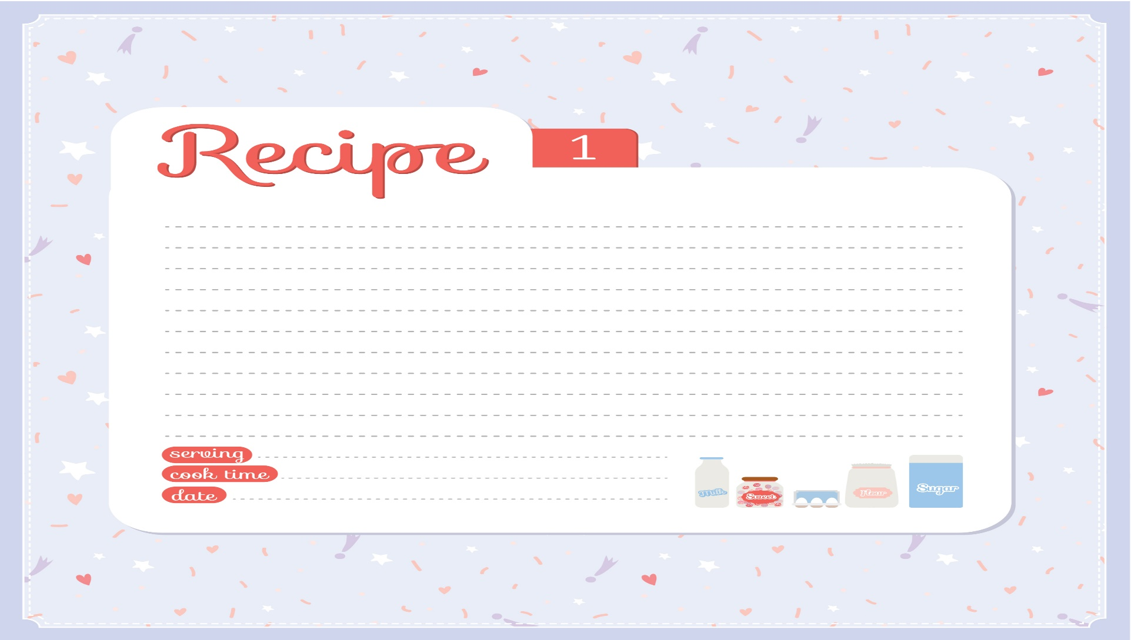
Recipes
Notes:
A recipe is a set of directions on how to use ingredients, equipment, preparation instructions and cooking techniques.
Measurements are listed in cups and measuring spoons.

Slide 4
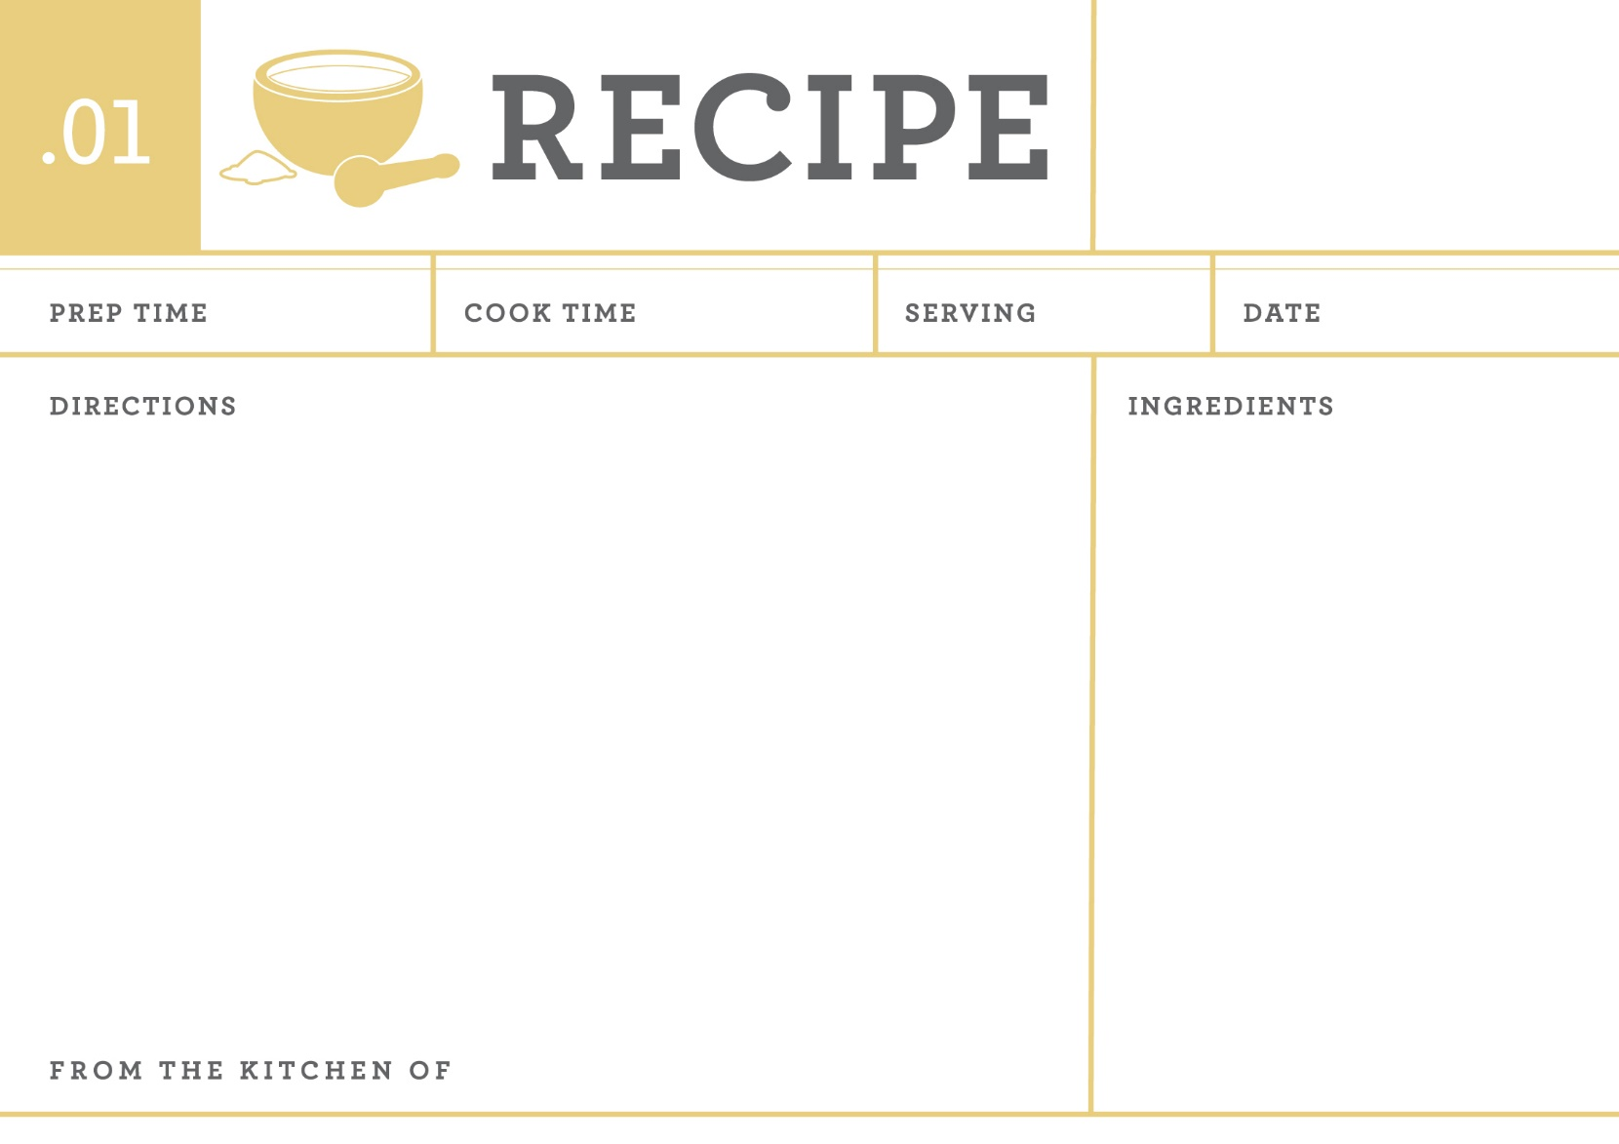
Standardized Recipes
Notes:
Are a set of written instructions used to consistently prepare a known quantity and quality of a certain food for a food service operation.
A standardized recipe is a recipe that has been carefully adapted and tested to ensure that it will produce a consistent product every time it is used.
Measurements are listed in weight and volume.

Slide 5
Comparison
  Recipes:
    Can follow any written format
    Ingredients listed in order of use
    Measurements are listed by cups and measuring spoons
    Preparation instructions included
    Small yields – usually 4 to 6
  Standardized Recipes:
    Format is clear for the foodservice establishment
    Ingredients listed in order of use
    Measurements are listed by weight and volume
    Preparation instructions may not be included
    Large quantity yields – 24 to 100+
Notes:
Recipes are different from standardized recipes in several areas.
Note – other differences may be added.

Slide 6
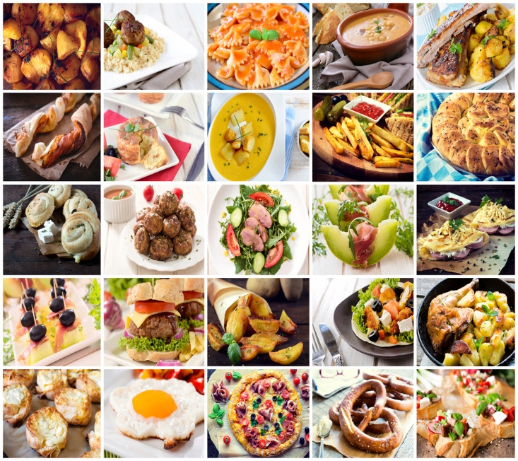
Benefits of Standardized Recipes
  Control of portion size and cost
  Consistency in quality and quantity
  Elimination of errors in food orders
  Elimination of waste in not overproducing food
  Increased efficiency
  Meeting customer’s expectations
Notes:
Each standardized recipe goes through a quality control to ensure that everything will meet the standards of the foodservice establishment.
The results will benefit the venue and the customers.

Slide 7
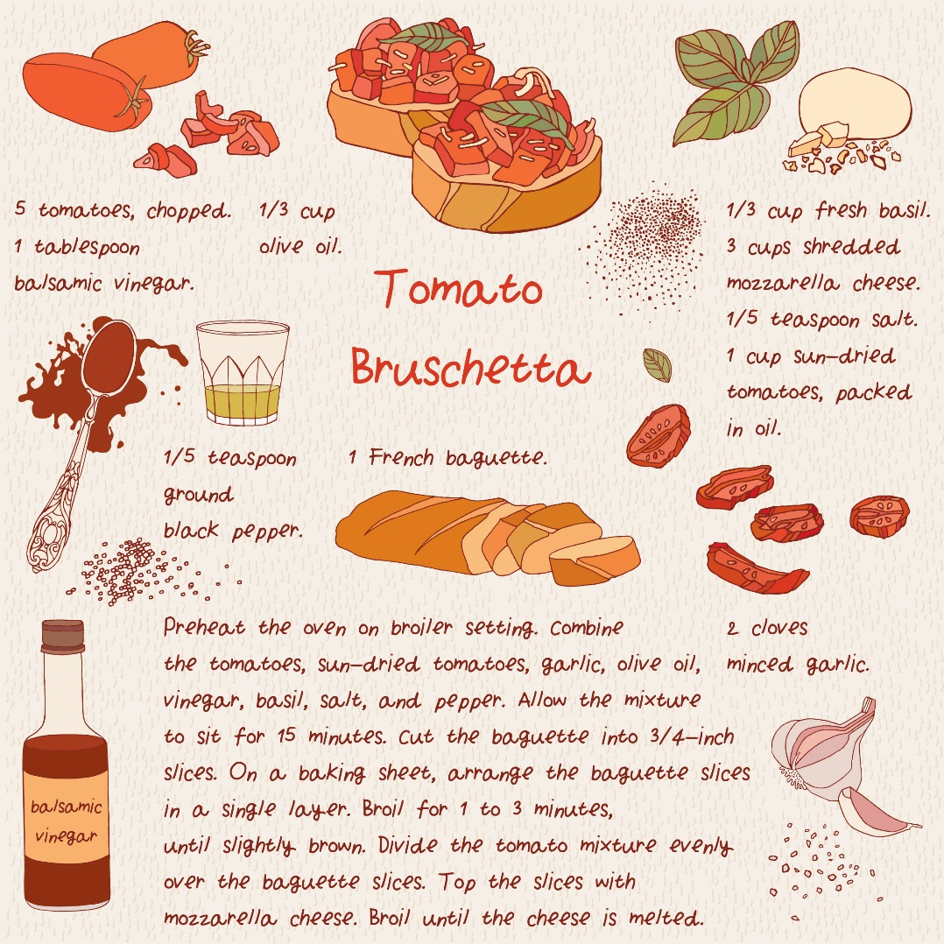
Components of a Standardized Recipe
  Recipe Name
  Yield
  Portion size
  Ingredient quantity
  Preparation procedures
  Cooking temperatures
  Cooking time
Notes:
Recipe name - the name on the recipe and on the menu should reflect the same product
Yield - the number of servings or portions the recipe produces
Portion size – the amount or size of an individual serving
Ingredient quantity – the measured portion of each ingredient
Preparation procedures – the step by step directions to produce recipe
Cooking temperatures – used for range tops and ovens where preheating may be required
Cooking time – important to cook the food the recommended time
Other items that may be included:
chef notes
equipment and utensils
plating instructions

Slide 8
Science of Baking
Formula
Recipe
Ingredients listed by decreasing weight
Precise weight measurements are used
Instructions not always included
Ingredients listed in order of use
Followed by procedures for successful results
Notes:
A formula is a special type of recipe that is used in baking.

Slide 9
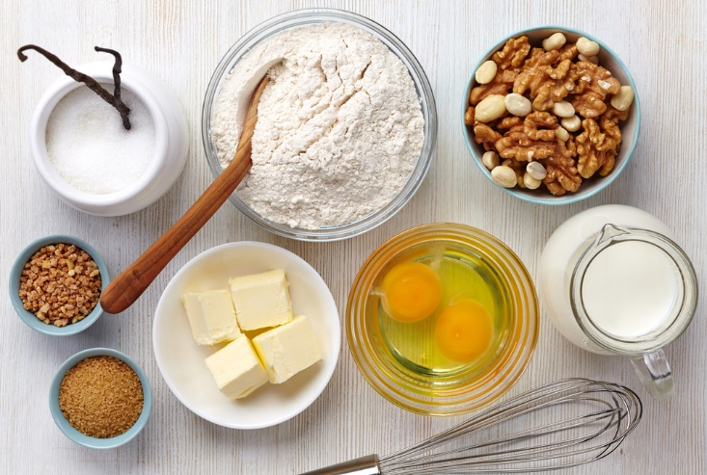
Standardized Recipes for Baking
  An exact science that requires precise measuring and accuracy
  Recipe includes the exact amount of each ingredient
  Often listed in percentages
Notes:
These recipes may not always include instructions needed to prepare the product.
A standardized recipe includes written procedures to prepare a known quantity and quality of a certain food.

Slide 10
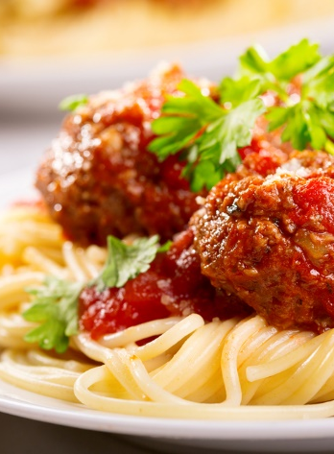
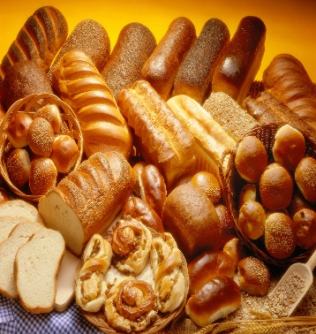
Conversion Factor
  Recipes may need to be changed to accommodate servings
  To increase or decrease recipes (2 steps):
    Formulas:
      New Yield ÷ Old Yield = Conversion Factor
      Old Yield x Conversion Factor = New Yield
Notes:
Conversion factor – Increasing or decreasing recipe ingredients by dividing the new yield by the current yield
We will practice converting recipes later in this lesson.

Slide 11
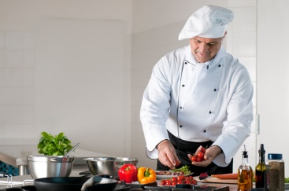
Mise en Place
  French phrase for “put in place”
  Work simplification
  Refers to:
    Reviewing the recipe before beginning work
    Having all foods and equipment ready
    A state of mental readiness
Notes:
Work simplification – performing a task in the most efficient way possible
This includes:
Assembling:
equipment
ingredients
serving pieces
tools
Involves:
cleaning and chopping vegetables
measuring spices
preheating oven
trimming meats

Slide 12
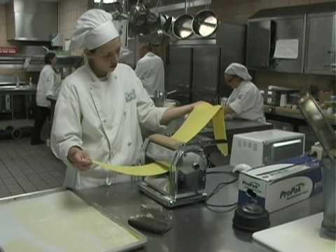
  Mise En Place Trailer
  (click on link)
(image from video)
Notes:
Click on hyperlink to view video:
Mise En Place Trailer
The title of the documentary comes from the French culinary term Mise En Place, the expression for everything in place the rigorous preparation of ingredients and equipment that leads to success in the kitchen. The documentary will follow Team Delhi as they learn that Mise En Place applies not only in the kitchen, but in life.
https://youtu.be/k411BjqGKUU

Slide 13
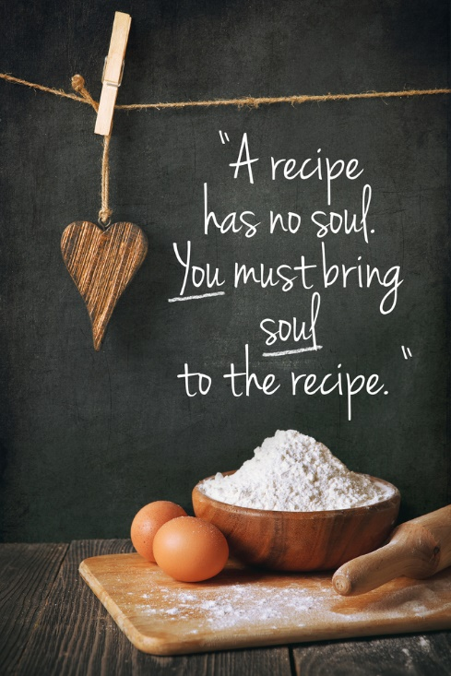
Notes:
What does this quote mean to you?

Slide 14
Let’s Review!
What is a standardized recipe?
What are some benefits of standardized recipes?
List the components of a standardized recipe.
What is a conversion factor?
What are the formulas to decrease or increase recipes?
What is mise en place?
How can a chef use work simplification in cooking?
What is mental readiness?
Notes:
Answers to the questions are found within the slide presentation or may vary with class discussion.

Slide 15

Questions?

Slide 16
References and Resources
  Images:
    Shutterstock™ images. Photos obtained with subscription. (Slides 1, 3, 4, 6, 7, 9, 10, 11, 13, 15)
  Textbooks:
    Culinary essentials. (2010). Woodland Hills, CA: Glencoe/McGraw-Hill.
    Draz, J., & Koetke, C. (2014). The culinary professional. Tinley Park, IL: Goodheart-Willcox Company.
    Foundations of restaurant management & culinary arts. (2011). Boston, MA: Prentice Hall.
  Websites:
    Institute of Child Nutrition
    Part of the School of Applied Science at The University of Mississippi, is the only federally funded national center dedicated to applied research, education and training, and technical assistance for child nutrition programs. It is funded by a grant administered through the United States Department of Agriculture (USDA), Food and Nutrition Service (FNS).
    http://www.nfsmi.org/

Slide 17
References and Resources
  Websites:
    What’s Cooking: USDA Mixing Bowl
    Food, Nutrition and Consumer Services works to harness the Nation's agricultural abundance to end hunger and improve health in the United States.
    http://www.whatscooking.fns.usda.gov/
  YouTube™:
    Mise En Place Trailer
    The title of the documentary comes from the French culinary term Mise En Place, the expression for everything in place the rigorous preparation of ingredients and equipment that leads to success in the kitchen. The documentary will follow Team Delhi as they learn that Mise En Place applies not only in the kitchen, but in life. https://youtu.be/k411BjqGKUU

