Slide 1
Restaurant Shark Tank Project
Restaurant Management
Notes:
Note: Images from the actual television series could not be used due to copyright rules.

Slide 3
Shark Tank
Notes:
Are you familiar with the TV show “Shark Tank?”
It is a television series that has aspiring entrepreneurs make business presentations to a panel of “shark” investors.
Do you have a great idea for a project but need money?
First, let’s find out about budgeting and forecasting to increase profits so that we can present our idea to investors.

Slide 4
Budgeting and Forecasting
Notes:
Budget is a guideline for spending money.
Forecasting is a prediction or estimation of a future event for a given time period

Slide 5
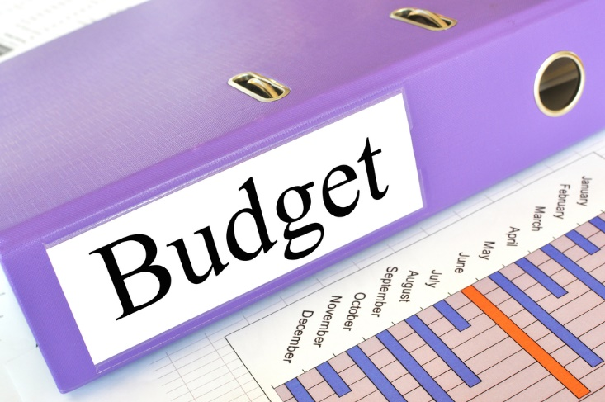
Budgets
Help businesses monitor spending
Key to maximizing profits
Lists anticipated sales and projected costs
Notes:
Management prepares the budget monthly or for longer periods depending on the organization.
Budgets are sometimes made by looking at the previous years’ spending while considering the forecast of revenue.

Slide 6
Types of Budgets
Annual
Estimated spending for one year, often divided by department
Long Range
Scheduling large expenditures
Monthly
Used to operate the business daily. Especially important for seasonal businesses
Notes:
Annual budgets are a prediction and estimation of the spending for a business for one year, usually the current year.
Then it often is divided by department and each department is expected to stay within their number for that year.
Long-range budget that will cover two to five years or more
This type of budget is good for scheduling large personnel growth and capital expenditures such as building expansion, property and large equipment.
A monthly budget is the natural extension of the annual budget and is used to operate the business daily.
Monthly budgets are especially important for seasonal businesses such as a cruise line.
Great care will need to be taken with each month’s budget to effectively reach the target budgets.
Looking at forecasts, revenue and budgets is the sound way to estimate the amount of company profits.

Slide 7
Forecasting
Future sales
Historical data
Predict future trends
Notes:
Forecasting depends on data from previous sales and can be used to predict future sales and trends.
It can be used to determine the amount to purchase for the next week, month or quarter.

Slide 8
Revenue
Also call sales
Money from the business from product sales
Notes:
Revenue is the actual money a company receives during a specific period including discounts and deductions for returned products.

Slide 9
Profits
All businesses want to make money!
Money left over after all expenses are paid
Profit = Revenue – Costs
Example:
Mario’s Bistro had a total sales revenue for the month of $125,000.00
Total costs for the month were $55,000.00
Profit equals $70,000.00
Notes:
Profits is money that is made in a business, through investing or selling a product after all the costs and expenses are paid.
Expenses include building rental, equipment, insurance, salaries, supplies, technology and utilities

Slide 10
Investors
Notes:
Thinking of expanding? Then you might need investors.
Investors put money to use, by purchase or expenditure, in something offering potential profitable returns, as interest, income or appreciation in value.
They invest their own money hoping for a return of more than they put in.

Slide 11
Recipe for Restaurant Profits
(click on link)
Notes:
Click on hyperlink to view video:
Recipe for Restaurant Profits: Restaurant Success Series from ICE and American Express Cutting corners is easy and fast, but could you end up leaving money on the table? Discover the number one thing you need to know to make money and be successful in the restaurant business. Plus, ICE’s experts will teach you why everything from the attire of your staff to the design of your flatware can boost or hinder sales. https://youtu.be/fEKyJyYbywM

Slide 12
Let’s Review!
What is a budget?
What are three types of budgets?
Which budget estimates spending for a year?
What does forecasting do?
What is revenue also called?
What is the equation for profit?
Who are investors?
Do you have a concept or product investors may be interested in?
Notes:
Answers to the questions are found within the slide presentation or may vary with class discussion.

Slide 13
Questions?

Slide 14
References and Resources
Images:
Microsoft Clip Art images. (Slides 3, 7, 8, 10)
Shutterstock™ images. Photos obtained with subscription. (Slides 1, 4, 5, 9, 12, 14, 15)
Textbooks:
Leugers, M. (2014). Controlling costs in foodservice. Tinley Park, IL: Goodheart-Willcox.
Reynolds, J. S. & Chase, D. M. (2014). Hospitality services. (Tinley Park, IL: Goodheart-Willcox.
YouTube™:
Recipe for Restaurant Profits: Restaurant Success Series from ICE and American Express Cutting corners is easy and fast, but could you end up leaving money on the table? Discover the number one thing you need to know to make money and be successful in the restaurant business. Plus, ICE’s experts will teach you why everything from the attire of your staff to the design of your flatware can boost or hinder sales.
https://youtu.be/fEKyJyYbywM

