Slide 1
Rewards and Challenges:
Development in Late Adulthood
Notes:
How old is old? Leonard Hayflick theorized that every animal species has a maximum lifespan, based on the ability of cells to replicate themselves. For humans, this appears to be about 110-120 years. That seems like a really, really long time, doesn’t it? However, as you age, so will the people around you, and your perspective will change.
Think about an elderly person that you know…someone in relatively good health. If they could live in that state of good health, would you want them to have another twenty or thirty years? What about yourself?
Let’s explore some of the rewards and challenges that occur during late adulthood.

Slide 3
“The secret of genius is to carry the spirit of the child into old age, which means never losing your enthusiasm.”
-Aldous Huxley
Notes:
What does this quote mean to you?

Slide 4

Research Tells Us That…
Although there are many physical changes that happen in later adulthood, most physical decline does not happen until people are quite advanced in age.
Notes:
Although there are many physical changes that happen in later adulthood, most physical decline does not happen until people are quite advanced in age. People are living longer and are in better health than ever before in history. Later adulthood is divided into three categories: the young old, the old, and the very old, which begins in the 90s.

Slide 5

Age Divisions of Late Adulthood
Late adulthood is usually divided into three periods:
the young old, ages 65 to 74
the old, ages 75 to 90
the very old, ages 90 and older
Notes:
The Social Security Administration defines late adulthood as individuals who are 65 years of age or older. Late adulthood is usually divided into three periods:
the young old, ages 65 to 74
the old, ages 75 to 90
the very old, ages 90 and older
Within each of those age divisions is a broad range of individuals with very different abilities and health statuses. The elderly are the fastest growing segment of the United States population. In 2003, 1 in 8 Americans were over the age of 65. By 2030, approximately 22% of the population will be over 65 (Polan).
Fortunately, changes in physical appearance related to aging occur gradually and offer the opportunity for adjustment as they happen. As couples grow old together, their roles may change significantly. Illness often causes changes in the role of nurse or caregiver. Retirement can also be a source of stress or conflict as couples adjust to being in each other’s presence more during the day.

Slide 6
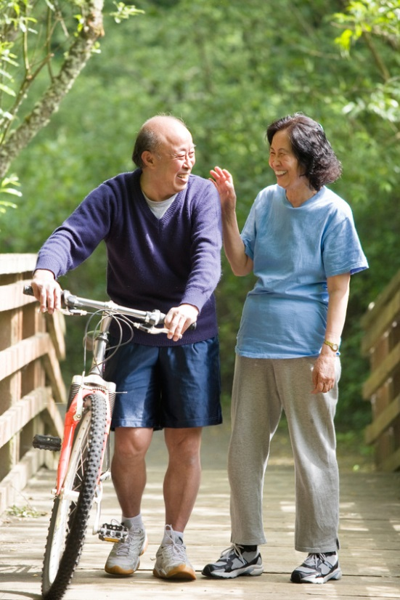
Physical and Cognitive Development
Notes:
Late adulthood comes with many changes. The two most evident are physical changes and changes in cognitive ability. We’ll begin our exploration with those.

Slide 7
On Your Handout, Write What You Know About
Physical Development in Late Adulthood
Cognitive Development in Late Adulthood
Notes:
Allow for questions and discussion.

Slide 8

Biological Theories of Aging
Why do we age?
Notes:
The question of aging has long troubled man. Biological development in late adulthood is generally observed in the effects of aging on the body and how these effects influence life expectancy. There are several theories with many possible answers, and we’ll explore a few of them.

Slide 9
Wear and Tear Theory
Aging is due to the cumulative effects of hard work and lifelong stress
Cells and tissues have vital parts that wear out, resulting in aging
First introduced by Dr. August Weismann, a German biologist, in 1882
Notes:
According to Dacey, “The wear and tear theory seems the most obvious explanation for aging, but there is actually little evidence for it. To date, no research has clearly linked early deterioration of organs with either hard work or increased stress alone.” Another type of wear and tear theory states that “as cells die, they must synthesize new proteins to make new cells. As this is done, occasionally an error occurs. Over time these errors mount up. This accumulation of errors may finally grow serious enough to cause organ failure.”

Slide 10
Mitochondrial Theory
As we age, mitochondria become less
efficient: less ATP production
Mitochondria are subject to free--radical damage
Anti--oxidants “protect” mitochondria
Notes:
Mitochondrial Theory: Aging is caused by the decay of mitochondria, tiny cellular bodies that supply energy for function, growth and repair.

Slide 11

Cellular Clock Theory
We die because our cells are programmed to do so.
Perhaps aging follows a biological timetable, maybe even a continuation of the one that regulates growth and development in our early years.
Notes:
Cellular Clock Theory: Cells have an internal clock that is genetically programmed to stop dividing after a certain number of reproductions.
The cellular clock theory was introduced by Leonard Hayflick. He believed that cells can divide a maximum of about 75 to 80 times. As we age, our cells become less capable of dividing. This theory states that we only live as long as we are “programmed” to live. It implies that we might be following a growth and development timeline, even into old age. However, there is little evidence to support this theory either.

Slide 12
Free-Radical Theory
Highly unstable molecules produced by metabolism react with our cells and cause mutations
These mutations cause cells to break down
Recent research has lead us to believe that genes do play a part in how long we live
How it actually works is still a scientific mystery
Notes:
Free-Radical Theory: Highly unstable molecules produced by metabolism react with our cells and cause mutations. These mutations cause cells to break down.
Recent research has lead us to believe that genes do play a part in how long we live. How it actually works is still a scientific mystery.
With free radical theory, though cleanup systems within cells exist, the damage is cumulative over time. Mitochondria, the engines of cell metabolism, are thought to play a central role because of the disproportionate free radicals they produce. The damage can lead to a range of disorders including cancer and arthritis.

Slide 13
Cell Replication
Every species in the animal kingdom has a maximum lifespan
Maximum lifespan is determined by genetically programmed limit on the number of times a cell can replicate itself
For humans, it appears to be about 110 – 120 years
Notes:
The cell replication theory states that every animal has a maximum lifespan, which is genetically determined by the number of times cells can reproduce themselves. This theory states that, for humans, it appears to be about 110-120 years.

Slide 14
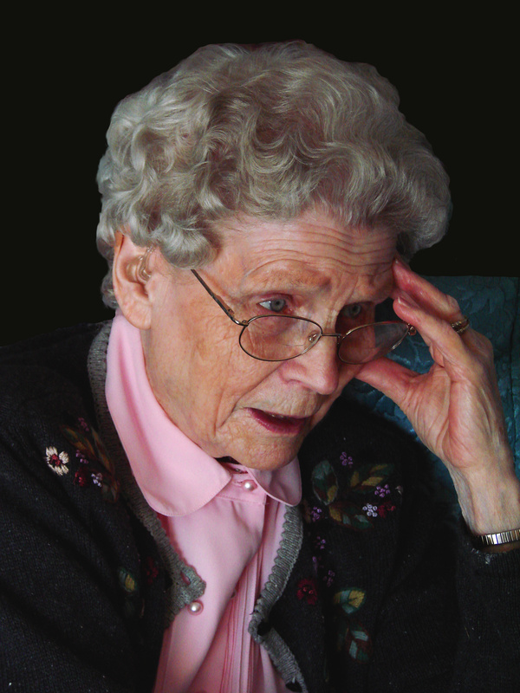
Hormonal Stress Theory
Long, elevated levels of stress-related hormones have been connected to increased risks of certain diseases:
Cardiovascular
Cancer
Diabetes
Hypertension
Notes:
Hormonal Stress Theory: Aging in the body’s hormonal system can lower resistance to stress and increase the likelihood of disease.
As people age, their hormonal stressors remain at elevated levels longer than when they were younger. These long, elevated levels of stress-related hormones have been connected to increased risks of certain diseases. Diseases include cardiovascular disease, cancer, diabetes and hypertension. This has also been linked to older adults experiencing a decline in immune system functioning.

Slide 15

Other Effects on Lifespan
Gender
Environment, such as water quality in some parts of the world
Disease
Accidents
Notes:
There are, of course, other reasons why people do not live to the expected age. Gender is a factor, as it is a well-known fact that women generally live longer than men. An early onset of illness and disease can impact our lifespans, as can accidents. When we talk about expected lifespan, we are talking about the age to which one is expected to live and die “of old age.”

Slide 16
Centenarians
Centenarians are people 100 years of age or older.
Notes:
Centenarians are people who are 100 years old or older. Do you know anyone in that age category? It appears that these people are simply more resistant to disease than other people.
What factors contribute to the survival of these people? Smith’s (1997) research suggests that, “although these people are not necessarily more robust than their contemporaries (whom they’ve outlived), they are relatively resistant to illnesses such as cancer and circulatory diseases.” [quoted by Dacey, p. 448]
Other possible explanations for longevity include:
Diet
Low-stress lifestyle
Caring community
Being active
Spirituality
Would you want to live to be 100 years old? Why or why not?

Slide 17
Physical Development
Notes:
What changes in physical appearance and movement characterize late adulthood?

Slide 18
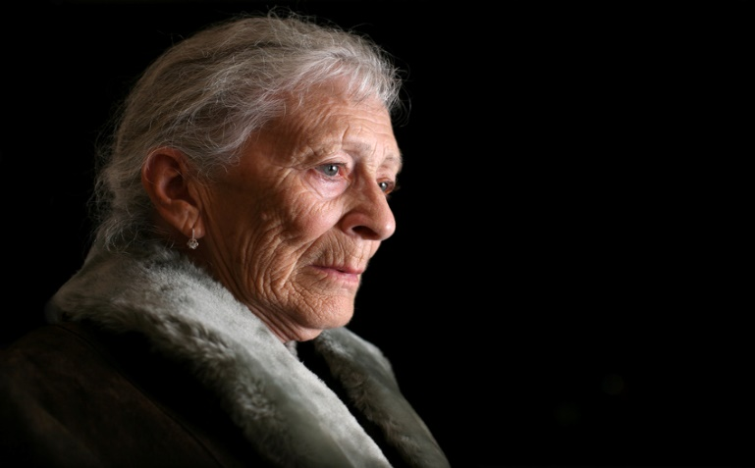
Physical Skills
Some skills decline as we grow older, particularly manual dexterity
While reaction time does decrease, sometimes this may be impacted by ageism
These abilities can be improved
Notes:
Older persons have a decreased reaction time. That is, it takes them a bit longer to respond than it used to. However, some research suggests that some of this is due to ageism, a prejudiced view that perceives older people to be less capable than younger people. If older people are treated in a condescending manner, they sometimes react with less self-assurance and less competence. This can seriously impact the quality of life for older people. Reaction time can be impacted by motivation, depression, anxiety, response styles and strategies.

Slide 19
Sensory Abilities
  Tips to protect your hearing:
  Stay away from loud or prolonged noises when you can.
  Turn down the music volume.
  Buy power tools that have sound controls.
  When you must be around noise, either at work or at play, use something to protect your hearing.
Notes:
Hearing begins to decline in middle age. Begin to protect your hearing health now so that the decline may be even less. It is so important to protect your hearing now, so that it will last as long as possible. Most people begin to lose hearing in their 40s, so protecting your hearing health is very important.

Slide 20

Sensory Abilities
Eye health
  Remember the value of regular checkups to ensure eye health.
  Any out-of-the-ordinary events should be immediately checked out.
Notes:
Another one of the senses we can protect is our sight. Proper eye care and regular well-visits can help extend our vision health.

Slide 21

Other Body Systems Undergo Change
Skeletal system
Skin
Teeth
Hair
Gastric system
Movement
Notes:
All of these systems are changing, just as they have been changing throughout our lifetimes. Declines in mobility, sight, hearing and depth perception may require older adults to seek living assistance.

Slide 22
Some Physical Things We Can Control
Eating for Health
Click on Links
Exercise for Enjoyment
Notes:
There are things we can do to increase our lifespans. Daily habits can make a big difference. Let’s look at two videos that talk about how the way we live our lives can impact our expected lifespans.
NIH Senior Health
Seniors can find answers to their medical questions from the comfort of their own homes.
http://nihseniorhealth.gov/videolist.html

Slide 23

Theories of Cognitive Development

Slide 24

Fluid Intelligence
Depends on the proper functioning of the nervous system
Measured by tasks that show age-related declines (speeded tasks, tests of reaction time)
On-the-spot reasoning ability
Notes:
Fluid intelligence describes our ability to think on the spot, reason and make decisions.

Slide 25
Crystalized Intelligence
Demonstrates the cumulative effect of culture and learning of tasks
Is a store of knowledge from the surrounding culture
Remains very stable throughout life
Older adults are better at such things as defining words, doing tasks that they have done in adulthood, grammar, and things that rely on general knowledge
Notes:
Crystalized intelligence is more about our long-term memory; things that have been hard-wired into our system.

Slide 26
Most Common Forms of Dementia
Alzheimer’s
  Discovered by German neurologist Alois Alzheimer in 1906, but did not gain attention until the 1970s
  Researchers now believe a gene is involved
  Difficult to diagnose and treat
Vascular Dementia
  Decreased blood flow to the brain
Notes:
The normal brain consists of billions of nerve cells (neurons), which convey messages to one another chemically. Alzheimer’s victims appear normal, but their brains are undergoing severe changes. Brain autopsies show severe brain damage, including the death of neurons. Once neurons die, they can never be replaced. New medications are being used that appear to preserve the health of nerve cells before they die.
No one knows what causes Alzheimer’s, but some possible causes are a virus, environmental factors, or even an overabundance of metal (primarily aluminum) accumulation in the brain. It appears that Alzheimer’s burns holes in the cells, impairing their function. There is some thought that large doses of vitamin E may help prevent the disease and may slow its progress. All these possibilities are currently being researched.

Slide 27
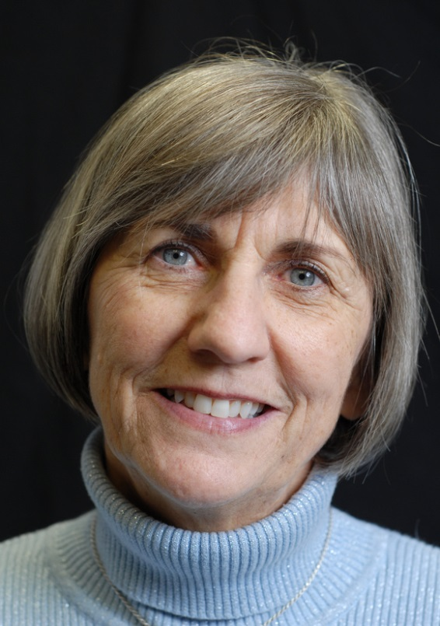
Cognitive Development
Diagnosing Alzheimer's Disease
(click on link)
Notes:
Here is a short video on diagnosing Alzheimer’s disease.
NIH Senior Health
Diagnosing Alzheimer’s Disease
http://nihseniorhealth.gov/alzheimersdisease/symptomsanddiagnosis/video/a3_na.html?intro=yes

Slide 28
Cognitive Rehabilitation
Cognitive rehabilitation teaches people to recall important information and improve daily tasks
The learning does not appear to be transient; abilities were maintained for three months following the rehabilitation
Notes:
If there are cognitive issues, we are learning that some of these things can be re-taught. People can learn how to recall important information and improve their daily tasks. It’s encouraging to note that the learning appears to “stick”; people really can learn and retain the information.
There are new ways to combat the key enzymes that contribute to Alzheimer’s. There are new understandings of how to immunize people against a protein that becomes abnormal, possibly contributing to Alzheimer’s. Human gene therapy may eventually offer a way to heal damaged brain cells. And, finally, there are new educational techniques to help people coping with Alzheimer’s.

Slide 29

Preventing Memory Loss
Preventing Memory Loss
(click on link)
Notes:
As we age, it is also important to exercise our minds. Various types of games and mental gymnastics can help. In addition, if people feel good about themselves, we know that they are better-equipped to maintain their mental capabilities. As younger people, we can help the older people we know feel competent and self-confident. Do you have any suggestions about how we can do that?
Are there things we can do to help memory loss? A recent Harvard Health Publication had some ideas. Let’s visit that site and read what it has to say.
Harvard Health
Preventing memory loss: Seven preventative steps.
www.health.harvard.edu/newsweek/Preventing_memory_loss.htm

Slide 30

Societal and Cultural Changes
Notes:
Do gender roles change in late adulthood? Explain.
How does society and culture impact the lives of the elderly in our country/in our town?

Slide 31
Did you know?
In 1900, the over-65 population was 3 million, only 3% of the total U.S. population
Today, 23 million men and women over 65 constitute 12% of our population
By the year 2040, it will have reached 20% of the population

Slide 32
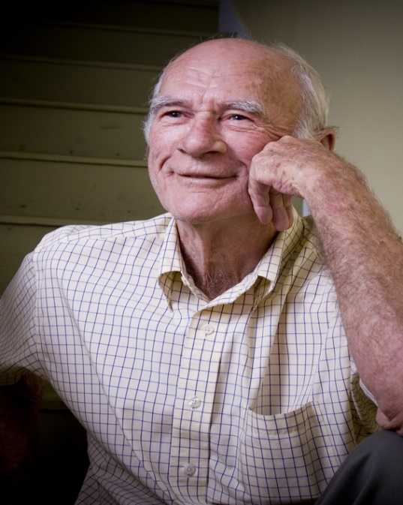
Societal and Cultural Changes
Age Discrimination Act
Increasing retirement age
Effect of a mobile society on caring for elderly family members
Technology
Others?
Notes:
Society has changed greatly when it comes to the way older adults are treated. The Age Discrimination Act of 1967 was a big step forward in older adults being treated fairly in the workplace. The age of retirement is increasing. Our mobile society has changed the way families interact. Technology impacts us all, including the elderly. We’ll discuss all of these topics. Do you have other comments about the way society and culture impacts adults in later life?

Slide 33
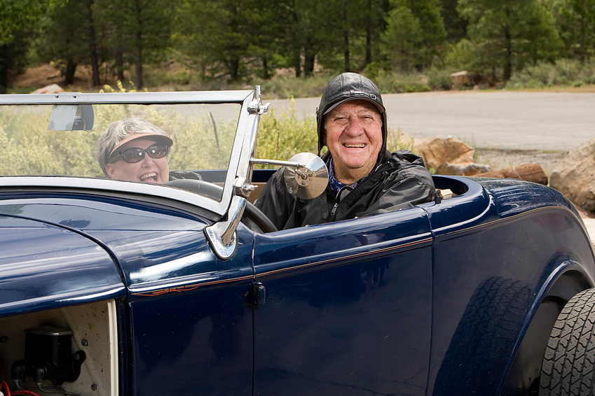
Age Discrimination Act
“The Age Discrimination in Employment Act of 1967 (ADEA) protects individuals who are 40 years of age or older from employment discrimination based on age.”
Notes:
In 1967, the Age Discrimination Act (ADEA) was passed into law. This act protects individuals against acts of ageism in the workplace. In a way, this heralded a change in our society’s attitude about late adulthood. The ADEA’s protections apply to both employees and job applicants. Under the ADEA, it is unlawful to discriminate against a person because of his/her age with respect to any term, condition or privilege of employment, including hiring, firing, promotion, layoff, compensation, benefits, job assignments and training.

Slide 34

Increasing Retirement Age
What do you think? Should the full retirement age be raised to 70?
  Over the last 20 years, personal savings have decreased in the United States.
  79% of baby boomers have plans to work during retirement.
Notes:
Full retirement age for many baby boomers is now 67. Do you think it should be raised to 70? Why or why not?

Slide 35

Effects of Mobile Society
Families are more mobile.
Often this means they are not physically close.
How can ties be strong under these circumstances?
What does this mean for the elderly?
Notes:
As our society becomes more mobile and transient, families are often separated by great distances. How can we keep strong family ties under these circumstances? How can technology help? What problems does this mobile society create for the elderly? How are people you know handling these situations?

Slide 36

Technology
Computers
Cell phones
Alarm systems
Digital televisions
Satellite radio
Convection cooking
Self-parking cars
Notes:
Technology has turned our society on its head. It has completely changed the way we live. How has this technology changed the lives of the elderly people that you know? One aspect is that these technological changes can be very intimidating to older people, particularly if they are patronized by the younger people in their lives. One way we can help older people use new technologies is to encourage their independence and self-confidence.

Slide 37
Our Responses to the Elderly
Gratitude
Respect
Neglect
Elder abuse
Notes:
Nobel Laureate Elie Wiesel emphasized the need for gratitude to the elderly for their role in helping us remember the lessons of the past (Abeles, 1997; cited in Dacey, 2009). Another aspect should be respect for their experiences and wisdom. One organization showing respect for the activities of the (now) elderly is Honor Flight, an organization that honors veterans from all wars, but is currently focused on the few remaining World War II veterans.
Unfortunately, the opposite side of the coin is also exhibited. Elder abuse and neglect is a wide-spread, though rarely-reported, problem. As the aging population grows, it is inevitable that these problems will continue. As a society, we must become educated about these issues and work to eradicate them.

Slide 38
Elder Abuse
According to the World Health Organization:
“Elder abuse is a violation of human rights and a significant cause of illness, injury, loss of productivity, isolation and despair.”
Notes:
Why do you think elder abuse would be considered a violation of human rights?
Current research indicates most cases of abuse are committed by people known and trusted by the elderly person. Sadly, most are family members, including adult children and spouses as well as strangers or caregivers. Abusers have no specific type. They can be men or women of any age, race or socio-economic status.
The 2010 Census recorded the greatest number and proportion of people age 65 and older in all of decennial census history. This census indicated 40.3 million or 13% of the population fell in this category. Numbers are uncertain, but one study found 7.6-10% of participants had experienced abuse that year. Other studies have shown 1 in 14 cases are never reported, and financial exploitation was self-reported at 41 per 1,000 surveyed.

Slide 39
What are the Warning Signs of Elder Abuse?
Bruises, abrasion, burns
Unexplained withdrawal from activities or unusual depression
Sudden changes in financial situations from exploitation
Bedsores, unattended medical needs, poor hygiene, unusual weight loss
Belittling, threats, and other uses of power and control by spouses are indicators of verbal or emotional abuse.
Tense relationships and frequent arguments between caregiver and elderly person are also signs.
Notes:
Who do I call if I suspect elder abuse?
If the abuse is serious or dangerous, call 911 or local police.
You can contact Eldercare Locator on weekdays at 1-800-677-1116.
In Texas, you can call 1-800-252-5400.
Go to the NCEA website and find out other resources specific to your location.
Why should I care about elder abuse?
You should care because it can happen to anyone. It is up to loved ones to be vigilant and make progress in reducing the likelihood of their family members being abused.
Look up the NCEA fact sheet, “Why Should I Care about Elder Abuse?” for more information at:
http://www.ncea.aoa.gov/Resources/Publication/docs/WhatIsAbuse_2010.pdf

Slide 40
Family and Other Relationships
Notes:
What characterizes the relationships of older adult parents and their adult children?

Slide 41

How do Family Relationships Impact our Later Years?
Gender role changes; both men and women; move toward androgyny.
How does widowhood impact the family?
Notes:
In later life, both men and women tend to take on some of the aspects of the other gender. Women may become more tolerant of their aggressive characteristics, whereas men may become more tolerant of their more nurturing aspects. Do you think this has an impact on the family?
How does widowhood impact the family? What things have to be put in place when such an event occurs?

Slide 42
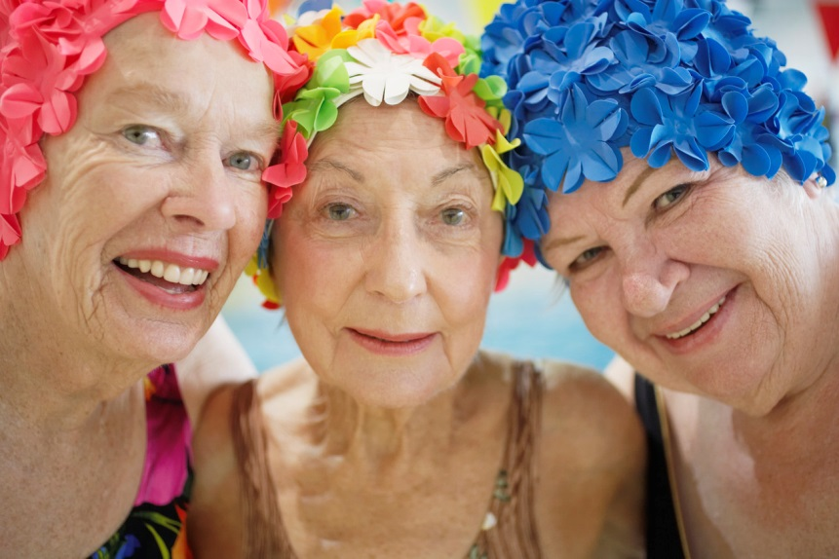
How do Relationships With Others Impact Our Later Years?
It appears that the number and extent of friendships that a person has does not directly affect lifespan.
These relationships are related to quality of life.
Notes:
Friendships remain important in late adulthood, even into very, very old age. Persons who interact with others tend to be happier and show fewer signs of depression.

Slide 43
Think About the Discussion on Elder Abuse
How do positive relationships with family and friends impact the risk factor for abuse?
Do you know of any elderly people who are alone in their homes or who are in some type of care facilities and never receive visitors?
Notes:
How do positive relationships with family and friends impact the risk factor for abuse? Do you know of any elderly people who are alone in their homes? Do you know some who are in care facilities and receive few visitors? How can we help these people? How can we encourage people to stay in close contact with their elderly relatives?

Slide 44

Socializing With Others
Senior Centers
(click on link)
Notes:
Community agencies and entities can be valuable social centers for older adults.
NIH Senior Health
Senior Centers.
http://nihseniorhealth.gov/longtermcare/communitybasedservices/video/seniorcenters_na.html?intro=yes

Slide 45
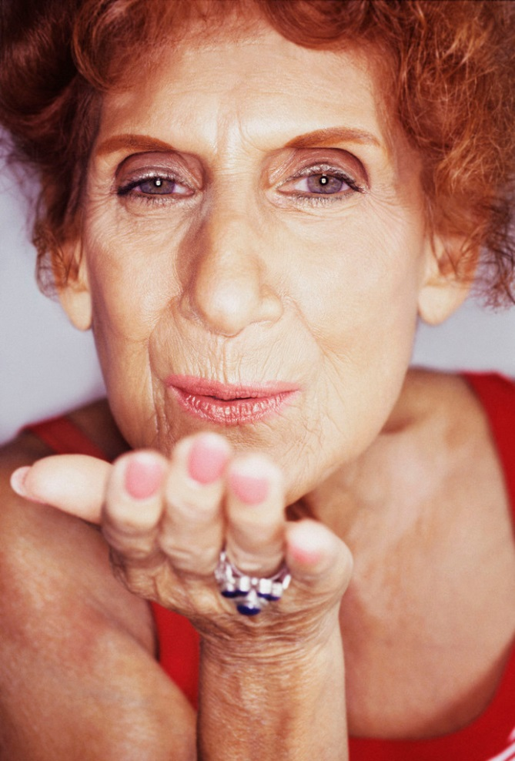
To Summarize
Our senior years really can be our golden years
Much of our health and well-being is in our own hands
Notes:
Finally, late adulthood is not something to be feared, merely something to be approached with preparation and eagerness. It is another developmental stage of life.

Slide 46

Questions?

Slide 47
References and Resources
Images:
Microsoft Clip Art: Used with permission from Microsoft.
Journals:
Eastman, P. (2000, January). Scientists piecing Alzheimer’s puzzle. AARP Bulletin, 41 (1), 18–19.
Kunlin, J. Modern Biological Theories of Aging. Aging and Disease. v.1(2); October, 2010. PMC2995895
Textbooks:
Dacey, J. , Travers, J. and Fiore, L. (2009). Human development across the lifespan. (7th). Columbus, OH: McGraw-Hill
Santrock, J. (1997). Life-span development. (6th). New York, NY: McGraw-Hill.
Welch, K. (2012). Family life now. 2nd. New York, NY: Allyn & Bacon.

Slide 48
References and Resources
Websites:
American Association of Retired Persons (AARP) Public Policy Institute
Raise the full retirement age.
http://www.aarp.org/content/dam/aarp/research/public_policy_institute/econ_sec/2012/option-raise-the-full-retirement-age-AARP-ppi-econ-sec.pdf
Harvard Health
Preventing memory loss: Seven preventative steps.
www.health.harvard.edu/newsweek/Preventing_memory_loss.htm
National Center on Elder Abuse (NCEA)
The NCEA is the place to turn to for up-to-date information regarding research, training, best practices, news and resources on elder abuse, neglect and exploitation.
http://www.ncea.aoa.gov/
National Institute on Aging (NIH)
NIH SeniorHealth features authoritative and up-to-date health information from Institutes and Centers atNIH
http://nihseniorhealth.gov/videolist.html
National Library of Medicine
Aging changes in the senses.
http://www.nlm.nih.gov/medlineplus/ency/article/004013.htm

Slide 49
References and Resources
North Dakota State University
Making Sense of Sensory Changes as We Age.
http://www.ag.ndsu.edu/pubs/yf/famsci/fs1378.pdf
Ohio State University Extension Service
Sensory Changes.
http://ohioline.osu.edu/ss-fact/pdf/0174.pdf
Society for Human Resources Management
The future of retirement.
http://www.shrm.org/research/futureworkplacetrends/documents/visions0305.pdf.
Videos:
NIH Senior Health
It can help seniors find answers to their medical questions from the comfort of their own homes.
http://nihseniorhealth.gov/videolist.html

