Slide 1
Principles of Applied Engineering
  How to Make a Model Rocket

Slide 3

Set a Goal
Set a specific goal for:
  How high you want your rocket to go
  How long you want it to take to land
  How gently your rocket will land – place an egg inside to see if your rocket can land without breaking it
  Or any other goal. Example: Place a small RC car inside the rocket and program it to activate on landing and exit the rocket

Slide 4
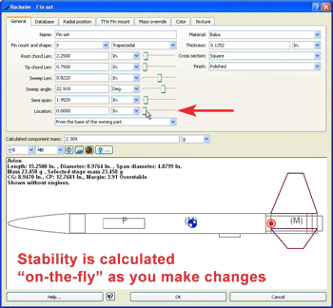
Research
Research formulas about rocket stability, the forces on a rocket, and basic rocket construction techniques
Formulas can help you predict how high your rocket will go
RockSim software is helpful to design your software
Nasa.gov is a helpful resource for basic rocket construction

Slide 5
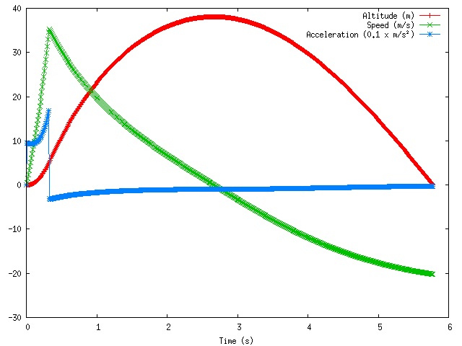
Helpful Formulas
F=1/2xpxv^2xAxcd where F==force of drag, p=density of air, v=velocity of rocket, A=reference area of rocket, cd=coefficient of drag
The reference area is the area seen from the top view of the rocket
The velocity of the rocket can be estimated using RockSim

Slide 6
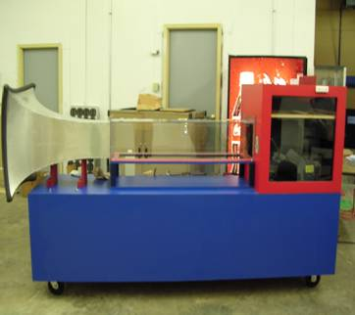
Formulas Continued
Force is equal to the change in momentum with respect to the change in time
Force=(m(v))(d/dt)
Use a wind tunnel and measure the speed of the wind at 0 seconds and at 1 second. Also find the mass of the rocket at 0 seconds and at 1 second
The force = (final massxfinal velocity-initial massxinitial velocity)/(final time-initial time)
Coefficient of Drag=F/(.5×p×v^2×A)

Slide 7
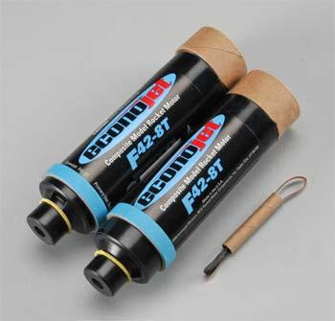
Brainstorming
Begin sketching designs for possible rockets
Parts that you should consider are: parachute/streamer, body material and size, nose cone length, engine type, and fins
Also consider placement of the center of mass and placement of movable mass
Use RockSim to estimate how your possible designs will perform
Decide on a design to construct
Order the parts that you need
Order an extra set of parts while you are ordering. You will probably have a few crash landings

Slide 8
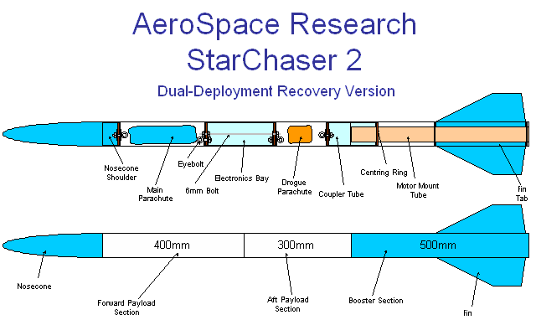
Brainstorming Continued
Use RockSim to estimate how your possible designs will perform
Decide on a design to construct
Order the parts that you need early
Order an extra set of parts while you are ordering. You will probably have a few crash landings
Consider making two rockets of different designs so you can choose the best one in the end

Slide 9
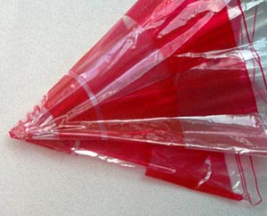
Construction Tips
Measure the mass of the parts that you obtained and enter those masses into RockSim – the default RockSim masses may not be the same. Make any necessary adjustments
Include flame-retardant recovery wadding above the engine mount to keep the parachute/streamer from burning
Make a compartment for the altimeter to keep it stable, and drill four 1/8 inch-diameter holes in the body tube around the altimeter casing so the altimeter makes accurate readings

Slide 10
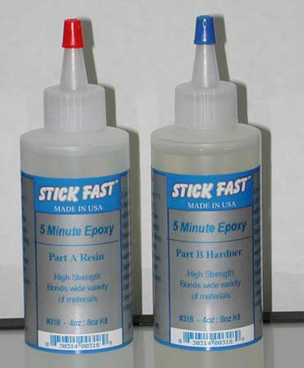
Construction Tips Continued
The parachute must be folded correctly – do not just shove it in the rocket
Use epoxy to glue the fins in place, and consider using epoxy to reinforce the edges of the fins. Be careful with the epoxy. Do not get it on you
The engine should fit snuggly in the engine mount. It may help to put masking tape around the outside of the engine spiraling from top to bottom. This adds just enough circumference to the engine that will fit firmly. This can also work on the nose cone.

Slide 11
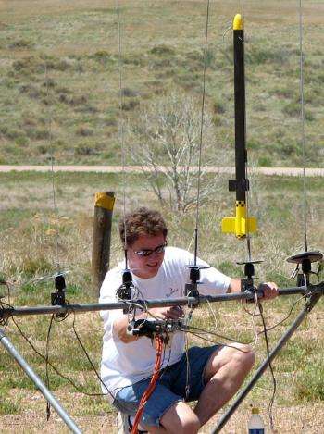
Flying
Get a launching site approved. You can not just launch anywhere
Check the weather before you launch. Try to pick the least windy day
Point the launch-stick slightly against the wind when launching
Use a device to detect when a plane is coming
The wind can take a rocket very far. Make sure you know to watch where the rocket comes down

Slide 12
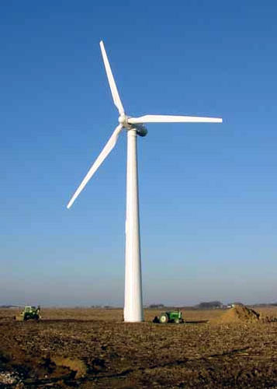
Evaluation
Compare your actual results to your goal and your RockSim results
Make any necessary design adjustments to meet your goal
It may take many flights to find the best solution, so test your rockets far before any deadline to allow for bad weather and time to fix and adjust your rockets
RockSim is helpful, but not always accurate in real life. Trial and error is the best method in the end. You will probably go through many designs and rockets before you find a successful one

Slide 13
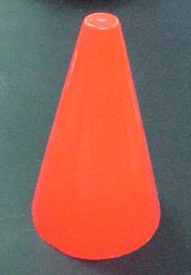
Challenge
Create a bottle rocket that can fly 150 feet and come down safely with the use of a parachute.
Carry an egg in the bottle rocket. Build the rocket so that the egg does not break upon landing
A bottle rocket will require more readily available and cheaper materials. This would be a good way to learn about rocket fundamentals before really building the real thing

Slide 14
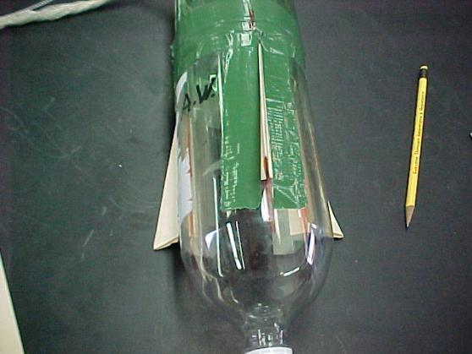
Bottle Rocket
Materials needed will be: 2 2-liter bottles, one small plastic cone, duct tape, scissors, string, manila folder, large plastic trash bag, masking tape and a hole puncher
You will use the manila folder as material to make the fins
Pressurized water will be the propellant for the bottle rocket

Slide 15

Challenge
Create a rocket that can safely carry a remote control car or other mobile device, and engineer the device to activate upon contact with the ground, and move out of the rocket tube safely
One possibility: Use an RC car or mechanical bug that has an on/off switch. Include a spring in your rocket that will compress upon landing, and therefore retract, also which would act like a pogo stick and flip the switch on the car/bug

Slide 16
Reference
Hayhurst, Pat. "Mr. Hayhurst's Quick and Easy Bottle Rocket." LnHS Home Page. NSTA, 7 Nov. 2004. Web. 25 May 2010.

