Slide 1
Safety and Sanitation Guidelines
Hospitality Services

Slide 3

Hospitality Industry Goals
  Make sure guests feel:
    Good
    Safe
    Happy
    Welcome
Notes:
We will focus on safety in this lesson. Safety and Sanitation Guidelines slide presentation is divided into three sections: • Guest Safety and Sanitation Basics • Emergency Situations • Equipment Safety and Maintenance

Slide 4
Guest Safety and Sanitation Basics
  Safety
  Liability Limits
  Key Control Procedures
  Health Inspections
  Cleaning and Sanitizing
  Sanitizing Guest Rooms

Slide 5


Safety
  Guests expect:
    Food to be wholesome and safe
    Personal belongings to be safe
    Equipment to be in safe working order
    Hospitality businesses to be prepared for accidents and emergencies
Notes:
When guests visit restaurants, hotels, and other hospitality businesses they expect all food to be wholesome and safe. Customers expect their persons and their belongings to be safe when they stay at lodging properties. Guests also expect hospitality businesses to be prepared for accidents and emergencies.

Slide 6
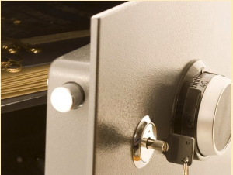
Liability Limits
  Depends on the situation
  Safe deposit boxes available
  Innkeeper’s Laws
    Limits the amount of money a hotel must pay a guest
Notes:
Liability means responsibility to pay for damage or loss. The degree of liability depends on the situation. Most hotels provide a safe deposit box or an in-room safe for guests to place valuables. Most states have rules that protect hotels by limiting the amount of their liability for losses and is known as Innkeeper’s Laws. A limitation of liability is a limit on the amount of money that a hotel must pay a guest for a loss of property. Hotels must post signs that explain liability limits and provide a safe for valuables.

Slide 7
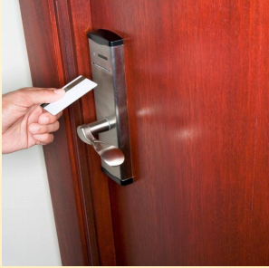
Key Control Procedures
  Systems:
    Hard key
    Electronic key
  Key card
    Size of a credit card
    Made of:
      Plastic
      Metal
      Pressed paper
Notes:
Hard key system – a metal key fits into a keyhole in a lock. Less expensive in the beginning but guests forget to return them at checkout. They can be lost or stolen and then the locks have to be replaced and new keys made. In the long run, they are more expensive. Electronic key system – “key” is actually a card with a magnetic strip that contains the room combination. More expensive in the beginning but if lost or stolen, the computer can cancel combination. Key card fits into a special lock in the door, where the magnetic strip is read. If the combination matches, the door is unlocked. They do not have the room number or hotel information on them.

Slide 8

Health Inspections
  Conducted regularly by local health department
  Inspections include:
    Kitchen
    Storage
    Bar
    Restaurant areas
Notes:
Inspectors look for compliance with sanitation standards, the absence of pests, proper care and handling of food, proper food storage techniques, and correct temperature of wash water.

Slide 9
Cleaning and Sanitizing
  Cleaning removes food and dirt from surface
  Sanitizing reduces pathogens on a surface to safe levels
  Prevents the spread of pathogens to food.
    Steps:
      Clean the surface
      Rinse the surface
      Sanitize the surface
      Allow the surface to air-dry
Notes:
Click on the hyperlink Sanitizing the Kitchen to view the video. All surfaces must be cleaned and rinsed. Such as: •Walls •Storage shelves •Garbage containers Any surface that touches food must be cleaned and sanitized. Such as: •Knives •Stockpots •Cutting boards Sanitizing the Kitchen Consumers can protect themselves by preventing the spread of germs by both cleaning and sanitizing surfaces where food is prepared. This video explains how to make sanitizing solution with ingredients most people already have around the house. http://youtu.be/_9IhS2jv2OM This solution can also be used to sanitize work surfaces.

Slide 10

Sanitizing Guest Rooms
  Bathrooms
    Sink
    Toilet
    Tub
    floor
  Linens
    Sheets
    Pillowcases
    Pillow protectors
    Towels
    Washcloths
Notes:
Guest rooms often provide good places for pathogens to grow. Many different people use them every day and even bring germs with them. Bathrooms and laundry must be cleaned and sanitized to prevent illness.

Slide 11
Emergency Situations
  Emergencies
  Safety Guidelines
  Fire Extinguisher
  First Aid and CPR
  Threats

Slide 12

Emergencies
  Emergency Action Plan
    Fire
    Natural disasters
    Medical emergencies
    Industrial accidents
    Civil disturbances
Notes:
Fires can result from: •careless handling of cigarettes and matches •defective electrical wiring •defective appliances and heating equipment •grease buildup in ventilation hoods •unattended flames in the kitchen •flammable liquids Natural disasters include: •Weather emergencies •Hurricanes •Tornadoes •Lightning •Blizzards •Flooding •Earthquakes Medical emergencies include: •Minor injuries •Life-threatening events Industrial accidents include: •Chemical spills •Gas explosions •Toxic chemical releases •Nuclear power plant accidents Civil disturbances include: •Riots •Acts of war •Workplace violence •Terrorist attacks

Slide 13
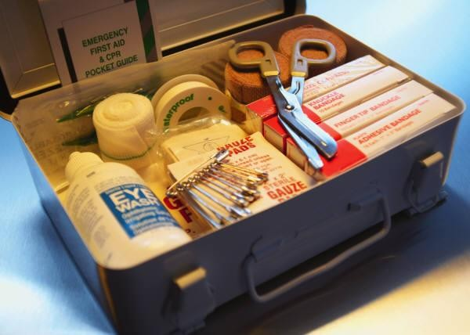
Safety Guidelines
  Be sure to locate:
    Potential dangers
    Emergency exits and routes
    Handwashing stations
    First aid kits
    MSDS information
Notes:
Be aware of your surroundings and locate: • any potential dangers • where to exit in case of emergency

Slide 14
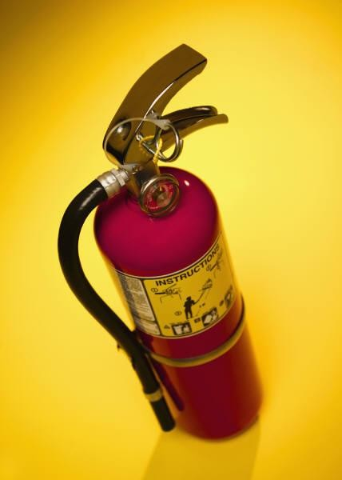
Fire Extinguisher Tutorial
  Know how fire extinguishers are classified
  Inspect the fire extinguisher
  Decide if you will evacuate or stay and fight
  Remember the acronym PASS
    Pull the pin
    Aim at the base of the fire
    Squeeze the lever
    Sweep back and forth
Notes:
Click on the hyperlink Fire Extinguisher Tutorial to view the short video. Training video for using a fire extinguisher http://youtu.be/2Z2C13gJh-g Step 1: Know how fire extinguishers are classified Know how fire extinguishers are classified. Class A extinguishers are for common combustibles like paper or wood; Class B are for flammable liquids; and Class C are for electrical fires. The Red Cross recommends ABC classified fire extinguishers for home use. Step 2: Inspect the fire extinguisher Inspect the fire extinguisher before use. Read instructions and warnings; check that the pressure gauge needle is in the green portion of the gauge; and check for a clogged nozzle, a broken seal, or other damage. A fire extinguisher won’t work if it’s not properly charged. The pressure gauge measures the charge. Step 3: Decide if you'll evacuate or stay and fight Decide if you’ll evacuate or stay and fight the fire. Consider the size of the fire, the amount of smoke in the room, and whether there is a reliable escape route. Step 4: Remember the acronym PASS Remember the acronym PASS. It stands for Pull, Aim, Squeeze, and Sweep. Step 5: Pull the pin that unlocks the operating handle Pull the pin or ring that unlocks the fire extinguisher’s operating handle, and aim the extinguisher at the base of the fire. Aim at the fire from 6 to 8 feet away. Step 6: Squeeze extinguisher lever to discharge contents Squeeze the extinguisher lever to discharge its contents, and sweep the hose back and forth until the extinguisher is empty. Food Network star Alton Brown used a carbon dioxide fire extinguisher, a water cooler bottle, and a tennis racket to make a fruit smoothie on television.

Slide 15
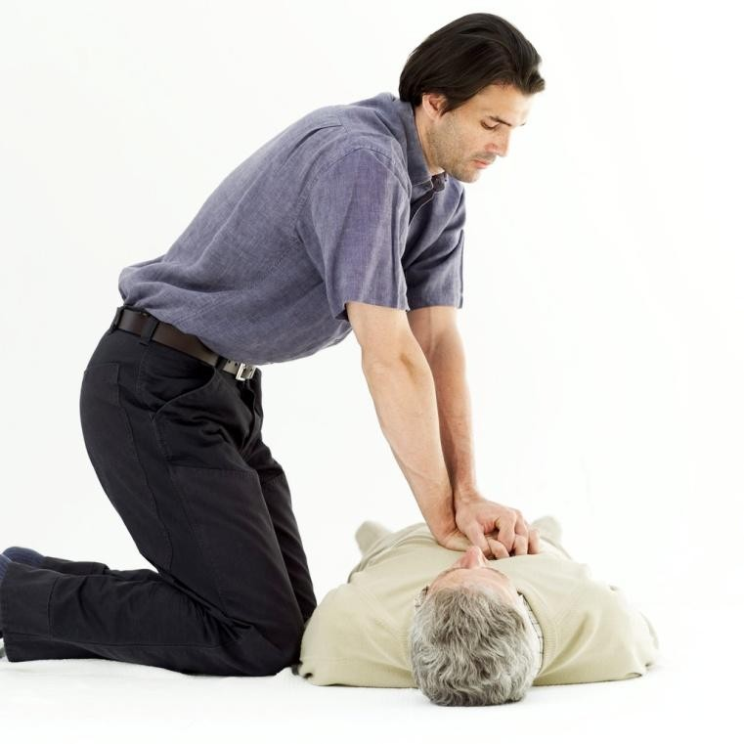
First Aid and CPR
  Examine the victim
  Determine what is wrong
  Choose an appropriate treatment
  Carry out that treatment
Notes:
First aid is a treatment given to an injured or suddenly ill person before professional medical care arrives. Access to a first aid kit is beneficial. Encourage students to enroll in a hands-on first aid and CPR course from the American Red Cross, the American Heart Association, or the National Safety Council. Click on hyperlink to view short video on CPR. Official 2012 Hands-Only CPR Instructional Video Learn how to perform CPR in this 60-second video showing Hands-Only CPR in action http://youtu.be/zSgmledxFe8

Slide 16



Threats
  People
  Hazards and accidents
  Natural disasters
Notes:
People include: • trespasser – a person who enters a place of business or a guest room who does not belong there • intruder – a person who enters a place of business or a guest room who does not belong there • criminal – a person who has committed a crime • terrorist – a person who tortures or kills people for a political cause • thief – a person who robs and steals property from people and places • arsonist – someone who sets fires • burglar – a person who enters a building for the purpose of committing a crime • employees – sometimes steal money, supplies, hotel property, and guests’ property • guests – sometimes steal hotel property (towels and blankets) Hazards and accidents include: • fires • slips and falls • equipment breaking • illness Natural disasters include hurricanes, tornadoes, floods, and earthquakes.

Slide 17
Equipment Safety and Maintenance
  Engineering
  Safety

Slide 18
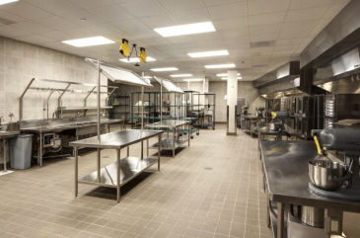
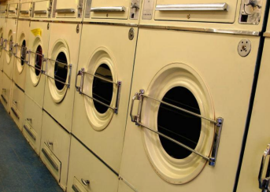
Engineering
  Concerned with keeping all equipment in good working order
  Provides preventive maintenance for:
    Kitchen equipment
    Laundry equipment
Notes:
Most restaurants and hotels contain a variety of equipment. Much of the equipment in restaurants and hotels is potentially hazardous and engineering is charged with keeping all items in good working condition.

Slide 19

Safety
  Equipment in restaurants and hotels is potentially hazardous
  Engineering is charged with:
    Preventing disasters
    Minor repairs
    Replacement of unsafe equipment
Notes:
The purpose of engineering is to keep the facility in top condition for safety, guest satisfaction, and profitability.

Slide 20
References/Resources
  Images:
    Microsoft Office Clip Art: Used with permission from Microsoft.
  Textbook:
    Reynolds, J. S. (2010). Hospitality services: Food & lodging. Tinley Park, IL: Goodheart-Willcox Company.
  YouTube™:
    Fire Extinguisher Tutorial
    Training video for using a fire extinguisher
    http://youtu.be/2Z2C13gJh-g
    Official 2012 Hands-Only CPR Instructional Video
    Learn how to perform CPR in this 60-second video showing Hands-Only CPR in action
    http://youtu.be/zSgmledxFe8
    Sanitizing the Kitchen
    Consumers can protect themselves by preventing the spread of germs by both cleaning and sanitizing surfaces where food is prepared. This video explains how to make sanitizing solution with ingredients most people already have around the house.
    http://youtu.be/_9IhS2jv2OM

