Slide 1
Say What? The Communication Process
  Interpersonal Studies
Notes:
Communication is a process and not a skill. The process involves a sender and a receiver, encoding and decoding of messages, the channel or media in which the message travels and barriers or filters. Communication involves a layering of many processes in an effort to be successful.
How many people have you communicated with today?
How did you communicate with them?
Were you successful in conveying your message? Why or why not?

Slide 3
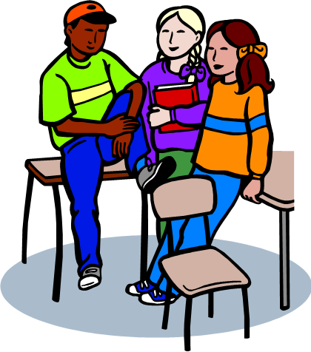
What are some examples of communication between individuals?
Notes:
Possible answers:
E-mail
Hand-written note or letter
Nonverbal communication
Print media
Telephone
Texting
Social media
Verbal communication
Video messaging
Do you feel you are an effective communicator?
What does an effective communicator look like? Sound like?
Why is it important to be an effective communicator?
Has your lack of communication skills ever affected a relationship? Workplace? School?

Slide 4
The Communication Process
Sender
Receiver
Encoding
Decoding
Message
Notes:
Sender is the person who initiates the communication. The sender must, in some verbal or nonverbal manner, pass the message along to another.
Encoding is the means by which the sender makes the message understandable to the receiver. Encoding is accomplished through language or some other method.
Message is what is being communicated. The message is the part of the communication that must be recognized and understood.
Decoding is the process of recognizing the message being sent. The receiver must use his or her skills (verbal and nonverbal) to try to determine the message being sent.
Receiver is the person to whom the communication is directed. The receiver intercepts the message and hopefully interprets it correctly.

Slide 5
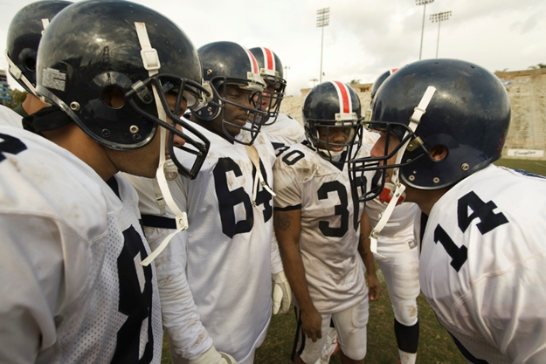
Types of Communication
  Impersonal communication
  Interpersonal communication
Notes:
Impersonal Communication
one-way communication processes
used to give basic information such as company policies, instructions or facts
generally, organizations use memos, letters, e-mail, voice mail or bulletin boards (quick easy ways to “get word out”)
limitations of impersonal communication:
people receiving information usually have no opportunity to ask sender questions or to clarify vague wording
Interpersonal Communication
occurs when people involved talk and listen (dialogue)
for true communication to take place:
message must be understood by the person receiving information in the same way the sender intended
feedback is the way to make sure message has been understood
limitations of interpersonal communication:
takes more time than impersonal type

Slide 6

Interpersonal Communication
Notes:
How to Improve Interpersonal Skills
This VideoJug presentation shows you how to improve your interpersonal skills with the aid of some simple coaching techniques.
http://youtu.be/w97dR3OJB1k

Slide 7
What are communication filters?
Notes:
Have you ever had problems getting your message across to your parents, teachers, peers or an employer?
What happened?
What were the end results?
What caused the breakdown in communication? The breakdown in communication was impacted by communication filters. Communication filters are things like biases, attitudes and emotions that affect our perceptions of others.

Slide 8

Communication Filters
  Semantics
  Emotions
  Attitudes
Notes:
Semantics
Semantics are words or labels that stand for something, and the meanings of words lie within us. Many words have less precise meanings than others and are interpreted by different people in different ways. During a conversation, semantics can be used to mask the true feelings or intentions of the individual. Politicians and diplomats are exceptionally adept with the use of semantics! It is important to be precise and explicit in communicating with individuals.
Emotions are the most powerful communication filter.
a sender who is emotional or angry is perceived differently
emotions can prevent the receiver from hearing what the speaker has to say
emotional state can make the listener too susceptible to the speaker’s point of view
it is important to detach one's self from emotional feelings and think of verbal content
Attitudes are beliefs backed up by emotions; deeply embedded ideas and feelings. Attitudes can be present when the:
receiver is bias towards accents, ethnicity, mannerisms, dress, demeanor or physical characteristics
sender is bias towards the listener’s ethnicity, mannerisms, dress, demeanor or physical characteristics
receiver and/or sender are bias towards the other's opinions (religious preference, gender orientation, political viewpoints or social perspectives)
receiver is impressed with the speaker's looks, voice, dress or mannerisms, and is therefore more likely to be receptive to the message
Have you ever experienced communication problems due to semantics, emotions or attitudes? What happened?

Slide 9

Communication Filters
  Role expectations
  Gender bias
Notes:
Role expectations are how people expect themselves and others to act.
Communicators with role expectations expect a person to stay within the confines of a particular role and tend not to listen when he or she talks “outside” his or her expected role (example: your best friend, who has never dated, is telling you how to treat a boy/girlfriend).
They also refuse to allow people to change their roles and take on new ones (example: elections for cheerleader tryouts, homecoming queen, team caption or job promotions). Sometimes people use roles to alter the way they relate to others (example: see themselves as brainy, outgoing or macho).
Gender bias is the tendency to impact messages received from the opposite gender. An example would be a “woman’s place” or a “man’s work.”
Have you ever experienced communication problems due to role expectations or gender bias? What happened?

Slide 10
  What are nonverbal messages?
Notes:
Ask students for examples of nonverbal messages.
Is this a sufficient way of communicating? Why or why not?

Slide 11

Nonverbal Messages
  Language of the eyes
  Common eye language
    Touching
    Blinking
    Averting
    Dilated pupils
    Constricted pupils
    Expressions
Notes:
Nonverbal messages are the “silent messages” of our bodies.
Research indicates that our nonverbal messages carry five times as much impact as verbal messages when verbal and nonverbal messages match:
they give the impression that we can be trusted and that what we are saying reflects what we truly believe
when body language contradicts spoken words, listeners become confused, lose trust and question credibility in the speaker
Language of the Eyes
the eyes transmit more information than any other part of body
because eye contact is so revealing, people generally observe unwritten rules about looking at others
the amount of eye contact is dependent on culture
in the United States, a direct, prolonged stare between strangers is usually considered impolite or even aggressive
people entering elevators or other crowded areas will glance at others briefly, acknowledge their presence and then look away
in business settings, people expect more direct eye contact; the general rule is when communicating in a business setting, your eyes should meet the other person’s about 60 to 70 percent of the time
Common “Eye Language”
deceit – touching eye, increased blinking of eyes, averting eyes
like being in someone’s presence – dilated pupils
dislike being in someone’s presence – constricted pupils
expressions: sparkling eyes, playful eyes, deceitful eyes, sad eyes or scared eyes

Slide 12

Nonverbal Messages
  Gestures
  Proxemics
Notes:
Gestures:
nonverbal messages are sent every time individuals cross their arms, place a finger by their mouths, clench their hands or cross their legs
gestures indicate whether people are open or closed to communication, how comfortable an individual is in a given situation and who is the true leader of a group
often individuals who agree with the speaker will mirror the speaker’s posture or expressions
gestures common in American culture have dramatically different meanings to people from outside the United States
a. nodding one's head up and down means “yes” in most countries but means “no” in Greece and Bulgaria
b. the common American gesture of nonchalantly folding your arms in front of you shows disrespect in Fiji
Proxemics are how people define their personal space and position themselves around others. Edward Hall is an American anthropologist who pioneered a study which determined the spatial needs of humans. Comfort zones are invisible buffers by which we define our personal space.
a. Public comfort zone – (4 feet to 12 feet)
1) range of distance that is placed between individual and strangers
2) (for example: sales person, new acquaintance or maintenance person)
b. Social comfort zone - (1 ½ feet to 4 feet)
1) range of distance that is placed between individuals at social functions
2) (for example: weddings, church, parties or neighborhood gatherings)
c. Intimate comfort zone (6 inches to 18 inches)
1) range of distance that is placed between individuals with whom we are emotionally and physically close
2) (for example: family members, spouse, boy/girl friend or close friends)
3) population density factor
a. people from highly populated areas limit their personal space out of spatial necessity
b. people from rural areas extend the radius of personal space
4) cultural factor
a. Europeans and Asians have a social zone that is comparable to our intimate zone

Slide 13
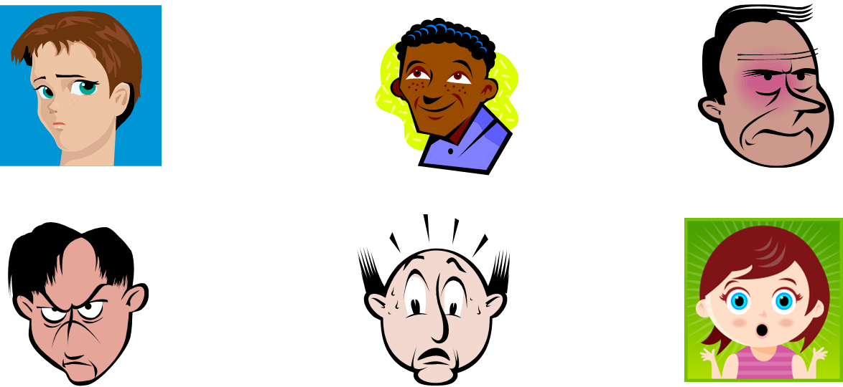
Most People Express and Can Recognize
Six Basic Emotions
Notes:
These are all examples of nonverbal communication.
Have you ever seen these emotions with a family member? Friends? Co-workers? At school?

Slide 14
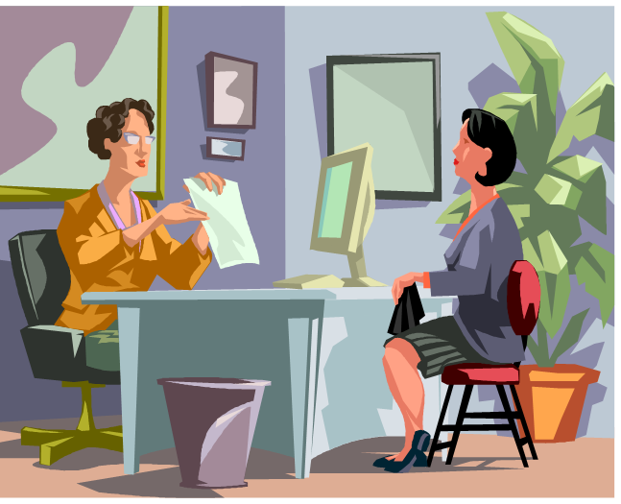
Using Nonverbal Messages in a Job Interview
  As easy as P.I.E.
    Poise
    Interest
    Expressiveness
Notes:
Here is what the research tells us: There are three things that you want to convey nonverbally in a job interview. It's as easy as P.I.E.
Poise. Research clearly shows that people with poise come off best in job interviews. What is poise? It is when an individual appears confident, comfortable and in charge of his- or herself. He or she is able to control nervous behavior and appears attentive and "ready to take on the world." It is important to practice interviewing so that you are able to gain this sense of confidence and display that confidence and poise nonverbally.
Interest. It is important that you nonverbally (and verbally) indicate that you are interested in the job, the company and the interviewer. Do not yawn, look bored or look away. Make eye contact (of course not too much eye contact - it's not a stare-down contest), be attentive and lean forward slightly.
Expressiveness. Demonstrate high, positive energy and put some positive emotions into your answers. You should present yourself in a positive way nonverbally, including smiling occasionally (but not too much, and don't smile inappropriately or at the wrong time). Definitely do not scowl, display anger or roll your eyes.

Slide 15
Nonverbal Messages in a Job Interview
Click on Picture
Notes:
Interview Tips - The Most Important Interview Non-Verbal
Do you know what the most important interview non-verbal is? Watch this video to find out.
http://youtu.be/tAGWhnpcYlA

Slide 16
Who is responsible for effective communication?
Notes:
Ask the students this question and proceed with a discussion.
What does effective communication look like? Sound like?

Slide 17
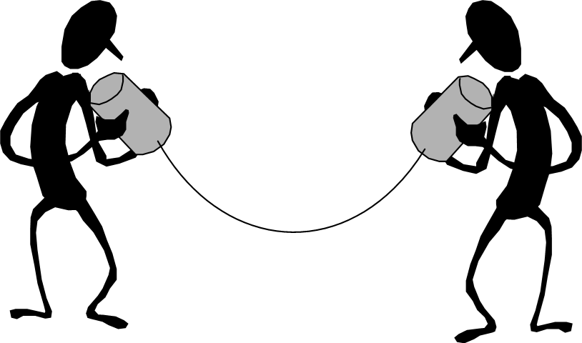
Responsible Effective Communication
  Both sender and receiver share equal responsibility.
Notes:
Who is responsible for effective communication?
both the sender and receiver share equal responsibility
the communication loop is complete when the receiver understands, feels or behaves according to the message of the sender
receivers must provide senders with enough feedback to ensure that an accurate message is passed through all the filters that might alter it

Slide 18

Influences on Effective Communication
  Body language
  Culture
  Environment
  Feelings
  Location
  Past experiences
  Perception
  Situations
Notes:
Body language – Things such as gestures, facial expressions and posture comprise body language.
Culture – Certain cultures have rules about communicating with others.
Environment – Heat and cold alter communication. We usually communicate more effectively when we are comfortable.
Feelings – Anger, sadness, happiness and excitement can all affect how we communicate. We often say hurtful things in a fit of anger.
Location – We also tend to communicate more effectively in a location with which we are familiar and feel comfortable.
Past experiences – Past experiences with people or situations can affect communication.
Perception – (A mental image; a comprehension or understanding of something) Comprehension and understanding of things varies from individual to individual.
Situations – Stressful situations can alter communication. Unfamiliar situations may affect communication.

Slide 19

Improving Personal Communication
  Send clear messages
  Use words carefully
  Use repetition
  Use appropriate timing
  Develop listening skills
Notes:
Improving Personal Communication
Send clear messages
don’t talk too fast
don’t be too verbose
be aware of communication filters
ask purposeful questions to make sure you were understood
Use words carefully
use simple and precise language
avoid words that might be vague
avoid technical language and trendy jargon
Use repetition
studies show that repetition is an important element in ensuring communication accuracy
use parallel channels of communication: verbal instructions followed by memo, text or note
Use appropriate timing
not wise to communicate when receiver is extremely busy, angry or upset
Develop listening skills
research from Ohio State University has shown the amount of time people spend on different parts of communication process:
listening—45%
speaking—30%
reading—16%
writing—9%
people listen at a 25% efficiency rate in typical situations
discrepancy between rate of speaking and rate of hearing—
people speak approximately 150 words per minute
listening capacity is about 450 words per minute
because the message is usually much slower than our capacity to listen, we have plenty of time to let minds roam, think ahead and plan what to say next

Slide 20


I-Statements versus You-Statements
  I-Statements
    Focus on your point of view
      I see…
      I feel …
      I think …
      I wonder …
      I wish …
      I plan …
      I believe …
      I can …
      I want …
  AVOID You-Statements
    You shouldn’t say that…
      You just need to get over that…
      You never do anything right…
      You are so gullible…
      You always bring up old issues…
      You need to be more responsible…
      You just need to forget what happened…
      You don’t know what you are saying…
Notes:
What is an I-statement and what is a You-statement?
Individuals need to learn to clearly speak up for themselves. Using I-statements to express thoughts, feelings and ideas can help us speak for ourselves - from our point of view.
You-statements are negative and often place blame or attack the receiver. How many times has someone made negative comments to you? Were you able to get your point of view across?
I-statements give you the responsibility and control over what you communicate to others.
Do you ever have a hard time telling someone how you really feel or how you really think? Maybe a friend asked to lend him or her $50.00. Perhaps you were not sure how to say no without hurting his or her feelings. You lend him or her $50.00 and now you are worried about making your car payment. Learning how to use I-statements can give you more control over what you communicate to others. How would you use an I-statement to say no to your friend?
Possible answers:
I see you need help but I have a car payment that is due day after tomorrow. I am really sorry.
Teacher note: Ask students for additional responses to this scenario using I-statements as listed on this slide. You may assign a scribe to write the responses on the board.
You-statements attack the receiver’s self-esteem. As a result, the receiver responds in a defensive manner. The person may feel that his or her thoughts, opinions or plans are unimportant. Some feelings the receiver might experience are:
Angry
Defensive
Hurt
Inadequate
Inferior
Labeled
Resistant
Stubborn
Worthless
Do you think this is an effective way to communicate? Has anyone ever made you feel like this during a conversation? Have you ever made someone feel defensive during a conversation? What happened?

Slide 21

Listening Skills
  Active listening
  Empathic listening
Notes:
Active listening is the process of feeding back to the speaker what listeners think the speaker meant.
cultivate listening attitude
focus full attention
take notes
ask questions
Empathic Listening
practice objective listening
accept what is said even if you don’t agree
take time to hear what the person has to say
What are some situations where you are required to be an active listener? Empathic listener?
Are you a good listener?

Slide 22
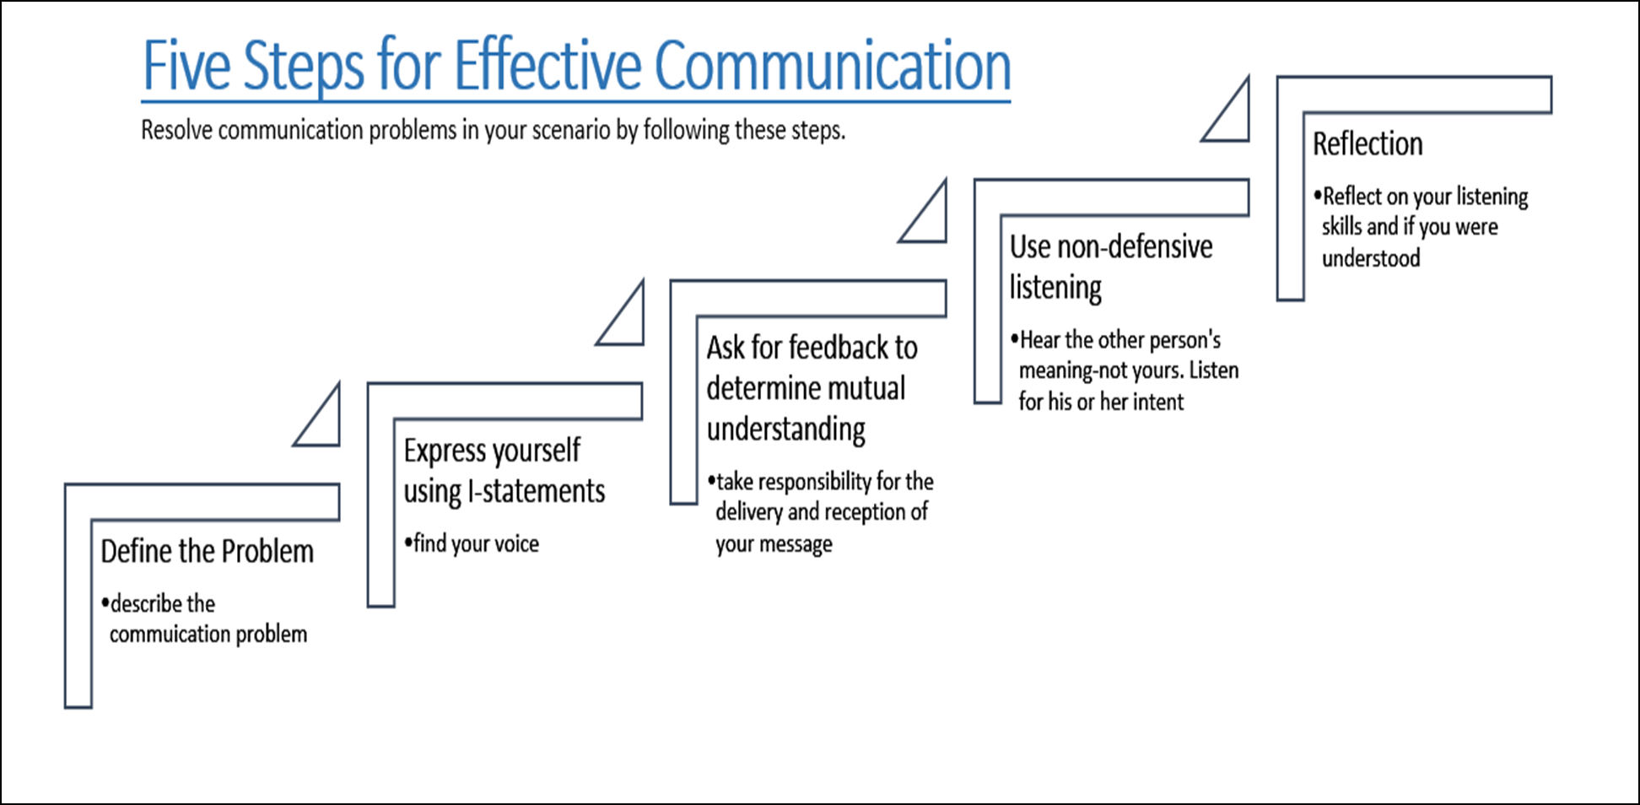
Notes:
1. Define the problem. Take time to understand what the problem is to gain a fuller perspective on what you want to communicate.
2. Express yourself without blaming the other person. By taking responsibility for your own feelings, you can convey your message. For example, “I feel angry when you do not listen to me.”
3. Ask for feedback to determine if there is a mutual understanding. Do not assume the other person understood what you said. Assumptions have started more than their fair share of arguments. If the other person did not understand you, this is the time to adjust what you said for better understanding.
4. Stop what you are saying, thinking and doing to give the other person your full attention. Hear what the other person is saying. Listen for his or her intent.
5. Reflect on the communication process. What was the outcome? Was your message heard and understood? Was there a mutual understanding? Were both members of the communication process satisfied with the outcome?

Slide 23

Communication - Component of a Healthy Relationship
Notes:
Why do you think communication is an important component of a healthy relationship?

Slide 24

Good Communication
  What are four ingredients to successful communication?
Notes:
What are the four ingredients to successful communication in a relationship?

Slide 25

Good Communication
  Four Ingredients to Successful Communication
    Empathy
    Keeping in touch
    Sharing your ups and downs
    Listening
Notes:
Good Communication
Four Ingredients to Successful Communication
What is empathy? Empathy allows you to understand how your significant other feels without sharing the same feelings at the moment.
Keeping in touch: Talking about thoughts or feelings to keep up-to-date if your partner’s view has changed; recounting your day with each other
Sharing your ups and downs: Sharing support and guidance
Listening: Poor listening blocks effective communication, so talk honestly and listen carefully
What are some other tips which promote good communication between couples?

Slide 26

Problem Solving and Communication
  Good listening is fundamental to a satisfying relationship
Notes:
There is a saying that goes, “We cannot help but communicate.” Even if our intent is to say nothing and to provide no feedback to another person, we are constantly communicating nonverbally through our facial expressions, eye contact and body language. When the verbal messages we send are not congruent with our body language, the listener may be unclear as to the meaning of the spoken words. In other words, message sent is often a message not received because our words do not match our body language; we are sending a mixed message.
The term positive affect is used in regard to communication and couple satisfaction. It is interesting to note that showing signs of affection, verbally and nonverbally, is important throughout marriage and enhances marital satisfaction. The research findings of Gottman and Levenson (2000) indicate that the absence of positive affect—not the presence of negative affect—was highly predictive of later divorce.
Good listening is fundamental to a satisfying relationship. Some examples of principles and techniques of effective communication are the attitude of listening, avoiding interruption and criticism, discovering how things look from your partner’s point of view, and listening sympathetically. Active listening involves paying close attention to what the other person is saying and is coupled with giving feedback.
Good communication fosters couple satisfaction and is an important component of family cohesion (emotional bonding of family members). Some characteristics of strong families include an appreciation for one another, positive communication, a high degree of commitment, a spiritual orientation and how family members can foster positive feelings for other family members

Slide 27

Questions?

Slide 28
References and Resources
  Images:
    Microsoft Clip Art: Used with permission from Microsoft.
  Textbook:
    Sasse, C.R. (2004). Families today. New York: Glencoe/McGraw Hill.
  Websites:
    Free Management Library
    Online integrated library for personal, professional, and organizational development. This site is filled with information on interpersonal skills, listening, verbal, and nonverbal communications.
    http://managementhelp.org/communicationsskills/index.ht

Slide 29
References and Resources
    TruceWorks
    Five Steps for Effective Communication in a Relationship
    http://truceworks.com/resources/five_steps_effective_communication
  YouTube™:
    How to Improve Interpersonal Skills
    This VideoJug presentation shows you how to improve your interpersonal skills with the aid of some simple coaching techniques.
    http://youtu.be/w97dR3OJB1k
    Interview Tips – The Most Important Interview Non-Verbal
    Do you know what the most important interview non-verbal is? Watch this video to find out.
    http://youtu.be/tAGWhnpcYlA

