Slide 1
Selection and Care of Clothing: Part I
Principles of Human Services

Slide 3
Acceptable Clothing for a Job Interview

Slide 4

What is the purpose of a job interview?

Slide 5

What qualities is an employer looking for?

Slide 6

The Job Interview
As an interview candidate, you have your foot in the door, but so do all the other candidates who are being interviewed.
Impressions DO count when evaluating someone, particularly for a professional position.

Slide 7

Interview Success
Interview success includes:
Being on time
Dressing conservatively
Giving a firm handshake
Maintaining good eye contact
Monitoring your response time to questions
Watching your body language

Slide 8
Job Interviews for Teens
For any job interview, it's important to impress the interviewer from the moment you arrive. Learn what you should and should not do during the interview so you can avoid embarrassing faux pas!
Job Interview Tips for Teens
(click on link)

Slide 9
Interview Attire
Professional dress is not just about clothes, but overall professional appearance.
You will want your possible future employer to be impressed with your look, but you do not want to upstage the interview.

Slide 10

Men’s Clothing
A man can wear a suit.
A male should wear a button-up shirt with or without a simple neck tie.
Make sure clothes are clean, pressed and in good condition.

Slide 11

Women’s Clothing
Women can also wear a suit in traditional colors.
Conservative colors are most appropriate.
Dress appropriately

Slide 12
Caring for Your Clothes

Slide 13
How do you maintain and properly care for your wardrobe?

Slide 14
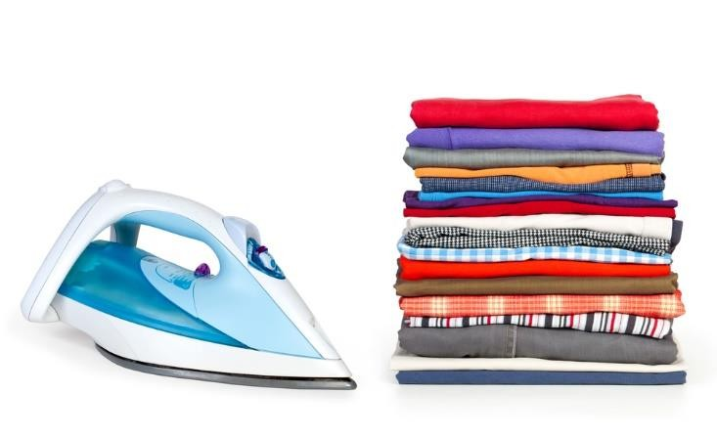
How to Take Care of Your Clothes

Slide 15
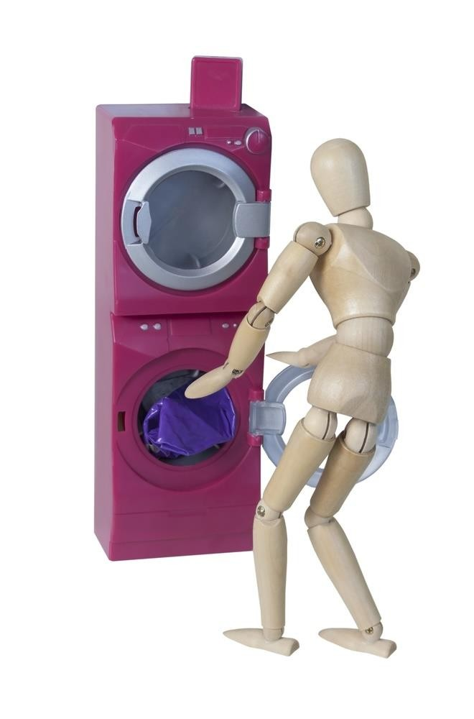
Washing Your Clothes

Slide 16
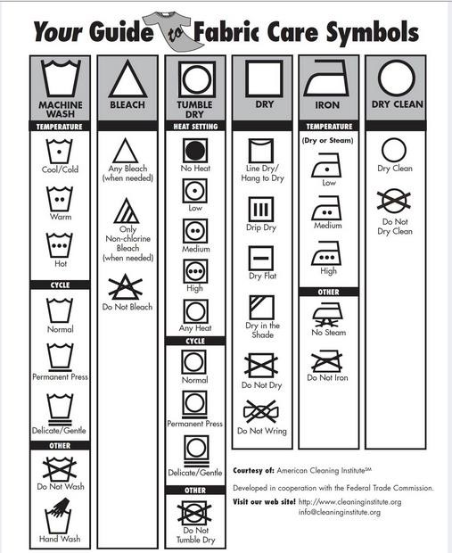
Fabric Care Symbols

Slide 17
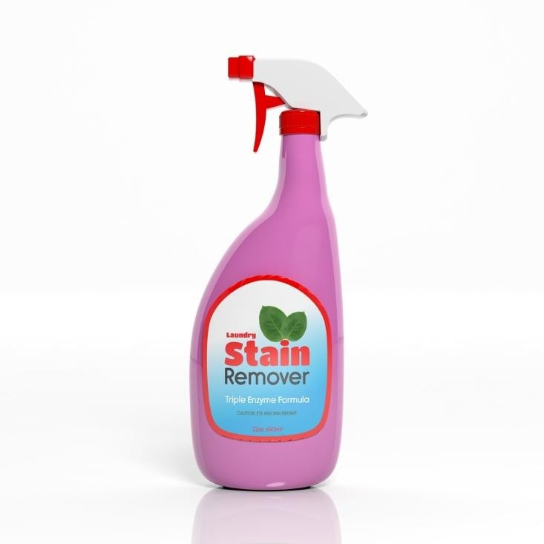
Stain Removal Chart

Slide 18

Lipstick Stain

Slide 19
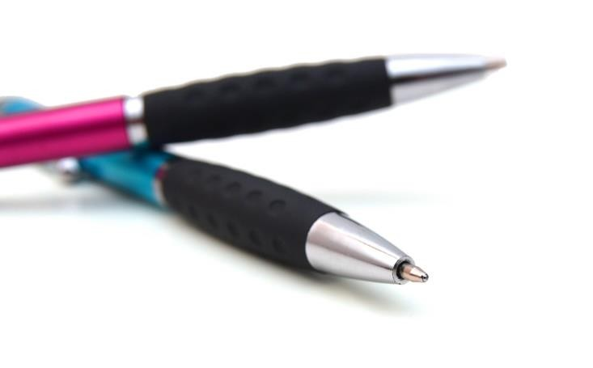
Ink Stain

Slide 20
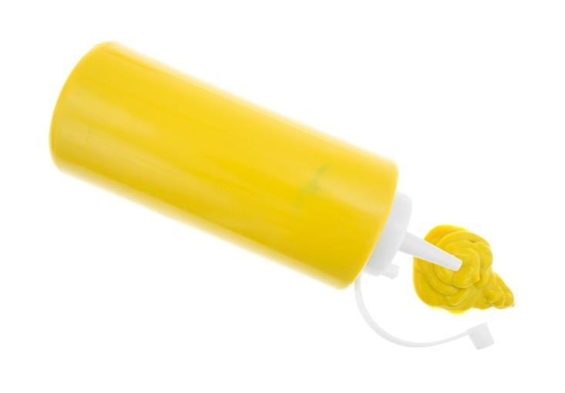
Mustard Stain

Slide 21

Melted Wax Stain

Slide 22
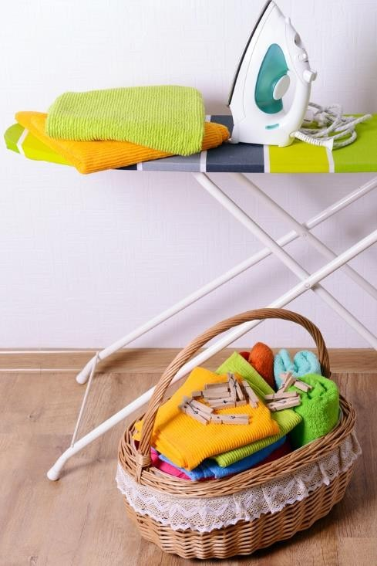
Ironing Your Clothes
Check the care label before pressing your garment
Ironing helps clothes look sharp and pressed

Slide 23
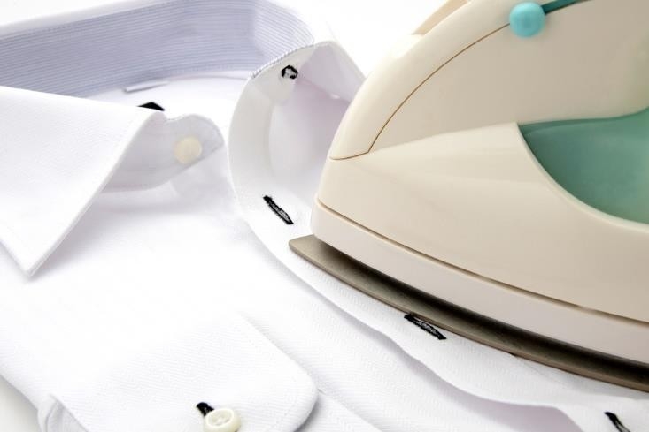
How to Iron Clothes

Slide 24
Developing a Personal Wardrobe Plan

Slide 25
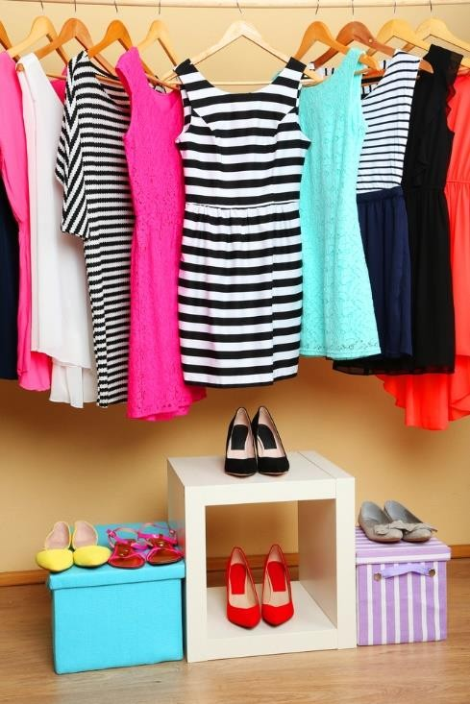
Selecting and Buying Clothes
Have a shopping plan
Selecting and buying clothes should involve the decision-making process
Take an inventory of your wardrobe to help you make good purchasing decisions

Slide 26

Clothing Needs versus Wants
Clothing needs include clothing items that are necessary for the individual to be comfortable, protected and appropriately dressed for daily activities
Clothing wants include clothing items that the individual wishes to have

Slide 27
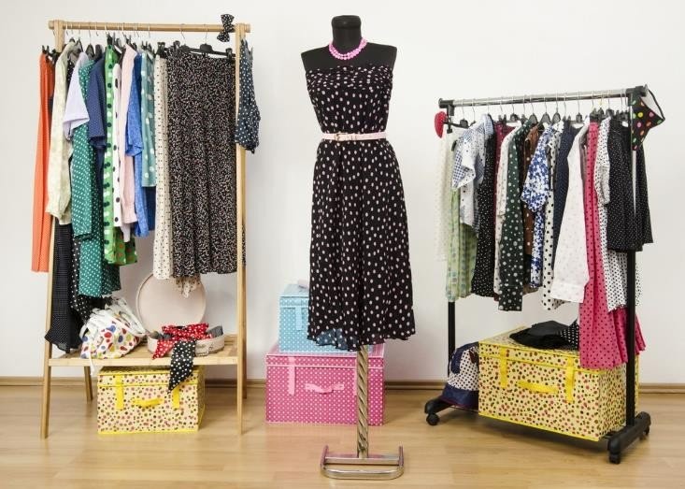
Clothing Considerations
When you are shopping for new clothes, consider the following determining factors:
Can I wear it for more than one season?
Is the item a good value?
Does it hold its shape well?
Does it resist wrinkles?
Is it comfortable to wear?
Is it durable and long lasting?

Slide 28
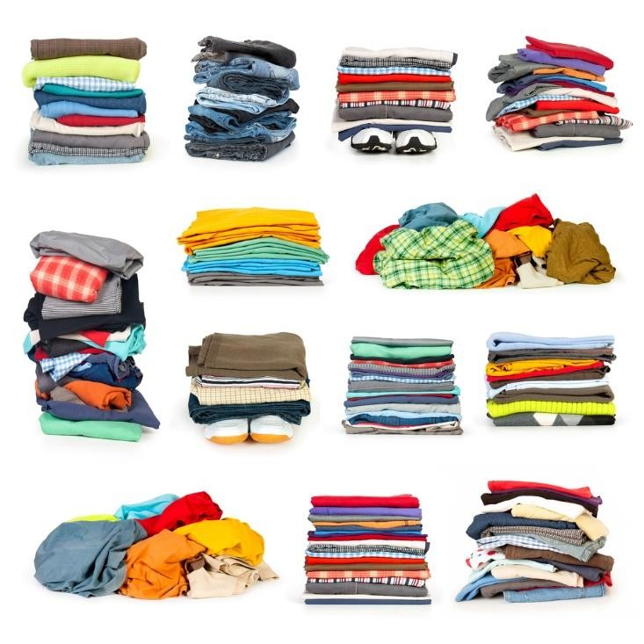
Clothing Factors

Slide 29

Identifying Quality in Clothing
Tips for determining quality in garments:
Be sure buttons are sewn on tight
Check the construction of the garment on the inside
Check the seams; look for undone threads, tears or loose seams
Determine if fabric is wrinkle-resistant
Look through the fabric to examine for a tight weave
Ensure that patterns such as plaids or stripes line up at the seams

Slide 30
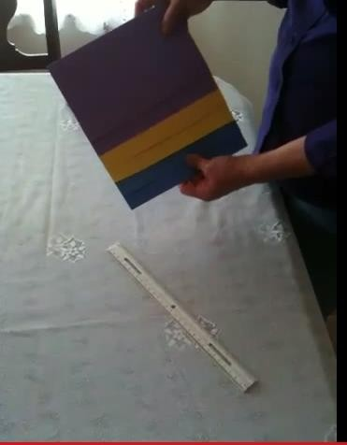
Six Panel Organizer

Slide 31
Review
Name five tips for selecting proper attire for a job interview.
Why is it important to give a firm handshake at a job interview?
What are two benefits of properly maintaining your clothing?
Why is it important to always check the care label before you wash a garment?
List four tips for determining quality in garments.

Slide 32
References and Resources
Images:
Microsoft Clip Art: Used with permission from Microsoft™. (Slides 7, 10, 11, 12 and 22)
Photos obtained through a license with Shutterstock™.com. (Slides 1, 4, 5, 6, 9, 15, 16, 18, 19, 20, 21, 23, 24, 26, 27, 28, 29, 30 and 32)
American Cleaning Institute ® (slide 17)
Textbooks:
Johnson, L. (2004). Strengthening family & self. Tinley Park, IL: Goodheart-Wilcox.
Websites:
About.com - Job Interview Tips for Teens http://video.about.com/jobsearch/Job-Interview-Tips-for-Teens.htm
Dressing for Interview Success - How to dress professionally for an interview http://www.collegegrad.com/jobsearch/Competitive-Interview-Prep/Dressing-for-Interview-Success
The American Cleaning Institute - Cleaning products play an essential role in our daily lives. By safely and effectively removing soils, germs and other contaminants, they help us to stay healthy, care for our homes and possessions, and make our surroundings more pleasant. http://www.cleaninginstitute.org/
How to Iron Clothes - Four methods to iron clothes. http://www.wikihow.com/Iron
How to Take Care of Your Clothes - Taking care of your clothes will not only make them last longer, but will also make you look better. Buying new clothes is costly, and at times unnecessary, when you take care of the clothes that you already have. http://www.wikihow.com/Take-Care-of-Your-Clothes

Slide 33
References and Resources
Tarleton State University: Dress to Impress – Professional Attire TSU provides illustrations, videos and articles to help you prepare for any professional occasion. Http://www.tarleton.edu/careerservices/Students/dress-to-impress.html
Videos:
How to Dress for an Interview for Teens: Business Style Etiquette Tips for how to dress appropriately for a job interview. http://youtu.be/flT7IqtojsU
How to Remove Wax from Clothes or Material - Remove Wax from Clothes or Material. Wax can easily drip from candles onto a tablecloth and colored wax stains can be tough to remove. Our expert, Bea Knapp will show you a quick and easy way to deal with wax stains. http://www.videojug.com/film/how-to-remove-wax-from-clothes-or-material?channel=pose
Job Interview Tips for Teens - For any job interview, it’s important to impress the interviewer from the moment you arrive. Learn what you should and should not do during the interview so you can avoid embarrassing faux pas! http://video.about.com/jobsearch/Job-Interview-Tips-for-Teens.htm
Six Panel Organizer - Students can use this manipulative as a sequential description of a topic or to show connection between a central idea, concept or process. http://youtu.be/UILX5mMhXyA
Too Much Detergent Can Damage Your Washing Machine - Besides hurting your washing machine, too much soap can lead to mold and mildew, as well as added wear and tear on your clothes. http://www.tbd.com/articles/2011/02/too-much-detergent-can-damage-your-washing-machine- 53125.html

