Slide 1
Serving Senior Citizens
Notes:
When we think of seniors, we think high school seniors - the top dogs - those who rule the school.
But there are other seniors and they can help us with our future by connecting us to the past.

Slide 3
Senior Citizens
Notes:
Senior Citizens are also referred to as elderly, older adults, retired, retiree, golden ager and more. Have you heard of any other names?

Slide 4
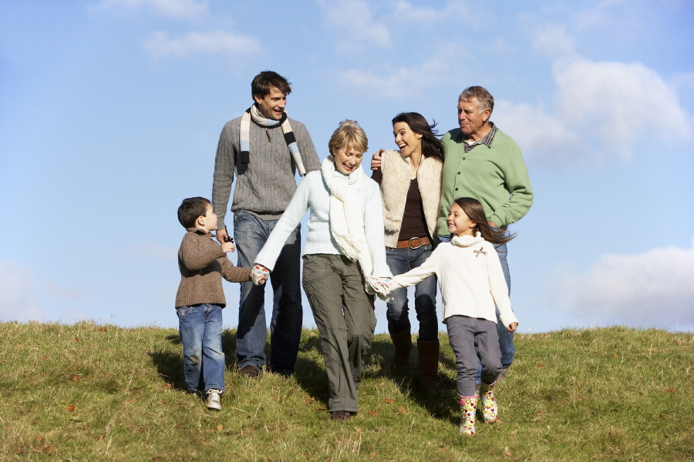
Who Are They?
  Parents
  Grandparents
  Great Aunts and Uncles
  Great grandparents
Notes:
They are parents, grandparents, great aunts and uncles, great grandparents.
But before they became any of these people, they were teenagers just like you. They played sports, went to school, fell in love, traveled, had careers, and eventually married and raised a family.

Slide 5
They Love What We Love
  Time with family
  Time with friends
  Games
  Dancing
  Laughing
  Technology
  Sports
  And so much more……
Notes:
Senior citizens are not any different from us. They love many of the same things that we love. (read list)
Have students add more ideas to list or complete Enrichment Activity – T Charts = Similarities and Differences.

Slide 6
What Do You Think?
  What are they interested in?
  What do they enjoy doing?
  What do they love?
  What do they need?
  What are you interested in?
  What do you enjoy doing?
  What do you love?
  What do you need?

Slide 7
They are ready to share a world of experiences with us
Notes:
Many senior citizens are still very active and many need a little assistance. They have a world’s worth of experiences and they are ready and willing to share with us.

Slide 8
What part of our world will we share with them?
Notes:
In the same way, we have a world’s worth of experiences we can share with them. What will you share?

Slide 9
Questions?

Slide 10
Resources and References
  Images:
    Microsoft Office Clip Art: Used with permission from Microsoft.
  Websites:
    Maryland Department of Education Programs Service> Learning>Aging
    http://marylandpublicschools.org/MSDE/programs/servicelearning/aging
    Seniors List
    Senior Citizen Activities
    http://www.seniorslist.com/activities/senior-citizen-activities-m.php

