Slide 1
Show Me the Money!
Budgeting and Forecasting Revenues

Slide 3

Revenue Management
  Key to maximizing profit
Notes:
Revenue Management is important because it is the key to maximizing profit. We can name all kinds of important reasons for managing revenue, but the single most important reason is that is it THE KEY to maximizing profit. Profit is why most businesses exist. Without profit, a hotel will not stay in business.

Slide 4

Concept
  Two elements:
    Pricing
    Methods
  Revenue Manager
    Role is maximization of revenue for each guest room
Notes:
Since it is so important, let’s take a closer look. What exactly is revenue management? It is comprised of two elements: • the determination of a hotel’s room pricing using various pricing strategies, pricing rates, and discounts • the methods used to sell hotel rooms whether it is to a walk-in customer, a repeat customer, or even a reservation from the internet These elements are used in order to maximize income (or revenue) and profit. In larger hotels, this responsibility will reside with a Revenue Manager and can consist of one or more full-time positions or in smaller hotels, the responsibility may reside with the Front Office Manager, the Director of Sales and Marketing, or the General Manager. Either way, the essential role of revenue management is maximization of revenue for each guest room.

Slide 5

Revenue Manager Responsibilities
  Devise and implement pricing strategies
    Approve flexible room rates
    Approve discounts to a variety of groups (AAA or AARP)
    Approve exclusive rates to select guests
  Meet revenue goals
  Bring value to guests
  Forecast future room sales
Notes:
Let’s break down the responsibilities of the revenue manager. The revenue manager must devise and implement many different pricing strategies and room rates. Room rates will vary based on demand. We will take a look at how price is affected by demand later. However, the revenue manager is the person to go to for approval of flexible room rates when someone wants a discount, perhaps for a wedding party that needs 15 rooms, or a travel club that needs 8 rooms. The revenue manager also approves discounts to a variety of national groups such as AAA or AARP and also approves exclusive rates to select important guests. The revenue manager is responsible for meeting the revenue goals set by the owners or general manager and do so while bringing value to guests. Another responsibility is to forecast room sales into the future so appropriate planning can be done by all departments.

Slide 6
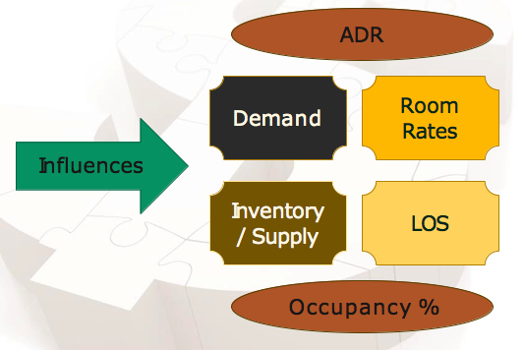
Revenue Management
  Factors of Influence
Notes:
To better understand revenue and profitability, we must look at what affects them. We’ll call this the factors of influence. Demand – the amount of goods or services (rooms) consumers want to buy at a specific price (room rate). Demand is ever changing. Different hotels have increased demand at different times. Some have better demand in winter such as near a ski resort and others have increased demand for rooms in the summer such as those near beaches. Other hotels will have demand fluctuations during the week versus weekend such as those that cater to business travelers versus vacationers. Regardless of the type of hotel, a room rate or price will be high when demand is high. After all, why give discounts when the demand is already there? Likewise, discounts are offered when demand is low in order to try and create demand. The revenue manager’s job is to know the demand and price accordingly to maximize revenue. Supply – the total amount of goods or services (rooms) available for sale – also called inventory and that number is fixed and perishable for hotels. It is fixed because a hotel cannot increase its number of rooms (supply) when demand increases. A 200 room hotel is fixed at a maximum of 200 rooms each night (assumes no rooms are down for repairs). The supply is also considered perishable since each night a room is unsold, that potential revenue is lost. Room Rate – the single rate or price for a specific type of room. A room’s rate is relative to the demand and supply of rooms in a given location. For instance, a convention is taking place in a city that has a total of 4 hotels with 800 rooms and the demand is for 700 rooms. Prices can be set at a given rate as most rooms in the city will be taken. However, if a new hotel opens before the convention and now there are 1100 rooms, the demand is still 700 and the prices set by the hotels will be influenced by the occupancy. This is called the law of supply and demand.
Occupancy rate is a measurement used in pricing. It is determined by dividing the total rooms occupied by the number of rooms available. As used above 700 / 800 = 87.5% and is then changed to 700 / 1100 = 64%. ADR – short for average daily rate – is a measurement used by the revenue manager to measure the average of all of the rooms’ rates together that have been sold. They will measure, track, and try to increase the overall ADR rather than manage individual rooms each and every night. They will use the ADR in conjunction with demand as a means to increase demand. It is calculated taking the total room revenue and dividing by the total number of rooms sold. It is important to note that it is a DAILY rate, and as such Monday’s ADR will be different from Saturday’s ADR as different rates are charged for different nights as well as different types and sizes of rooms. LOS – short for length of stay – the number of nights a hotel’s individual guest use their rooms. LOS is computed by dividing the total number of room nights sold by the total number of guests. For example, 300 room nights sold divided by 100 guests equals an average length of stay of 3 nights per guest. Increasing the LOS will positively affect revenue and profitability as it also reduces cost. Housekeeping costs go down when guests stay longer as well as the front desk costs. It is much cheaper to have one guest stay 4 nights than it costs to have 4 guests stay for one night each. In theory, the revenue will stay the same but profits are maximized because costs have decreased. As you can see, there are many factors that influence the revenue and profitability of a hotel…..and this is not all of them! Competition, location, construction in the area, weather/storms, economy, and much more also affect revenue. But it is the life-blood of a business and must be managed.

Slide 7

Room Revenue Forecasting
  Room revenue forecasting should include:
    Rooms available to sell
    Estimated rooms to be sold
    Estimated occupancy rate
    Estimated ADR
Notes:
One of the best ways to manage a business and revenue is through budgets and forecasts. A room revenue forecast is of great assistance because it makes up approximately 50% to 75% of a full-service hotel’s revenue and even greater percentage of a limited-service hotel. Budgets and forecasts are essential elements of managing your business because the demand affects more than just revenue or sales volume. It affects the number of staff such as, front desk and housekeeping to have on hand, how many supplies are needed, how many parking attendants and valets to hire, and how much food and beverage will be needed. All of these will help forecast costs for the hotel’s budget. A forecast can be very detailed or quite simple but will contain the following: • Rooms available to sell • Estimated rooms to be sold • Estimated occupancy rate • Estimated ADR

Slide 8
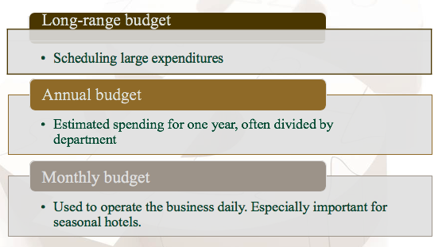
Budgets
  A guideline for spending money
Notes:
Maximizing profit is not all about forecasting correctly, but to also forecast, understand, and control costs. How revenue and cost work together is the answer to unlocking the secrets of a successful and profitable hotel. Costs, just like revenue, must also be forecasted. This is where budgets come into play. Most businesses will have multiple types of budgets such as a long-range budget that will cover two to five years or in some cases even longer. This type of budget is good for scheduling large capital expenditures. There are annual budgets which fluctuate less than the long-range budget. These budgets are a prediction and estimation of the spending for a hotel for one year. It often is divided by department and each department is expected to stay within their number. These budgets are sometimes made by looking at the previous years’ spending while considering the long-range budget and the forecast of revenue. A monthly budget is the natural extension of the annual budget and is used to operate the business daily. Monthly budgets are especially important for seasonal hotels. Great care will need to be taken with each month’s budget to effectively reach the target budgets. For example, a ski resort hotel will generate most of its revenue during the winter months and also likely need to spend more money during the winter season as well. You would not want to spend the bulk of the budget during the summer before your busiest season.

Slide 9

Questions?

Slide 10
References/Resources
  Images
    Microsoft Office Clip Art: Used with permission from Microsoft.
  Textbooks
    Reynolds, J. S. (2010). Hospitality services: Food & lodging. Tinley Park, IL: Goodheart-Willcox Company.
    Hayes, D. K. and Ninemeier, J. D. (2007). Hotel Operations Management, Second Edition. Upper Saddle River, New Jersey: Pearson Education, Inc.

