Slide 1
Sign Me Up!
Curricular and Extra-Curricular Activities

Slide 3
Terms
  Curricular
    Activities that are connected to the regular curriculum or program of courses and may carry academic credit
  CTSO
    Acronym for Career and Technology Student Organization
  Extra-curricular
    Outside the regular curriculum or program of courses, usually carrying no academic credit
  Organization
    An administrative and functional structure
Notes:
Curricular activities may take place during the course period or are tied to the course and its credit for the course. Examples of curricular activities may include band, choir, orchestra, journalism or yearbook.
CTSOs include any organization that is a part of the Career and Technical Education department.
Extra-curricular activities includes activities that extend beyond the classroom and are not tied to course credit. Examples of extra-curriculars are DECA, FCCLA, SkillsUSA and TAFE. We will discuss these organizations in more detail later.
An organization of students is necessary for the CTSO to operate.

Slide 4
Discussion
  Curricular Activities available on campus
  Extra-curricular Activities available on campus
Notes:
At this time, discuss with your students the curricular activities that are available on your campus.
At this time, discuss with your students the extra-curricular activities that are available on your campus.

Slide 5
Get a Head Start
  2010 Facts:
    32% of HS students participated in extracurricular activities
    Students who participate in extra-curricular activities are more likely to attend college
Notes:
According to the National Center for Educational Statistics, in 2010, 32% of high school students participated in extra-curricular activities. The study conducted also said that students who participated in extra-curricular activities were more likely to attend college.

Slide 6
Curricular and Extra-Curricular Activities Available at Our local High School(s)
Notes:
At this time, discuss with your students the curricular and extra-curricular activities that are available on your local high school(s).

Slide 7
Career Preparation Courses I & II
  Two or three-elective credits
  Available to juniors and seniors
  Partnership between the coordinator (teacher), the student, and the student’s employer
  Course work
  Students work a minimum of 15 hours a week
Notes:
One curricular activity that career and technical students can participate in is Career Preparation Course I and II. This course is an articulation between the teacher, student and employer in which the student agrees to take courses and work a minimum of 15 hours per week.

Slide 8
Benefits of Career Preparation I & II
  Discover details about a specific industry
  Acquire transferable skills
  Balance school, work, extra-curriculars, etc.
  Learn to work with others
  Experience what the “real world” expects of you
  Get paid!
Notes:
Career preparation courses give students a real-world experience that provide them with a wide variety of skills while the student is getting paid for the position.

Slide 9

Practicum Courses
  Field based internship within an area of interest
  Can be a paid or non-paid status
  Usually integrated part of the school day
Notes:
Practicum courses provide students with real-world experiences, however usually without pay. An internship is a method of on-the-job training.

Slide 10
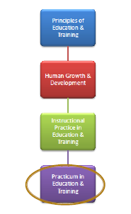
Education and Training
Notes:
Students who enroll in the Education and Training career cluster pathway can take a class during their senior year that allows them to work in the elementary classroom, one-on-one with students. Check with your local high school(s) to see what their program offers and share with your students.

Slide 11
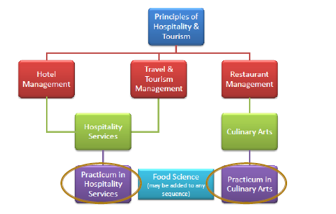
Hospitality and Tourism
Notes:
Students who enroll in the Hospitality and Tourism career cluster pathway can take a class during their senior year that allows them to work in the hospitality industry. Check with your local high school(s) to see what their program offers and share with your students.

Slide 12
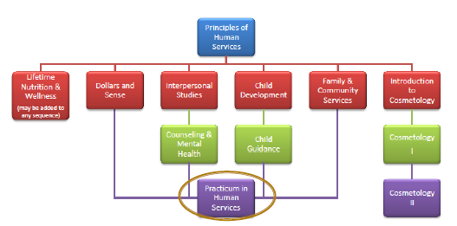
Human Services
Notes:
Students who enroll in the Human Services career cluster pathway can take a class during their senior year that allows them to work with children or families. Check with your local high school(s) to see what their program offers and share with your students.

Slide 13
Career and Technical Students Organizations (CTSOs)
  Family and Community Leaders of America (FCCLA)
  SkillsUSA
  Texas Association of Future Educators (TAFE)
Notes:
The Education and Training, Hospitality and Tourism and Human Services clusters contain several CTSOs. The four main CTSOs available for students to participate in are DECA, FCCLA, SkillsUSA and TAFE.

Slide 14
Benefits of Joining Clubs/Organizations
  Acquiring/Developing New Skills
    Organization
    Professionalism
    Communication
  Acquiring/ Developing Social Skills
    Meetings
    Social gatherings
    Competitions
    Community service projects
  Meeting New People
    School
    Community
    State
    Nation
  Social Networking
    Friends
    Team mates
    Colleagues
    References
Notes:
There are many benefits of joining a club or organization. What do you think some of the benefits are? Allow time for student responses.
CTSOs offer students a variety of ways to acquire new skills useful in the classroom and workplace. CTSOs teach organization because students must be able to balance both classroom work and the duties that come with joining an organization. Students can also learn professionalism and communication skills through peer interactions.
Students can develop social skills through attending meetings, social gatherings, competitions, participation in community service projects and more.
Through CTSOs, you will have the opportunity to meet new people around your school, community, state and nation through local, regional, state and national meetings.
Through CTSOs students are able to meet a variety of people within their field of interest who serve as their social network of friends, team mates, colleagues and references for school and work.

Slide 15
Benefits of Joining Clubs/Organizations
  New Experiences
    Competitions
    Travel
    Friendships
  Improve Communication Skills
    Running student meetings
    Competing in speaking events
  Resume Building
    Newly acquired skills
    Experiences
    Activities
    Awards
    Professional references
  Participate in Competitions
    Local
    Regional
    State
    National
Notes:
When a student joins a CTSO, they become involved in several new experiences such as competitions, travel and new friendships.
Through competitive speaking events, students in CTSOs have the ability to improve their communication skills.
CTSOs allow students to build their resume by adding skills, experiences, activities, awards and professional references from participation in the organization.
Several areas for competitions are available through CTSOs through the local, regional, state and national level.

Slide 16
Benefits of Joining Clubs/Organizations
  Opportunities to Travel
    Competitions
    Conferences
    Workshops
    Training
Notes:
There are several opportunities for travel to new areas through competitions, conferences, workshops and training.

Slide 17
Questions?

Slide 18
References and Resources
  Fiscus, L. and Hyslop Dixon, A. (2010). Career and Technical Student Organizations: A Reference Guide (3rd ed.). The 2010 High School Graduate. Retrieved from www.thehighschoolgraduate.com/editorial/UStraining.htm
  National Center for Educational Statistics. (2013). Extracurricular activities of high school students. Retrieved from http://nces.ed.gov/programs/coe/indicator_exa.asp

