Slide 1
Sports Nutrition
  Eating Healthy and Keeping Fit

Slide 3


Nutrition for athletes
  Body needs the right amount of:
    Carbohydrates
    Protein
    Fats
    Vitamins
    Minerals
    Fluids
Sports Nutrition: Who Delivers?
Notes:
Without proper nutrition, an athlete will not be able to achieve his or her maximum athletic potential.
Click on hyperlink to view video:
Sports Nutrition: Who Delivers?
A sports dietitian is the smart choice for high quality sports nutrition guidance and other sports nutrition services, including sports nutrition program development and management.
http://www.scandpg.org/sports-nutrition/working-with-a-sports-nutritionist/#who-delivers

Slide 4
Eating Right will
  Help you train longer and at a higher intensity
  Delay the onset of fatigue
  Promote recovery
  Help your body adapt to workouts
  Improve body composition and strength
  Enhance concentration
  Help maintain healthy immune function
  Reduce the chance of injury
  Reduce the risk of heat cramps and stomach aches
Notes:
Most athletes can meet their nutritional needs by following the Dietary Guidelines for Americans.
If extra calories are needed, they should come from nutrient dense foods high in starches or complex carbohydrates.
Drink plenty of fluids to avoid dehydration.

Slide 5
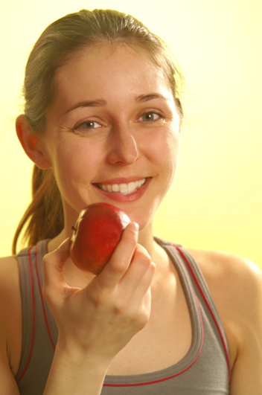
Eat Before exercising
  Three to four hours before
  Meals high in carbohydrates and low in fat
  Food that are easy to digest
  Do not overeat
  Drink plenty of water
Notes:
Suggested foods to eat before exercising:
apple slices
fruit and yogurt smoothie
grilled cheese sandwich
oatmeal
peanut butter

Slide 6
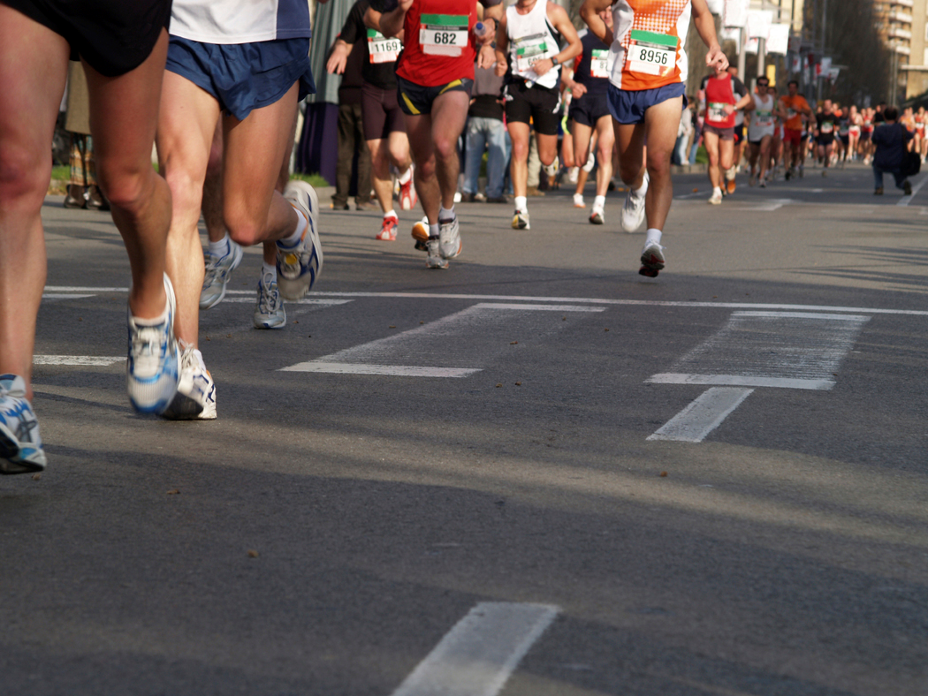
Endurance events
  Gaining in popularity
  5K, 10K
  Marathons
  Triathlons
Notes:
Can you name any other endurance events?
Nutritional needs increase depending on length of event, fitness level and gender.
Sports drinks are recommended to replace electrolytes lost.
Drink plenty of water.

Slide 7
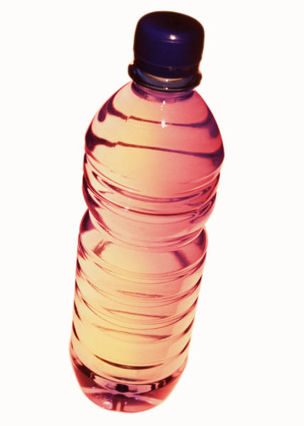
After physical activity
  Continue with plenty of fluids
  Protein to aid muscle tissue
  Carbohydrates
Notes:
Suggested foods after physical activity:
fruits smoothie
graham crackers with peanut butter
rice bowl
sports drink
stir fry
whole wheat sandwich

Slide 8
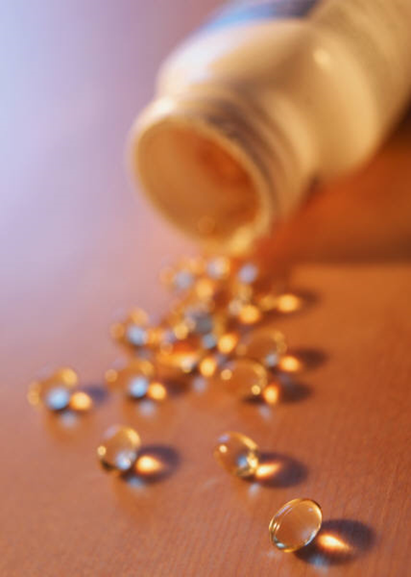
Supplements
  No need if eating balanced diet
  Not proven that extra vitamins and minerals enhance athletic performance
  Should be monitored by a physician
Notes:
All sorts of dietary supplements claim to make you faster, stronger, more energized and slimmer.
Athletes train hard to reach their peak performance, so products that offer an edge can be enticing.
But, Buyer Beware - Effectiveness and safety do not have to be confirmed before supplements hit store shelves. Learn how to spot a fraud and where to find trustworthy information

Slide 9
References and Resources
  Images:
    Microsoft Office Clip Art: Used with permission from Microsoft.
  Textbooks:
    Duyff, R. L. (2010). Food, nutrition & wellness. Columbus, OH: Glencoe/McGraw-Hill.
    Kowtaluk, H. (2010) Food for today. Columbus, OH: Glencoe/McGraw-Hill.
    Weixel, S., & Wempen, F. (2010). Food & nutrition and you. Upper Saddle River, NJ: Pearson/Prentice Hall.

Slide 10
References and Resources
  Video:
    Sport Nutrition: Who Delivers?
    A sports dietitian is the smart choice for high quality sports nutrition guidance and other sports nutrition services, including sports nutrition program development and management.
    http://www.scandpg.org/sports-nutrition/working-with-a-sports-nutritionist/#who-delivers
  Website:
    Academy of Nutrition an Dietetics
    The worlds largest organization of food and nutrition professionals
    www.eatright.org

