Slide 1
State of the Economy and Travel Decisions

Slide 3
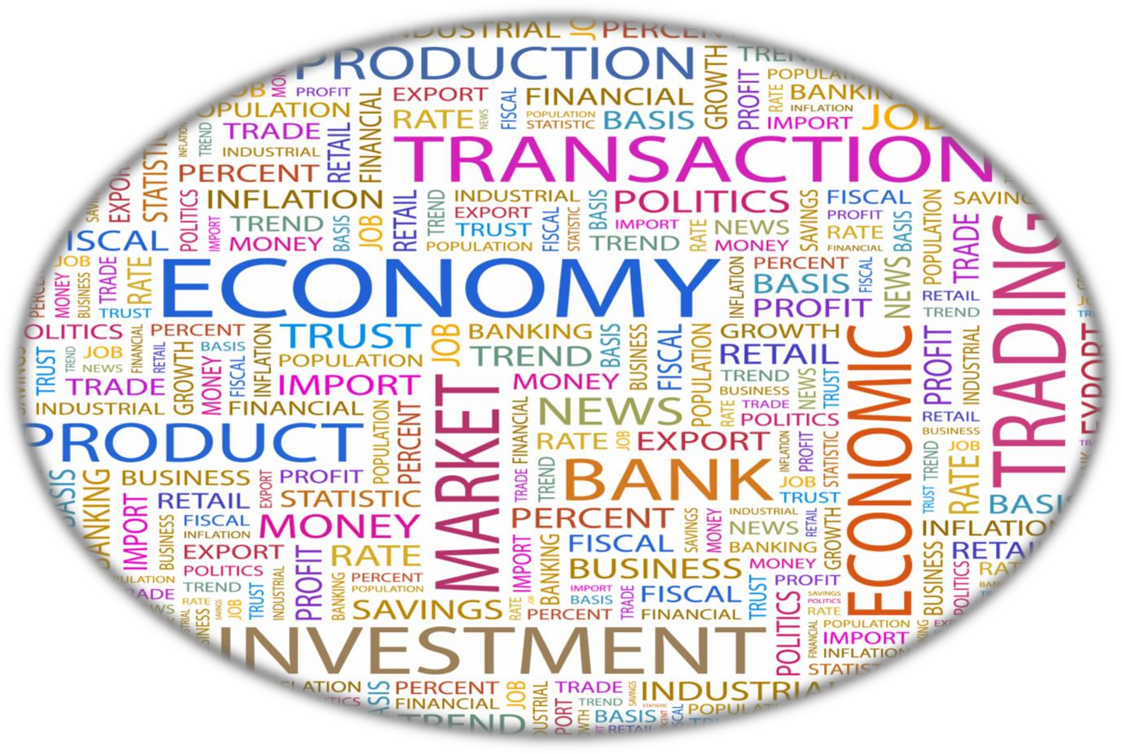
State of the Economy
Economic indicators:
Gross Domestic Product growth rates
Inflation rates
Levels of current account and budget surpluses or deficits
Unemployment rates

Slide 4
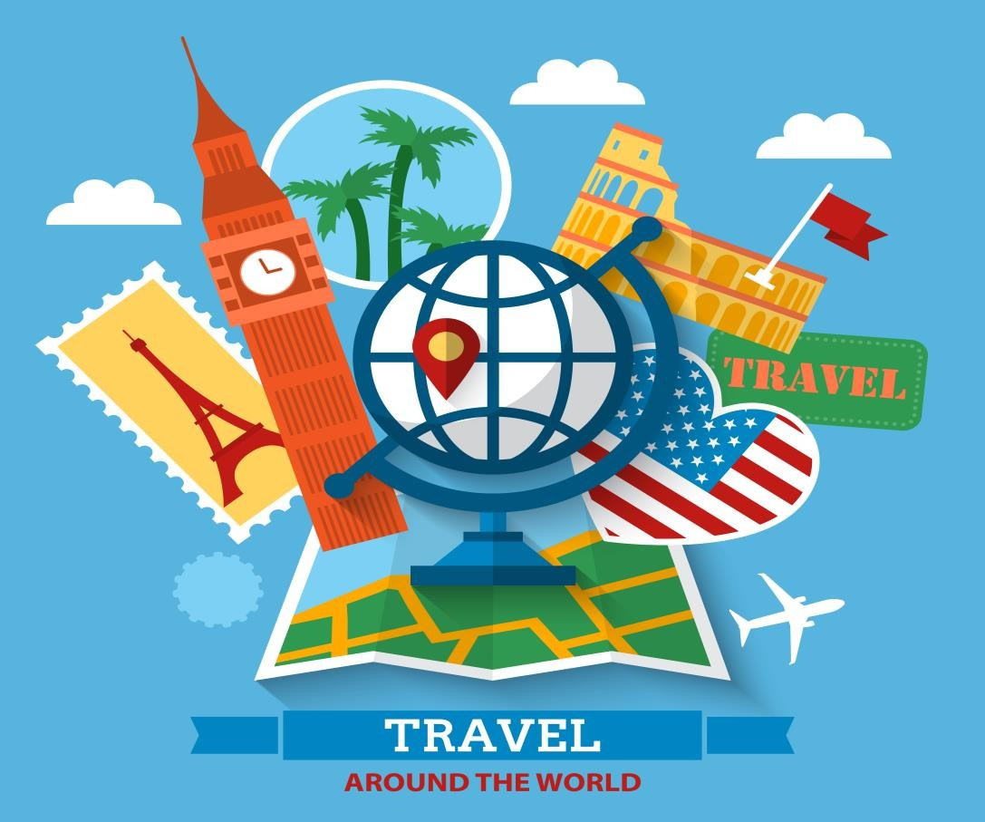
Travel and Tourism
The world’s largest industry
Rapidly growing
Has a major impact on national economies around the world

Slide 5
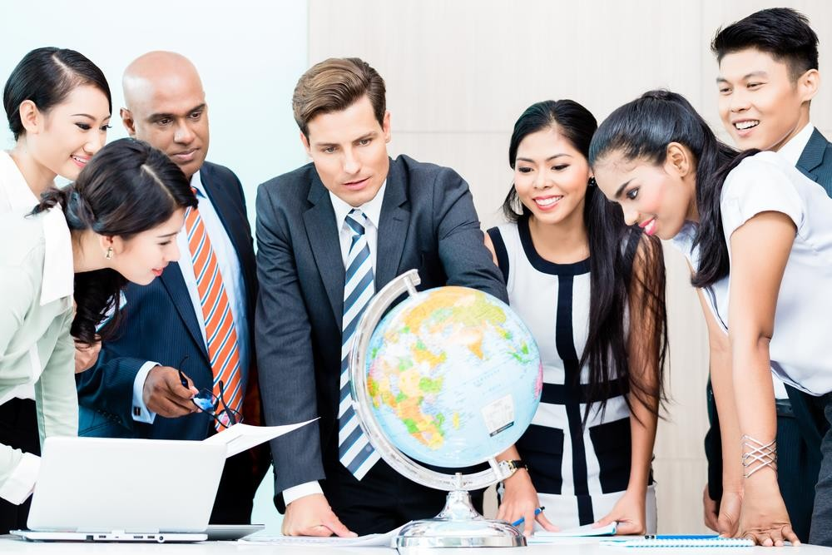
Economics of Travel and Tourism, Recession, Expansion

Slide 6
Economics of Travel and Tourism
Good Economy
Businesses do well
  Expansion
Slow Economy
Businesses do poorly
  Recession

Slide 7
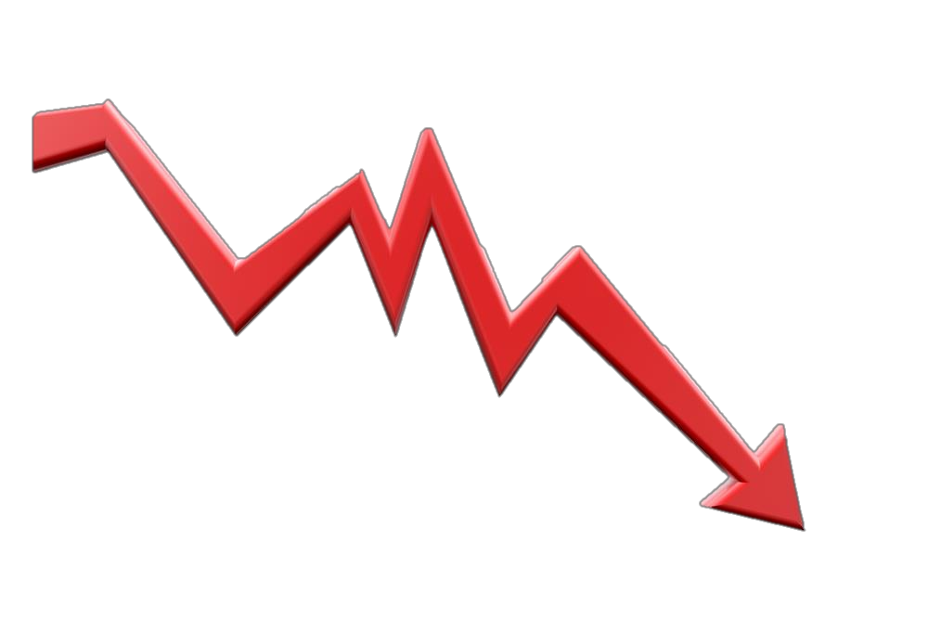
Recession
Economy slows down and does poorly
People lose jobs
People have less money for:
  Eating at restaurants
  Recreation
  Travel

Slide 8
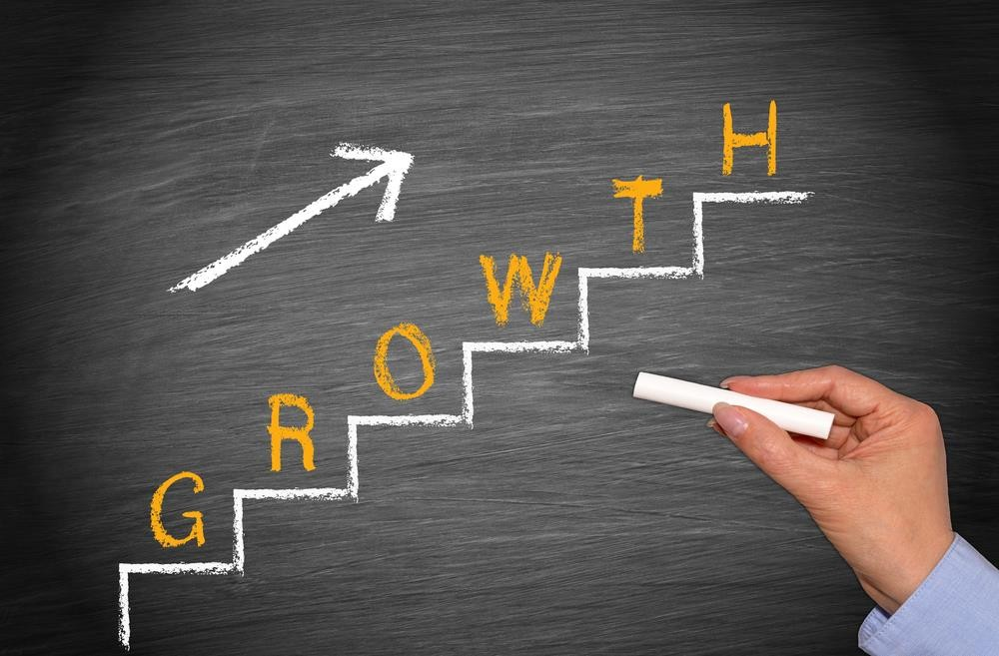
Expansion
Economy grows and does well
People have more money to spend
People spend on:
  Eating at restaurants
  Recreation
  Travel

Slide 9
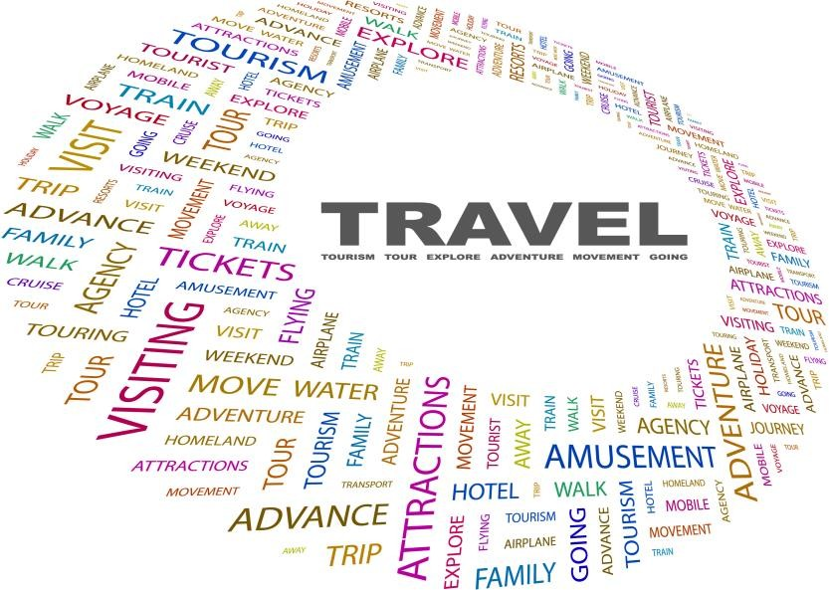
Travel Decisions

Slide 10
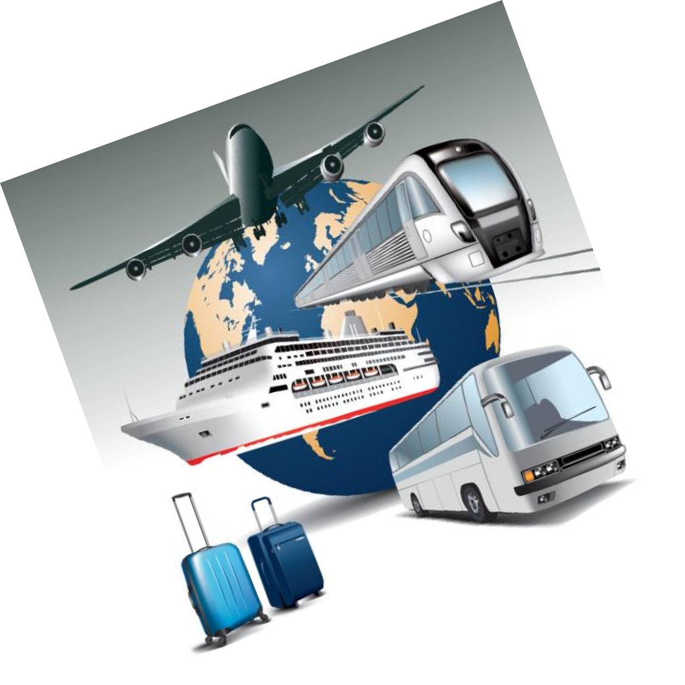

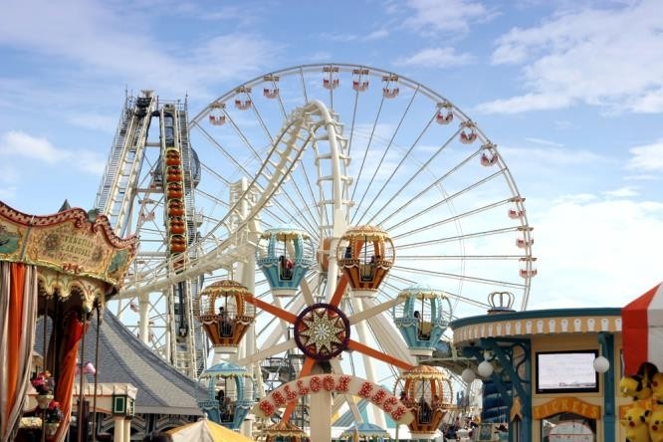
Travel Decisions
Products and Services
Entertainment
Food
Gifts
Lodging
Recreation
Transportation

Slide 11

What makes the world go round?
Click on photo

Slide 12
Let’s Review!
How do we define state of the economy?
Why is the state of the economy vital to the travel and tourism industry?
During a recession, what happens to the economy?
During a good economy, what happens in the travel and tourism industry?

Slide 13


Slide 14
References and Resources
Images:
Shutterstock™ images. Photos obtained with subscription. (Slides 1, 2, 3, 4, 5, 6, 7, 8, 9, 10, 11, 12, 13)
Textbooks:
Ninemeier, J. D. & Perdue, J. (2008). Discovering hospitality and tourism. Upper Saddle River, NJ: Pearson
Education, Inc.
Reynolds, J. S. (2010). Hospitality services: Food & lodging. Tinley Park IL: Goodheart-Wilcox Company. Websites:
YouTube™:
What makes the world go round? World Travel and Tourism Council
Recognizing the impressive role tourism plays in world economy. Tourism is an "industry you can bank on"!
https://www.youtube.com/watch?v=yMqHEAufxQY

