Slide 1
Strategies to Deter Child Abuse
Child Guidance

Slide 3
Child Abuse and Neglect
  Last year:
    231 Texas children died because of abuse or neglect at the hands of their parents or guardians.
    65,948 children were confirmed victims of abuse or neglect.
    17,108 children were removed from their homes because of abuse or neglect.
Notes:
It's hard to talk or even think about child abuse – but child abuse and neglect are simply too destructive to be ignored. Last year:231 Texas children died because of abuse or neglect at the hands of their parents or guardians.65,948 children were confirmed victims of abuse or neglect.17,108 children were removed from their homes because of abuse or neglect. Help for Parents. Hope for Kids It's not easy being a parent. But recognizing that you have room for improvement is the first step toward becoming a better parent. Here you will learn where to find the help you need to begin your journey toward becoming a healthier, happier family.

Slide 4
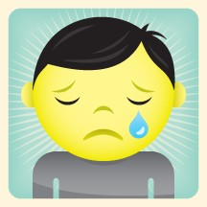
Child Abuse
  Texas Department of Family and Protective Services investigates reports of abuse and neglect of children.
Notes:
Texas Department of Family and Protective Services •Child Protective Services responsibilities include: Investigates reports of abuse and neglect of children. •Provides services to children and families in their own homes. •Places children in foster care. •Provides services to help youth in foster care make the transition to adulthood. •Places children in adoptive homes.

Slide 5
Physical Abuse
  Physical abuse is non accidental physical injury (ranging from minor bruises to severe fractures or death) as a result of punching, beating, kicking, biting, shaking, throwing, stabbing, choking, hitting (with a hand, stick, strap, or other object), burning, or otherwise harming a child.
Notes:
Physical abuse is non accidental physical injury (ranging from minor bruises to severe fractures or death) as a result of punching, beating, kicking, biting, shaking, throwing, stabbing, choking, hitting (with a hand, stick, strap, or other object), burning, or otherwise harming a child, that is inflicted by a parent, caregiver, or other person who has responsibility for the child. Such injury is considered abuse regardless of whether the caregiver intended to hurt the child. Physical discipline, such as spanking or paddling, is not considered abuse as long as it is reasonable and causes no bodily injury to the child. Neglect is the failure of a parent, guardian, or other caregiver to provide for a child’s basic needs. Neglect may be:• Physical (e.g., failure to provide necessary food or shelter, or lack of appropriate supervision)• Medical (e.g., failure to provide necessary medical or mental health treatment)• Educational (e.g., failure to educate a child or attend to special education needs)• Emotional (e.g., inattention to a child’s emotional needs, failure to provide psychological care, or permitting the child to use alcohol or other drugs).

Slide 6
Sexual Abuse
  Sexual abuse includes activities by a parent or caregiver such as fondling a child’s genitals, penetration, incest, rape, sodomy, indecent exposure, and exploitation through prostitution or the production of pornographic materials.
Notes:
Sexual abuse includes activities by a parent or caregiver such as fondling a child’s genitals, penetration, incest, rape, sodomy, indecent exposure, and exploitation through prostitution or the production of pornographic materials.

Slide 7
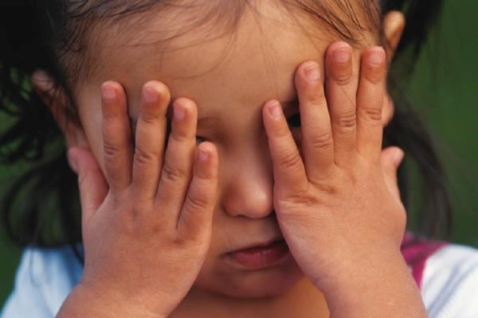
Emotional Abuse
  Emotional abuse (or psychological abuse) is a pattern of behavior that impairs a child’s emotional development or sense of self-worth. This may include constant criticism, threats, or rejection, as well as withholding love, support, or guidance.
Notes:
Emotional abuse (or psychological abuse) is a pattern of behavior that impairs a child’s emotional development or sense of self-worth. This may include constant criticism, threats, or rejection, as well as withholding love, support, or guidance. Emotional abuse is often difficult to prove and, therefore, child protective services may not be able to intervene without evidence of harm or mental injury to the child.

Slide 8
Abandonment
  A child is considered to be abandoned when the parent’s identity or whereabouts are unknown, the child has been left alone in circumstances where the child suffers serious harm, or the parent has failed to maintain contact with the child or provide reasonable support for a speciﬁed period of time.
Notes:
Abandonment is now defined in many states as a form of neglect. In general, a child is considered to be abandoned when the parent’s identity or whereabouts are unknown, the child has been left alone in circumstances where the child suffers serious harm, or the parent has failed to maintain contact with the child or provide reasonable support for a specified period of time.

Slide 9

Substance Abuse
  Substance abuse is an element of the deﬁnition of child abuse or neglect in many States.
Notes:
Substance abuse is an element of the definition of child abuse or neglect in many states. Circumstances that are considered abuse or neglect in some states include:• Prenatal exposure of a child to harm due to the mother’s use of an illegal drug or other substance• Manufacture of methamphetamine in the presence of a child• Selling, distributing, or giving illegal drugs or alcohol to a child• Use of a controlled substance by a caregiver that impairs the caregiver’s ability to adequately care for the child.

Slide 10
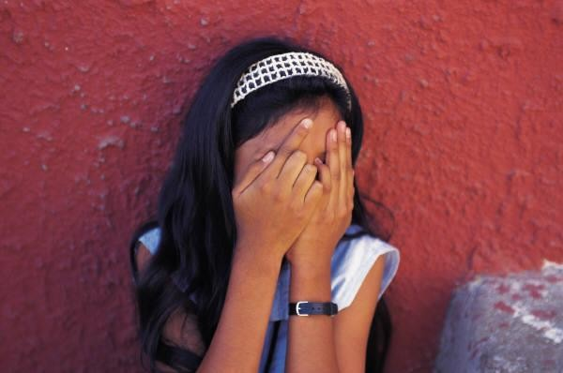
Child Maltreatment: Consequences
  Most of the studies examining the consequences of child maltreatment have used a retrospective approach.
Notes:
Most of the studies examining the consequences of child maltreatment have used a retrospective approach. This requires conducting studies to determine if any association exists between a history of childhood abuse and/or neglect and current health conditions in adults. Fewer research projects have employed a more rigorous longitudinal approach. This type of research strategy identifies children who are at risk or who have already been maltreated and follows them for a long period of time, sometimes decades, to see what conditions develop.

Slide 11

Physical Consequences
  Maltreatment during infancy or early childhood can cause important regions of the brain to form and function improperly with long-term consequences on cognitive, language, and socioemotional development, and mental health.
Notes:
Physical
Last year, 231 Texas children died because of abuse or neglect at the hands of their parents or guardians. Maltreatment during infancy or early childhood can cause important regions of the brain to form and function improperly with long-term consequences on cognitive, language, and socioemotional development, and mental health (DHHS 2001). For example, the stress of chronic abuse may cause a "hyperarousal" response in certain areas of the brain, which may result in hyperactivity and sleep disturbances (Dallam 2001; Perry 2001).Children may experience severe or fatal head trauma as a result of abuse. Non fatal consequences of abusive head trauma include varying degrees of visual impairment (e.g., blindness), motor impairment (e.g., cerebral palsy) and cognitive impairments (National Center on Shaken Baby Syndrome 2009).Children who experience maltreatment are also at increased risk for adverse health effects and certain chronic diseases as adults, including heart disease, cancer, chronic lung disease, liver disease, obesity, high blood pressure, high cholesterol, and high levels of C-reactive protein(Felitti et al. 1998; Danese et al. 2009).

Slide 12

Psychological Consequences
  In one long-term study, as many as 80 percent of young adults who had been abused met the diagnostic criteria for at least one psychiatric disorder at age 21.
Notes:
In one long-term study, as many as 80 percent of young adults who had been abused met the diagnostic criteria for at least one psychiatric disorder at age 21. These young adults exhibited many problems, including depression, anxiety, eating disorders, and suicide attempts (Silverman et al. 1996).In addition to physical and developmental problems, the stress of chronic abuse may result in anxiety and may make victims more vulnerable to problems such as post-traumatic stress disorder, conduct disorder, and learning, attention, and memory difficulties (Dallam 2001; Perry2001).

Slide 13
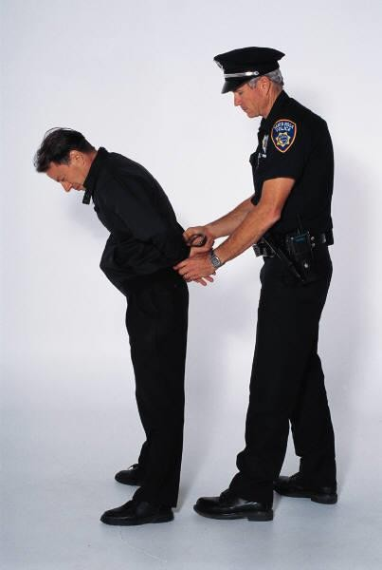
Behavioral Consequences
  Children who experience maltreatment are at increased risk for smoking, alcoholism, and drug abuse as adults, as well as engaging in high- risk sexual behaviors.
Notes:
Children who experience maltreatment are at increased risk for smoking, alcoholism, and drug abuse as adults, as well as engaging in high-risk sexual behaviors (Felitti et al. 1998; Runyan et al. 2002).Those with a history of child abuse and neglect are 1.5 times more likely to use illicit drugs, especially marijuana, in middle adulthood (Widom et al. 2006).Studies have found abused and neglected children to be at least 25 percent more likely to experience problems such as delinquency, teen pregnancy, and low academic achievement(Kelley et al. 1997). Similarly, a longitudinal study found that physically abused children were at greater risk of being arrested as juveniles. This same study also found that abused youth were less likely to have graduated from high school and more likely to have been a teen parent(Langsford et al. 2007).A National Institute of Justice study indicated that being abused or neglected as a child increased the likelihood of arrest as a juvenile by 59 percent. Abuse and neglect also increased the likelihood of adult criminal behavior by 28 percent and violent crime by 30 percent (Widom & Maxfield 2001).Early child maltreatment can have a negative effect on the ability of both men and women to establish and maintain healthy intimate relationships in adulthood (Colman et al. 2004).

Slide 14
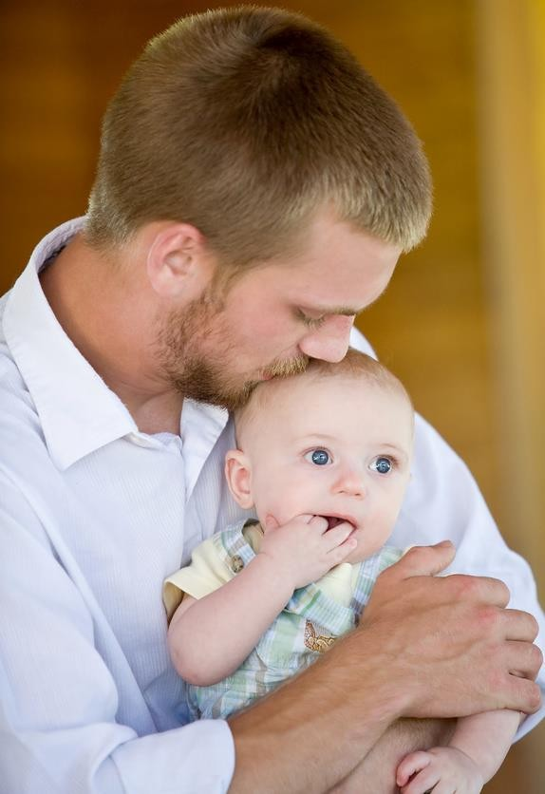
Prevention Programs
  Public awareness
  Skills-based curricula
  Parent education
  Home visitation
  Respite and crisis care programs
  Family resource centers
Notes:
Prevention Programs Prevention activities are conducted by many state, local, and tribal governments, as well as community and faith-based organizations. The services they provide vary widely. Some prevention services are intended for everyone, such as public service announcements(PSAs) aimed at raising awareness about child abuse within the general population. Others are specifically targeted for individuals and families who may be at greater risk of child abuse or neglect. An example of this might be a parenting class for single teen mothers. Some services are developed specifically for families where abuse or neglect has already occurred, to reduce the negative effects of the abuse and prevent it from happening again. Common activities of prevention programs include: Public awareness, such as PSAs, posters, and brochures that promote healthy parenting, child safety, and how to report suspected abuse Skills-based curricula that teach children safety and protection skills. Many of these programs focus on preventing sexual abuse Parent education to help parents develop positive parenting skills and decrease behaviors associated with child abuse and neglect. Parent support groups, where parents work together to strengthen their families and build social networks Home visitation, which focuses on enhancing child safety by helping pregnant mothers and families with new babies or young children learn more about positive parenting and child development
Respite and crisis care programs, which offer temporary relief to caregivers in stressful situations by providing short-term care for their children Family resource centers, which work with community members to develop a variety of services to meet the specific needs of the people who live in surrounding neighborhoods Two elements have been shown to make prevention programs more effective, regardless of the type of service or intended recipients. Involving parents in all aspects of program planning, implementation, and evaluation helps ensure that service providers are working in true partnership with families. Parents are more likely to make lasting changes when they are empowered to identify solutions that make sense for them. Another key to success is providing prevention services that are evidence based. This means that rather than relying on assumptions or "common sense," research has been conducted to demonstrate that a particular service improves outcomes for children and families. This helps service providers feel confident in what they are doing. It can also help justify a program’s continued funding when resources are scarce.

Slide 15
Protective Factors
  Nurturing and attachment
  Knowledge of parenting and of child and youth development
  Parental resilience
  Social connections
  Concrete supports for parents
Notes:
Protective Factors Prevention programs have long focused on reducing particular risk factors, or conditions that have been found through research to be associated with child abuse and neglect in families. Increasingly, prevention services are also recognizing the importance of promoting protective factors, conditions in families and communities that research has shown to increase the health and well-being of children and families. These factors help parents who might otherwise be at risk of abusing or neglecting their children to find resources, supports, or coping strategies that allow them to parent effectively, even under stress. The following protective factors have been linked to a lower incidence of child abuse and neglect: Nurturing and attachment. When parents and children have strong, warm feelings for one another, children develop trust that parents will provide what they need to thrive. Knowledge of parenting and of child and youth development. Parents who understand how children grow and develop can provide an environment where children can live up to their potential. Parental resilience. Parents who are emotionally resilient have a positive attitude, creatively problem solve, effectively address challenges, and are less likely to direct anger and frustration at their children. Social connections. Trusted and caring family friends provide emotional support to parents by offering encouragement and assistance in facing the daily challenges of raising a family. Concrete supports for parents. Parents need basic resources such as food, clothing, housing, transportation, and access to essential services that address family-specific needs (such as childcare, health care, and mental health services) to ensure the health and well-being of their children.

Slide 16
Child Maltreatment: Prevention Strategies
  Effective prevention strategies are necessary to promote awareness about child maltreatment and to foster commitment to social change.
    Child-Parent Centers
    Nurse-family Partnership
    Triple P Program for parents
Notes:
Child Maltreatment: Prevention Strategies Child maltreatment is a serious problem that can have lasting harmful effects on victims. The goal for child maltreatment prevention is simple—to stop child abuse and neglect from happening in the first place. However, the solutions are as complex as the problem. Prevention efforts should ultimately reduce risk factors and increase the factors that buffer against risk. In addition, prevention should address all levels that influence child maltreatment: individual, relationship, community, and society. Effective prevention strategies are necessary to promote awareness about child maltreatment and to foster commitment to social change. Interventions with Impact on Child Maltreatment Child-Parent Centers Child-Parent Centers (CPCs) provide comprehensive educational and family support to economically disadvantaged children and their parents. The program requires parental participation and emphasizes a child-centered, individualized approach to social and cognitive development. In a matched control trial, children participating in these centers had a 52 percent reduction in child maltreatment (Reynolds & Robertson, 2003).Nurse-family Partnership Nurse-Family Partnership is a nurse home visitation program for low-income, first-time parents and their children beginning prenatally and continuing up to the child’s second birthday. The program encourages healthy behaviors during and after pregnancy, teaches appropriate parenting skills, and links parents to community services. Triple P-Positive Parenting Program Triple P is a multi-level system of parenting interventions based on need usually delivered through health care. In the U.S. Triple P System Trial, funded by the CDC, researchers found a 28% reduction in substantiated abuse cases, a 44% reduction in child out-of-home placements, and a 35% reduction in hospitalizations and emergency room visits for child injuries in nine study counties in South Carolina where parenting interventions were implemented (Prinz et al., 2009).
Triple P-Positive Parenting Program Triple P is a multi-level system of parenting interventions based on need usually delivered through health care. In the U.S. Triple P System Trial, funded by the CDC, researchers found a28% reduction in substantiated abuse cases, a 44% reduction in child out-of-home placements, and a 35% reduction in hospitalizations and emergency room visits for child injuries in nine study counties in South Carolina where parenting interventions were implemented (Prinz et al.,2009).
Triple P-Positive Parenting Program
Triple P suggests simple routines and small changes that can make a big difference to your family
http://www.triplep.net/glo-en/home/

Slide 17

Action Plans
  It's up to us as a community to make a difference in our children's lives. It's up to all of us to keep children safe from abuse and neglect. We can do this as individuals and together as a community.
Notes:
Children are the future of our communities, and their growth and development affect us all. It’s up to us as a community to make a difference in our children's lives. It's up to all of us to keep children safe from abuse and neglect. We can do this as individuals and together as a community. Sometimes it's as simple as conversing every day. Seeing an out-of-control adult mistreat a child is very disturbing. Fortunately, there are things you can do to help. Talk to the adult to take their attention off the child. Say things like:•My child upsets me too, sometimes. •Your child has beautiful eyes. •Children can wear you out, can't they? Is there anything I can do to help? Distract the child, if misbehaving, by talking to the child. Look for chances to praise the parent or child. Help a child who is in danger. For example, if the child is left unattended in a grocery cart, stay with the child until the parent returns. Avoid saying anything critical or giving negative looks because that is likely to increase the parent's anger and could make matters worse. You can become a leader in your community by promoting child abuse prevention – particularly during April, which is Child Abuse Prevention Month.

Slide 18

What Can Teachers and Child-Care Workers Do?
  Teachers and child-care workers are often a child's first line of defense. They play a big role in their lives.
Notes:
What can teachers and child-care workers do? Teachers and child-care workers are often a child's first line of defense. They play a big role in their lives. Here are a few ideas about things teachers and child-care workers can do to emphasize the importance of child abuse prevention. •Have children create child abuse prevention bulletin boards. •Designate Blue Ribbon Day on campus. •Have your classes design and make blue ribbons to wear and explain that it's the symbol for preventing child abuse. •Help "stomp out" child abuse by having children collect new pairs of socks to donate to the local Rainbow Room or Child Protective Services (CPS) office. •Hold a teddy bear drive for your local police department or children's advocacy center for children in crisis. •Send child abuse prevention information home in homework folders or report cards. •Have your classes participate in the Adopt-A-Caseworker program by providing new clothing and other items for the children they serve.

Slide 19
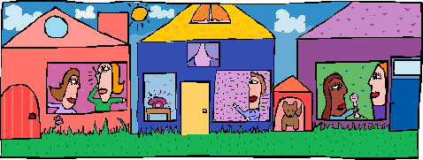
What Can Neighbors Do?
  As neighbors, we need to do our part to increase public and private investment in our neighborhoods. Get to know your neighbors. Learn to recognize any problems that might lead to abuse or neglect.
Notes:
What can neighbors do? Neighborhoods should be safe and supportive places where children and families thrive. As neighbors, we need to do our part to increase public and private investment in our neighborhoods. Get to know your neighbors. Learn to recognize any problems that might lead to abuse or neglect. It's up to us to protect children from abuse and neglect. What can you do?•Host an ice cream social on your street to get to know your neighbors. •If you see a child under age five unsupervised, stop and help locate their caregiver. •Offer a helping hand for single parents in your neighborhood. For example, babysit, cook a meal, or transport children. •Help form an after-school safe house for children. •Volunteer at your local school, Rainbow Room, social service agency's children's shelter, or CPS office. •Be a mentor to neighborhood youth. •Host a basketball, baseball, or soccer game to encourage relationships between children in the neighborhood. •Start a playgroup in your neighborhood

Slide 20
What Can Faith-Based Organizations Do?
  A community's most influential organizations are often its religious institutions. Churches, temples, synagogues, mosques, and other faith-based groups play an important role in helping families and children who are at risk of child abuse.
  Spiritual leaders can add their voices to preventing abuse and neglect.
Notes:
What can faith-based organizations do? A community's most influential organizations are often its religious institutions. Churches, temples, synagogues, mosques, and other faith-based groups play an important role in helping families and children who are at risk of child abuse. Spiritual leaders can add their voices to preventing abuse and neglect. •Copy materials from this website and distribute them through Sunday school classes and the church bulletin. •Offer to help congregation and community members who need short-term relief from care giving and foster-care responsibilities. •Have a mentoring program that works one-on-one with children and families and gives them positive role models. •Give parents information about child development, parental stress, and community resources. •Share information with your members about prevention hotlines and how to report child abuse and neglect. •Sponsor after-school programs and safety trainings for children. •Partner with your local Children's Advocacy Center or child welfare board to host an informational meeting on child abuse prevention and/or how to become a foster/adoptive parent. •Train religious and lay leaders to recognize child abuse and neglect, to work with victims and their families, and to make appropriate referrals. •Develop parenting and child development curricula as part of church education and outreach. •Develop training programs for youth in your congregation who want to be babysitters. •Celebrate children and families by holding a family affair day. •Host a book drive for new books and donate them to your local Rainbow Room or children’s shelter. •Organize a baby shower to collect diapers, formula, car seats, and other supplies to support families in need, including foster families. Donate these items to your local Rainbow Room or CPS office. •Participate in the Adopt-A-Caseworker program. Contact your local CPS office or community specialist for more information.

Slide 21

What Can Coaches and Sports Leagues Do?
  Child-centered coaching is a philosophy that emphasizes the importance of helping young children develop their positive overall self-image through sports. "Try your hardest to do the best you can" is the message that, when carried over to other aspects of life, will truly help children have fun and feel like winners.
Notes:
What can coaches and sports leagues do? Child-centered coaching is a philosophy that emphasizes the importance of helping young children develop their positive overall self-image through sports. "Try your hardest to do the best you can" is the message that, when carried over to other aspects of life, will truly help children have fun and feel like winners. Why Children Play Sports •Have fun. •Learn and improve skills. •Be with friends and make new ones. •Experience excitement. •Feel successful or like a winner. •Exercise and become physically fit. Why Children Drop Out of Sports •Not enough playing time. •Being criticized and insulted. •Mismatching. •Stress. •Feeling failure or like a loser. •Poor organization.
The Child-Centered Coach •Understands the child is the main reason the game is played. •Promotes winning as a feeling – winning is knowing that you have done your best. •Praises players for being and doing. •Uses only gentle touch and respects the privacy of a child's body. •Motivates the players to provide continuous, positive support for all team players. •Uses comparable playing time to give everyone a moment of glory. •Creates a mood that makes the game fun. •Expects a child to perform only as much as the child's age allows. •Establishes clear expectations and standards of conduct that promote success and sportsmanship. •Encourages appropriate behavior by using praise, appropriate touch, and privileges. •Treats players with respect when administering discipline. •Teaches players how to appropriately express and manage feelings of discomfort. •Knows that kids look to coaches for direction and example.

Slide 22
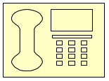
How Can I Report Abuse, Neglect, or Exploitation?
  If you suspect child abuse, you can report it by calling 1-800-252-5400 24 hours a day, seven days a week, nationwide. Or
  visit www.txabusehotline.org and place a report through our secure website, and you will receive a response within 24 hours.
Notes:
How can I report abuse, neglect, or exploitation? The Texas Department of Family and Protective Services (DFPS) has a central place to report:•Child abuse and neglect. •Abuse, neglect, self-neglect, and exploitation of elderly or adults with disabilities living at home. •Abuse of children in child-care facilities or treatment centers. •Abuse of adults and children who are in state facilities or are helped by programs for people with mental illness or intellectual disabilities run by the Texas Department of State Health Services (DSHS) or Texas Department of Aging and Disability Services (DADS).Texas law says anyone who thinks a child, a person 65 years or older, or an adult with disabilities is being abused, neglected, or exploited must report it to DFPS. A person who reports abuse in good faith is immune from civil or criminal liability. DFPS keeps the name of the person making the report confidential. Anyone who does not report suspected abuse can be held liable for a misdemeanor or felony. Time frames for investigating reports are based on severity of allegations. Reporting suspected child abuse makes it possible for a family to get help. If you suspect child abuse, you can report it by calling 1-800-252-5400 24 hours a day, seven days a week, nationwide. Or visit www.txabusehotline.org and place a report through our secure website, and you will receive a response within 24 hours. We cannot accept e-mail reports of suspected abuse or neglect. Learn more about reporting abuse and neglect at www.dfps.state.tx.us.

Slide 23
Real Stories of Hope
  Help and Hope Videos
Notes:
Watch the five videos about real stories of hope. Help for Parents. Hope for Kids It's not easy being a parent. But recognizing that you have room for improvement is the first step toward becoming a better parent. Here you will learn where to find the help you need to begin your journey toward becoming a healthier, happier family. http://www.helpandhope.org/

Slide 24
How You Can Help
  Get to know your neighbors
  Help a family under stress
  Reach out to children in your community
  Be an active community member
  Keep your neighborhood safe
  Learn how to recognize and report signs of child abuse and neglect
Notes:
How You Can Help Parenting is one of the toughest and most important jobs in America, and we all have a stake in ensuring that parents have access to the resources and support they need to be successful. Entire communities play a role in helping families find the strength they need to raise safe, healthy, and productive children. Here are some things you can do: Get to know your neighbors. Problems seem less overwhelming when support is nearby. Help a family under stress. Offer to babysit, help with chores and errands, or suggest resources in the community that can help. Reach out to children in your community. A smile or a word of encouragement can mean a lot, whether it comes from a parent or a passing stranger. Be an active community member. Lend a hand at local schools, community or faith-based organizations, children's hospitals, social service agencies, or other places where families and children are supported. Keep your neighborhood safe. Start a Neighborhood Watch or plan a local "National Night Out” community event. You will get to know your neighbors while helping to keep your neighborhood and children safe. Learn how to recognize and report signs of child abuse and neglect. Reporting your concerns may protect a child and get help for a family who needs it.

Slide 25
Hotlines and Online Resources
  Find Services Near You
  Find Help
  Picture Door Organizer
Notes:
Note to teacher: Enter your county to determine what resources are available in your area. See All Lesson Attachments tab in lesson for a handout of all the hotlines and online resources. •Hotlines, parenting skills •Child Development information •Texas Baby Moses Hotline •Food / Clothing / Housing, Jobs/Child Care •Drugs / Alcohol, Stress / Anxiety / Depression / Counseling •Family Violence •Legal Assistance phone numbers and resources
It's not easy being a parent. But recognizing that you have room for improvement is the first step toward becoming a better parent. Here you will learn where to find the help you need to begin your journey toward becoming a healthier, happier family.
Students will be creating a picture door organizer for their project during Independent Practice. Please view the video to make sure the students understand how to construct the organizer. Picture Door Organizer This organizer is a multi-purpose tool. The students can incorporate information, key terms, sequential events, graphics and concept ideas. It has a hidden element that will make a presentation pop! http://youtu.be/weY4PtrfM3o

Slide 26
References/Resources
  Microsoft Clip Art: Used with permission from Microsoft.
  Textbook:
    Decker, C. (2011). _Child development: Early stages through age 12_. (5th ed.). Tinley Park: Goodheart-Willcox Company.
  YouTube:
    Picture Door Organizer
      This organizer is a multi-purpose tool. The students can incorporate information, key terms, sequential events, graphics and concept ideas. It has a hidden element that will make a presentation pop!
      http://youtu.be/weY4PtrfM3o
  Websites:
    Center for Disease Control
      Child Maltreatment Prevention
      http://www.cdc.gov/ViolencePrevention/childmaltreatment/
    Children's Bureau
      The Children’s Bureau (CB) is the first federal agency within the U.S. government—and in fact, the world—to focus exclusively on improving the lives of children and families.
      http://www.acf.hhs.gov/programs/cb

Slide 27
References/Resources
  Websites:
    Help for Parents. Hope for Kids
      It's not easy being a parent. But recognizing that you have room for improvement is the first step toward becoming a better parent. Here you will learn where to find the help you need to begin your journey toward becoming a healthier, happier family.
      http://helpandhope.org/preventing-child-abuse.html
    Medline Plus
      Child Abuse
      http://www.nlm.nih.gov/medlineplus/childabuse.html
    Texas Department of Family and Protective Services
      Help for Parents. hope for Kids
      http://www.helpandhope.org/index.html
    U.S. Department of Health and Human Services
      Child Abuse and Neglect
      https://www.childwelfare.gov/can/
    U.S. Department of Health and Human Services
      Preventing Child Abuse and Neglect
      https://www.childwelfare.gov/pubs/factsheets/preventingcan.cfm

