Slide 1
Successful Lab Management Guidelines
Notes:
In order for the lab to run smoothly, lab and food safety rules must be followed so that everyone will have a successful learning experience.
The following guidelines are suggested activities. Be sure to follow your school district guidelines.

Slide 3
Recipes Measurement Standards Baking and Cooking Terms Lab Guidelines
Notes:
This slide presentation will cover the following topics:
Recipes
Measurement standards
Cooking terms
Lab guidelines
The lesson may be used in its entirety or used a section at a time.

Slide 4
Recipes
  A well-written recipe should have:
    Recipe name
    List of ingredients
    Yield
    Cooking method, temperature, and time
    Equipment needed
    Step-by-step directions
    Nutritional analysis
Notes:
A recipe is a set of directions for making a food or beverage.
As you know, anyone can write a recipe and post it on the Internet and write cookbooks. But are they easy to follow?
All recipes should include:
Recipe name
List of ingredients – ingredients are given in exact amounts and they are listed in the order they are used
Yield – the amount or the number of servings that the recipe makes
Cooking method, temperature, and time – Cook, bake, chill at certain temperatures and the amount of time needed
Equipment needed – type and size of pan, dish, or container needed to prepare recipe
Step-by-step directions – good recipes have clear, easy-to-follow directions that describe all of the steps in logical order
Nutrition analysis – choose recipes that provide the calories and nutrients you need

Slide 5
Recipe Tips
  Read the recipe thoroughly
  Gather ingredients and equipment needed
  Multiply or divide recipe if needed
Notes:
This is a good time to start collecting recipes if you have not already begun. Choose recipes you can prepare successfully.
Places to find recipes:
Cookbooks
Family
Friends
Internet
Magazines
Newspapers
Package labels
Review the recipe carefully to make sure it has all the needed information. Then practice the recipe to work out any problems.

Slide 6
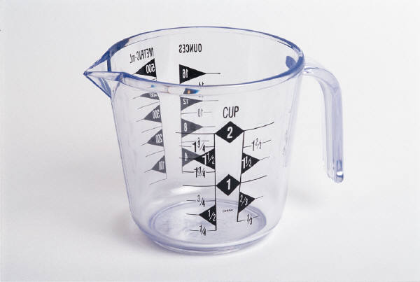
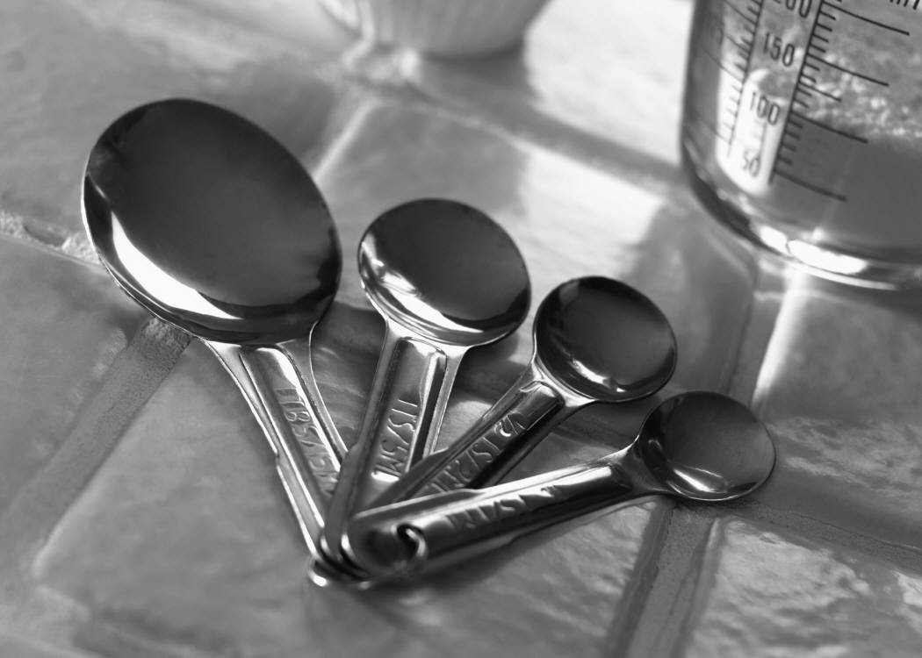
Measurement Standards
Notes:
An important skill needed for successful food preparation is knowledge of measurements, measuring equipment, and equivalents.

Slide 7
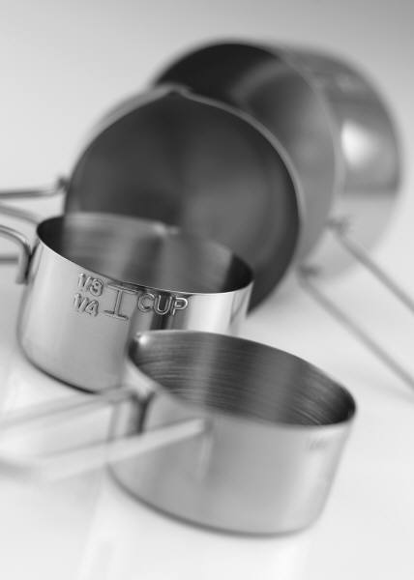
Measuring Standards
  Recipe success depends on accurate measuring
  Abbreviations may be used to save space
  Liquids, dry ingredients, and fats are measured differently
Notes:
Coffee mugs, soup spoons, and juice glasses do not work well as measuring tools as they may vary in sizes.

Slide 8
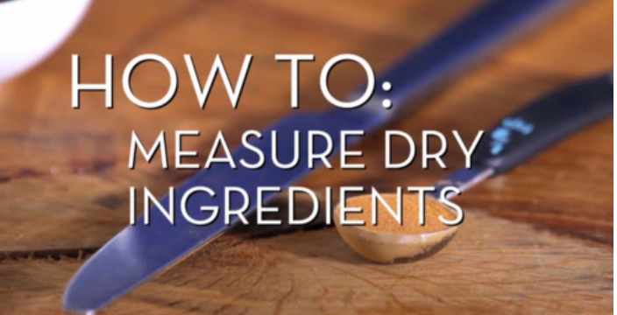
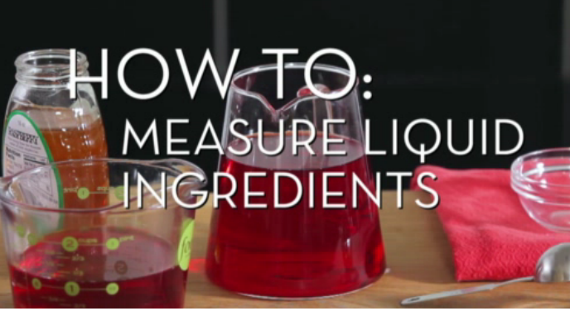
Measuring Utensils
  Dry measuring cups
  Liquid measuring cups
  Measuring spoons
How to Measure Dry Ingredients
How to Measure Wet Ingredients
click on links
Notes:
Display the measuring utensils:
Dry measuring cups
Liquid measuring cups
Measuring spoons
View Food Network’s videos on measuring:
How to Measure Dry Ingredients
Exact measurement for dry ingredients is key for baking. Use our tricks!
http://www.foodnetwork.com/videos/how-to-measure-dry-ingredients/85008.html
How to Measure Wet Ingredients
Here's how to measure liquids for accurate results every time.
http://www.foodnetwork.com/videos/how-to-measure-wet-ingredients/85130.html

Slide 9
Baking and Cooking Terms

Slide 10
Cooking Terms
  Baking and cooking techniques
  Cutting foods
  Mixing ingredients
  Other terms
Notes:
Cooking Terms may be divided into four categories:
Cutting foods
Mixing ingredients
Cooking techniques
Other
Definitions may vary from textbook to Internet but the following slide will include basic definitions.

Slide 11
Cooking Terms
  Baking and Cooking Techniques
    Bake
    Boil
    Broil
    Sauté
    Simmer
    Steam
    Stir Fry
  Cutting Foods
    Chop
    Dice
    Grate or shred
    Peel
    Slice
    Mince
Notes:
Baking and cooking techniques
Bake – To cook in an oven
Boil – To heat a food so that the liquid gets hot enough for bubbles to rise and break the surface
Broil – To cook under direct heat
Brown – To cook over medium or high heat until the surface of food browns or darkens
Sauté – To cook quickly in a little oil, butter, or margarine
Simmer – To cook in liquid over low heat (low boil) so that bubbles just begin to break the surface
Steam – To cook food over steam without putting the food directly in water (usually done with a steamer)
Stir Fry – To quickly cook small pieces of food over high heat while constantly stirring the food until it is crisply tender (usually done with a wok)
Cutting foods
Chop – To cut into small pieces
Dice – To cut into small cubes
Grate or Shred – To scrape food against the holes of a grater making thin pieces
Peel – To strip off the outside skin or peel
Slice – To cut a food into large, thin pieces with a slicing knife
Mince – To cut into very small pieces, smaller than chopped or diced pieces

Slide 12
Cooking Terms
  Mixing Ingredients
    Beat
    Blend
    Cream
    Fold
    Knead
    Mash
    Mix
    Toss
  Other Recipe Terms
    Drain
    Grease
    Marinate
    Preheat
    Season
Notes:
Mixing ingredients
Beat – To mix ingredients together using a fast, circular movement with a spoon, fork, whisk, or mixer
Blend – To mix ingredients together gently with a spoon, fork, or until well-combined
Cream – To beat ingredients, such as shortening and sugar, until they are soft and creamy
Fold – To gently mix a light, fluffy mixture into a heavier one
Knead – To press, fold and stretch dough until it is smooth and uniform, usually done by pressing with the heels of the hands
Mash – To squash food with a fork, spoon or masher
Mix – To stir ingredients together with a spoon, fork, or electric mixer until well-combined
Toss – To mix ingredients, such as salad greens and dressing, by tumbling them with tongs or a large spoon and fork
Other recipe terms
Drain – To remove all the liquid using a colander or strainer
Grease – To lightly coat with oil, butter, margarine, or non-stick spray so food does not stick when cooking or baking
Marinate – To soak food in a liquid to tenderize or add flavor to it (the liquid is called a “marinade”)
Preheat – To turn oven on ahead of time so that it is at the desired temperature when needed (usually takes about five to ten minutes)
Season – To add flavorings such as salt, pepper, herbs and spices to a food before or during cooking

Slide 13
Lab Guidelines

Slide 14
Rules
  Time
  Personal belongings
  Personal hygiene
  Food safety
  Duties
  Teamwork
  Laundry
  Absence from lab
  Other
Notes:
This is the time to discuss lab rules for your classroom so that the lab runs smoothly. Listed are a few items to discuss. Other rules may be added.
Time – remind students that labs begin promptly when the bell rings so that they may complete their lab in the allotted time
Personal belongings – backpacks, purses, and other items should be stored away from the kitchen so that items are not in the way. Jewelry should also be removed and stored in a safe place
Personal hygiene – hair should be pulled back, hands washed, and clean aprons worn the day of lab (hair nets may be provided if studying for food safety)
Food safety – remind students of food safety rules learned in prior lesson
Duties – explain the duties and responsibilities for each person in the group
Teamwork – remind students that the lab experience is a group activity and everyone should work together to complete the lab. No one in the group should leave the lab until the kitchen is checked and they are dismissed
Laundry – explain laundry procedures
Absence from lab – explain how a student who is absent the day of lab can make up the lab grade
Other – anything else that is important for a successful lab

Slide 15

Questions?

Slide 16
References and Resources
  Images:
    Microsoft Office Clip Art: Used with permission from Microsoft.
  Textbooks:
    Duyff, D. L. (2010). Food, nutrition, and wellness. Columbus, OH: Glenco/McGraw-Hill.
    Kowtaluk, H. (2010). Food for today. Columbus, OH: Glencoe/McGraw-Hill.
  Food Network™ Videos:
    How to Measure Dry Ingredients
    Exact measurement for dry ingredients is key for baking. Use our tricks!
    http://www.foodnetwork.com/videos/how-to-measure-dry-ingredients/85008.html
    How to Measure Wet Ingredients
    Here's how to measure liquids for accurate results every time.
    http://www.foodnetwork.com/videos/how-to-measure-wet-ingredients/85130.html

