Slide 1
Table Settings, Etiquette and Presentation

Slide 3
Table settings
  Basics
  Cover
  Meals at Home

Slide 4
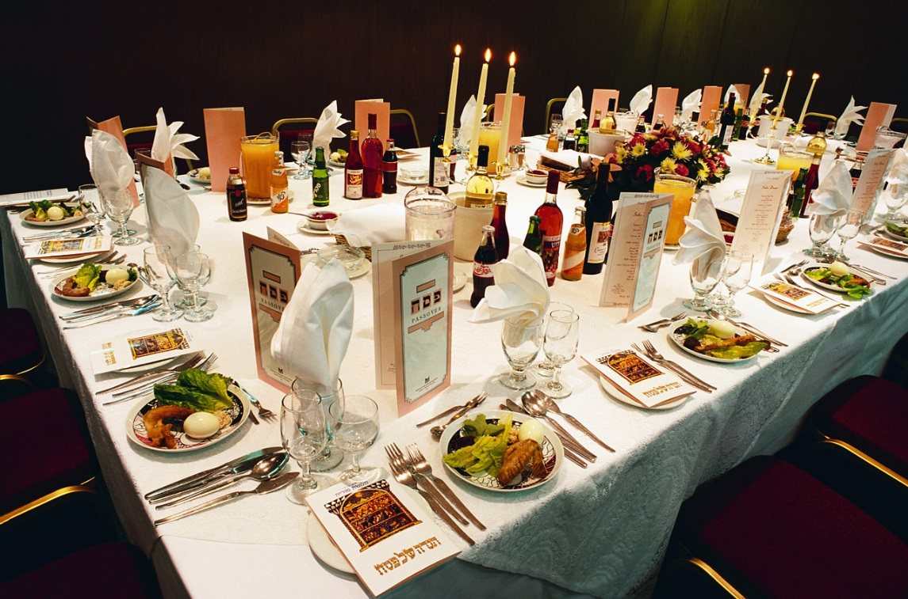
Basics
  Table should be set before people sit down to eat
  Start with a clean, sanitized table
  Place the linens
    Tablecloths
    Placemats
  Add a simple decoration
Notes:
Clean and sanitize table before setting the table.
Table Linens
Tablecloths – coverings for the entire table
Runners – long, narrow cloths that run down the center of the table
Place mats – cover the area of a single place setting
Napkins - a square piece of cloth or paper used at a meal to wipe the fingers or lips and to protect garments. Can be placed to the left of the forks or folded on the dinner plate or tucked into a glass
Decorations can include a candle or small vase with flowers.

Slide 5
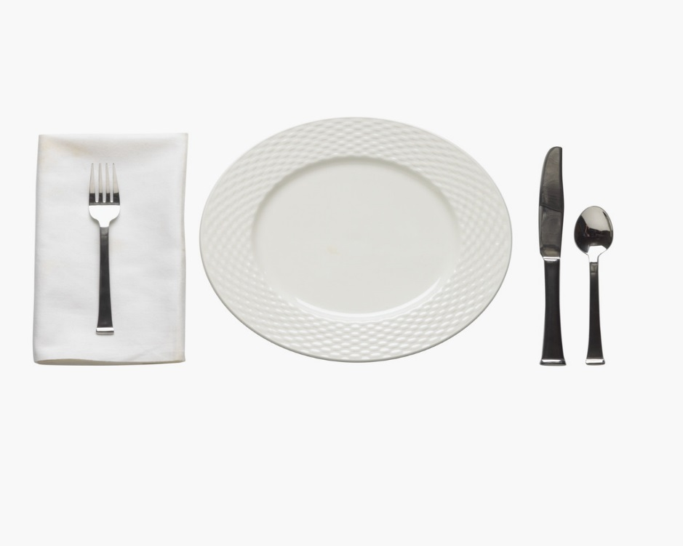
Cover
  The area containing a person’s tableware
  Set in order:
    Dinner plate
    Flatware
    Glassware
    Bread and salad plates
    Napkin
Notes:
Place Setting
Dinner Plates – center on cover, about 1 inch form the edge of the table
Flatware – arrange in the order in which it will be used, starting from the outside and working toward the plate. Knives are the right of the plate with the blade facing the plate. Spoons are the right of the knife. Forks are the left of the plate, tines up
Glassware – water glass should be placed at the tip of the dinner knife. Beverage glass to the right of the water glass. Cup and saucer is placed to the right of the spoon
Bread and salad plates – should be placed above the forks. If both being used, place the salad plate to the left of the forks

Slide 6
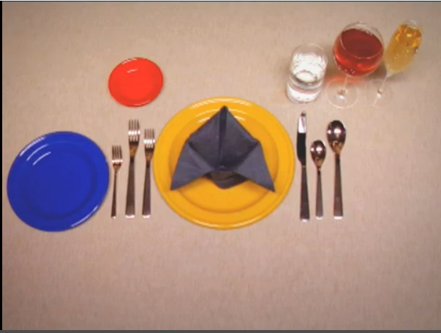
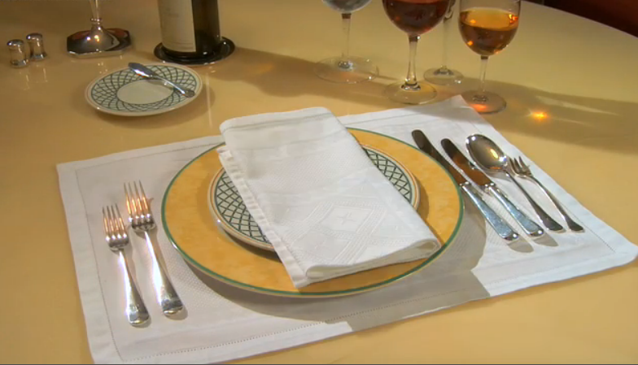
Table settings
How to Set a Classic Dinner Table
How to Set a Formal Table
(click on links)
Notes:
View videos on table settings:
How to Set a Classic Dinner Table
Figuring out which fork to use for which course can be confusing enough, but having to actually set those forks—and everything else on the table? A recipe for disaster… or a chance to strut your etiquette stuff.
http://www.howcast.com/videos/578-How-to-Set-a-Classic-Dinner-Table
How to Set a Formal Table
Learn how to set a formal table and you'll no longer be intimidated by someone else's!
http://www.howcast.com/videos/308988-How-to-Set-a-Formal-Table

Slide 7

Meals at home
  Buffet
  Family Service
  Modified English Service
  Plate Service
Notes:
Buffet - a method of serving food in which people help themselves to food set out on a table
Family service - serving meals in which food is placed in serving dishes and passed around the table
Modified English service - a more formal way of serving a meal for a small group as foods for the main course are brought to the table in serving dishes and are placed in front of the host, along with a stack of dinner plates. The host then serves the main course and vegetables on each dinner plates and passes the plate to the right
Plate service - serving meals in which food is portioned out on individual plates in the kitchen and brought to the table

Slide 8
Etiquette
  Good Table Manners

Slide 9
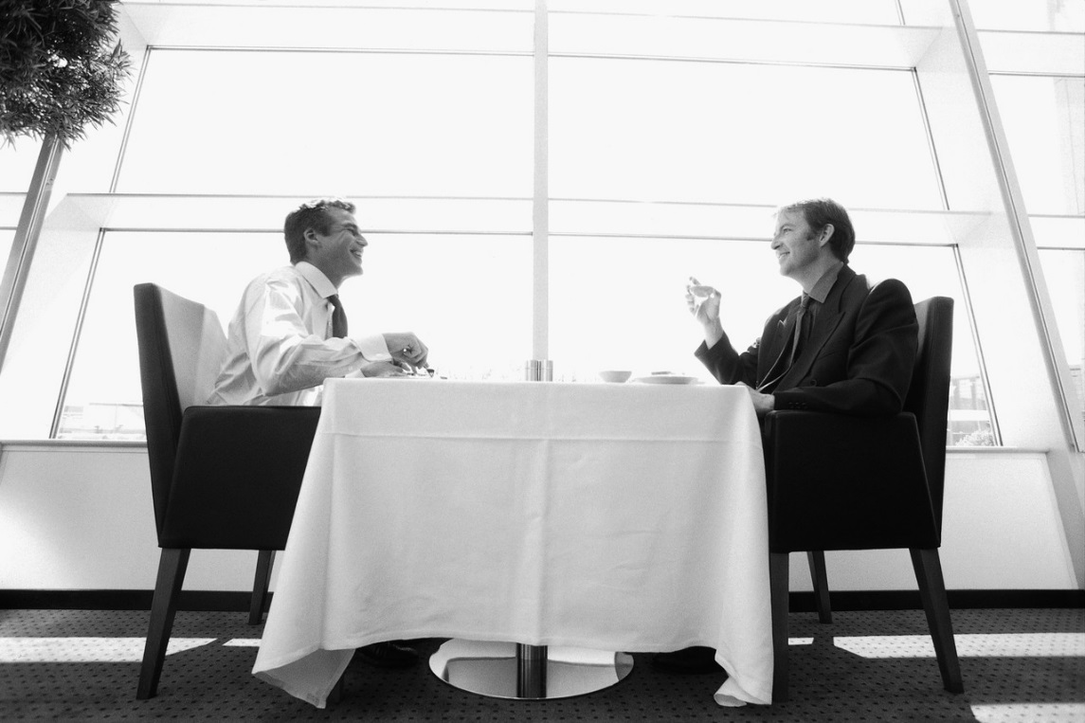
Good Table Manners
  Shows respect and consideration for others
  Allows you to feel comfortable in social situations
  Is an asset in the working world
  Meetings and interviews may take place during meals
  Rules may vary in different cultures
Notes:
Discuss with students how valuable good table manners are in the business world.
Refer to handout Table Etiquette (see All Lesson Attachments tab) for more information.

Slide 10
Presentation
  Appealing

Slide 11
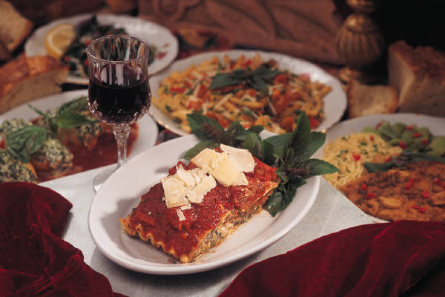
Appealing
  Color
  Flavor
  Shape and size
  Temperature
  Texture
Notes:
Color – Choose foods in a variety of colors
Flavor – food flavors should complement and keep the taste buds interested
Shape and size – create different effects by changing the food’s form and proportion
Temperature – affects its taste and texture as well as food safety. Keep hot foods hot and cold foods cold
Texture – refers to the way food feels when you chew it. Aim for a variety of textures

Slide 12

Questions?

Slide 13
References and Resources
  Images:
    Microsoft Office Clip Art: Used with permission from Microsoft.
  Textbooks:
    Draz, J. & Koetke, C. (2010). The culinary professional. Tinley Park, IL: Goodheart-Willcox Company.
    Kowtaluk, H. (2010). Food for today. Columbus, OH: Glencoe/McGraw-Hill.
  Videos:
    How to Set a Classic Dinner Table
    Figuring out which fork to use for which course can be confusing.
  http://www.howcast.com/videos/578-How-to-Set-a-Classic-Dinner-Table
    How to Set a Formal Table
    Learn how to set a formal table and you'll no longer be intimidated by someone else’s!
    http://www.howcast.com/videos/308988-How-to-Set-a-Formal-Table

