Slide 1
Talking Safety

Slide 3
Talking Safety
  You will learn about:
    Ways young workers can get hurt on the job
    Common health and safety hazards on the job
    Ways to reduce or control workplace hazards
    Emergencies in the workplace and how to respond
    What to do if you see something at work that could hurt you or make you sick
    What legal rights and protections young people have at work

Slide 4

Lesson One: Younger Worker Injuries

Slide 5
What is Your Experience with Work?
  How many of you have ever had a job?
  Where did you work?
  What did you do?
  Have you ever been hurt at work, or do you know someone who was?
  Have you ever been uncomfortable with a task you’ve been asked to do at work?

Slide 6
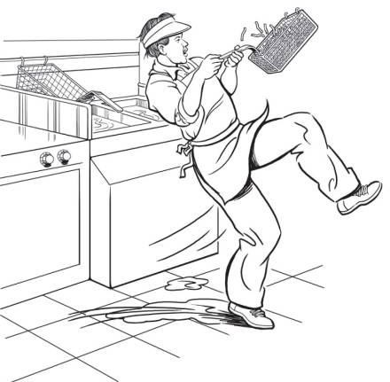
Examples of Teen Work Injuries: John’s Story
  The Impact of Work Injuries
  Job: Fast food worker
  Injury: Slipped on greasy floor
  Why do you think this happened?
  What could have prevented John
  from getting hurt?

Slide 7
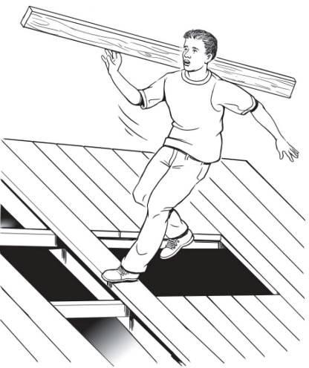
Teen Work Injuries: Antonio’s Story
  The Impact of Work Injuries
  Job: Construction helper
  Injury: Fell from roof
  Why do you think this happened?
  What could have prevented
  Antonio from being killed?

Slide 8
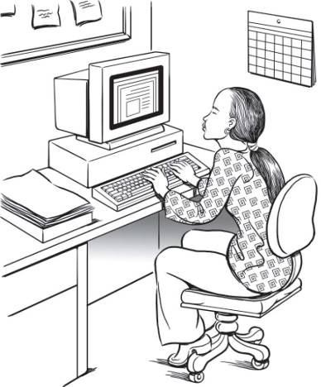
Teen Work Injuries: Keisha’s Story
  The Impact of Work
  Job: Computer data entry
  Injury: Repetitive stress injury
  Why do you think this happened?
  What could have prevented
  Keisha from being killed?

Slide 9
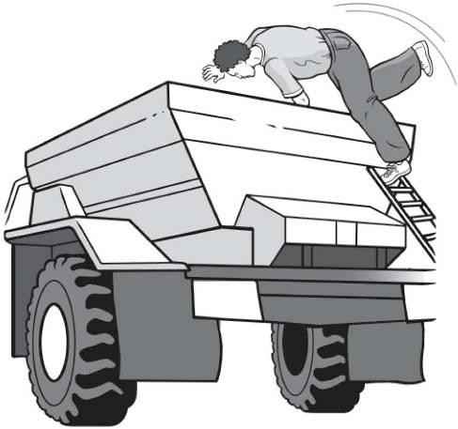
Teen Work Injuries: Francisco’s Story
  The Impact of Work Injuries
  Job: Landscaping worker
  Injury: Death
  Why do you think this happened?
  What could have prevented
  Francisco from being killed?

Slide 10
Teen Work Injury Statistics
  Many youth are injured on the job:
    158,000 <18-year-olds injured/year in the US
    52,600 <18-year-olds to the ER for work injuries
    38 <18-year-olds die each year
  Young workers are injured at a higher rate than adult workers.

Slide 11
Where Teens are Injured
Leisure and hospitality (includes restaurants)
Leisure and hospitality (includes restaurants)
Retail
Retail
Services and Other
Services and Other
Manufacturing, Construction, Transporation
Information, Finance and insurance
Agriculture and Forestry
Manufacturing, Construction, Transporation
Information, Finance and Insurance
Agriculture and Forestry
2% 2%
5%
_{4%} 3%
5%
14%
46%
19%
45%
31%
24%
Teen Work Injury Statistics

Slide 12
Job Safety Quiz
  The law says your employer must give you training about health and safety hazards on the job.
  ______________True ______________False
  The law sets limits on how late you can work on a school night if you are under 16.
  ______________True ______________False
  If you are 16 years old you are allowed to drive a car on public streets as part of your job.
  ______________ True ______________False

Slide 13
Job Safety Quiz continued…
  If you are injured on the job, your employer must pay for your medical care.
  ______________True ______________False
  How many teens get injured on the job every year in the U.S.?
  ______________One per day ______________One per hour
  ______________One every 10 minutes

Slide 14

Why are Young Workers Injured at High Rates?
  Video and Discussion

Slide 15
Key Points of the Young Workers Curriculum
  You will learn more about:
    How to identify and reduce hazards on the job
    What laws protect teens from working too late or too long
    What laws protect teens from doing dangerous work
    How to solve health and safety problems at work
    Which agencies enforce health and safety laws and child labor laws
    What to do in an emergency

Slide 16
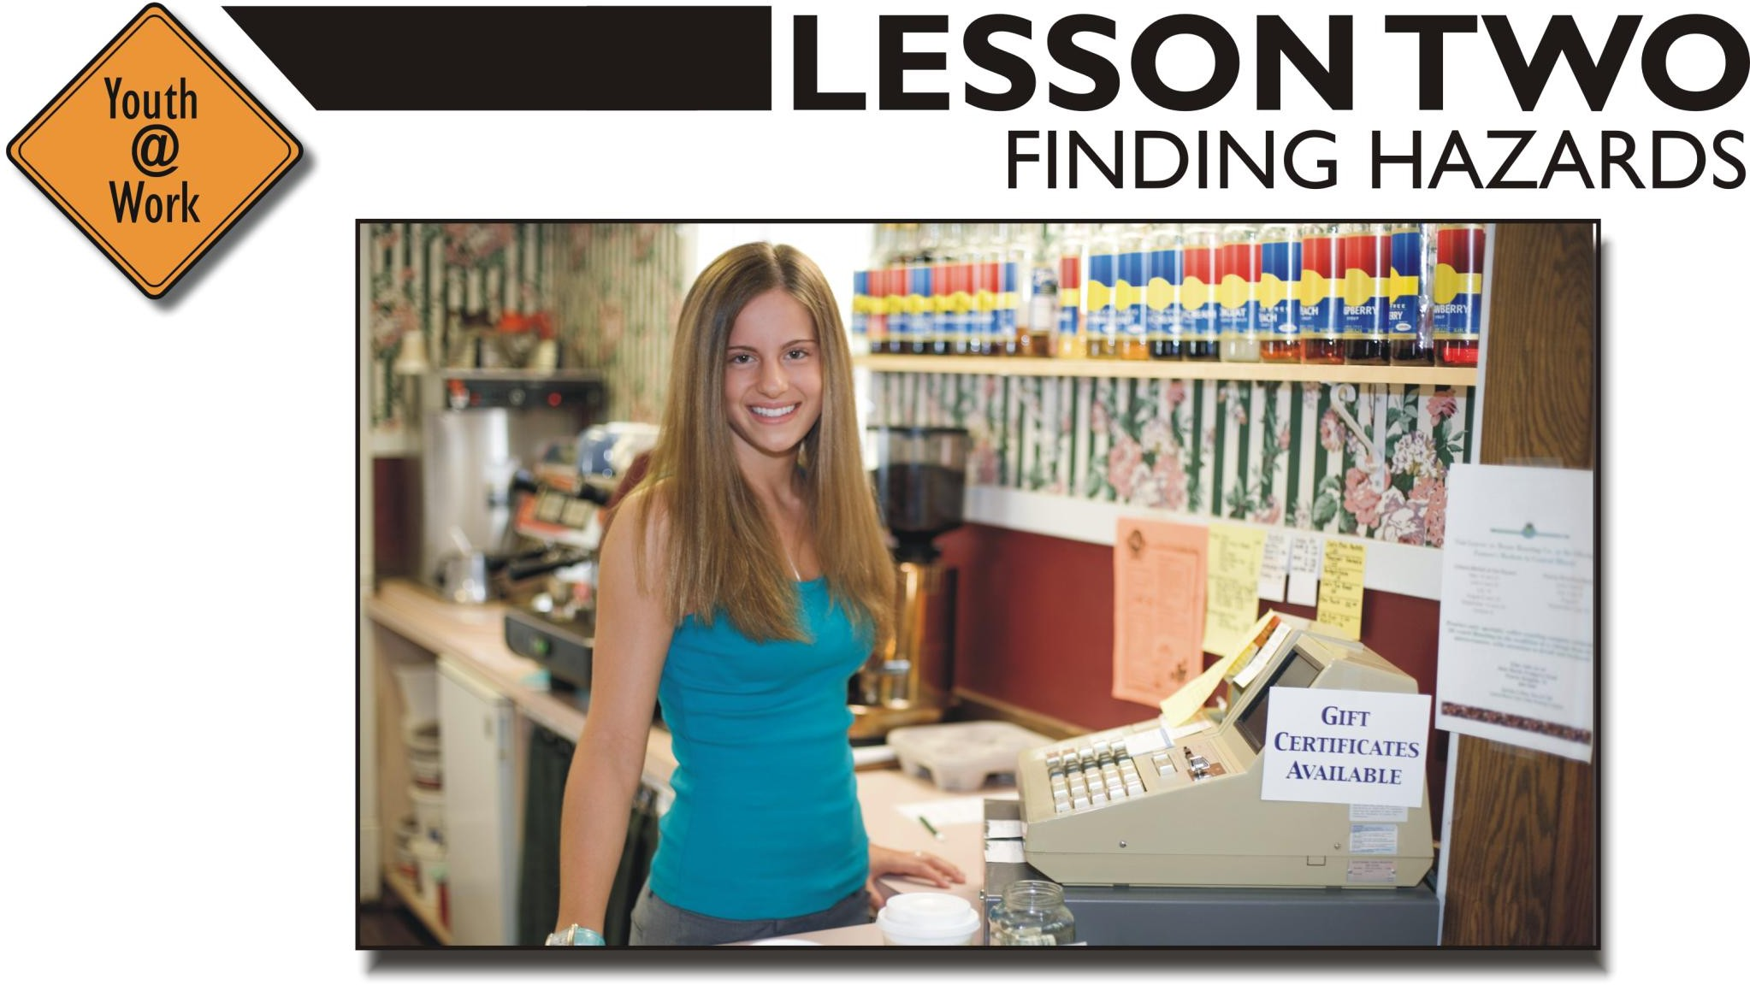
Lesson Two: Finding Hazards

Slide 17
Job Hazards
  A job hazard is anything at work that can hurt you either physically or mentally
  Safety hazards can cause immediate accidents and injuries
    Examples: knives, hot grease, etc.
  Chemical hazards are gases, vapors, liquids, or dusts that can harm your body
    Examples: cleaning products or pesticides

Slide 18
Job Hazards
  Biological hazards are living things that can cause sickness or disease
    Examples: Bacteria, viruses, or insects
  Other health hazards are harmful things, not in other categories, that can injure you or make you sick. They are sometimes less obvious because they may not cause health problems right away
    Examples: noise, radiation, repetitive movements, heat, cold, stress

Slide 19
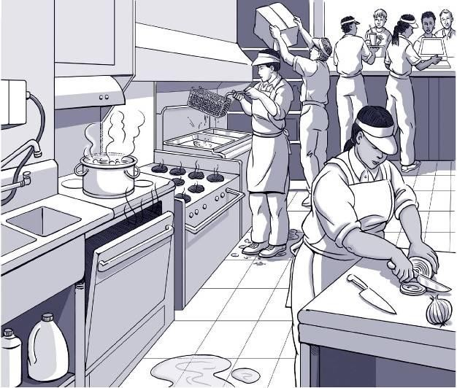
Find the Hazards: Fast Food
  Illustrated Workplaces

Slide 20
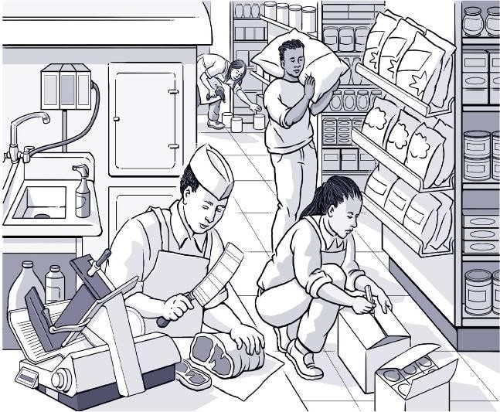
Find the Hazards: Grocery Store
  Illustrated Workplaces

Slide 21
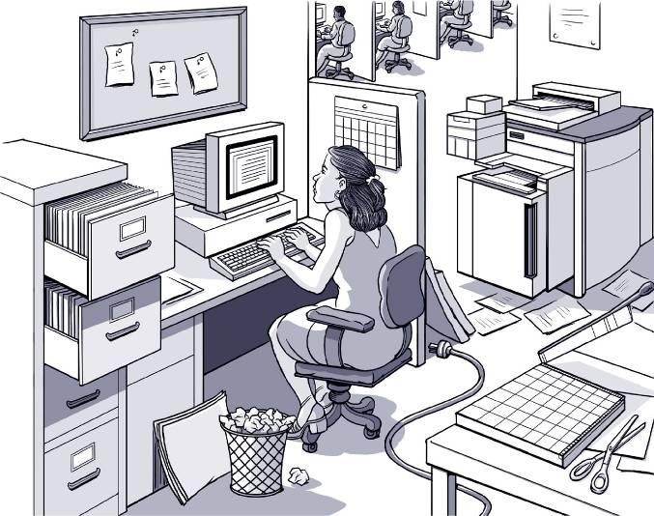
Find the Hazards: Office
  Illustrated Workplaces

Slide 22
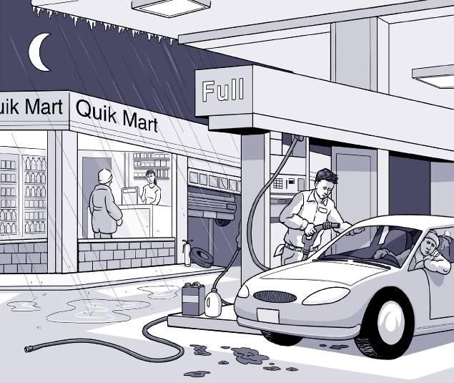
Find the Hazards: Gas Station
  Illustrated Workplaces

Slide 23
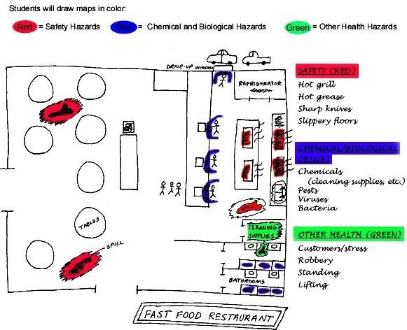
Hazard Mapping Activity

Slide 24
Finding Hazards: Key Points
  Every job has health and safety hazards
  You should always be aware of these hazards
  Find out about chemicals at work by checking labels, reading MSDSs (Material Safety Data Sheets), and getting training

Slide 25
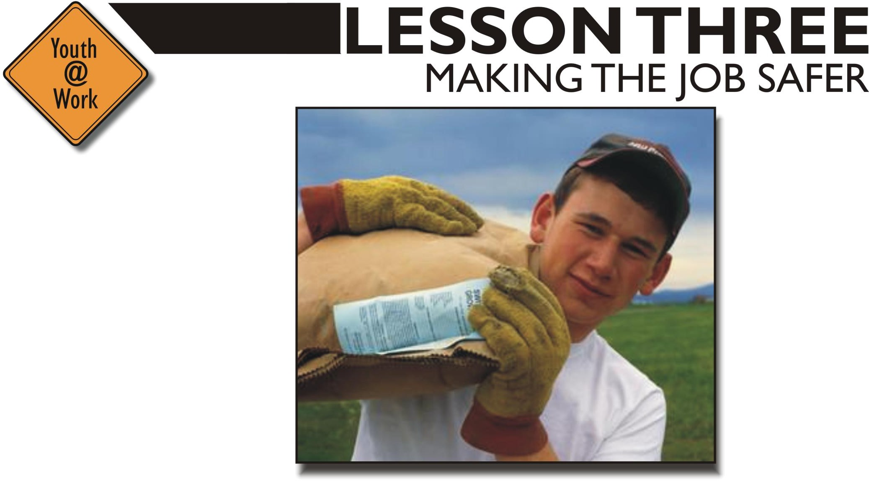
Lesson Three: Making the Job Safer

Slide 26
Controlling Hazards
Remove
the Hazard
(e.g., use safer chemicals)
Work Policies and Procedures
(e.g., assign enough people
to do the job)
Personal Protective Equipment
(e.g., wear gloves, use a respirator)

Slide 27
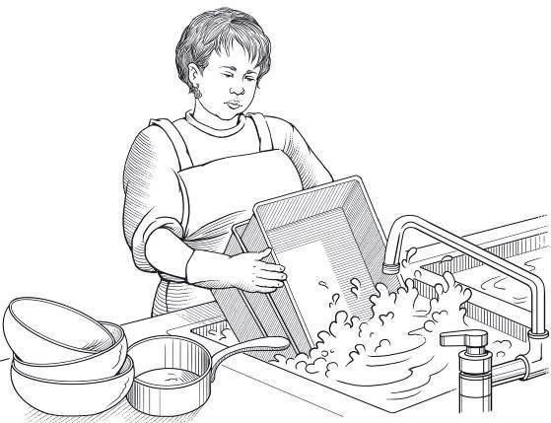
Eliminating or Reducing Hazards: Jamie’s Story
  $25,000 Safety Pyramid Game
  Job: Hospital dishwasher
  Injury: Dishwashing chemical splashed in eye

Slide 28
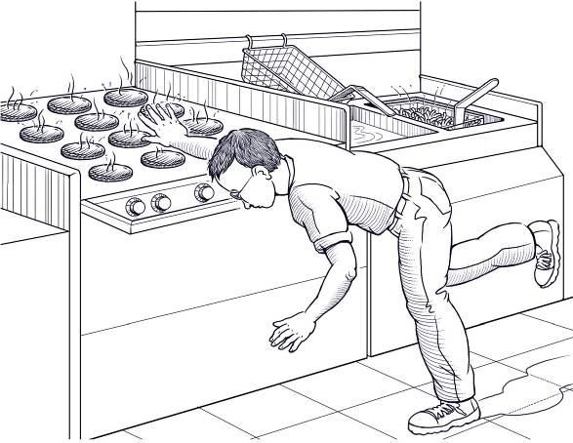
Eliminating or Reducing Hazards: Billy’s Story
  $25,000 Safety Pyramid Game
  Job: Fast food worker
  Injury: Burned hand on grill

Slide 29
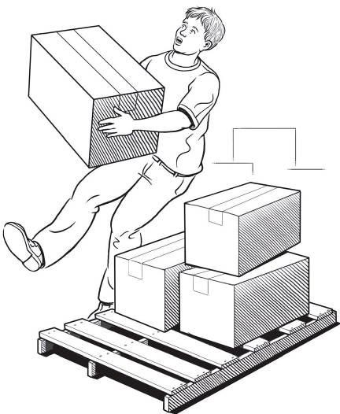
Eliminating or Reducing Hazards: Stephen’s Story
  $25,000 Safety Pyramid Game
  Job: Grocery store clerk
  Injury: Hurt back while loading boxes

Slide 30
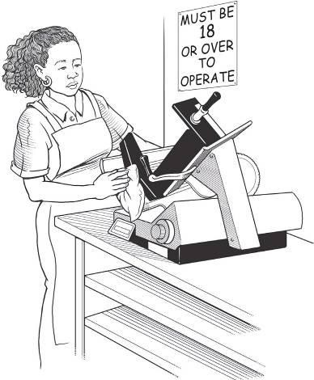
Eliminating or Reducing Hazards: Terry’s Story
  $25,000 Safety Pyramid Game
  Job: Grocery store deli clerk
  Injury: Cut finger on meat slicer

Slide 31
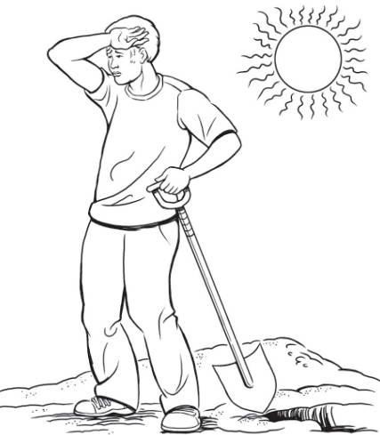
Eliminating or Reducing Hazards: Chris’ Story
  $25,000 Safety Pyramid Game
  Job: City public works employee
  Injury: Fainted due to heat

Slide 32
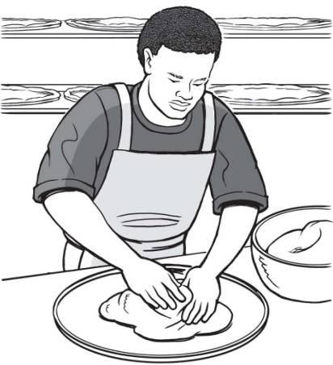
Eliminating or Reducing Hazards: James’ Story
  $25,000 Safety Pyramid Game
  Job: Pizza shop employee
  Injury: Repetitive motion injury

Slide 33
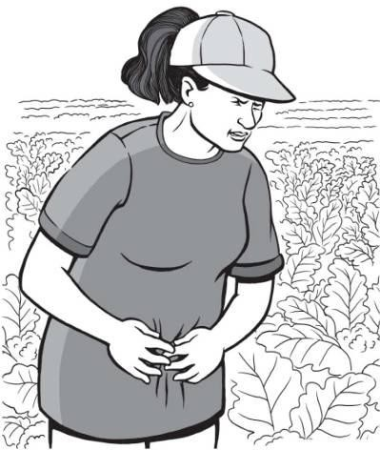
Eliminating or Reducing Hazards: Maria’s Story
  $25,000 Safety Pyramid Game
  Job: Farmworker
  Injury: Pesticide poisoning

Slide 34
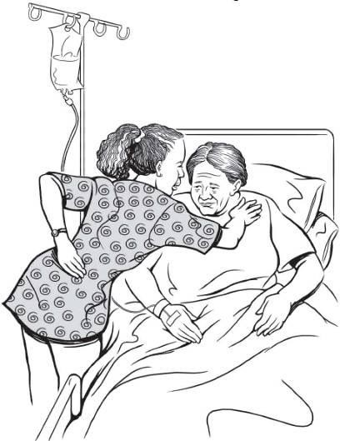
Eliminating or Reducing Hazards: Sara’s Story
  $25,000 Safety Pyramid Game
  Job: Nursing aide
  Injury: Back, neck, and shoulder pain

Slide 35
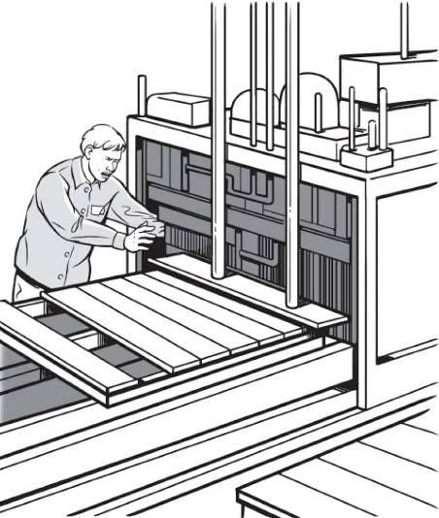
Eliminating or Reducing Hazards: Jamie’s Story
  $25,000 Safety Pyramid Game
  Job: Pallet making
  Injury: Amputated arm

Slide 36
Making the Job Safer: Key Points
  OSHA requires employers to provide a safe workplace.
  It’s best to get rid of a hazard completely, if possible.
  If your employer can’t get rid of the hazard, there are usually many ways to protect you from it.

Slide 37

Lesson Four: Emergencies at Work

Slide 38
Emergencies at Work: Key Points
  Every workplace should have an emergency action plan
  The plan should cover:
    What to do in different emergencies
    Where shelters and meeting places are
    Evacuation routes
    Emergency equipment and alert systems
    Who’s in charge
    Procedures to follow when someone is injured
  The workplace should have practice drills
  Workers should be trained on everything in the plan

Slide 39
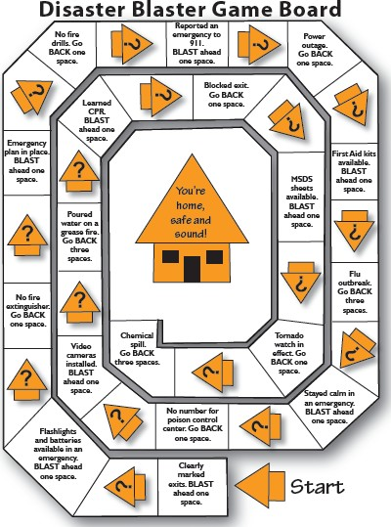
Emergencies at Work
  Disaster Blaster Game
  Emergencies in the News activity

Slide 40

Lesson Five: Know Your Rights

Slide 41
Know Your Rights
Jeopardy Game
Rights on the Job | Dangerous Work and Work Permits | Hours for Teens and Working Safely | Job Injuries and Getting Help
$100 | $100 | $100 | $100
$200 | $200 | $200 | $200
$300 | $300 | $300 | $300
$400 | $400 | $400 | $400
$500 | $500 | $500 | $500

Slide 42
Know Your Rights: Key Points
  Federal and state labor laws:
    Set minimum age for some tasks
    Protect teens from working too long, too late or too early
  OSHA says every employer must provide:
    A safe workplace
    Safety training on certain hazards
    Safety equipment
  By law, your employer is not allowed to fire or punish you for reporting a safety problem

Slide 43
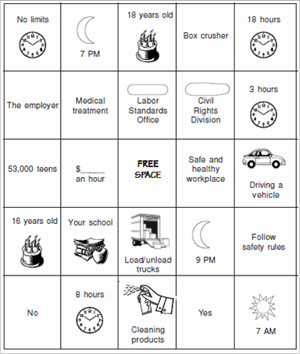
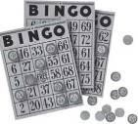
Know Your Rights
State Labor Law BINGO Game

Slide 44

Lesson Six: Taking Action

Slide 45
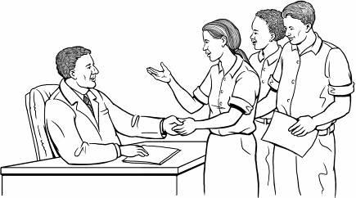
Handling Workplace Safety Problems
  Steps in Problem Solving
    Define the problem
    Get advice
    Choose your goals
    Know your rights
    Decide the best way to talk to the supervisor
    If necessary, contact an outside agency for help

Slide 46

Summing Up
  Know your:
    Rights
    Responsibilities
    Employer’s responsibilities
    How to solve problems

Slide 47
Questions?

