Slide 1
Technology in the Hospitality and Tourism Industry

Slide 3
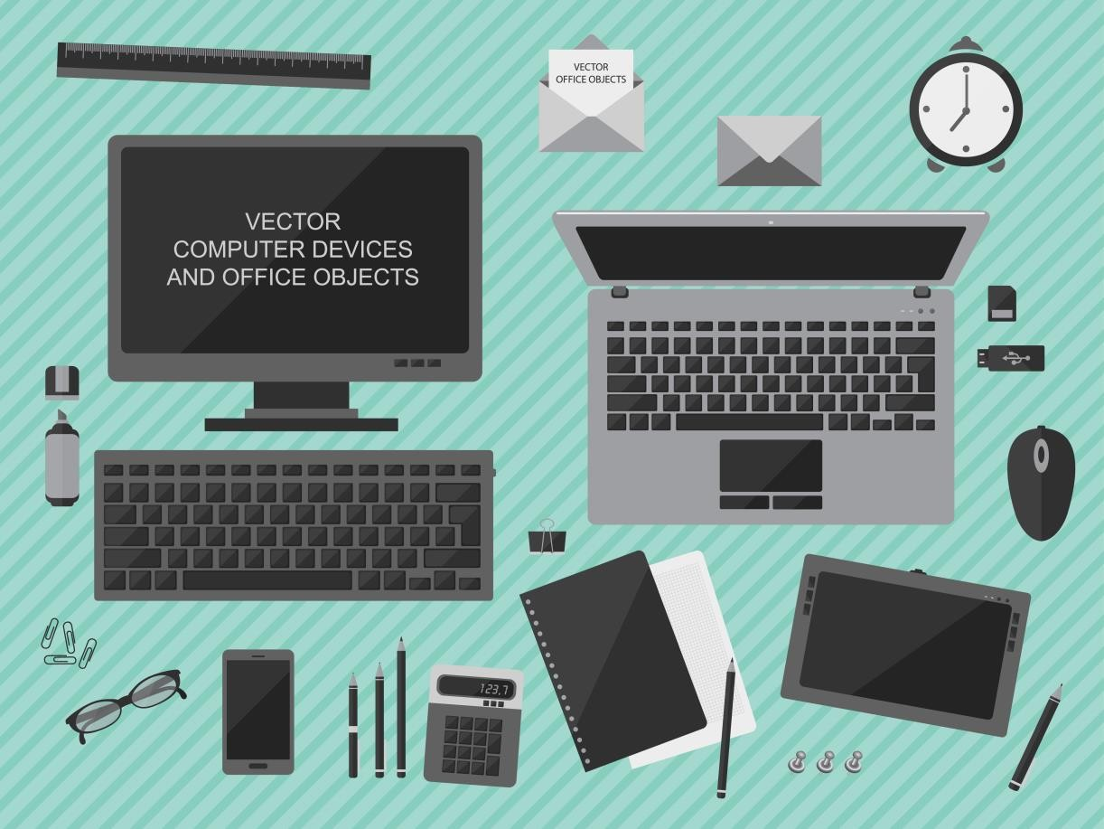
What is Technology?
The application of scientific knowledge for practical purposes, especially in industry

Slide 4

Property Management Systems Point of Sales Systems

Slide 5
Internet
Hospitality
Customers can:
Book hotel rooms online
Buy tickets for events
Make airline reservations
Plan vacations
Rent cars
View hotel website for location and room rates
Restaurants
Customers can:
Make reservations
Order take out food
View restaurant website for hours of operation, location and menus

Slide 6

Property Management System (PMS)
The computer software and hardware used to run lodging properties; keeps all the information for all departments

Slide 7
PMS Systems
Creates a guest folio
Keeps track of guest purchases
Generates a bill
Produces electronic key cards
Can handle:
Accounting
Inventory
Purchasing
Receiving

Slide 8

Point of Sales System (POS)
A computerized system for recording an order at the
place where the order is taken

Slide 9
POS Systems
Calculates charges and taxes
Keeps track of menu items sold
Processes credit cards
Records payments
Sends orders to kitchen
Tracks inventory
Can handle:
Accounting
Employee
Scheduling
Time clock
Payroll
Sales reports

Slide 10
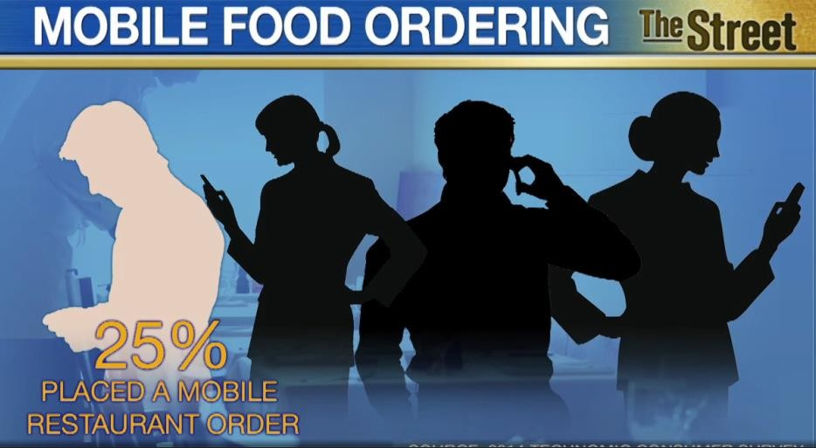
Technology is set to invade a restaurant near you in 2015

Slide 11
Wireless Communication
Equipment
Computers
Cell phones
Laptops
Pagers
Tablets
Two-way radios
Programs
Email
Social media
Facebook™
Twitter™
Instagram™
Text

Slide 12

Human Resources Information System (HRIS)
Used by human resource departments
Keeps track of employee information
Addresses
Anniversaries of hire date
Attendance
Birth dates
Disciplinary records
Names
Social security numbers
Wage histories

Slide 13

Other Technology Available
Computerized table management system
Electronic bulletin board
Kiosks
Wi-Fi

Slide 14


Slide 15
References and Resources
Images:
Shutterstock™ images. Photos obtained with subscription. (Slides 3, 4, 6, 7, 8, 9, 11, 12,
14)
Journal:
Brewer, P., Kim, J., Schrier, T., & Farrish, J. (2008). Current and Future Technology Use in
the Hospitality Industry.
Textbooks:
Reynolds, Johnny Sue. (2010). Hospitality Services. Tinley-Park, Illinois: The Goodheart-
Willcox Company.
Video:
Technology is set to invade a restaurant near you in 2015
2015 may well be the year that restaurants across the country put guests in control of their own dining experience by allowing them to place orders and pay their checks via tablets and place orders before they get to the counter. http://www.usatoday.com/media/cinematic/video/23130327/technology-is-set-to- invade-a-restaurant-near-you-in-2015/

