Slide 1
The Balancing Act
Managing a Career and Family

Slide 3
Working in Hospitality and Tourism
Notes:
Travel shows on television have boosted careers for many tour guides and travel destinations.
But there are advantages and disadvantages to working in the hospitality and tourism industry.

Slide 4

Advantages
Abundance of jobs
Advancement opportunities
Fast pace and variety
Meeting people
Pleasant workplace
Travel
Notes:
There are many advantages to working in the hospitality and tourism industry. Listed above are a few.
Can you think of any others?

Slide 5

Disadvantages
Hours of work
Relocation
Stress
Working conditions
Notes:
Careers in the hospitality and tourism industry can be stressful and physically demanding.
The hours are long and may include nights, weekends, and holidays.
Can you name any other disadvantages to a career in the hospitality and tourism industry?

Slide 6
Multiple Roles
Adult
Employee
Citizen
Spouse
Parent
Community member
Neighbor
Other
Notes:
Adult – We have to grow up!
Employee – This role will require that you be at work on time and perform your job well
Citizen – This role will require you to be informed about current events and vote
Spouse and parent - These roles add responsibility for relating to and taking care of others
Community member and neighbor – These roles may include responsibilities of organizing and participating in community activities
Other – These roles may include being a member of an athletic club, music group or other special interest groups

Slide 7
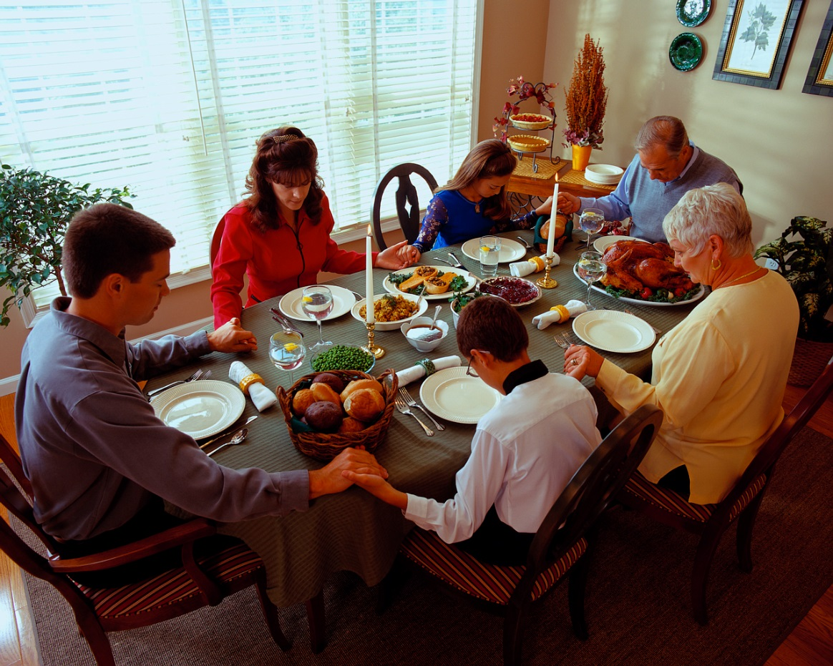
Family
May consist of:
  Spouse
  Children
  Grandparents
  Brothers and sisters
  Step-children
  Other relatives
Notes:
The functions of families are:
meeting the basic needs of family members such as food, shelter, clothing and education
giving emotional control such as helping each other during difficult times
teaching values such as right from wrong and what is most important in life
passing on culture and traditions such as teaching children how to get along with other people and about their family heritage
Who are your family members?

Slide 8

Families Struggling for Work-Life Balance
(click on link)
Notes:
Click on hyperlink to view video:
Families Struggling for Work-Life Balance
A new study released from the Pew Research Center found 37% of mothers say they want to work fulltime, due, in large part, to the recession and financial insecurity.
http://www.nbcnews.com/video/nightly-news/51186744/#51186744

Slide 9
Time and Energy Management

Slide 10
Time Saving Techniques
Avoid procrastination
Avoid time wasters
Be flexible
Do it right the first time
Make a To Do list
Practice work simplification
Prevent interruptions
Set goals
Stay organized
Take a break
Use a calendar
Use small amounts of time
Notes:
Take advantage of these tips to make time work for you.

Slide 11

Managing Your Energy
Amount changes daily
Identify your peak period
Levels vary with age
Increase levels by:
    Getting plenty of rest
    Eating healthy food
    Exercising regularly
Notes:
Understanding when we perform our best and what affects our energy can help us with our work.

Slide 12



Leisure Activities
Hobbies
Vacations
Community activities
Reflection
Notes:
Leisure time is the time you have free from work and other duties.
This time can include:
Hobbies
building
crafting
drawing
reading
Vacations
visiting family in other cities
visiting amusement parks
Community activities
participating in festivals, concerts or other local activities
Reflection
taking time for yourself by yourself
What is your favorite leisure activity?

Slide 13
Questions?

Slide 14
References and Resources
Images:
Microsoft Office Clip Art: Used with permission from Microsoft.
Textbooks:
Kelly-Plate, J., & Eubanks, E. (2004). Today’s teen. New York, NY: Glencoe/McGraw-Hill.
Reynalds, J.S. (2010). Hospitality services: Food & lodging. Tinley Park, IL: Goodheart-Willcox Company.
Video(s):
Families Struggling for Work-Life Balance
A new study released from the Pew Research Center found 37% of mothers say they want to work fulltime, due, in large part, to the recession and financial insecurity.
http://www.nbcnews.com/video/nightly-news/51186744/#51186744

