Slide 1
The Balancing Act: Parenting Responsibilities

Slide 3

Should you become a parent?
Are you ready for the responsibilities?
What are your plans for the future?
What can you give a baby?
Notes:
Parenting: The name given to the process of raising a child. Along with parenting come many responsibilities. A responsibility is a condition in which a person assumes the duties, obligations and accountability for something. Couples who are thinking about having a child need to make a self-assessment of their lives. Couples must consider how a baby will affect how they will share responsibilities. Some factors to consider are:
What are your plans for the future? Career? Marriage? Education? Retirement? Have children? Travel? Grandchildren? Other?
Do you fully understand and accept the responsibilities of having a child?
Do you have family support to help with the child?
Do you have the finances to support a child for 18 years (or longer)?
Do you have the time and energy to devote to a child?
How are you going to agree on sharing home and child care tasks?
How will the finances be affected by the addition of a baby?
What do you expect of a baby? Some parents expect many things from their babies. These expectations may be reasonable or unreasonable.
Will having a baby affect your job and career?
Will the mother work outside of the home?
Personal freedoms, an active social life and privacy are some of the first things sacrificed when a baby is born. A baby also may detain career and educational goals. Some responsibilities of rearing a child include providing proper nutrition; making decisions about discipline; teaching morals and values; paying medical bills, clothing and food; and spending time with the child.
At this time, can you give a baby what he or she might need? A baby needs the following:
Economic security
Educational opportunities
Emotional support
Proper nourishment
Responsiveness
Shelter
Unconditional love

Slide 4

Why do you want to have a baby?
Notes:
Good reasons for having a baby include the following:
You/we are committed to beginning a family.
You/we have many wonderful thoughts, ideas and possessions to share with a child.
You/we want to provide a beginning for a new life.
Poor reasons for having a baby include the following:
You/we want a baby because babies are cute.
You/we want a baby to carry your/our family name.
You/we want a baby because your/our friends are having babies.
You/we want a baby to provide you/us with love.
You/we want a baby to keep the relationship going.
You/we want a baby to escape the pressures of everyday life.

Slide 5

What do you expect of a baby?
Notes:
Some parents expect many things from their babies. These expectations may be reasonable or unreasonable.
Reasonable expectations may include:
A child will respond with love and affection to parents who are caring and supportive.
A child will contribute to the family through household responsibilities, sharing and affection when good role modeling is exhibited by parents.
Unreasonable expectations may include:
A baby will be cute and cuddly.
A child will be a mirror image of parents.
A child will provide companionship.
A child will provide a quick fix for a ruined marriage or relationship.
A child will provide security in old age.

Slide 6

Parenting Responsibilities
Some important responsibilities that affect the health and happiness of parents and children include the following:
Child guidance
Cognitive development
Financial responsibilities
Health and safety responsibilities
Legal and moral responsibilities
Social and emotional development
Notes:
The responsibilities of parenting are endless. Some important responsibilities that affect the health and happiness of parents and children include the following:
Child guidance
Cognitive development
Financial responsibilities
Health and safety responsibilities
Legal and moral responsibilities
Social and emotional development

Slide 7



Babies and Finances
Couples soon realize that children cost a lot!
The first year is expensive with prenatal and postnatal care of the mother and baby.
Notes:
Each extra child naturally increases the cost to a family. Some other costs pertaining to the first year include pediatrician visits and newborn items. As the child grows older, the costs get higher. What do new parents need for their baby before the baby arrives? As a class, let’s brainstorm and compile a list of items along with the costs.
Discuss the results of the list

Slide 8
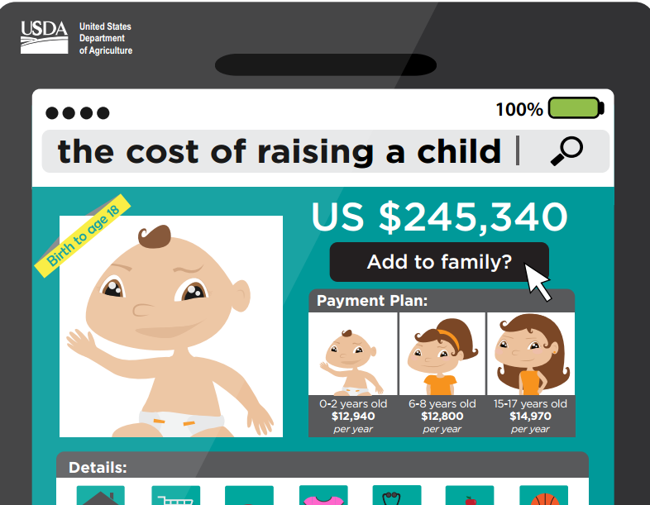
Cost of Raising a Child
(click on picture)
Source: United States Department of Agriculture
Notes:
According to the Expenditures of Children and Families report, a middle-income family with a child born in 2013 can expect to spend about $245,340 ($304,480 adjusted for projected inflation) for food, housing, childcare and education and other child-rearing expenses up to age 18. Costs associated with pregnancy or expenses occurred after age 18, such as higher education, are not included.
United States Department of Agriculture
Cost of raising a child to the age of 18. (August 2014)
http://www.cnpp.usda.gov/sites/default/files/expenditures_on_children_by_families/CRC2013InfoGraphic.pdf

Slide 9

Things to Think About
Know what you currently earn and how you spend the money.
Have a budget and make it a priority to put money aside in a savings account.
    Child care costs (if parents work)
    Clothing
    Food
    Medical bills
    Mortgage/rent
    Savings account
    Transportation
Notes:
Financial and career stability should be considered before deciding to have children. Children are expensive. Just as one must assess his or her financial condition before purchasing a car or home, individuals must seriously evaluate their ability to financially support a dependent child. The expense begins with the first pregnancy test or visit to the physician and does not end until the child is able to live and support himself or herself independently. Parents must have a budget and carefully examine their income to meet the high financial costs of having a baby. Responsible parents not only have to carefully manage their money daily, but they also must plan for large or unexpected expenses. These expenses might include illnesses, accidents or higher education. Some expenses include mortgage/rent, groceries, medical bills, transportation (car payments, insurance, gas and upkeep of the vehicle[s]), clothes and miscellaneous. What are some of the child care costs for the first year? Other costs can include:
Prenatal expenses
Childbirth expense
Infancy expenses
Childhood expenses
What specific expenses fall under each one list above?
What are fixed expenses? What are flexible expenses? Why is it important to set up a savings account? Parents need to see the importance of financial planning because their children are going to rely on them for financial support for many, many years.

Slide 10

Basic Needs of Children
Children have many needs. As a parent, you are responsible for meeting those needs.
Let’s brainstorm as a class, and develop a list of basic needs for children, from the time they are born until the age of 18.
Notes:
Every child must have basic needs met to ensure healthy development. A need is a condition in which something is required for physical or mental well-being. Basic needs consist of food, clothing, shelter, medical attention, love, attention, physical care such as hygiene, dental visits and immunizations and proper exercise.
Parents want their children to be safe the protected. Safety begins with medical checkups, immunizations and safe physical and emotional surroundings. To provide and maintain a safe environment, parents should be aware of safety practices to implement and to teach.
Children need affection. The affection of parents and other family members is important for the social and emotional development of children. The nurturing provided by a parent plays an important role in the development of positive self-esteem and in the development of a child’s relationships. For a young child, these relationships might include positive interactions with other children through play. Regardless of age, all children need to know that they are loved and accepted by their parents and family members.

Slide 11

Newborn’s Physical Needs
Newborns are totally dependent on their parents to meet their needs.
Parents have the personal choice of breastfeeding or bottle feeding their newborn.
Notes:
Physical needs include feeding, bathing, clothing and dressing the baby, diapering the baby, sleeping and exercise. When the neonate is born, he or she depends on someone to provide the nourishment that is necessary for survival. Many parents may be concerned about what feeding method is the best for their child. What are the advantages and disadvantages of both methods of feeding the baby? Cost? Is the nutritional value different for breast milk and formula? Discuss the emotional, social, mental and physical aspects of each method.
Breastfeeding advantages can include:
Antibodies that are present in the mother’s system can be passed to the infant through the breast milk.
Breast milk is easily digestible and gentle on the infant’s digestive system.
Breast milk is generally the best source of nourishment for the infant.
Breastfeeding helps to develop a close bond between the parents and infant.
Breastfeeding is convenient and time saving while costing no money.
The uterus of a woman who is breastfeeding tends to return to its normal size more quickly than if she was not breastfeeding.
Weight loss tends to occur more quickly when a woman breastfeeds.
What are some disadvantages of breastfeeding? Although there are benefits to breastfeeding, some disadvantages also exist.
Substances in the mother’s body can be passed to her infant through breast milk. Therefore, breast feeding women must be careful about taking medications or anything that could harm the infant.
Illness in the mother’s system can harm the infant. Since the infant has certain nutritional requirements, the breastfeeding mother must continue to follow a very nutritious diet.
Advantages to bottle feeding can include:
When feeding an infant a formula, parents can be sure that the infant is getting the needed nutrients while taking in no harmful substances.
The mother does not have to follow a strict diet and can take medications more freely if she is not breastfeeding her infant.
The father can feed the infant immediately after birth.
What are some disadvantages of formula?
Some of the biggest disadvantages of formula feeding are the cost and preparation time.
Bottles and supplies must be purchased in addition to the large quantities of formula an infant can drink.
The formula must be prepared and stored, and bottles must be washed and sterilized.
Formula does not contain antibodies that can fight infection in the newborn.
Why is it important to burp a baby?

Slide 12

Clothing and Dressing Needs
New parents enjoy selecting cute outfits for their newborn.
Clothing must be suitable for the newborn.
How can you save money on children’s clothing?
Notes:
Babies’ clothing should be clean, comfortable and easy to put on and take off. What are some other considerations for babies’ clothing? When choosing clothes for an infant, one must keep comfort and convenience in mind. Clothes should keep an infant warm, be easy to put on and take off and be easy to clean. A newborn grows quickly, so he or she will not be able to wear the same clothes for long. Therefore, buying a large quantity of any items is not economical because they will not be used much before they no longer fit. What are some basic clothing needs of newborns? Shoes are not necessary for a newborn. Socks or booties provide all the warmth and protection that in infant’s feet need. Basic clothing that the infant may need include nightgowns, stretch suits and undershirts. If the weather is cold, the infant also needs a cap and warmer clothes such as sweaters and snowsuits. Dressing your newborn is an excellent time to talk to him or her. They enjoy the sounds, eye contact and physical contact.

Slide 13



Diapering
Parents have two choices: cloth diapers or disposable diapers.
It is estimated, a baby will use close to 3000 diapers the first year.
Notes:
Infants can be diapered with either cloth or disposable diapers. A baby will need eight to ten diaper changes per day x 365 days per year = 2920 - 3650 in the first year. Disposable diapers have been the popular choice because of their convenience and simplicity. What are the advantages and disadvantages of disposable diapers and cloth diapers?
The advantages of disposable diapers can include:
Disposable diapers can be thrown away once they have been used.
Parents do not have to spend time washing diapers.
With the increase in dual-career families, disposable diapers are also used in the childcare setting.
Since disposable diapers are secured with adhesive tapes instead of diaper pins, the possibility of sticking the infant during changing does not exist with disposable diapers.
The disadvantages of disposable diapers can include:
The high cost of purchasing the disposable diapers
The higher incidence of diaper rash compared to cloth diapers
The amount of garbage created by disposable diapers
Laundering the diapers at home is the most economical method, but it can be very time consuming to wash diapers every day. If a diaper service is used, the cost is about the same as using disposable diapers. A diaper service picks up used diapers in a storage container and delivers clean ones to the infant’s home. When using cloth diapers, the person changing the diaper must be very careful to avoid sticking the infant with the diaper pin.
What must parents consider when choosing whether to use cloth diapers or disposable diapers? How much will it cost to diaper a baby for the first year? Is there a diaper service in our community?

Slide 14
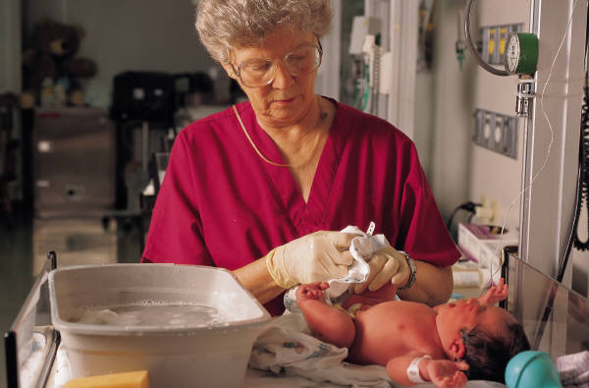
Bathing, Sleeping and Exercising Time
(click on picture)
Notes:
Some physicians recommend sponge baths until the navel area and umbilical cord are healed. A sponge bath is suitable for the bathing needs of a newborn. What is a sponge bath? When can you give your newborn a bath in a tub? Infants do not need to follow a strict bathing schedule. If an infant’s mouth and diaper area are kept clean, the infant can wait several days between baths. Frequent bathing can dry an infant’s skin. Therefore, daily baths may be avoided if the infant’s skin is dry. A shampoo is needed only once or twice a week. However, an infant’s scalp should be washed daily with soap and water to prevent cradle cap. Cradle cap is a rash that forms on an infant’s head and is characterized by dry, scaly patches.
Babies grow rapidly their first year of life. This is one reason they need so much sleep. Infants are light sleepers. They need a comfortable place to sleep where they will not be disturbed. When infants do sleep, their habits vary greatly. There is really no normal pattern parents can expect their infant to follow. A newborn infant usually sleeps about fourteen to eighteen hours each day. However, the infant does not continuously sleep for this amount of time. Short periods of alertness occur between the seven or eight daily sleep periods. Until the age of one, babies should be placed on their backs while sleeping. What is SIDS (Sudden Infant Death Syndrome)? What bedding equipment and supplies are needed?
It is very important to provide exercises for your newborn. Exercise helps develop their muscles, improves their coordination and is relaxing for the baby. It also provides bonding time between parent and baby.
Baby Center
How to Bathe a Newborn
http://youtu.be/-RnxD-KRkw8

Slide 15

24 Hours with a Newborn
(click on picture)
Notes:
24 Hours with a Newborn
Our baby Joshua is two weeks old and this video shows what a typical day is like with him.
http://youtu.be/m9QndNXcnCU

Slide 16
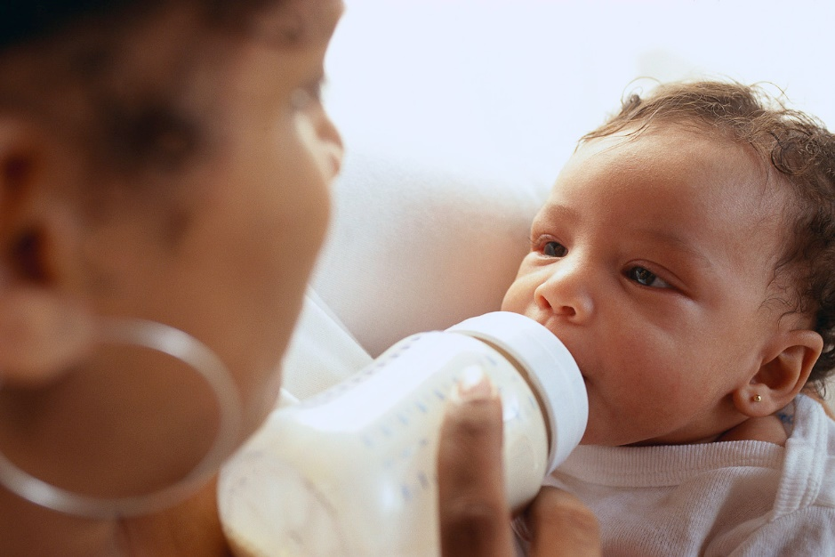
Health and Wellness
Breastfeeding is the natural way to feed a baby.
Feed a baby slowly and patiently.
Keep a baby active.
Limit computer and screen time to a minimum.
Try to limit the time a baby is in a swing, stroller or bouncer seat.
Notes:
Breast milk meets all a baby’s needs for about the first six months of life. Between six and twelve months of age, a baby will learn about new tastes and textures with healthy solid food, but breast milk should still be an important source of nutrition. Breastfeeding is the natural way to feed a baby, but it can be challenging. If you need help, you can call the National Breastfeeding Helpline at 800-994-9662 or get help on-line at http://www.womenshealth.gov/breastfeeding.
Feed a baby slowly and patiently, encourage s baby to try new tastes but without force, and watch closely to see if he or she is still hungry.
Keep a baby active. He or she might not be able to run and play like the "big kids" just yet, but there’s lots he or she can do to keep their little arms and legs moving throughout the day. Getting down on the floor to move helps a baby become strong, learn and explore.
Limit screen time to a minimum. For children younger than two years of age, the American Academy of Pediatrics (AAP) recommends that it’s best if babies do not watch any screen media.
Try not to keep a baby in swings, strollers, bouncer seats and exercise saucers for too long.

Slide 17

Learn the Signs – Act Early
(click on picture)
Notes:
Center for Disease Control
Learn the Signs-Act Early. Video on milestones of an infant
https://www.cdc.gov/ncbddd/actearly/multimedia/video.html

Slide 18
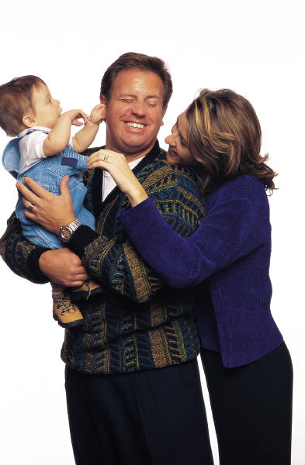
Positive Parenting Tips of Healthy Child Development
Answer when your baby makes sounds by repeating the sounds and adding words.
Praise your baby and give her lots of loving attention.
Read to your baby.
Sing to your baby and play music.
Spend time cuddling and holding your baby.
Talk to your baby.
Source: Centers for Disease Control and Prevention
Notes:
According to the Centers for Disease Control and Prevention, the following are some things you, as a parent, can do to help your baby during this time:
Answer when your baby makes sounds by repeating the sounds and adding words. This will help him learn to use language.
Praise your baby and give her lots of loving attention.
Read to your baby. This will help her develop and understand language and sounds.
Sing to your baby and play music. This will help your baby develop a love for music and will help his brain development.
Spend time cuddling and holding your baby. This will help him feel cared for and secure.
Talk to your baby. She will find your voice calming.

Slide 19

Play with your baby when she’s alert and relaxed.
Distract your baby with toys and move him to safe areas when he starts moving and touching things that he shouldn’t touch.
Take care of yourself physically, mentally and emotionally.
Notes:
Play with your baby when she’s alert and relaxed. Watch your baby closely for signs of being tired or fussy so that she can take a break from playing.
Distract your baby with toys and move him to safe areas when he starts moving and touching things that he shouldn’t touch.
Take care of yourself physically, mentally and emotionally.
Parenting can be hard work! It is easier to enjoy your new baby and be a positive, loving parent when you are feeling good yourself.
Teacher note: A pdf of this document for reprinting is available free of charge from
http://www.cdc.gov/ncbddd/childdevelopment/positiveparenting/infants.html

Slide 20

Child Safety First
Do not allow your baby to play with anything that might cover the baby’s face.
Do not shake your baby―ever!
Make sure you always put your baby to sleep on the baby’s back to prevent sudden infant death syndrome (commonly known as SIDS).
Never carry hot liquids or foods near your baby or while holding the baby.
Notes:
According to the Centers for Disease Control and Prevention, when a baby becomes part of your family, it is time to make sure that your home is a safe place. Look around your home for things that could be dangerous to your baby. As a parent, it is your job to ensure that you create a safe home for your baby. It also is important that you take the necessary steps to make sure that you are mentally and emotionally ready for your new baby. Here are a few tips to keep your baby safe:
Do not allow your baby to play with anything that might cover the baby’s face.
Do not shake your baby―ever! Babies have very weak neck muscles that are not yet able to support their heads. If you shake your baby, you can damage the baby’s brain or even cause death.
Make sure you always put your baby to sleep on her back to prevent sudden infant death syndrome (commonly known as SIDS).
Never carry hot liquids or foods near your baby or while holding the baby.

Slide 21

Child Safety First
Place your baby in a rear-facing car seat in the back seat while he is riding in a car.
Prevent your baby from choking by cutting the baby’s food into small bites.
Protect your baby and family from secondhand smoke.
Vaccines (shots) are important to protect your child’s health and safety.
Notes:
Here are a few additional tips to keep your baby safe:
Place your baby in a rear-facing car seat in the back seat while the baby is riding in a car. This is recommended by the National Highway Traffic Safety Administration.
Prevent your baby from choking by cutting the baby’s food into small bites. Also, don’t let the baby play with small toys and other things that might be easy for the baby to swallow.
Protect your baby and family from secondhand smoke. Do not allow anyone to smoke in your home.
Vaccines (shots) are important to protect your child’s health and safety. Because children can get serious diseases, it is important that your child get the right shots at the right time. Talk with your child’s doctor to make sure that your child is up-to-date on her vaccinations.

Slide 22
Review
What are the needs of a newborn?
What safety precautions are required when caring for a newborn, an infant or a child?
Why is it important to be ready financially for a baby?
What are three positive parenting tips of healthy child development?
Why is it important to provide exercises for a newborn?

Slide 23


Slide 24
References and Resources
Images:
Microsoft Clip Art: Used with permission from Microsoft™. (Slides 3, 4, 5, 11, 12, 13, 14, 15, 16, 18, 19, 20, 21, 22 and 23)
Photos obtained through a license with Shutterstock.com™. (Slides 1, 6, 7, 9, 10 and 17)
United States Department of Agriculture (Slide 8)
Textbooks:
Clark, P., Couch, S., & Felstehausen, G. (2011). Managing life skills. Columbus, OH: Glencoe/McGraw-Hill.
Decker, Celia. (2011). Child development; early stages through age 12. 7th. Tinley Park, IL: Goodheart-Willcox.
Ryder, V., & Harter, M. B. (2010). Contemporary living. Tinley Park, IL: Goodheart-Willcox.
Websites:
Healthychildren.org
Common myths about breastfeeding.
http://www.healthychildren.org/English/ages-stages/baby/breastfeeding/Pages/Common-Myths-About-Breastfeeding.aspx

Slide 25
References and Resources
National Highway Traffic Safety Administration
Includes information on child safety precautions and laws pertaining to child safety seats.
http://www.nhtsa.gov/Safety/CPS
United States Department of Agriculture
Cost of raising a child to the age of 18. (August 2014)
http://www.cnpp.usda.gov/sites/default/files/expenditures_on_children_by_families/CRC2013InfoGraphic.pdf
Videos:
Babies Featurette
Featuring four babies in four different countries.
http://youtu.be/1-FKAsoGAP0
Center for Disease Control
Learn the Signs-Act Early. Video on milestones of an infant.
http://www.cdc.gov/CDCtv/BabySteps/
Baby Center
How To Bathe a Newborn
http://youtu.be/-RnxD-KRkw8
24 Hours with a Newborn
Our baby Joshua is two weeks old and this video shows what a typical day is like with him.
http://youtu.be/m9QndNXcnCU

